Slide 1


Movago
Move smarter. Go safer.
AI that checks every freight invoice against the shipment file and the approved rate card, before accounts payable pays it.
Team Odylytics · Nguyễn Minh Quân · Trần Tuấn Nghĩa · Nguyễn Trường Sơn · Nguyễn Minh Quân · Trương Nguyễn Bảo Khang
KTC Ideathon 2026 · Operations & Productivity
Notes:
Good morning. We are team Odylytics. Movago helps the accounts payable team at a freight forwarder check every freight charge before paying it. MOV-A-GO: Move smarter, Go safer, with AI in the middle. Track: Operations & Productivity, AI that extracts data from invoices and removes a bottleneck in a finance process. Confirm the registered member list before submitting.

Slide 2
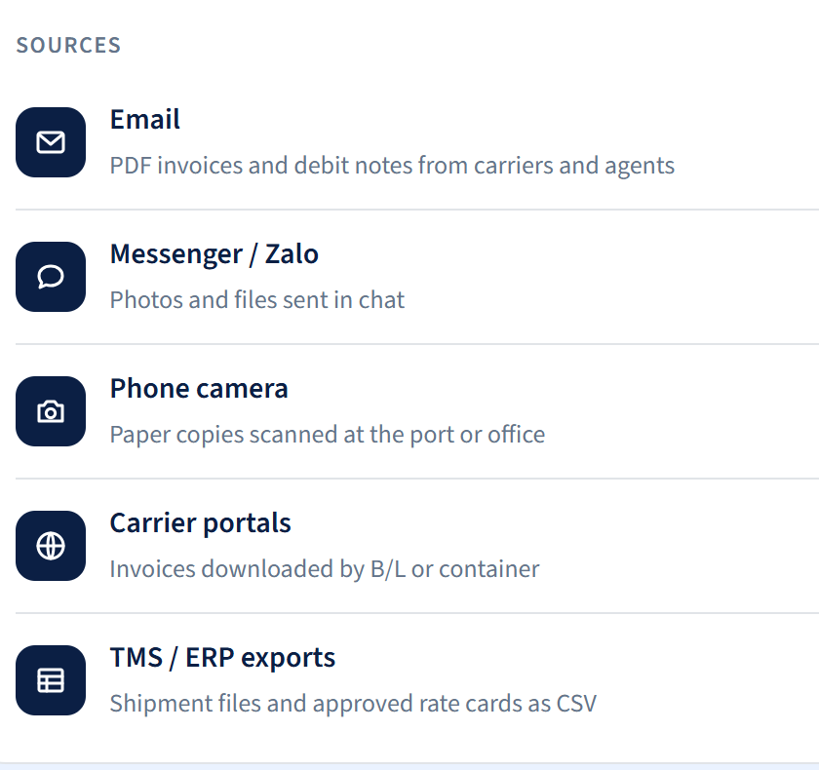
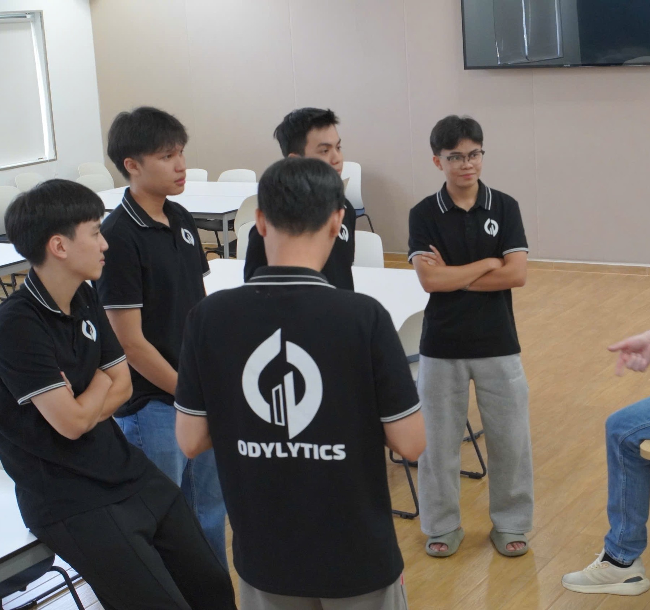
The evidence for one freight charge lives in three places
Business problem
Before every freight payment, accounts payable gathers three sources, compares each fee line and chases operations or pricing.
01
02
03
Invoice or debit note
Shipment file
Approved rate card
PDF or scan sent by email, Zalo or a carrier portal.
Route, container type and B/L number in the TMS or Excel.
Rates and surcharges held by pricing, in several versions.
Notes:
Context: a forwarder receives freight invoices from many carriers and agents. To know whether one fee line is right, accounts payable needs three things held by three teams: the supplier invoice, the shipment file in operations and the approved rate card in pricing. Job descriptions from Lacco and Flexport in Ho Chi Minh City describe this checking step. Left: the channels invoices arrive through, captured from our web demo.

Slide 3

Mid-sized ocean freight forwarders in Ho Chi Minh City
Target business and users
Business
Primary user
Verifies shipment
Verifies rate
Buyer
SME
Freight forwarder
AP
Payables accountant
OPS
Operations
PRICING
Rate owner
CFO
Chief accountant
Buys freight from many carriers
Checks each fee line before paying
Confirms shipment, container, service
Owns approved rates and surcharges
Owns budget and payment approval
4,000–4,500 forwarders in Vietnam
Loses time collecting three sources
Re-asked by email and Zalo
Confirms extra charges
Needs evidence before signing
Notes:
First customer: a mid-sized ocean freight forwarder in Ho Chi Minh City that buys from many carriers and can export shipment data. The primary user is the payables accountant. Operations and pricing verify. The buyer is the chief accountant or CFO. Pilot scope: one AP team, one lane or fee group, one or two suppliers. Industry context: about 4,000-4,500 forwarding companies nationwide (VLA estimate cited in the Ministry of Industry and Trade Vietnam Logistics Report 2025).

Slide 4
The correct charge depends on the shipment
Business insight
$127
$196
3–6%
Maersk DHC, 20' dry (VND 3.25M)
Maersk DHC, 40' dry (VND 5M)
of freight invoices have errors in audits (Transportation Insight)
Where does the current process fall short?
Manual
People-dependent
Payment risk
Eyes and Excel
Chasing operations and pricing
Wrong rate, wrong version, duplicates
Carriers name the same fee differently: “Documentation fee”, “Phí chứng từ”. Easy to miss at volume.
Missing evidence leaves invoices waiting on email and Zalo. Approvers never see the proof.
Overpayments are hard to recover. A resent invoice with a new file name can be entered twice.
Notes:
Why it matters: the same fee code has a different correct amount per shipment. Maersk publishes DHC from 1 May 2026 at VND 3.25 million (about USD 127) for a 20-foot dry container and VND 5 million (about USD 196) for a 40-foot. To judge an invoice you need the right shipment, container type and rate version. Today this is manual, depends on people, and risks wrong or duplicate payments. In markets with professional freight audit, a typical audit finds errors on 3-6% of freight invoices, mostly surcharges and misapplied discounts (Transportation Insight). Vietnam has no published figure, so our pilot will measure it. Other sources: Maersk notice of 31 March 2026; US GSA guidance on freight invoice audit and duplicate payments.

Slide 5

Invoices went digital; checking them did not
Why now
[Image: first page of Decree 254/2026/ND-CP]
Decree 254/2026/ND-CP and Circular 91/2026/TT-BTC took effect on 1 July 2026, replacing Decrees 123/2020 and 70/2025. Invoices now arrive as data, yet matching them to shipments and approved rates is still manual.
Personal Data Protection Law 91/2025/QH15 and Decree 356/2025/ND-CP set rules for storing and processing documents. [Cite articles after reading the full text.]
8.5B
+32.3%
4,000+
e-invoices in 2025 (tax authority)
trade, 10M 2026 (NSO)
forwarders (VLA)
Notes:
Issued 30 June 2026, effective 1 July 2026 (Forvis Mazars; Government portal). Nearly 8.5 billion e-invoices in 2025, over 20.3 billion cumulative (General Department of Taxation). Buyer-side articles still need to be read in the full text. Details: phan_tich_canh_tranh.md section 11.

Slide 6
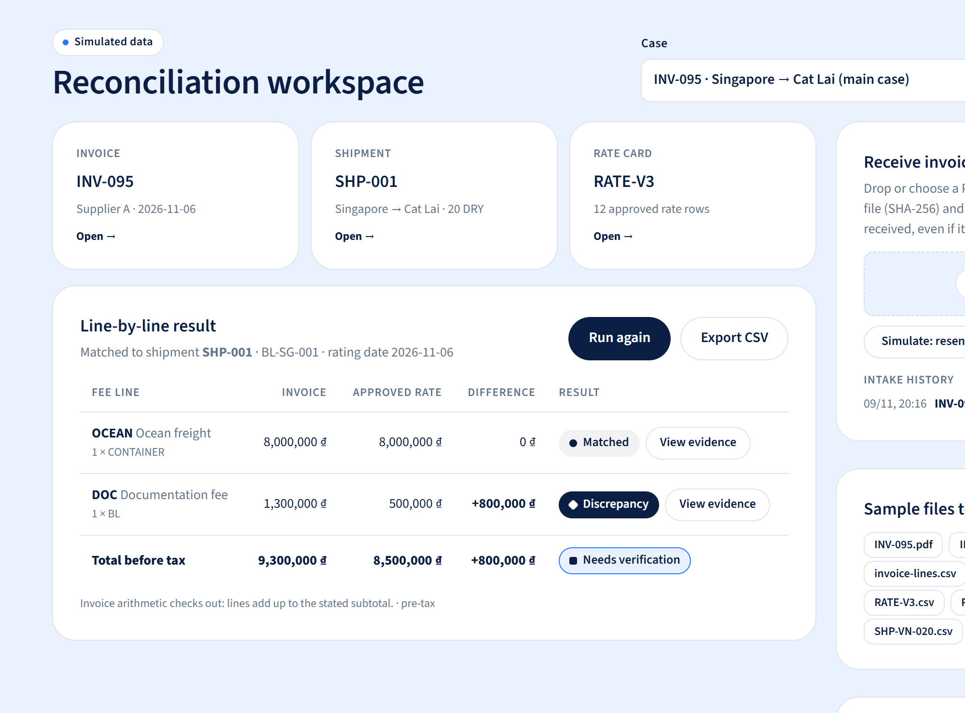
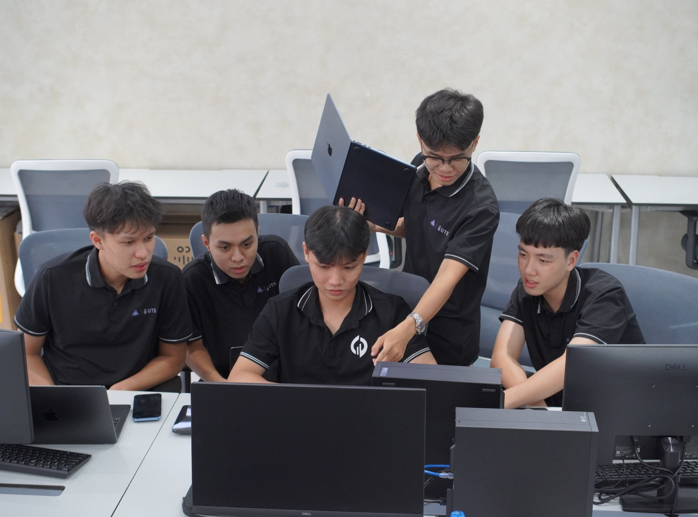
Movago: one screen to reconcile three sources
Proposed solution
Movago reads the invoice, matches the right shipment and rate version, then recalculates every fee line. Each line gets one result: Matched, Discrepancy or Missing basis, with sources on both sides.
Invoice
Movago
Accountants confirm on evidence. Payment approval stays with the people who hold that authority.
Shipment
Rate card
Movago reconciliation workspace · simulated data
Notes:
Instead of three windows, the accountant works on one screen. Movago matches the invoice to the shipment and rate card, recalculates each line and returns three statuses. Movago does not pay anything: it prepares the evidence so approvers decide faster and more accurately.

Slide 7
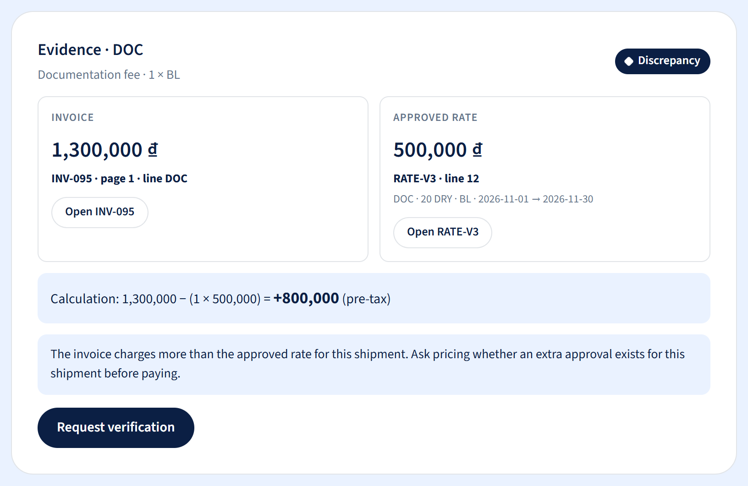

AI reads the documents, rules check the money
How AI helps
AI does what is slow for people: reading unstructured documents and understanding fee names. The money check runs on deterministic rules, so every result is repeatable and explainable.
Document AI reads invoices and quotes: lines, position
AI maps fee names: “Phí chứng từ” → DOC
Rules pick the rate by lane, container and effective date
1
2
3
Low confidence or ambiguity goes to a human reviewer
AI reads the invoice and marks each field
Rules recalculate: $51 − $20 = $31
AP opens the evidence and requests review
AI never sets the amount: every discrepancy has a calculation and a source
Notes:
AI is used where it fits: reading PDF or scanned invoices and normalising Vietnamese and English fee names to one code. The money comparison uses rules, because finance needs consistent, auditable results. Any field the AI is unsure about goes to a person. Right: the evidence view for case INV-095 in the web demo.

Slide 8
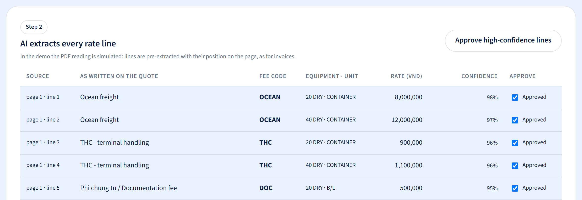
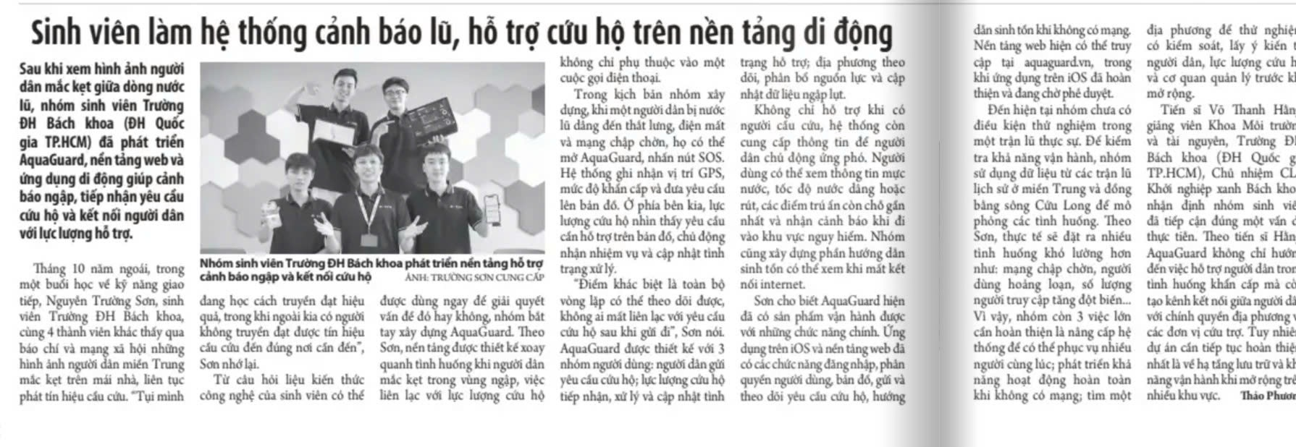
Four steps from quotation to report
How it works
01
02
03
04
Build the rate card
Receive and read invoices
Match and rate
Check and confirm
AI reads the carrier quotation; pricing approves each line, then exports the rate card.
AI extracts fee lines and positions. A SHA-256 fingerprint blocks resends.
Match by shipment or B/L plus supplier. Pick the rate card in force.
Flag Matched, Discrepancy, Missing basis. AP confirms and exports CSV.
MVP INPUT
A carrier quotation PDF, a VND invoice PDF and a shipment CSV.
Output: an approved rate card and a line-by-line report with sources
Notes:
Step 1 used to be manual: pricing typed each quotation line into Excel. Now AI reads the quotation, low-confidence lines get a separate look, and the rate card exports only after approval. Image: the Build rate card screen in the web demo (#/rates). Then invoices are received and read, matched to the shipment and the right rate version, and checked line by line with AP confirmation. The MVP only needs CSV exports, no deep TMS or ERP integration, so a company can try it right away.

Slide 9
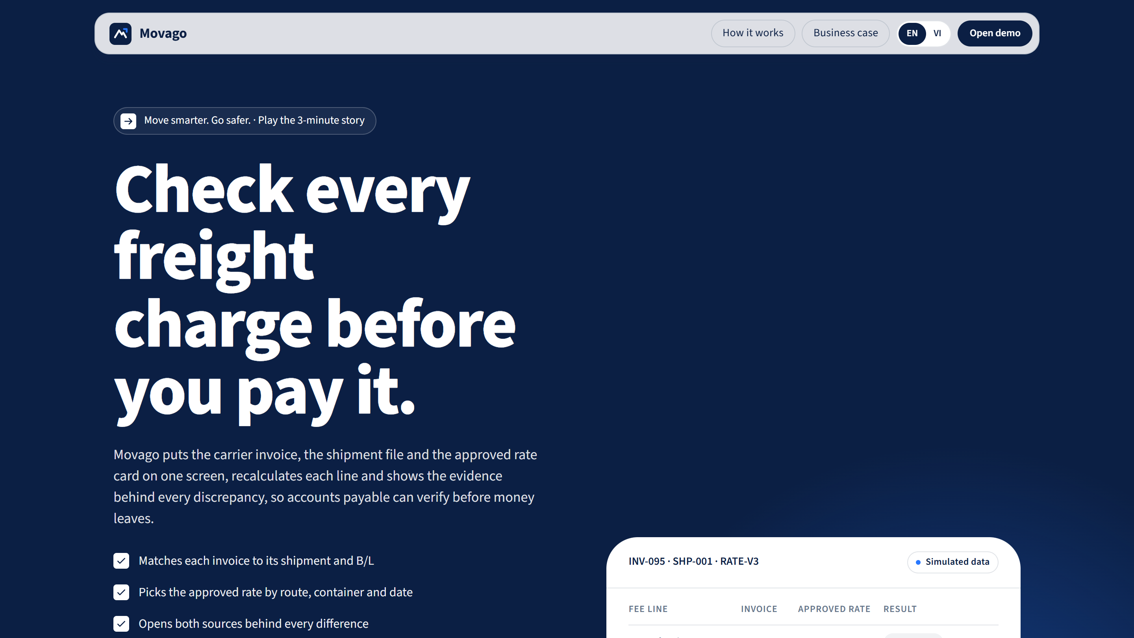
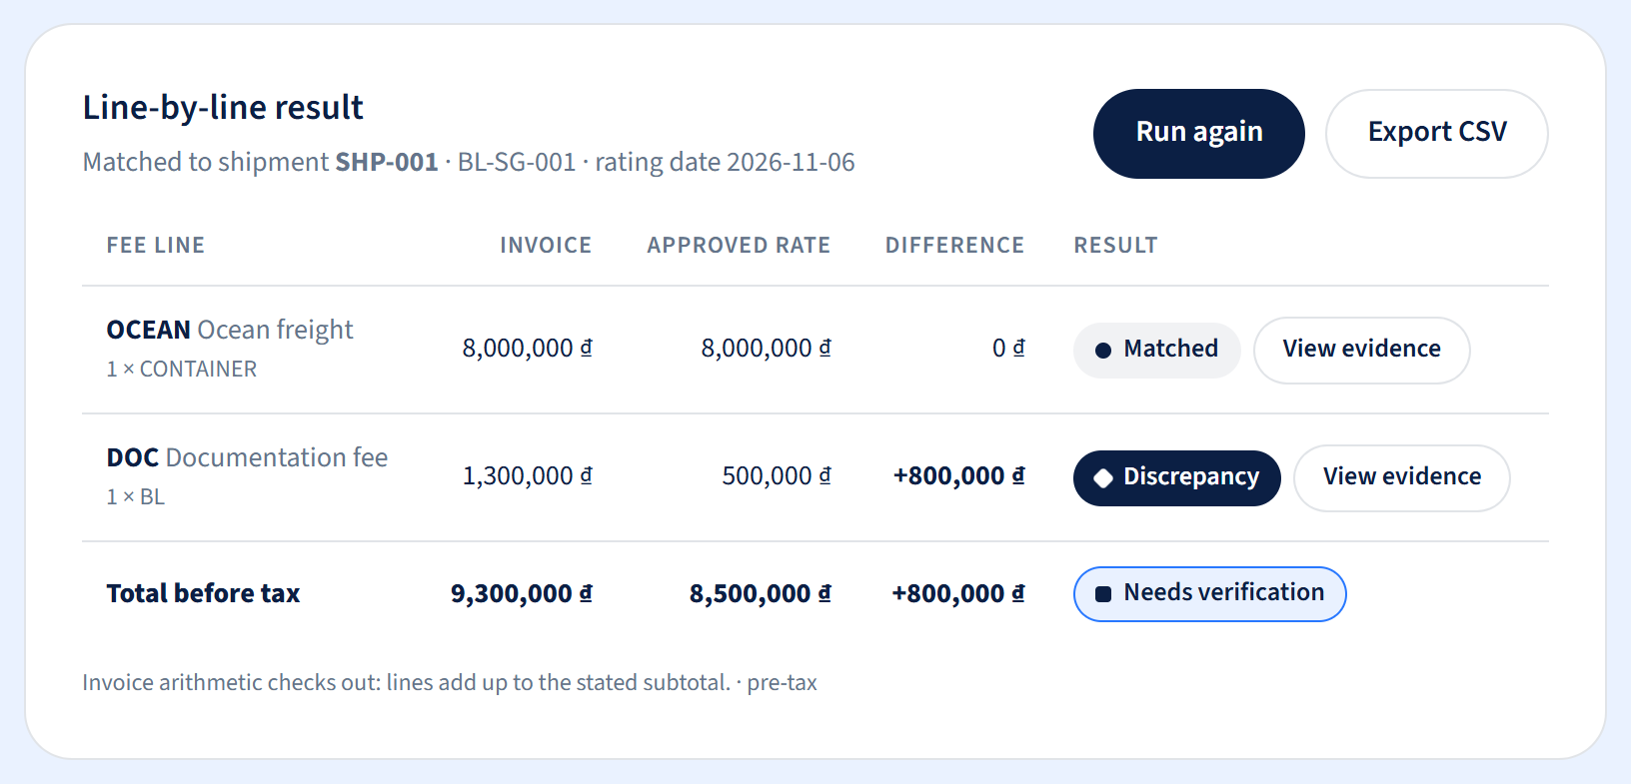
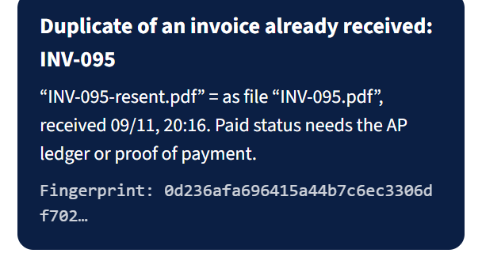

Case INV-095: documentation fee is $31 (VND 800,000) over
Mockup and demo
Main case result
+$31
The invoice charges a $51 (VND 1.3M) documentation fee; rate card RATE-V3 says $20 (VND 500,000). Movago holds the line for pricing to verify.
Movago landing page
Line-by-line result
Ocean freight $314 (VND 8M): Matched
DOC fee: Discrepancy +$31
Evidence: invoice page 1 ↔ RATE-V3 line 12
Evidence from both sides
Resent invoice caught after renaming
Simulated data · movago-odylytics.vercel.app
Notes:
Live demo: invoice INV-095 for shipment SHP-001. Ocean freight matches. The documentation fee is VND 1.3 million (USD 51) on the invoice versus VND 500,000 (USD 20) approved, USD 31 over before tax. The invoice is in VND, so the demo screens show VND. The accountant opens both sources, sees the calculation and requests verification from pricing. When the supplier resends the same invoice under a new name, Movago catches it by SHA-256 fingerprint. All data is simulated. Demo link: movago-odylytics.vercel.app

Slide 10


[n] payables accountants surveyed
User validation
[n]
[n]
[Interview photo]
[Interview photo]
Survey respondents
Interviews
[x%]
[x] min
[Role, company type]
[Role, company type]
Validated with
Willing to try (4–5/5)
Median minutes per invoice
[Organisation]
[What they confirmed or provided]
[Organisation]
[What they confirmed or provided]
[x] forwarders · [x] sample invoices tested
[Organisation]
[What they confirmed or provided]
Source: Odylytics survey and interviews, [date].
Notes:
FRAME. Fill from the survey results and interview notes. State the real sample size n.

Slide 11
A ~USD 1B freight audit market growing 13–14% a year
Market size
TAM
$1B
Global freight audit 2025, 13–14% CAGR (Mordor; KSI)
Price benchmark
$111–559
SAM
$565K
[Illustrative] 400 forwarders × $1,400/yr
ShipCheck sells line-level freight audit at this monthly range. Movago breaks even at $118 a month. LTV and CAC are measured after the pilot.
SOM
$42K
[Illustrative] 30 customers by year 3 (7.5% of SAM) × $1,400
$111
$118
[x]×
Pilot
1
forwarder in year one
ShipCheck Basic/mo
Movago break-even/mo
LTV : CAC after pilot
Bottom-up SAM
4,000+
forwarders (VLA)
10%
[illustrative] qualify: ocean, HCMC, AP
$1,400
subscription a year
SAM = firms × qualifying share × $1,400. The 10% illustration is replaced by VLA/HLA filtering.
Sources: Mordor Intelligence; Knowledge Sourcing Intelligence 08/2025; VLA via Vietnam Logistics Report 2025; ShipCheck, checked 9 Nov 2026. USD 1 = VND 25,500; EUR 1 = USD 1.12.
Notes:
TAM: USD 0.82–0.97B in 2025, 13.2–14.2% CAGR to 2030. The USD 565K (VND 14.4B) SAM is illustrative, assuming 10% of firms qualify. SOM USD 42K (VND 1.08B) a year: a target of 30 customers by year 3, 7.5% of SAM, following one pilot in 2027 and then scale-up. Both SAM and SOM are assumptions; say so. ShipCheck pricing: €99/199/499 (USD 111/223/559) a month, annual commitment.

Slide 12
A small pilot that breaks even at 3 minutes per invoice
Feasibility and business value
Volume
1,000
invoices per month (scenario)
Business model
B2B SaaS
Saved
6 min
per invoice: 15 down to 9 minutes
Subscription priced per unique invoice processed, plus a setup fee when custom configuration is needed. Buyer: chief accountant or CFO.
Freed
100 h
of handling time per month
3 min
≥ 30%
30–100
Value
$235
per month at $2.35/hour, before costs
break-even at $118/month
target cut in handling time
invoice sets in the pilot
Resources and technology
1
lane, 1–2 suppliers
CSV
no deep integration yet
3
roles: freight ops, engineering, UX
Document AI + rules engine + web app. The demo runs end to end.
Illustrative scenario. $2.35/h is below the average AP accountant salary (~$450/month, TopCV). APQC: $6 per invoice. Rate: USD 1 = VND 25,500 (9 Nov 2026).
Notes:
Feasible because the MVP is narrow: VND invoices, one shipment per invoice, a few fixed-price fee codes, data via CSV. Document AI reads, a rules engine calculates, a web app serves AP. Illustrative value: 1,000 invoices a month, 6 minutes saved each, 100 hours freed, about USD 235 a month at USD 2.35 (VND 60,000) per hour. At a subscription of USD 118 (VND 3 million) a month, saving 3 minutes per invoice breaks even. Success threshold to agree with the buyer: at least 30% fewer median handling minutes. These are planning assumptions, not results.

Slide 13
Freight logic + Vietnamese documents + no system change
Competitive advantage
Capability | Excel + email | G.O.L SMS Live | CargoWise IPP | Innomation | ShipCheck | Movago
AI reads PDF and scans | Manual | Not found | Yes | Yes | Partial | Simulated
Matches invoice to shipment | Manual | Partial | Yes | Not found | Partial | Demo
Checks each line vs approved rate | Manual | Not found | Partial | Partial | Yes | Demo
Catches duplicate invoices | Manual | Not found | Yes | Yes | Not found | Demo
Vietnamese fee names, documents | Yes | Yes | Not found | Yes | Not found | Demo
Builds rate card from quotation | Manual | Typed in | Not found | Not found | Yes (AI) | Simulated
No system change needed | Yes | Is the system | Needs CargoWise | Partial | Yes | Yes, via CSV
Yes / Partial / Not found = per public documentation · Demo = running in the Movago demo, not yet validated with customers
Sources: G.O.L, Innomation and ShipCheck product pages; Elicit Technology on the CargoWise Invoice Processing Portal (WiseTech partner), checked 9 Nov 2026.
Notes:
Movago has no single capability that nobody else has. The difference is the combination: freight logic, Vietnamese documents and no system change. We do not compete for CargoWise users: CargoWise checks invoices against job accruals, Movago against approved rate cards. First customers are mid-sized forwarders on G.O.L or Excel. Details: phan_tich_canh_tranh.md.

Slide 14
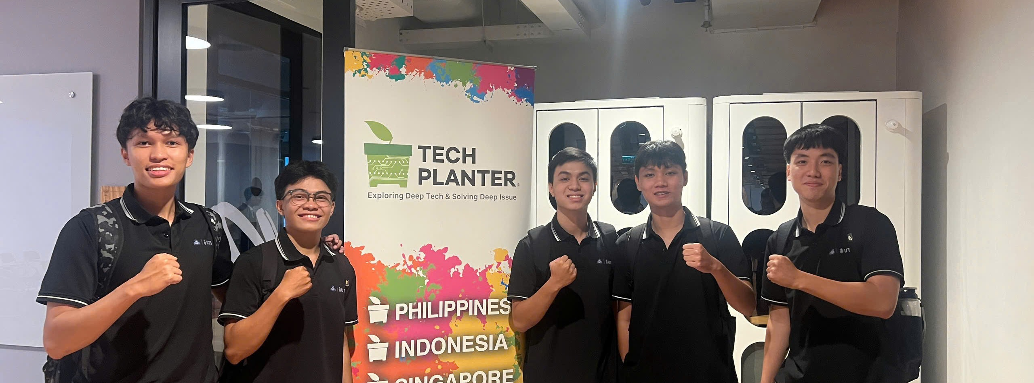
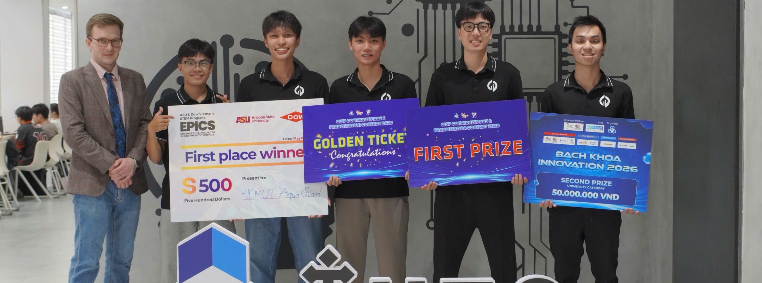

A team that has taken AI from lab to field
Team and roadmap
11/2026
Q1/2027
Q2/2027
Q3/2027
2028+
Ideathon
Pilot
More documents
Integrate
Scale
End-to-end demo, [n] interviews
1 forwarder, 30–100 invoice sets
Debit notes, XML e-invoices
TMS/ERP connectors
[Next market or product]
4 prizes
600+ surveyed · 300+ pilot users
1 AI core · 6 products
1st OISP 2025, 1st EPICS 8 (ASU & Dow VN), 2nd Bach Khoa Innovation, 1st Fessior DevCamp 2026
AquaGuard validated with users and rescue groups in flood season
Movago reuses the shared AI core; demo live at movago-odylytics.vercel.app
Nguyễn Minh Quân CEO, strategy and partners · Trần Tuấn Nghĩa CPO, product and UX · Nguyễn Trường Sơn CTO, AI core · Nguyễn Minh Quân Marketing · Trương Nguyễn Bảo Khang backend and DevOps
Advisors: Dr. Tobias Cibis (UTS) · Assoc. Prof. Nabin Sharma (UTS AI Drone Lab) · Dr. Vo Thanh Hang (HCMUT) · MSc. Bui Xuan Giang (HCMUT) · Prof. Nguyen Ngoc Dinh (Laval)
Notes:
Odylytics is a student-founded AI firm in Ho Chi Minh City working with universities in Vietnam, Australia, the US, France and Canada. Strengths that matter for Movago: AquaGuard went from research to real users (600+ surveyed, 300+ pilot users), the team runs surveys and interviews, it has a shared AI core to reuse, and the Movago demo is already built. The roadmap is a draft. Sources: odylytics.com (home and team pages, checked 9 Nov 2026); Odylytics company deck. Confirm each member’s role on Movago.

Slide 15


Check before you pay.
Move smarter. Go safer.
movago-odylytics.vercel.app
Ask: a 30–100 invoice-set pilot
with one forwarder in Ho Chi Minh City
odylytics@gmail.com
odylytics.com
Team Odylytics · KTC Ideathon 2026
Notes:
Movago lets accounts payable check every freight charge on evidence before paying. We are looking for one forwarder in Ho Chi Minh City to run a 30-100 invoice-set pilot that measures time and checking quality. Thank you.

