Slide 1
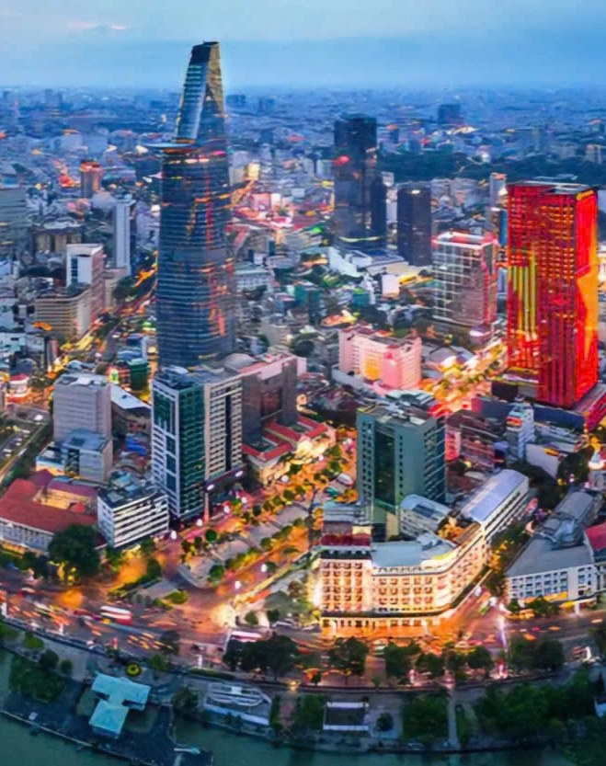

Q&A
Appendix: Q&A
Questions judges ask, with answers and evidence.
#1 Data
#2 AI errors
#3 Existing TMS
#4 Impact
Notes:
Appendix FRAME. Use during Q&A; not part of the 15 main slides.

Slide 2




#1 Is financial data safe?
Appendix
[One sentence: Movago handles documents under Law 91/2025/QH15 and Decree 356/2025/ND-CP.]
Image
[Icon or illustration]
Image
[Icon or illustration]
Image
[Icon or illustration]
Image
[Icon or illustration]
01
DATA MINIMISATION
02
HOSTED IN VIETNAM
03
ROLE-BASED ACCESS
04
RETENTION LIMITS
[Extract only fields needed to reconcile; mask personal data.]
[Storage and AI providers that meet local rules.]
[AP, operations and pricing see only their own work.]
[Retention period and deletion agreed with the customer.]
Notes:
FRAME. Cite specific articles after reading the texts. The brief lists the data conditions for the pilot.

Slide 3
#2 What if the AI reads it wrong?
Appendix
AI only reads. Rules do the maths. People confirm exceptions.
[Screenshot: a low-confidence field]
01
Confidence threshold
[Fields below x% go to a reviewer.]
02
Evidence you can open
Every value links to its place on the PDF.
03
Measured on real invoices
[Test kit result: x/y fields correct on n invoices.]
[Caption]
movago-odylytics.vercel.app
Notes:
FRAME. Fill in numbers from the extraction test kit after running it on real invoices.

Slide 4
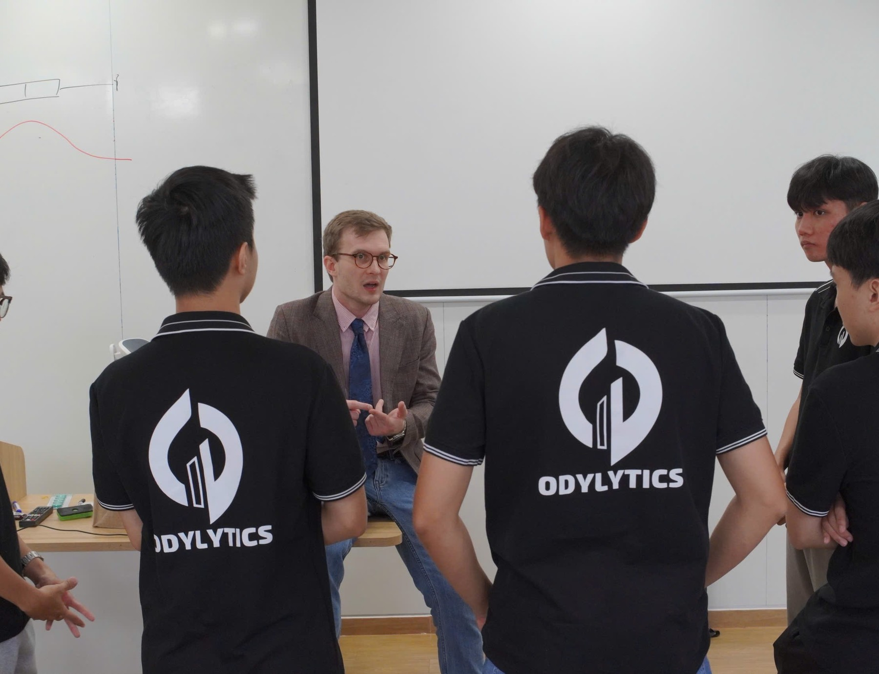
#3 Why not just use the existing TMS/ERP?
1
No replacement
[Diagram: TMS/ERP → export → Movago → report]
Reads exports from the TMS/ERP already in use.
2
Checks incoming invoices
[Difference from TMS accruals: confirm in interviews.]
3
Reads Vietnamese documents
Bilingual fee names, PDFs and scans.
4
Quick to trial
Pilot on CSV files, no integration needed.
Notes:
FRAME. Verify with question 7 of the interview guide.

Slide 5

#4 How do we measure impact?
Appendix
Image
[Chart or image]
[Chart or image]
Image
[Chart or image]
Image
[Chart or image]
≥ 30%
[x]%
[x]%
VND [x]M
Fewer handling minutes
Precision
Recall
Amount actually adjusted
Median, vs current process
Correct alerts / all alerts
Caught / all labelled errors
Separate from amounts only flagged
Notes:
FRAME. Metric definitions come from the project brief, pilot section.

Slide 6
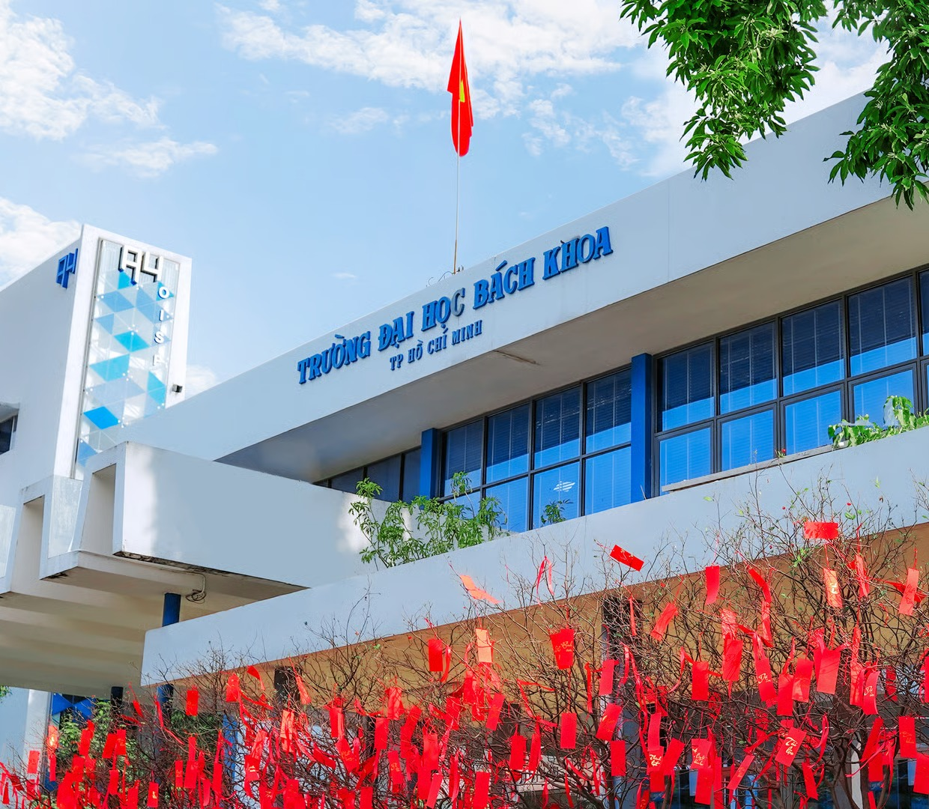
References
Appendix
[1] Maersk, Terminal handling charges Vietnam (OHC/DHC), 31/03/2026.
[2] Transportation Insight, Freight audit and payment: protecting profit in soft rates.
[3] APQC, What is the average cost to process an invoice?
[4] TopCV, Báo cáo lương Kế toán công nợ 2026.
[5] Bộ Công Thương, Báo cáo Logistics Việt Nam 2025.
[6] Cục Thống kê, Tình hình kinh tế – xã hội tháng 10 và 10 tháng 2026.
[7] Lacco Logistics và Flexport, mô tả công việc tại TP.HCM.
[8] US GSA, Transportation invoice audit.
[9] ONE Việt Nam, Customer advisory for surcharge, 2026.
[10] Luật Bảo vệ dữ liệu cá nhân 91/2025/QH15.
[11] Nghị định 356/2025/NĐ-CP.
[12] Nghị định 254/2026/NĐ-CP.
[13] Thông tư 91/2026/TT-BTC.
[14] G.O.L SMS Live; Innomation AutoMatching; ShipCheck: trang sản phẩm.
[15] Businessware Technologies qua RevExOS, invoice parsing benchmark 03/2026.
[16] Odylytics, khảo sát và phỏng vấn kế toán công nợ, [ngày].
[17] Odylytics, bộ kiểm thử trích xuất, [ngày].
[18] [Bổ sung]
Notes:
Full links are in colio_ai_business_problems.md and the project brief.

