Slide 1
Assignment
2015004239 정성운

Slide 2
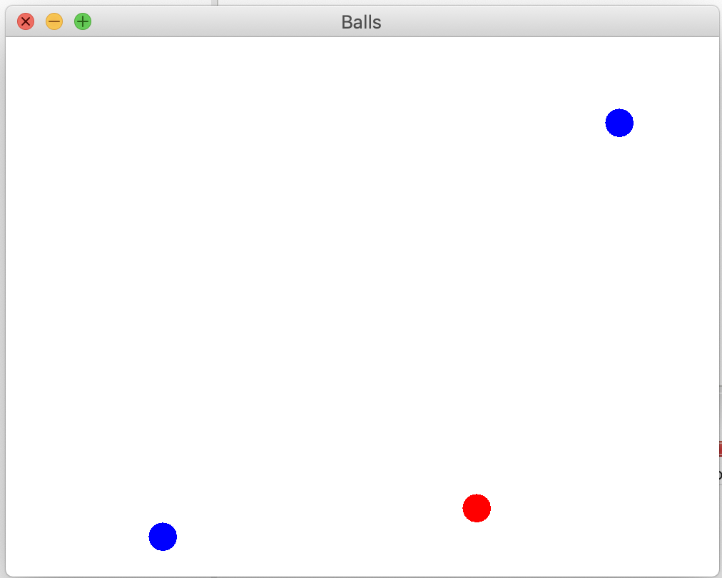

Slide 3
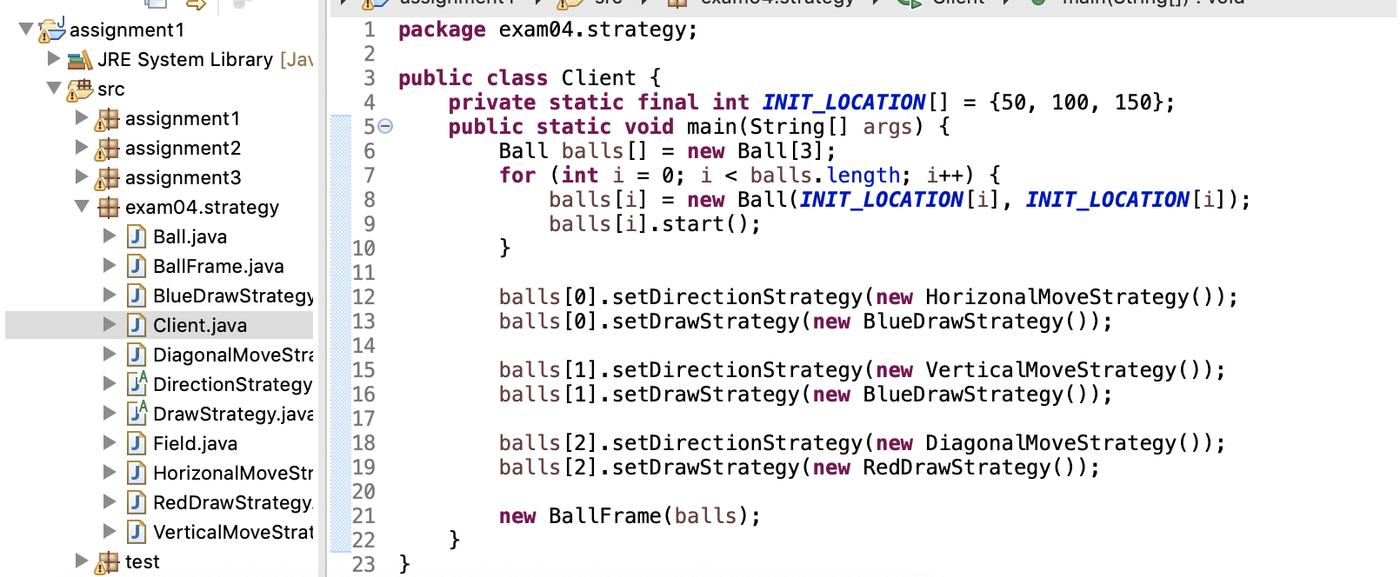

Slide 4
Strategy 패턴의 각 역할을 어떤 클래스가 하는가? 1. Context Ball 2. Strategy DrawStrategy, DirctionStrategy 3. Concrete Strategy DrawStrategy = BlueDrawStrategy/RedDrawstrategy DirectionStrategy = HorizontalMoveStrategy/VerticalMoveStrategy/DiagonalMoveStrategy

