Slide 1
CG Group 31
Unpaired Image-to-Image Translation using
Cycle-Consistent Adversarial Networks
王浩 王潇 强志文515021910060 515021910141 515030910367

Slide 2
Contents
1
Introduction
2
2
Related Work
3
Proposed Work
4
Limitations
5
Goals
6
Our Work
7
Conclusions

Slide 3
Introduction
Most of image translation methods are based on pairwise images as training input.
Obtaining desired images without paired training images is of great convenience.

Slide 4
Related Work
Works | features | Shortcomings
Neural style transfer | Combining the content of one image with the style of another image | Perform poorly in the transfiguration of painting to photo, etc.
Cross-modal scene networks | Learn a common representation across domains | Rely on task-specific, predefined similarity function between the input and output.
Text2image | Use Generative Adversarial Networks to generated images | Require paired training examples

Slide 5
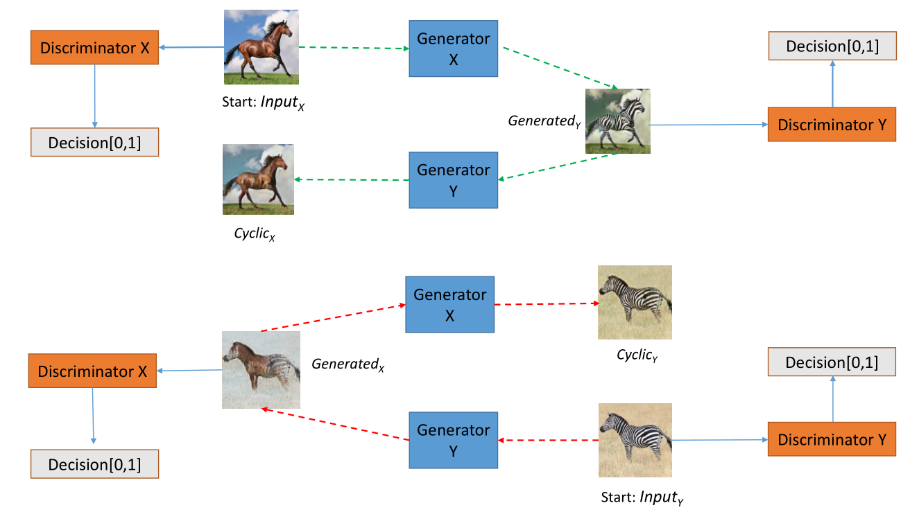
Proposed Work
Pipeline for the cycleGAN

Slide 6
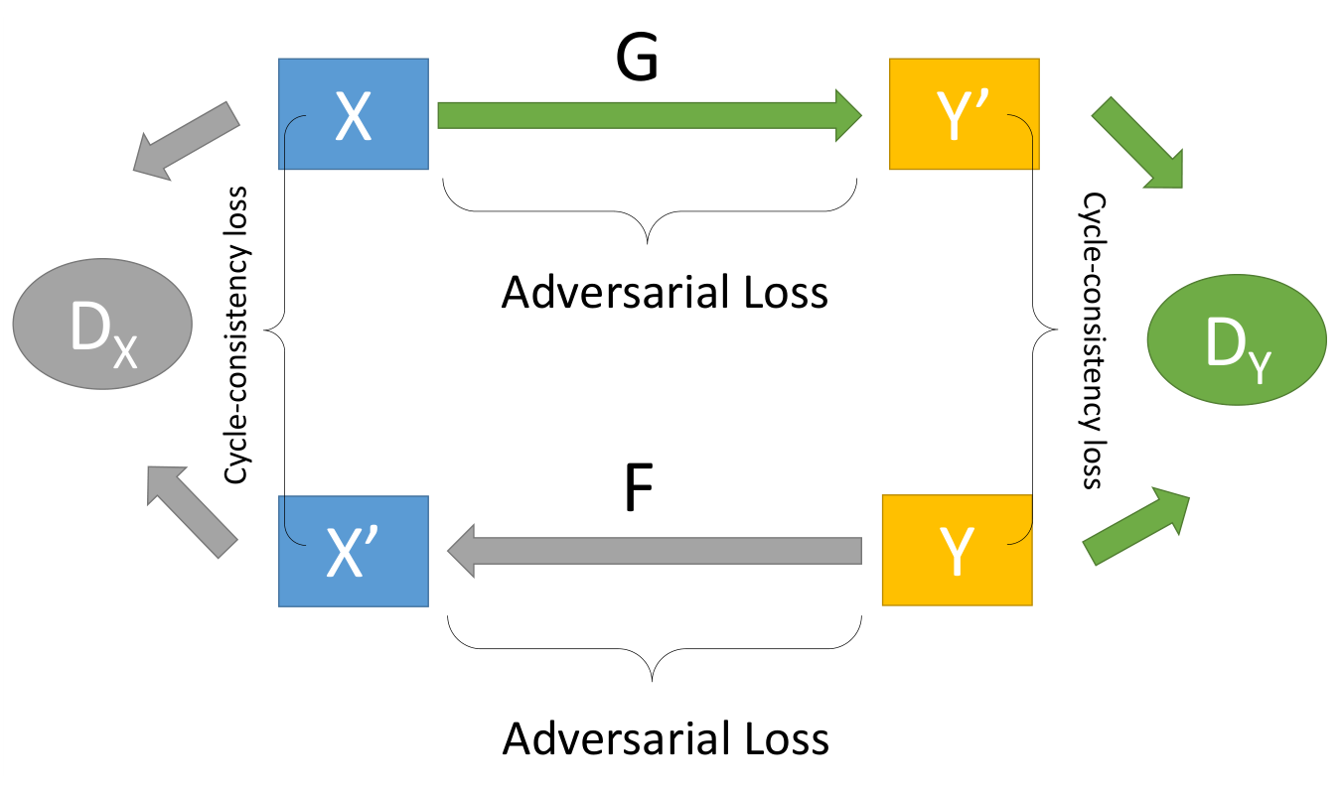
Proposed Work
An illustration of the full objective

Slide 7
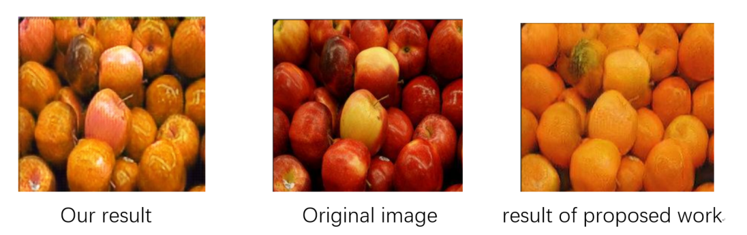
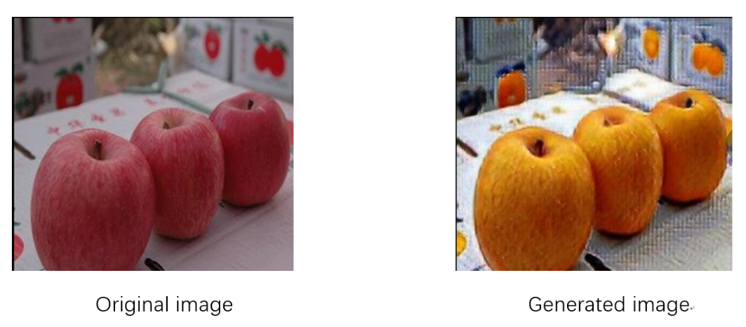
Limitations
Not easy to get a steady adversarial network.
Not easy to achieve shape translation.

Slide 8
Goals
Re-implement the CycleGAN.
Make some improvements to overcome some drawbacks of the original method.

Slide 9
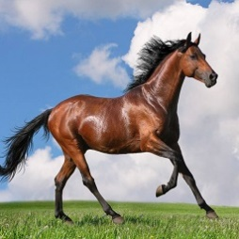
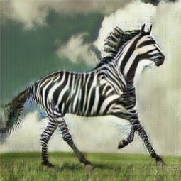
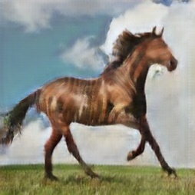
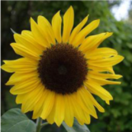
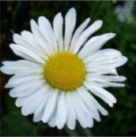
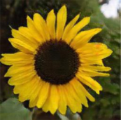
Our Work
Input image Generated image Cyclic image
A horse → zebra translation and
a sunflower → daisy translation

Slide 10
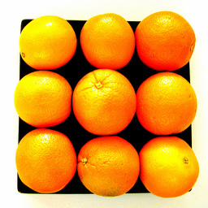
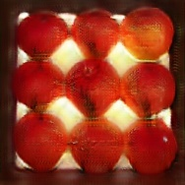
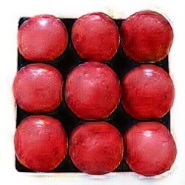
Our Work
Unpaired dataset -> unstable transform
Add “skip” between input and output.
Problem: high contrast colors appear in background.
Background colors disappear.

Slide 11
Conclusions
Successfully achieve image translation with unpaired image sets.
Improve the output images’ quality to some extent.
Improve the stability of the GAN network.

Slide 12
Thank you!

