Slide 1
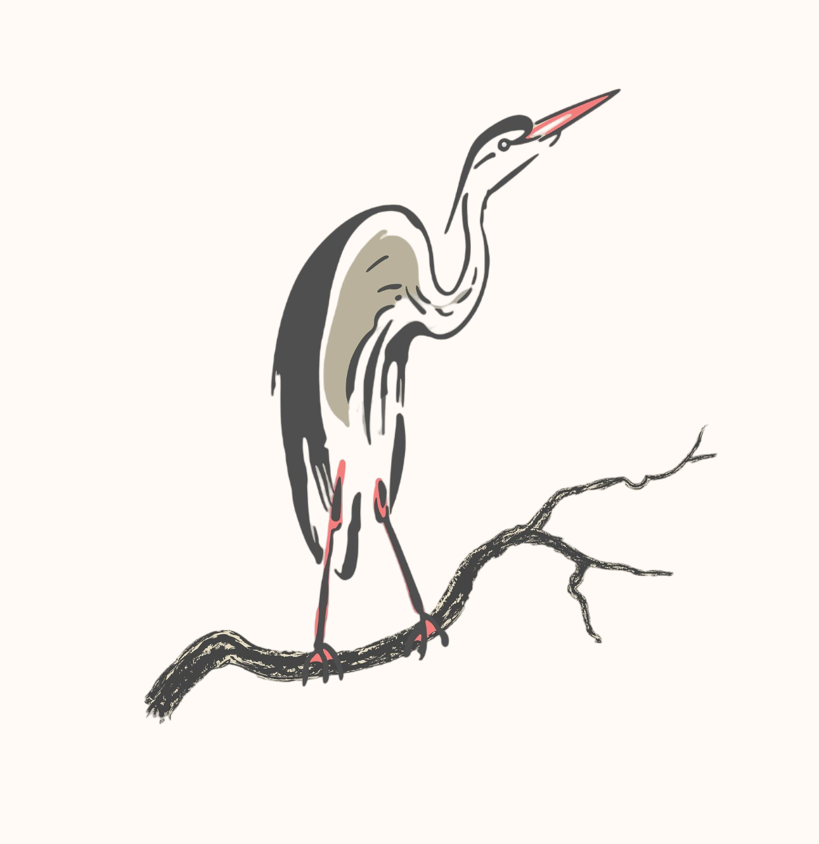
PETER ÖHLINGER
PhD Candidate

