Slide 1
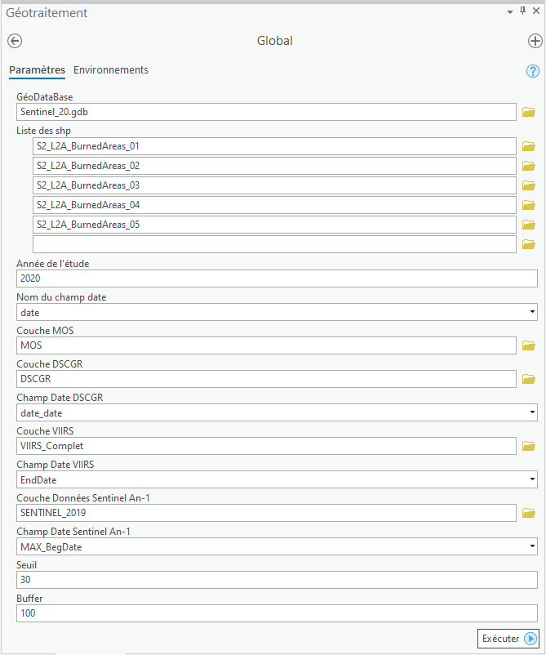
Champ au format Date des SHP
Champs au format Date des couches de Ref
Seuil spatial et temporel

Slide 2
Shape files
Fusion_Data_propre_dissolved
Merged_Data
TableDoublonsP1/2/3_Data
DoublonsDefinis_Merged_Data
Ss_DoublonsResult_Merged_Data
Merged_Data_Inter_MOS
MOS
Ss_DoublonsResult_Merged_Data_SansAb
DSCGR
Sentinel n-1
VIIRS
Fusion_Data_OverlapsALL90j
Fusion_Data
Fusion_Data_propre

Slide 3
GlobalV2.py
doublons.py
methodes.py
Aberrations_mos.py
reference.py
FctArcpy.py
regroupement.py

