Slide 1

E-Portfolio by Özen Beyazsahin

Slide 2
Agenda
Introduction
Why Xtext?
Who uses Xtext?
Domain specific languages
First Xtext project
What is possible?
Exercise

Slide 3
Introduction
framework for development of programming languages and domain-specific languages
powerful toolset in the Java ecosystem
Covers all aspects of a complete language infrastructure
Parser
Code generator
Interpreter
Complete IDE integration

Slide 4
Why Xtext?
Easy to learn
High quality
Performance
Features
Build the language you want
Single sourcing
Incremental Compiler

Slide 5
Who uses Xtext?
Used in many different industries
Mobile devices
Automotive development
Embedded systems
Game development

Slide 6
Domain specific languages
Porgramming languages
Specification languages that target a specific problem domain
Not able to implement all programs
Able to solve problem easier and faster
Completely and precisely
Internal and external DSLs

Slide 7
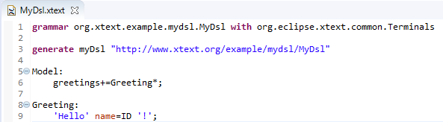
First Xtext project
Create a new Xtext project

Slide 8

First Xtext project

Slide 9
What is possible?
Validation
Quickfixes
Outline
Syntax highlighting
Formatter
Code generation
Scoping
Templates
Testing

Slide 10
It´s your turn!

Slide 11
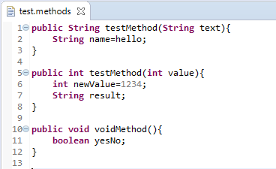
It´s your turn!

Slide 12

THANK YOU!

