Slide 1

Data Pulse
A Decentralized File-Sharing Platform
Presenting:
Rotem Porat
Ofek Ben Avraham
Supervisor:
Ronen Zilber
01

Slide 2

Introducing Data Pulse
Decentralized file-sharing platform.
Leveraging peer-to-peer (P2P) networking.
Fast, efficient, and reliable file transfers.
Users share load and resources.
Intuitive and easy-to-navigate interface.
02
Notes:
DataPulse is a decentralized file-sharing platform designed to make sharing digital files more efficient and user-friendly. By using peer-to-peer networking, DataPulse allows users to share and download files directly from each other without relying on a central server. This approach helps improve download and upload speeds while ensuring that the system is easy to use for everyone.

Slide 3
Objectives
Develop a decentralized file-sharing platform.
Focus on a user-friendly interface.
Ensure secure and reliable file transfers.
Maintain high data availability and system reliability.
Enhance performance for both uploads and downloads.
03
Notes:
The primary objective of our project is to develop a decentralized file-sharing platform that combines efficient file distribution with a user-friendly interface. Our focus is on creating a secure, reliable system that enhances both download and upload speeds while ensuring high data availability.

Slide 4

Existing Conditions
The growing of digital file sizes.
Bandwidth limitations in single-server systems.
Inefficiencies in traditional file distribution.
BitTorrent and µTorrent.
04
Notes:
In today’s digital world, we’re seeing a rapid increase in the size of files—whether videos, software, or other forms of digital content. This growth poses significant challenges for traditional file-sharing systems, especially those relying on a single server for uploads and downloads.
One major issue is the bandwidth limitation of these single-server systems. When multiple users attempt to download or upload large files at the same time, the server can become overwhelmed, resulting in slower download speeds and a poor user experience.
Moreover, traditional file distribution methods are often inefficient. These methods don’t fully utilize the potential of modern internet speeds, and the burden on a single server can create bottlenecks, further slowing down the process.
To address some of these issues, platforms like BitTorrent and µTorrent introduced decentralized methods that improve download speeds and reduce server load. However, despite their contributions, both platforms have their own limitations—particularly in terms of user interface complexity, which can be challenging for less technical users.
With DataPulse, we aim to build on the strengths of these established platforms while providing a more intuitive and accessible user experience, ultimately overcoming the limitations of existing solutions.

Slide 5
Need for DataPulse
A decentralized approach to file sharing.
Enhanced performance through optimized bandwidth utilization.
Tracker-based system for efficient peer discovery.
Scalable and secure file-sharing solution
User friendly UI interface
05
Notes:
As we've discussed the limitations of existing platforms, it’s clear why there is a need for DataPulse.
First, DataPulse introduces a decentralized approach to file sharing, reducing dependency on a single server and distributing the load across multiple peers. This ensures that the system remains robust even under high traffic.
Our platform enhances performance by optimizing bandwidth utilization. By allowing users to download from multiple sources simultaneously, we significantly improve download speeds and efficiency.
We’ve implemented a tracker-based system to facilitate efficient peer discovery, ensuring users can quickly connect with others who have the files they need.
DataPulse is designed to be scalable and secure. The system can easily handle an increasing number of users and file sizes without compromising on performance or security.
Lastly, DataPulse features a user-friendly and intuitive interface. Unlike existing platforms, our interface is accessible and easy to navigate, making it suitable for users of all technical levels.
In the next slides, we’ll explain in detail how we achieve these goals through our design and implementation process.

Slide 6
Research Approaches
Literature Review.
Technological Feasibility.
User Feedback.
06
Notes:
Our research for DataPulse started with a literature review to understand existing file-sharing technologies and identify areas for improvement.
Next, we assessed the technological feasibility by researching the protocols, frameworks, and programming languages that best suit our needs, such as P2P protocols, Python for backend development, and Angular for the frontend.
Finally, we gathered user feedback to refine our design and ensure it meets real-world needs.

Slide 7
Development Phases
Initial Research.
Design and Test Planning.
Test-Driven Implementation.
Continuous Testing and Refinement.
07
Notes:
Our development process will use Test-Driven Development, or TDD, a methodology where tests are written before code. TDD is well-suited for our project because it helps ensure that each part of the system is thoroughly tested and reliable from the start.

Slide 8
Algorithms
Technology
P2P Networking Algorithms.
Encryption Algorithms.
Error Correction.
Backend - Python.
Frontend - Angular.
Database - MongoDB.
Networking - WebRTC
08
Notes:
For algorithms, we’ll start with P2P networking algorithms to manage peer discovery and data transfer efficiently.
In terms of encryption, DataPulse will use AES and SSL to ensure robust security and privacy. AES is a widely-used encryption standard that will protect the data stored and shared within the network. It encrypts data into a secure format that can only be decrypted by authorized users, ensuring that sensitive information remains protected. SSL will be used to secure data transmission between peers, encrypting the data as it moves across the network to prevent interception or unauthorized access.
Additionally, error correction algorithms will maintain data integrity and availability, even if some peers go offline or errors occur during transfers.
On the technology side, Python is our choice for the backend, offering flexibility and strong support for web applications. Angular will power the frontend, ensuring a responsive and dynamic user interface. MongoDB will be used for the database, known for its scalability and capacity to manage large datasets. Finally, WebRTC will handle networking, enabling real-time peer-to-peer communication essential for a decentralized system.

Slide 9
Stages
System Design.
Backend Development.
Frontend Development.
Integration and Testing.
Deployment.
09
Notes:
These are the key stages of our development process, as outlined in the points on the slide. Each stage represents a crucial step in bringing DataPulse to life, so there’s no need to expand beyond them.

Slide 10
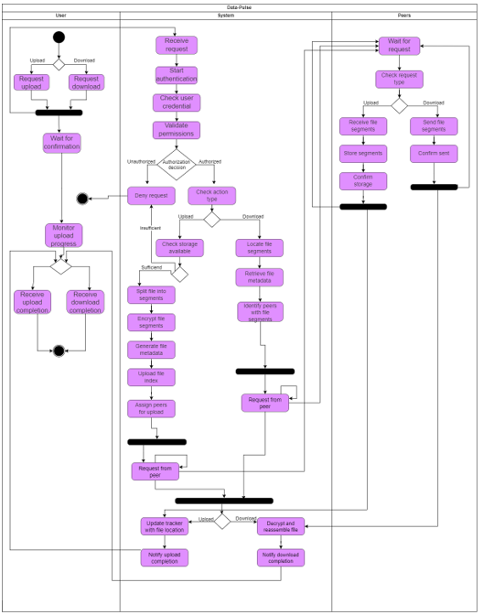
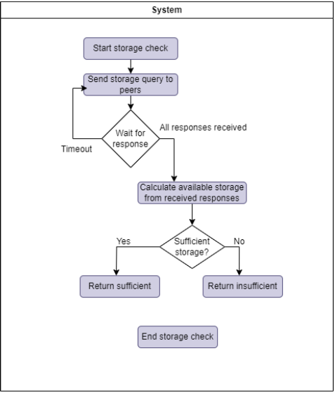
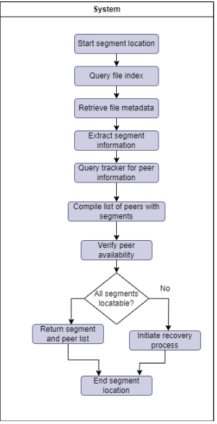
Activity
10
Notes:
Here, we have three key activity diagrams that illustrate different processes within the DataPulse system.
The first diagram shows the upload and download process. It outlines how a user initiates an upload or download request, how the system handles authentication, file segmentation, and the interaction with peers to store or retrieve file segments.
The second diagram focuses on the storage check process. It details how the system queries peers to ensure there is sufficient storage available before uploading files. This step is crucial to prevent failed uploads due to storage constraints.
The third diagram illustrates the segment location process. It shows how the system locates and verifies file segments across peers, ensuring that all necessary segments are available for download. If any segments are missing, the system initiates a recovery process.
These diagrams help visualize the complex workflows involved in decentralized file sharing, making it easier to understand how DataPulse manages file distribution, storage, and retrieval.

Slide 11
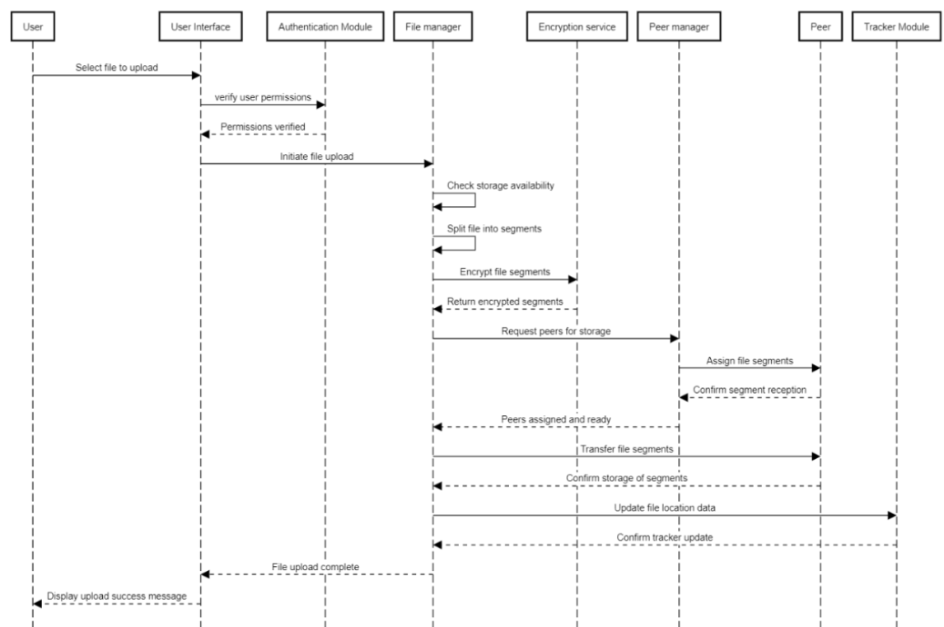
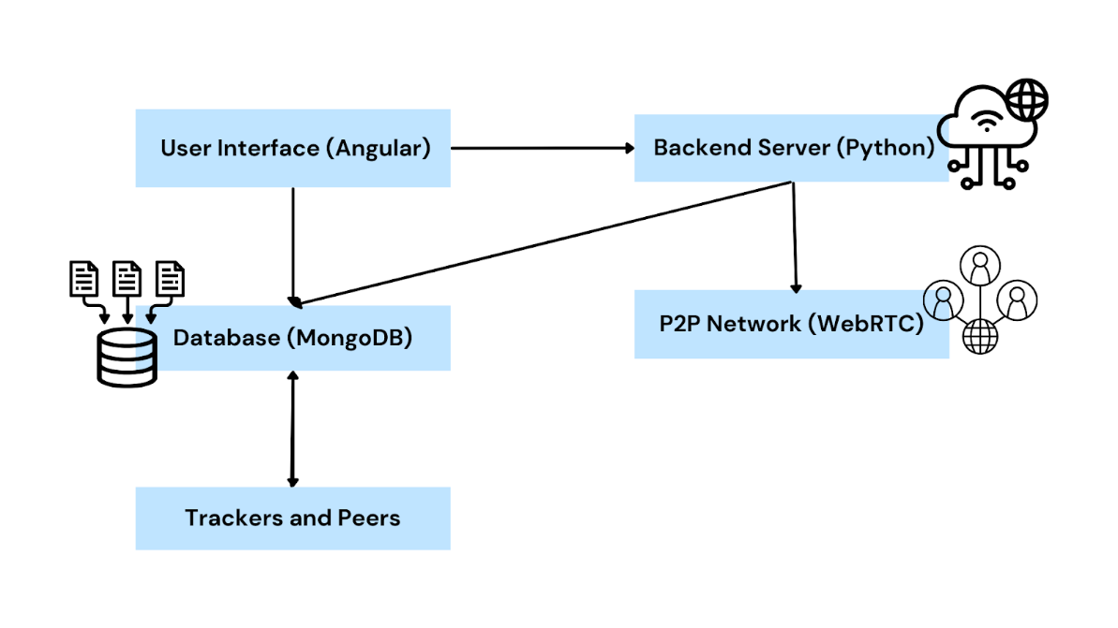
Upload File Sequence
11
Notes:
This sequence diagram illustrates the process of uploading a file in DataPulse.
The user starts by selecting a file to upload, which triggers the user interface to verify permissions with the authentication module.
Once permissions are verified, the file manager checks for available storage and then splits the file into segments. These segments are encrypted by the encryption service before being sent to the peer manager.
The peer manager then assigns these encrypted segments to peers for storage. Each peer confirms the reception of the segments, and the file’s location is updated in the tracker module.
Finally, the system confirms the upload and displays a success message to the user, completing the upload process.

Slide 12
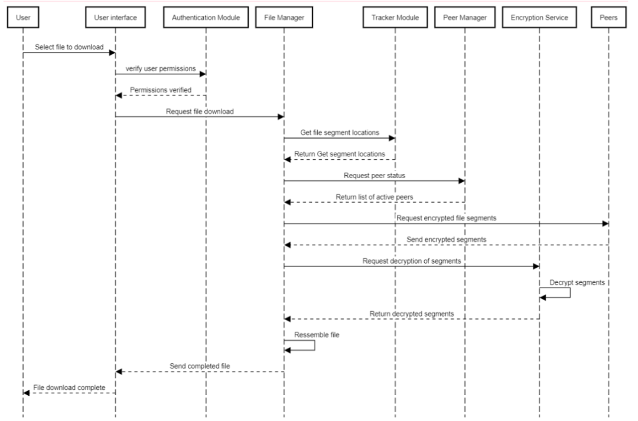
Download File Sequence
12
Notes:
This sequence diagram illustrates the process of downloading a file in DataPulse.
The user begins by selecting a file to download, which prompts the user interface to verify permissions with the authentication module.
Once permissions are confirmed, the file manager requests the file segment locations from the tracker module. The tracker provides the segment locations and a list of active peers.
The file manager then requests the encrypted file segments from the peers, which are sent back to the system. These segments are then passed to the encryption service for decryption.
After decryption, the file manager reassembles the segments into the complete file and sends it to the user, marking the download as complete.

Slide 13
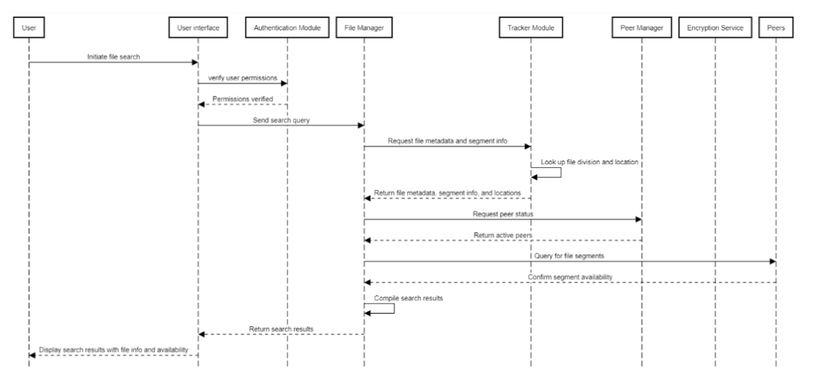
Search Sequence
13
Notes:
This sequence diagram outlines the process of searching for a file in DataPulse.
The user initiates a file search, which prompts the user interface to verify permissions with the authentication module.
Once permissions are confirmed, the file manager sends a search query to the tracker module, which retrieves file metadata, segment information, and peer locations.
The tracker module returns this data to the file manager, which then requests the peer status to ensure that the segments are available from active peers.
Finally, the search results, including file information and availability, are compiled and displayed to the user.

Slide 14
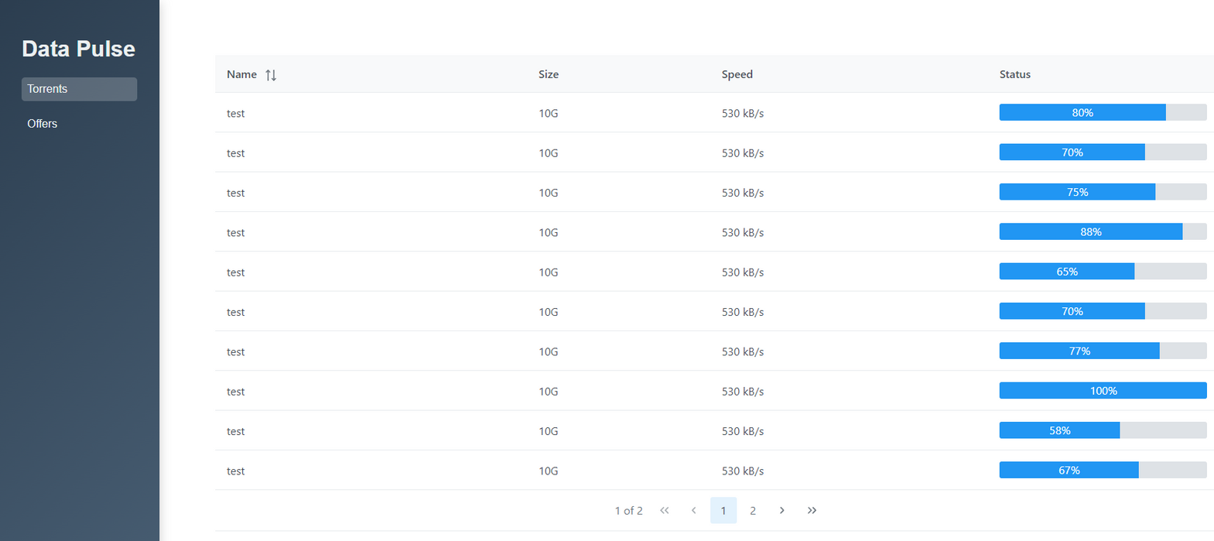
Torrents Screen
14
Notes:
this slide shows the user interface design for the Torrents screen in DataPulse.
On the left side, we have a sidebar with two categories: Torrents and Offers. The user can easily switch between these categories to manage their downloads.
The torrents section including details such as the file name, size, download speed, and the current status of the download progress. This clear and straightforward layout is designed to make it easy for users to track their downloads and manage their torrent files efficiently.
The interface aims to be user-friendly, with all the necessary information readily accessible in a clean and organized manner.

Slide 15
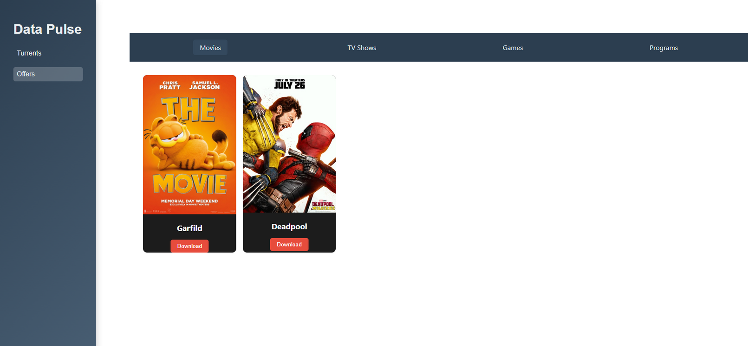
Offers Screen
15
Notes:
This slide showcases the design for the Offers screen in DataPulse.
On the left, the sidebar remains consistent with two categories: Torrents and Offers. The user can switch between these categories as needed.
At the top, there’s a navigation bar with different categories like Movies, TV Shows, Games, and Programs. Users can easily navigate through these categories to find specific offers.
The main section displays available offers as cards, each with a download button. This layout is designed to provide a Netflix-like browsing experience, making it simple and engaging for users to find and download content they’re interested in.

Slide 16
Innovative Features
Netflix-like Experience.
Simplified Navigation.
16
Notes:
DataPulse introduces several innovative features that set it apart from traditional file-sharing platforms.
First, we offer a Netflix-like Experience, where users can browse and select files with the same ease as streaming content. This visual and intuitive interface makes file sharing more accessible and engaging.
We’ve also focused on Simplified Navigation. Unlike many existing platforms with complex menus, DataPulse provides a straightforward, user-friendly interface that allows users to manage their downloads and uploads with minimal effort.

Slide 17
Anticipated Challenges
Handling High Traffic.
Ensuring Data Integrity.
Security Threats.
User Feedback Integration.
17
Notes:
As we develop DataPulse, there are several challenges we anticipate and plan to address.
First, Handling High Traffic will be crucial. As more users join the platform, we’ll need to ensure that the system remains responsive and efficient, even under heavy load.
Next, Ensuring Data Integrity in a decentralized network is another challenge. We’ll need to maintain the accuracy and availability of data, especially with peers joining and leaving the network.
Security Threats are always a concern in file-sharing platforms. We’ll implement robust encryption and security measures to protect user data and prevent unauthorized access.
Finally, User Feedback Integration is essential for improving the platform. We’ll need to balance incorporating user feedback with maintaining the technical integrity of the system.

Slide 18
Testing Process
Unit Testing.
Integration Testing.
System Testing.
Performance Testing.
Security Testing.
Usability Testing.
18
Notes:
We’ve outlined a comprehensive testing process to ensure DataPulse functions smoothly and securely.
We’ll start with Unit Testing, where we’ll test individual components to ensure they work correctly in isolation.
Next, we’ll conduct Integration Testing to verify that all components interact seamlessly with each other.
System Testing will follow, where we’ll assess the entire platform to ensure it meets our overall requirements.
We’ll also perform Performance Testing to measure how the system handles different loads, ensuring it remains responsive under high traffic.
Security Testing is crucial to identify and address any vulnerabilities, protecting user data and maintaining privacy.
Finally, we’ll focus on Usability Testing to ensure that the interface is intuitive and user-friendly, providing a smooth experience for all users.

Slide 19
Execution Method
Prepare the Test Environment.
Define Test Cases.
Execute Tests.
Analyze Results.
Address Issues.
Retest.
19
Notes:
Our testing process will follow a structured execution method to ensure thorough and effective testing.
First, we’ll Prepare the Test Environment by setting up a system that is similar to the real-world environment where the platform will be used.
Next, we’ll Define Test Cases that cover all critical aspects of the platform, ensuring we address every functionality and potential issue.
Once the test cases are ready, we’ll Execute Tests systematically to identify any bugs, performance issues, or security vulnerabilities.
After running the tests, we’ll Analyze the Results to understand the system’s performance and pinpoint areas that need improvement.
We’ll then Address Issues by fixing any problems identified during testing, optimizing the system as needed.
Finally, we’ll Retest to ensure that the issues have been resolved and that no new problems have been introduced.

Slide 20
Expected Results
Functional Components.
High Performance.
Secure Data
User-Friendly Interface
20
Notes:
Our testing and development efforts are aimed at achieving several key results.
First, we expect to have Functional Components, where each part of the platform works as intended, both individually and together.
We’re also aiming for High Performance, ensuring that the platform remains fast and responsive, even under heavy load.
Secure Data is another priority, with robust encryption and security measures in place to protect user information and ensure privacy.
Lastly, we aim to deliver a User-Friendly Interface that’s intuitive and easy to navigate, making the platform accessible to all users.

Slide 21
Thank you for listening.
21

