Slide 1
Financial Data Analytics in Python
Ofelya Rzayeva 221223910

Slide 2
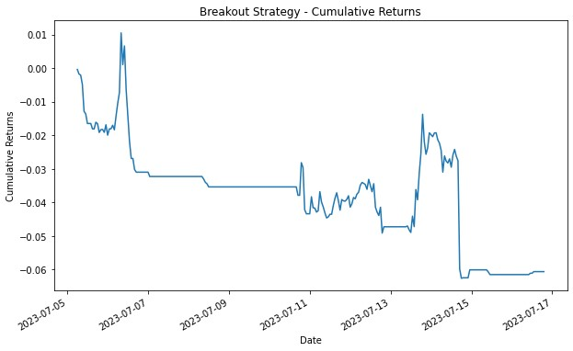
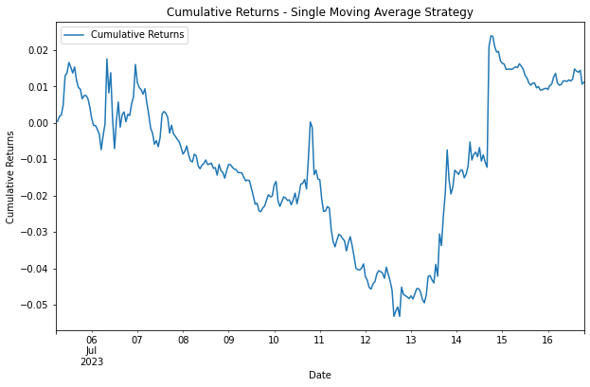
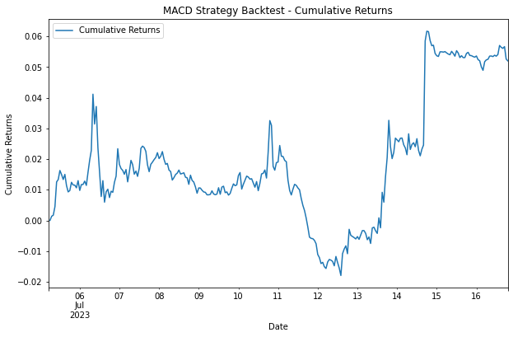
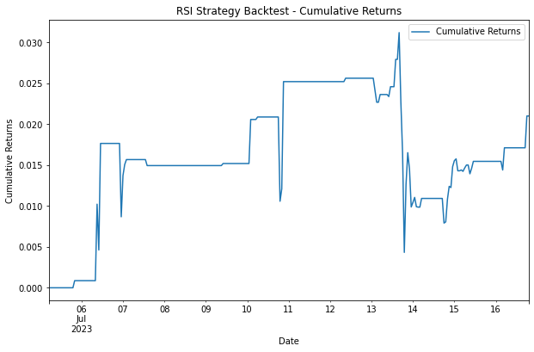

Slide 3
The Breakout Strategy
Prons
Cons
Capture Strong Trends
Clear Entry and Exit Signals
Volatility Exploitation
Risk Control
Objective and Rule-Based
Scalability
Potential for Early Entries
Measurable and Testable
False Breakouts
Market Noise
Whipsaw Movements
Lack of Trending Markets
Time Sensitivity
False Breakout Traps
Risk of Overtrading
Emotional Challenges

Slide 4
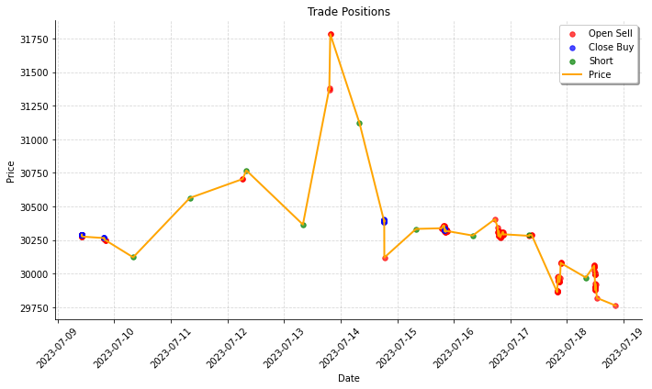

Slide 5
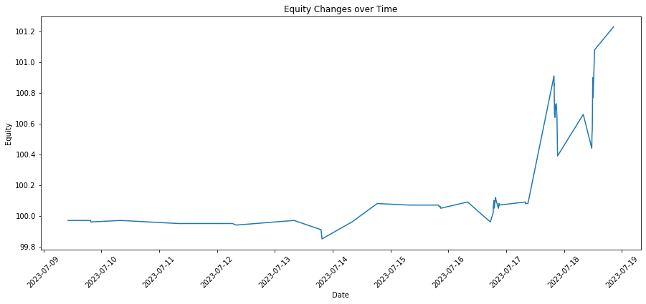
Changing equity

Slide 6
Total Trades: 279 Win Rate: 44.09% Annualized Return: -99.10% Annualized Volatility: 6.02% Sharpe Ratio: -16.47
Results

Slide 7
THANKS

