Slide 1
Golan Highest House App
Ofer Tauber
FullStack Developer

Slide 2

Hello!
I am Ofer Tauber
FullStack bootcamp Student
Originally from Jerusalem, currently lives in Tel Aviv
I come from a large and close-knit family 👪
Our parents decided to buy together a vacation house, in Katzrin.
The problem: the house will have many users, all living far away.
The solution: my middle-project in is a house-management app!

Slide 3
Golan Highest House App
What does it do?
Booking Management - Users can reserve dates, and indicate whether the rest of the family is invited to join or not.
Source of information - storage of "static" information such as home address, WiFi password, how to get there, etc.
Updates - Users can post important updates, for example on technical defects or changes that are important to be aware of. In addition - users can update the list of pantry contents.
Ofer Tauber | FullStack Developer

Slide 4
Demo
Let’s giv it a tray!
Ofer Tauber | FullStack Developer

Slide 5
Current Status
Login
Using Google Identity
New users can be created
User can not recover password.
Calendar
Users can create a new reservation, edit and delete it
All information is displayed graphically on the calendar.
Updates and information
Users can update the pantry list
Users can add entries to the list of updates (but not delete or edit them)
We only get the key next week!
Ofer Tauber | FullStack Developer
5

Slide 6
Thanks!
Any questions ?
You can find me at
ofertauber@gmail.com
www.linkedin.com/in/ofertauber/
Ofer Tauber | FullStack Developer
6

Slide 7
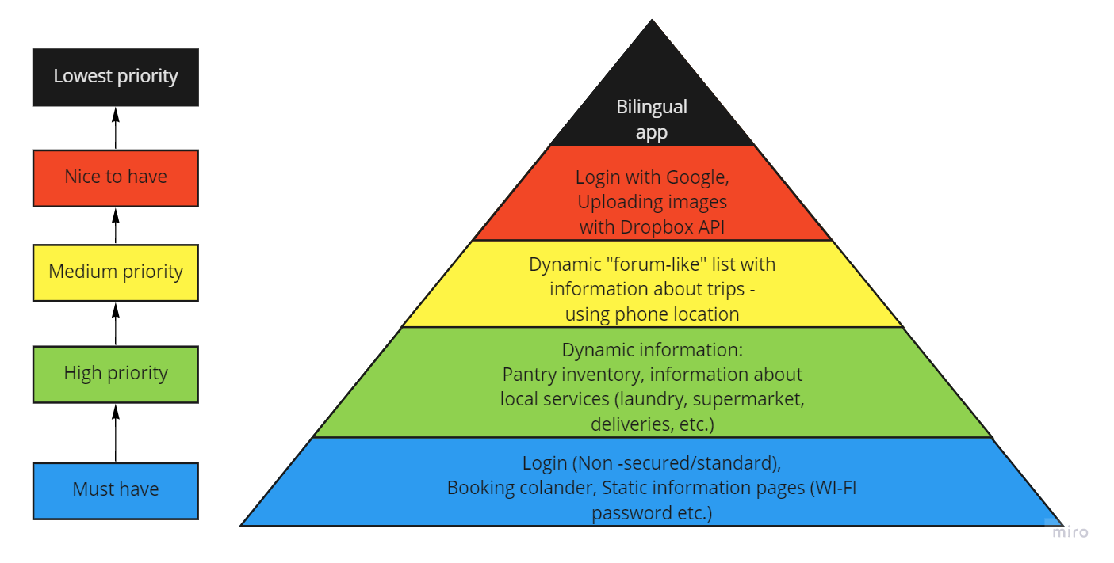
My Original Plan
Ofer Tauber | FullStack Developer

Slide 8
Capabilities I implemented in the app
AIP requests via Axios – get, post, put, delete
User verification using Google identity
Implementing momentJS library
Page swapping using React Route
Ofer Tauber | FullStack Developer
8

Slide 9

Difficulties I faced during the project
Finding a suitable calendar - I ended up building one from scratch
The design of calendar info-display
Using Google Login
"Mobile First“ design approach
About time planing…
Ofer Tauber | FullStack Developer
9

