Slide 1
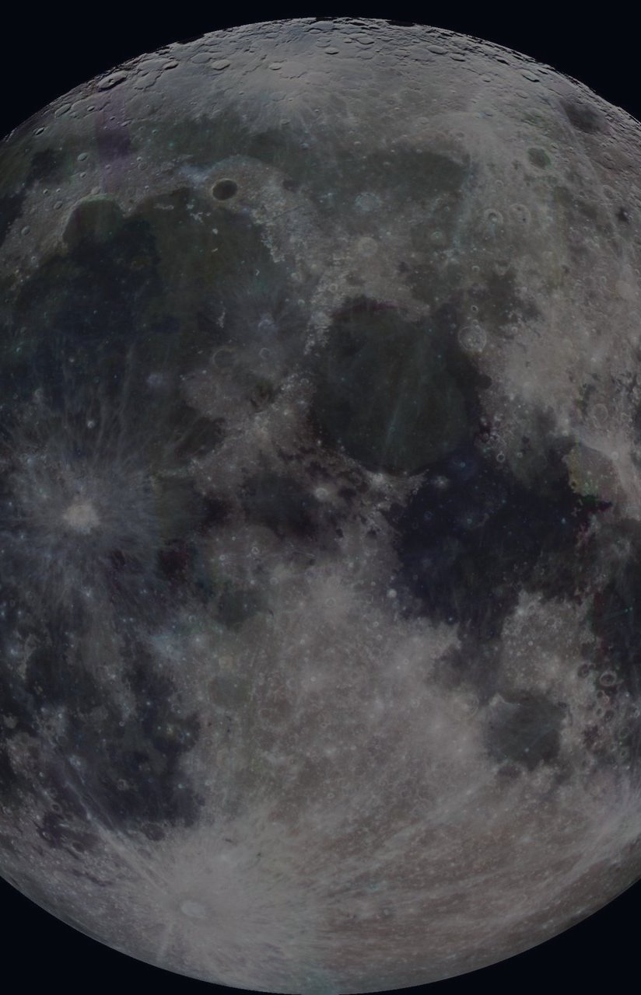

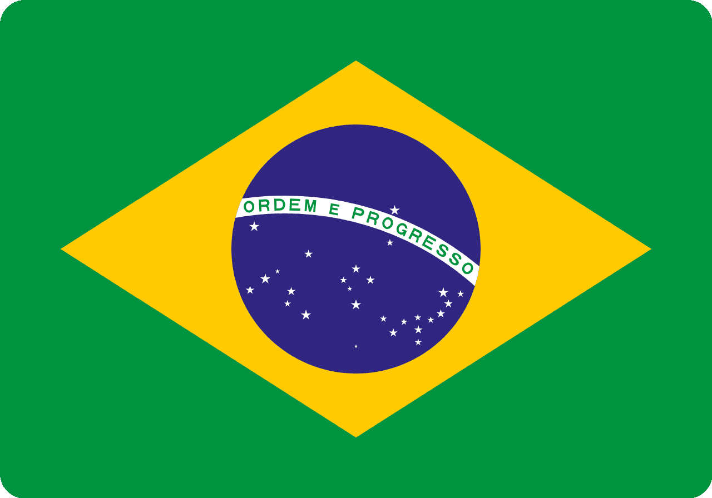
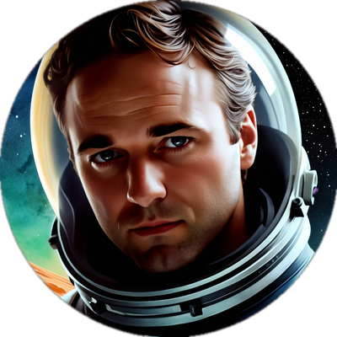
THE INTERNET'S SPACE PROGRAM
MoonDAO
Deep Space and the Lunar Economy
2nd Space Industry Workshop Brazil · Brazilian Space Agency (AEB)
Pablo Moncada-Larrotiz
Founder & Executive Director, MoonDAO
pablo@moondao.com · @pablo_moncada_ · moondao.com
Rio de Janeiro, Brazil
2nd Space Industry Workshop
Notes:
[~20s] Quick intro — who you are and why MoonDAO is on this panel. Don't linger, the content does the introducing.

Slide 2
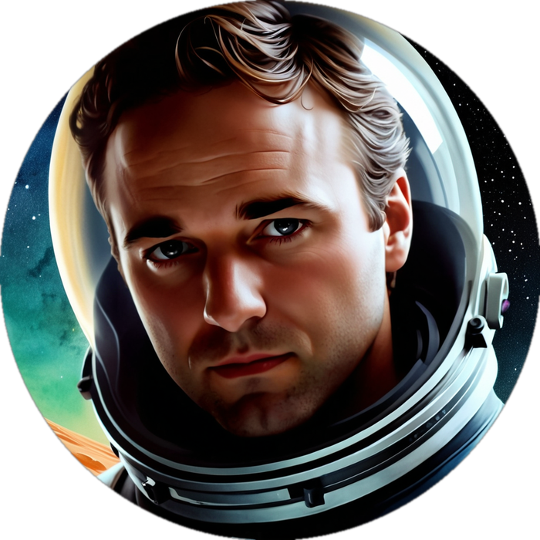
ABOUT THE SPEAKER
Pablo Moncada-Larrotiz
— Founder of MoonDAO. First elected Executive Lead, since 2021.
— Core contributor, ConstitutionDAO. Helped raise $47M in days for the U.S. Constitution.
— Google: Waymo & YouTube. Software engineer on self-driving perception at Waymo, and VR at YouTube.
— STEL. Biotech research engineering human tissue.
— University of Michigan. Computer Science & Mechanical Engineering.
Pablo Moncada-Larrotiz
Founder & Executive Director
MoonDAO
San Francisco, CA
pablo@moondao.com · @pablo_moncada_
“I see decentralization as a way to fix the risks of centralized control over billions of people's lives.”
MoonDAO · Deep Space and the Lunar Economy · 2nd Space Industry Workshop Brazil
02 / 14
Notes:
[~30s] One or two sentences max — the room can read the bullets. Land on ConstitutionDAO before Google; it's the most relatable proof point for a non-crypto audience.

Slide 3
WHO WE ARE
What Is MoonDAO
An onchain community — anyone, anywhere — pooling resources to fund and govern humanity's next steps into space.
OUR MISSION
To accelerate the development of a self-sustaining, self-governing settlement on the Moon.
— Decentralized. Governed onchain via the $MOONEY token.
— Global & permissionless. Anyone, anywhere can join, fund, or build.
— Radically transparent. Every vote and dollar is public onchain.
$8M+
12,000+
80+
2
Raised onchain
to fund space access
$MOONEY
token holders
Space R&D projects
funded via governance
Crowdfunded citizen-
astronauts sent to space
MoonDAO · Deep Space and the Lunar Economy · 2nd Space Industry Workshop Brazil
03 / 14
Notes:
[~40s] Define MoonDAO in one breath before the stats: an onchain community funding and governing space access. Let the four numbers do the heavy lifting.

Slide 4
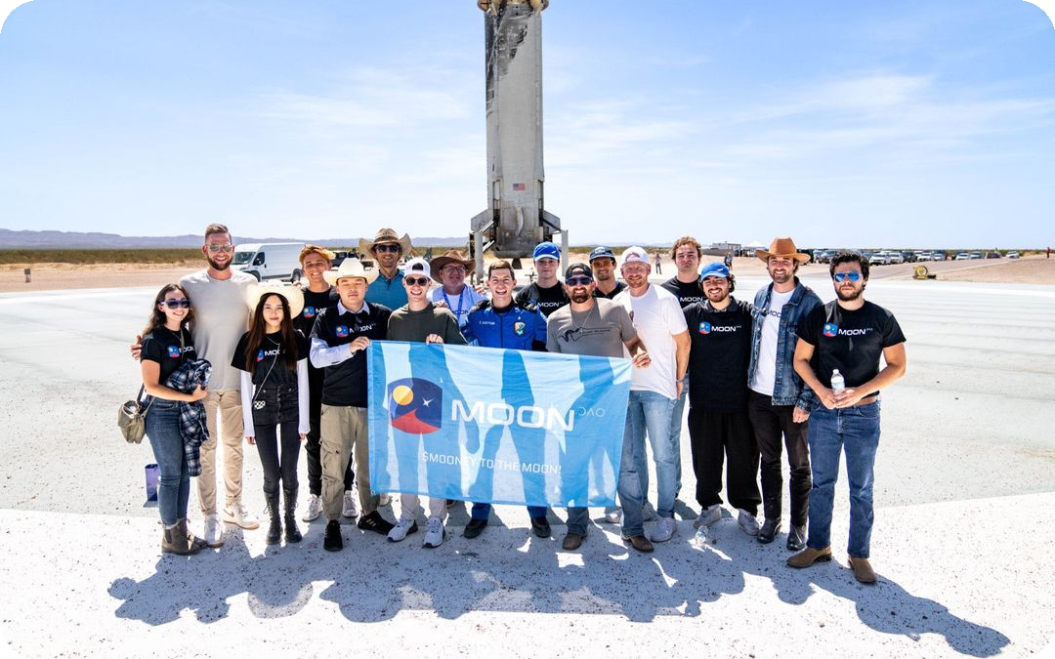
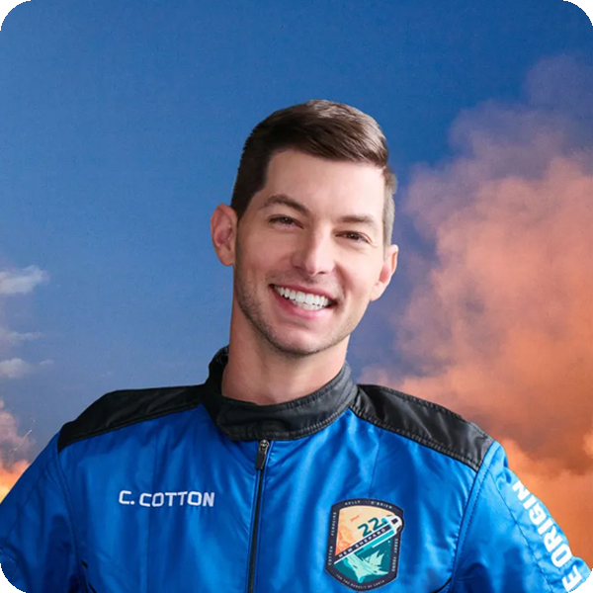
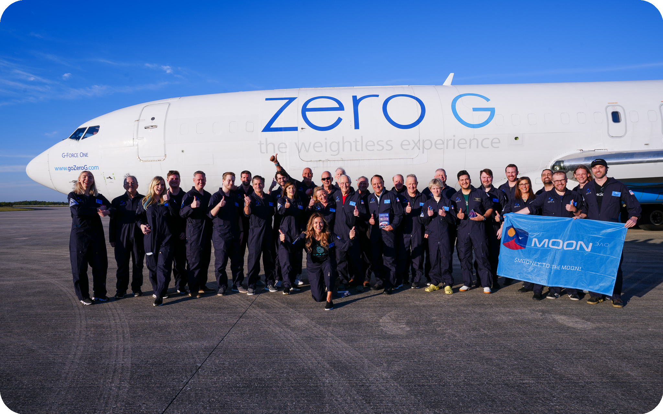
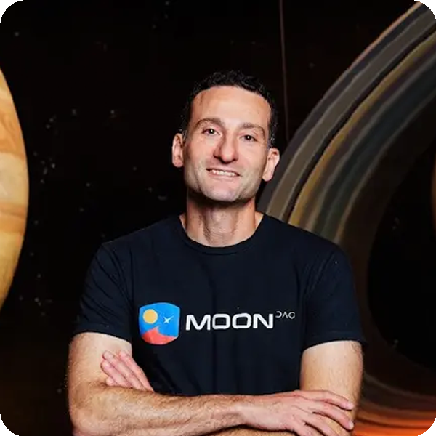
OUR STORY
Five Years of Milestones
2021
2022
2023
2024
2025
MoonDAO Launches
$8M Raised + First Astronaut
80+ Projects Funded
Network + 2nd Astronaut
Constitution Reaches the Moon
First DAO focused on space
exploration & lunar settlement
2,600 ETH raised; Coby Cotton
flies on Blue Origin's NS-22
Community governance funds a
thriving space R&D ecosystem
Space Acceleration Network launches;
Dr. Eiman Jahangir flies to space
MoonDAO Launchpad ships; our
constitution lands on the lunar surface
Team at Blue Origin’s launch site
Coby Cotton — 1st MoonDAO astronaut
Zero-gravity training flight
Dr. Eiman Jahangir — 2nd astronaut
MoonDAO · Deep Space and the Lunar Economy · 2nd Space Industry Workshop Brazil
04 / 14
Notes:
[~45s] Walk left to right once, quickly. Slow down only on 2022 (first astronaut) and 2025 (constitution on the Moon) — those are the two moments that make people lean in.

Slide 5
WHAT WE DO
Core Initiatives
Human Spaceflight
Fund Space R&D
Space Training
Two crowdfunded citizens sent to space by onchain vote.
$600K+ allocated to 80+ projects via open governance.
Zero-gravity flights and astronaut-prep experiences.
Space Acceleration Network
Transparent Governance
Lunar Settlement Roadmap
An onchain “startup society” for the space industry.
Every vote and treasury move, public onchain.
Constitution, Launchpad, and missions — building toward the Moon.
MoonDAO · Deep Space and the Lunar Economy · 2nd Space Industry Workshop Brazil
05 / 14
Notes:
[~40s] Don't read every card. Group them verbally: 'flight access, funding, training, network, governance, and the roadmap that ties it together.'

Slide 6
FUNDING INNOVATION
DePrize: A Prediction Market for Space Delivery
1
Back a Team
2
Live Odds
3
Winner Delivers
Wager ETH on who delivers first
Every bet grows the shared prize
Community declares winner; backers get paid
8 CAPABILITY VERTICALS ON THE TECH TREE
Comms / PNT
Surface Construction
Habitat
ISRU Plant
Power
Rover
Crewed Base
Lander
THE MATH, WORKED
→ Bet 1 ETH on a provider priced at 40% odds
+1.32 ETH
→ 5% → prize pool · 95% → market (2.375 shares at $0.40)
→ Less the 1% LMSR fee → ≈ 2.35 shares held
net gain + 50 $OVERVIEW,
funded by other bettors
→ If they win: shares redeem 1:1 → ≈ 2.32 ETH back
MoonDAO · Deep Space and the Lunar Economy · 2nd Space Industry Workshop Brazil
06 / 14
Notes:
[~50s] Walk the 3-step mechanism fast, name the 8 verticals as one group ('comms, construction, habitat, ISRU, power, rover, crewed base, lander'), then slow down for the worked math — the +1.32 ETH number is the one that lands. Frame it as a new financing primitive, not 'crypto betting.'

Slide 7
FUNDING INNOVATION
Surviving the 354-Hour Lunar Night
THE PHYSICS
THE EXTREMES
THE MATH
354 hrs
257°C
120 tons
of total darkness, every cycle
swing between sun and shadow
of batteries — for one night
• The Moon is tidally locked: one rotation = one 29.5-day orbit
• South Pole sunlit ground: up to 54°C (130°F)
• 40 kWe load × 354 hrs ≈ 14,160 kWh needed
• → sunrise to sunrise (“lunar day”) = 29.5 Earth days
• Nearby permanent shadow: as low as −203°C (−334°F)
• At Tesla Powerwall density (13.5 kWh / 114 kg):
• → continuous night ≈ 14.75 days = 354 hours
• Colder than anywhere ever recorded on Earth
• → ≈ 1,050 units ≈ 120 metric tons of batteries
• No atmosphere → no convection — heat only radiates away
• Regolith insulates the subsurface, but can't power a base
• NASA's whole heavy-lander budget: 15 tons, total
THE ANSWER — a 40 kWe fission reactor, shielding, and radiators fit the same 15-ton lander and run for a 10-year design life. NASA calls this civil-space shortfall #1.
Sources: NASA — The Harsh Environment of the Lunar South Pole; NASA Fission Surface Power Program; NASA HLS Lunar Thermal Analysis Guidebook.
MoonDAO · Deep Space and the Lunar Economy · 2nd Space Industry Workshop Brazil
07 / 14
Notes:
[~55s] This is the technical-depth moment. Walk physics → extremes → math in order, landing on '120 tons of batteries vs. a 15-ton lander.' It shows MoonDAO understands the engineering, not just the funding mechanics.

Slide 8

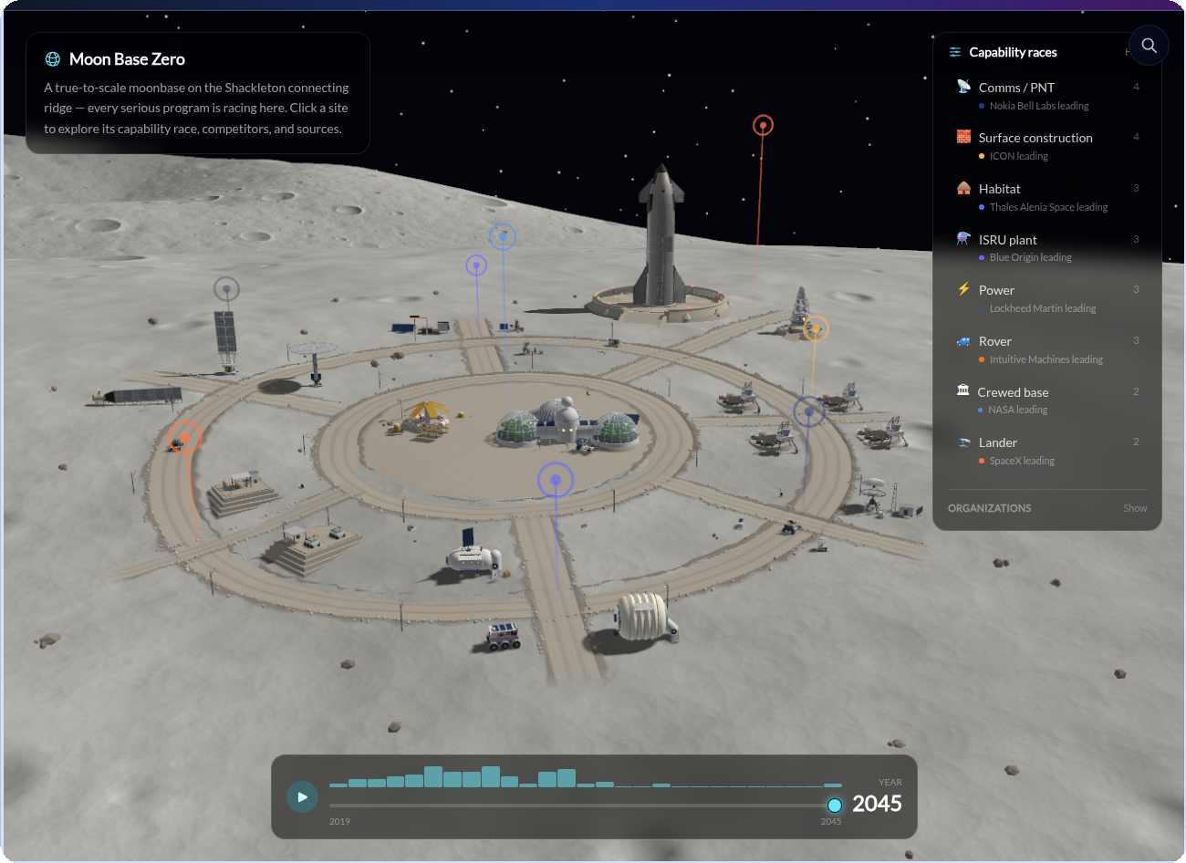
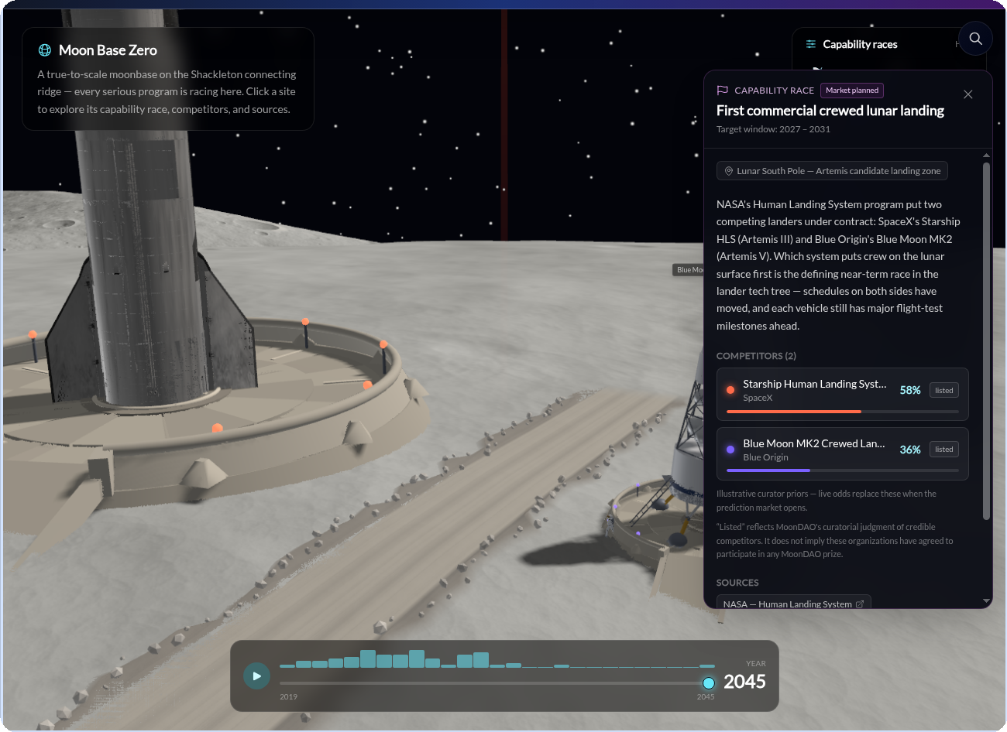
FUNDING INNOVATION
Moonbase Zero
IN DEVELOPMENT
moondao.com/moonbase
Click a race to see live competitors, criteria, and sources
A true-to-scale 3D site on the Shackleton connecting ridge — 8 capability races, 24 real competitors, all publicly sourced.
MoonDAO · Deep Space and the Lunar Economy · 2nd Space Industry Workshop Brazil
08 / 14
Notes:
[~35s] This is the real, live product — say so explicitly. Point out the second screenshot shows an actual capability race opened live, with real competitors and sources.

Slide 9
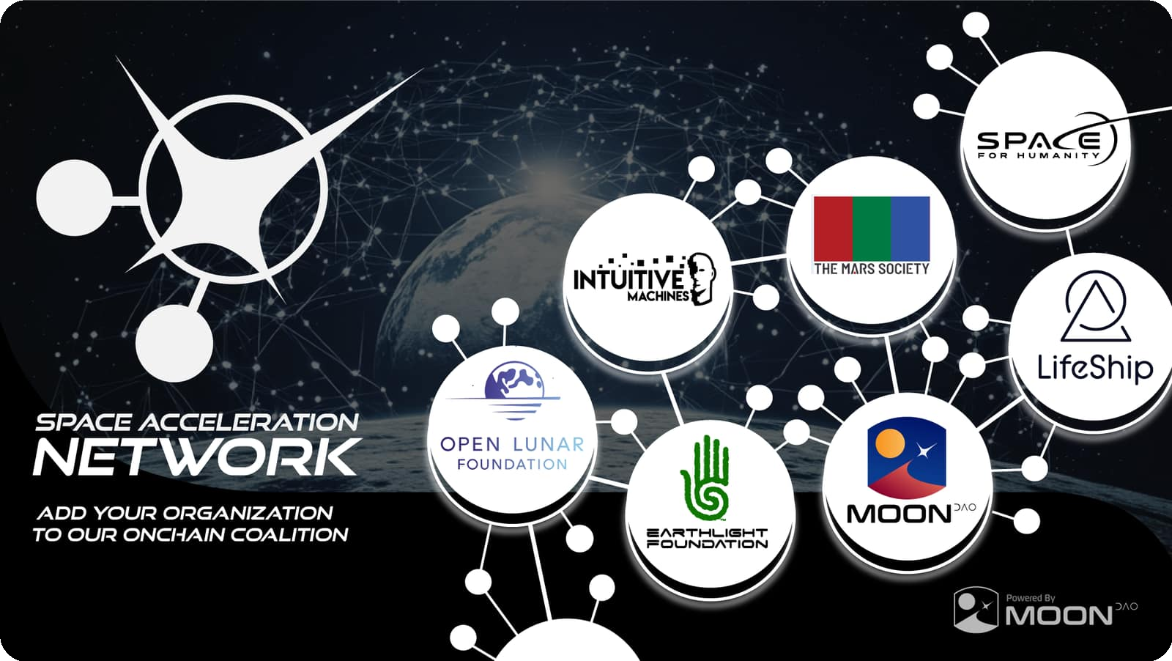
THE BIGGER PICTURE
A Level Playing Field for the Next Space Age
Deep space used to require a national agency — or a billionaire.
— Permissionless. Any country, company, or individual can fund and compete.
— Already global. 25+ countries in the Space Acceleration Network.
— An open invitation. To anyone in this room — and your own ecosystem back home.
25+
12,000+
100%
Countries in the
Space Acceleration Network
$MOONEY
token holders worldwide
Onchain, transparent
votes & treasury
MoonDAO · Deep Space and the Lunar Economy · 2nd Space Industry Workshop Brazil
09 / 14
Notes:
[~40s] This is the slide that answers the panel's brief directly — make it personal to whoever's in the room, not just the named institutions.

Slide 10
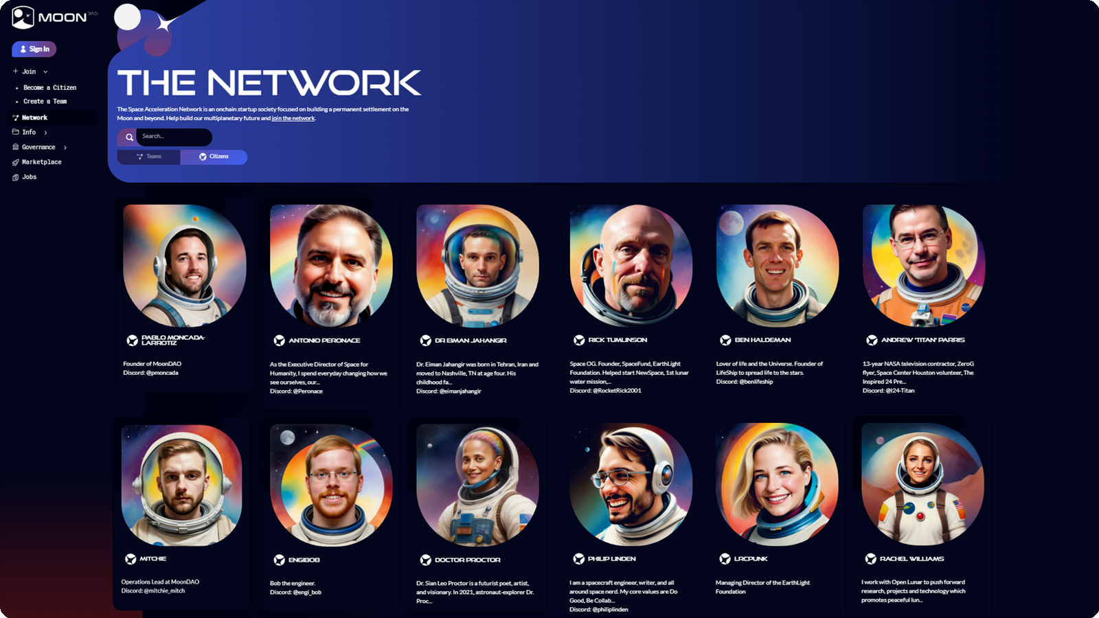
THE BIGGER PICTURE
Our Global Citizens
12,000+ $MOONEY holders and a growing roster of onchain “citizens” — engineers, artists, and space professionals — building this together.
MoonDAO · Deep Space and the Lunar Economy · 2nd Space Industry Workshop Brazil
10 / 14
Notes:
[~15s] Quick, human beat — real people, real names, behind the onchain numbers. Don't over-explain, let the faces land.

Slide 11

THE NEXT OPPORTUNITY
Go to Space with Frank White
Funding a flight for the author of “The Overview Effect” — and one MoonDAO community member — to finally see Earth from space.
MoonDAO · Deep Space and the Lunar Economy · 2nd Space Industry Workshop Brazil
11 / 14
Notes:
[~10s] Let this breathe — pause on the title before moving to Frank White. This is the pivot from 'here's how we fund & build' to 'here's the live opportunity.'

Slide 12
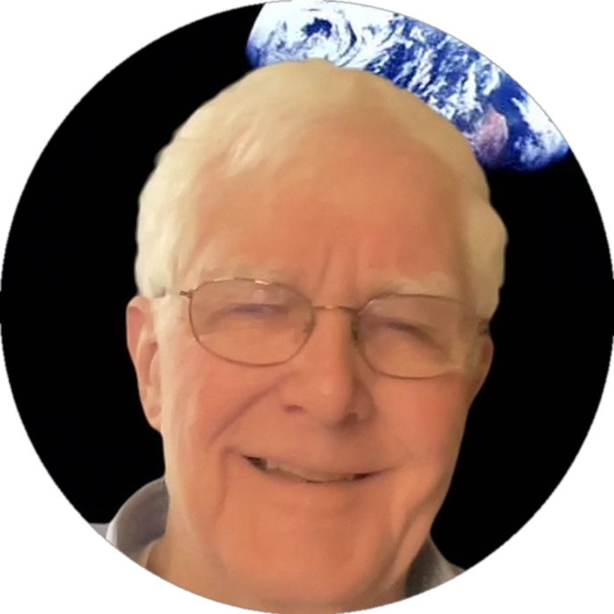
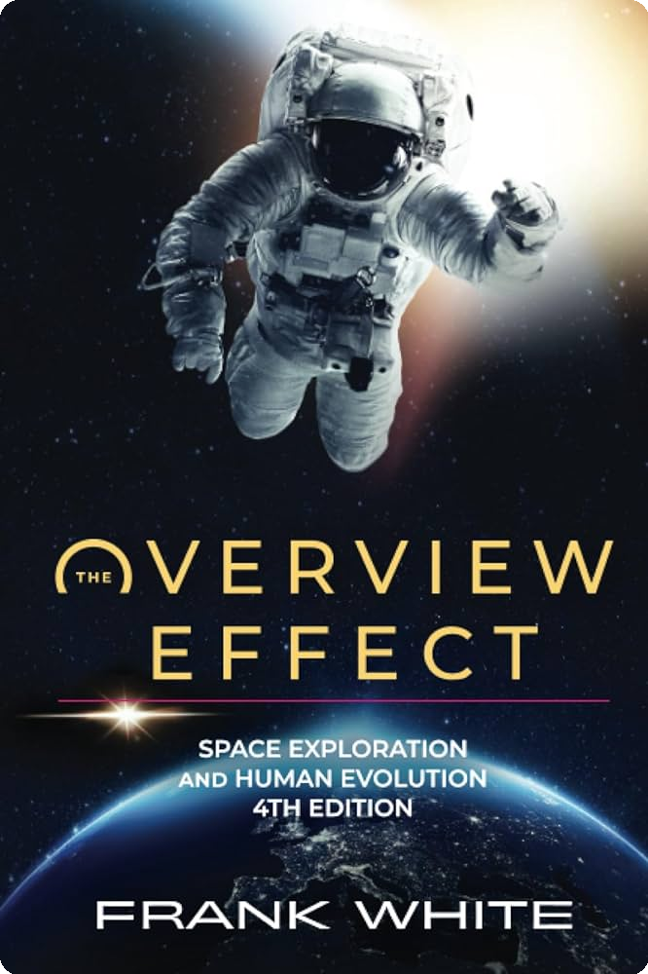
THE NEXT OPPORTUNITY
Who Is Frank White
— Coined “the Overview Effect.” The name for the shift astronauts feel seeing Earth from space.
— 40 years of research. Interviewed 50+ astronauts and cosmonauts.
— Shaped the industry. Co-founded the Overview Institute; inspired a documentary.
— Has never been to space.
Frank White
Author, “The Overview Effect”
“Astronauts describe seeing Earth from space as an instant, visceral realization that we share one planet, one atmosphere, one destiny — the Overview Effect.”
“The Overview Effect,” 4th ed.
MoonDAO · Deep Space and the Lunar Economy · 2nd Space Industry Workshop Brazil
12 / 14
Notes:
[~45s] Frank is the emotional core of this section — 40 years, 50+ astronauts, coined the term, and has never flown himself. That irony is the hook.

Slide 13

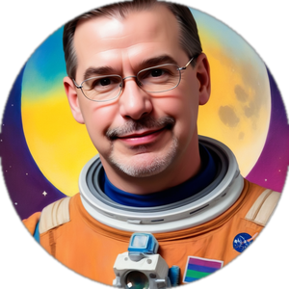


THE NEXT OPPORTUNITY
Fly to Space with Frank White
Top candidates
25 advance to Round 2
69%
funded
1
Andrew "Titan" Parris
2,083 $OVERVIEW
2
EngiBob
680 $OVERVIEW
$172K of $250K
3
Jas
Support Frank &
Back a Candidate
157 contributors
goal secures a seat
652 $OVERVIEW
moondao.com/overview-vote
Any Citizen can enter and climb.
$100+ grants free citizenship — and a shot at flying alongside Frank.
MoonDAO · Deep Space and the Lunar Economy · 2nd Space Industry Workshop Brazil
13 / 14
Notes:
[~40s] Point at the QR code directly — invite the room to scan right now while you talk. These are real, live candidates on the board; anyone can enter and climb it.

Slide 14
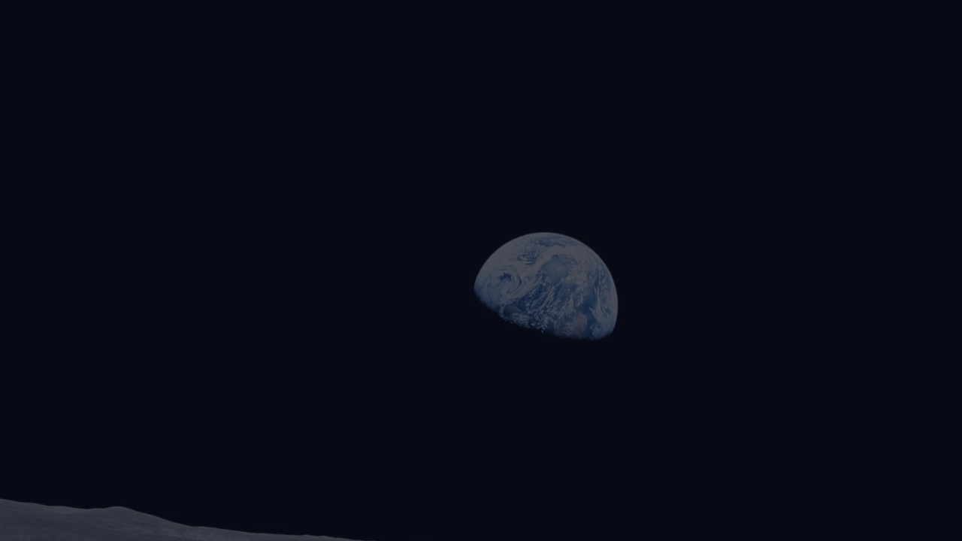
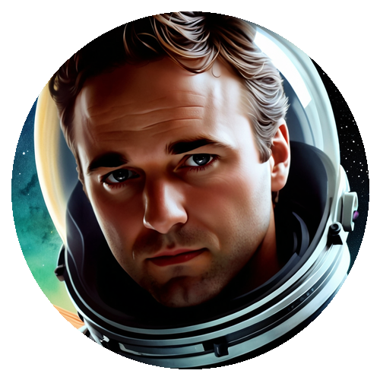

MOONDAO
Let's Build the Lunar Economy Together
Pablo Moncada-Larrotiz
Founder & Executive Director, MoonDAO
pablo@moondao.com · @pablo_moncada_
Scan to Join MoonDAO
moondao.com/join
moondao.com · Discord: moondao.com/discord
MoonDAO · Deep Space and the Lunar Economy · 2nd Space Industry Workshop Brazil
14 / 14
Notes:
[~20s] Point at the QR code — invite people to scan and join MoonDAO before you leave the stage. Contact info stays up during Q&A.

