Slide 1
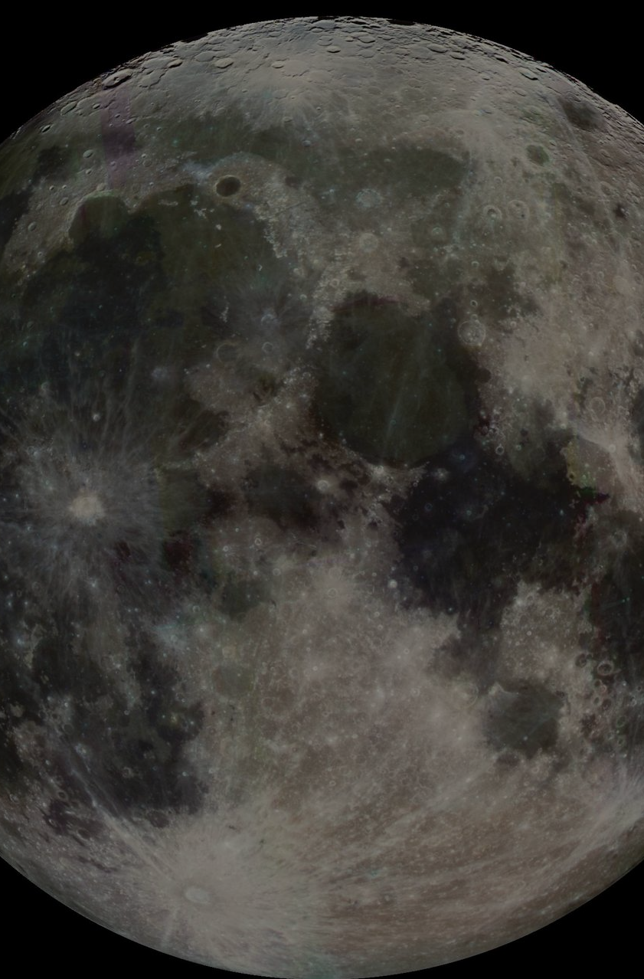

MOONDAO TOWN HALL · 8 OCTOBER 2026
Executive Branch
Final Report
Q2 2026 – Q3 2026 · MDP-249 · Project #131
Pablo Moncada-Larrotiz Executive Lead
Ryan Communications, community & partnerships
Miguel Frontend & product engineering
Grades shown are provisional, for Executive Lead review
Notes:
[0:20] Hi everyone. This is the Executive Branch's final report for MDP-249, the Q2 to Q3 2026 term, which ran from May through early September. I'm presenting on behalf of Pablo, Ryan and Miguel. Ten minutes: what we said we'd do, what happened, what it cost, and how we'd grade ourselves. All numbers are measured from on-chain data as of yesterday, October 7, and the full written report is posted with links to every transaction.

Slide 2
WHAT WE COMMITTED TO
MDP-249: three objectives, five months, $132k
1
2
3
Frank & DePrize
Grow the network
Run the DAO well
Secure a seat for Frank, or deploy DePrize with the Frank White capital, and launch a competitive lunar simulation and prototyping initiative.
Citizens 199 → 300, Teams 20 → 30, 60% of Teams using jobs or the marketplace, discovery calls with 15+ Teams.
Budget discipline, new project system, operational audit, for-profit plan, Realistic Goals, GDPR, an Executive Branch election.
PASSED 26 MAY
FUNDED
CORE BUDGET
BONUS POOL
91% · 21 voters
1 May – 3 Sep 2026
$132,000
$24,000 at risk
MoonDAO Town Hall · Executive Branch Final Report, Q2 – Q3 2026 (MDP-249) · Data as of 7 Oct 2026
02 / 13
Notes:
[0:40] Quick reminder of the mandate. MDP-249 passed the Member House on May 26 with 91% from 21 voters. Five months, $132,000 core budget plus a $24,000 bonus pool that only pays on verified milestones. Three objectives: first, put Frank in space or deploy DePrize with a lunar challenge. Second, grow the Space Acceleration Network and get Teams using jobs and the marketplace. Third, run the DAO's operations within budget, with a new project system, an audit, a for-profit plan and an election.

Slide 3
AT A GLANCE
The term in six numbers
Live
+33%
20 → 25
DePrize on Arbitrum
Citizens
Teams
Mainnet 25 Aug · 5 competitions on mainnet, 8 on Sepolia
199 → 265 minted · 238 active (target 300)
Five new Teams, all active (target 30)
44%
$132.7k
359
Teams using services
Spent vs $132k budget
Merged pull requests
11 of 25 posted a job or listing (target 60%)
Within 0.6% · payroll via LlamaPay streams
Three-person team · 1 May – 7 Oct
MoonDAO Town Hall · Executive Branch Final Report, Q2 – Q3 2026 (MDP-249) · Data as of 7 Oct 2026
03 / 13
Notes:
[0:50] The headline numbers. DePrize is live on Arbitrum with five competitions. Citizens grew 33%, from 199 to 265 minted, 238 currently active, the fastest growth we've had, but short of 300. Teams went from 20 to 25. Spending landed within 0.6% of the budget. And the three of us merged 359 pull requests, roughly double the previous pace, largely thanks to AI-assisted development.

Slide 4
OBJECTIVE 1 · DEPRIZE
DePrize is live on Arbitrum
25 AUG
11 SEP
18 SEP
26 SEP
Mainnet launch
Security fix
Full lifecycle
Four lunar races
DePrize #1: The Moon Is A Harsh Mistress (demo prize)
Bug H-01 found in review, fixed and redeployed before any race
Sepolia: bet, declare winner, redeem, end to end
Registered on Arbitrum, each with its own market
Touchdown
Night Shift
First Tracks
Water Ice
Next upright working lunar landing
First machine to work through a lunar night
Commercial rover egress and drive
First in-situ surface water ice
6 competitors
8 competitors
6 competitors
4 competitors
Not yet: public betting on the races, an analog prototype test, and revenue. Landed ~8 weeks after the month-2 target; mainnet bets so far are internal tests (0.0127 ETH).
MoonDAO Town Hall · Executive Branch Final Report, Q2 – Q3 2026 (MDP-249) · Data as of 7 Oct 2026
04 / 13
Notes:
[1:00] Objective 1. Phase 1 of the Overview Flight raised capital, but you voted to keep fundraising rather than convert it into a prize pool, so we built DePrize as general MoonDAO infrastructure instead. It went live on Arbitrum on August 25 with a demonstration prize, The Moon Is A Harsh Mistress. A security review found a bug in the market contract, which we fixed and redeployed before any race went live. Then on September 26 we registered four lunar capability races: Touchdown, Night Shift, First Tracks and Water Ice. We ran the full lifecycle on testnet, including declaring a winner and paying out. Honest caveats: this landed about eight weeks after the month-2 target, and so far the only bets are our own test bets, so no revenue yet.

Slide 5
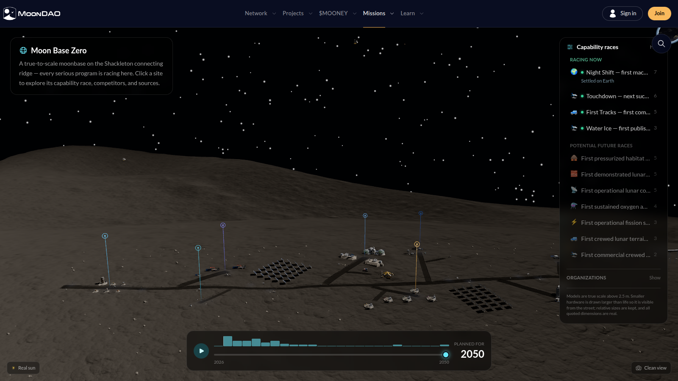
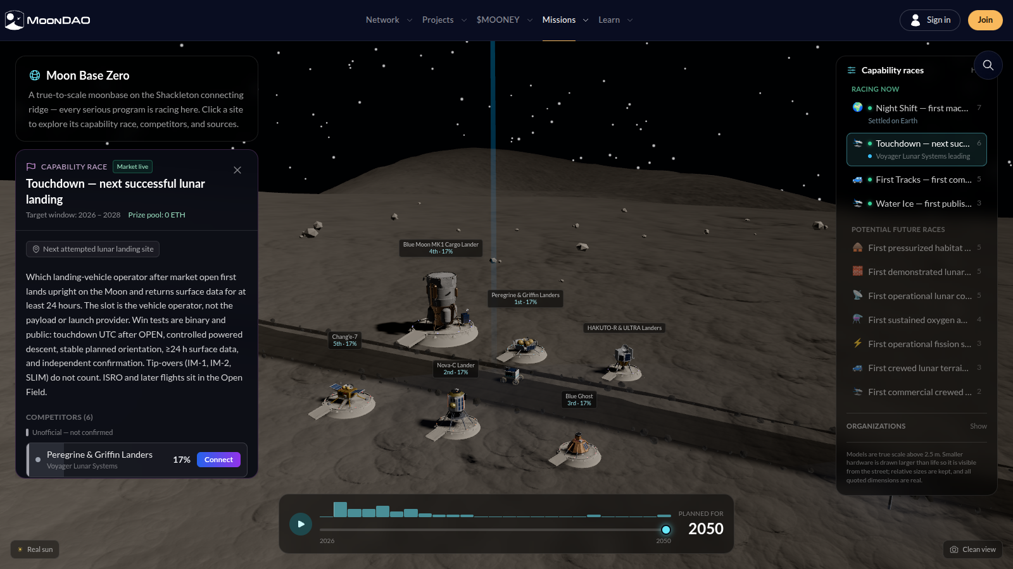
OBJECTIVE 1 · LUNAR SIMULATION
Moon Base Zero: every race, on the Moon
The base on the Shackleton connecting ridge, with the four live races
Touchdown race: six landers, rules and live DePrize odds
50 projects
33 organizations
12 capability goals
336 unit tests
First shipped 23 Jul
MoonDAO Town Hall · Executive Branch Final Report, Q2 – Q3 2026 (MDP-249) · Data as of 7 Oct 2026
05 / 13
Notes:
[0:50] Instead of running the lunar simulation as an outside challenge, Miguel built it in-house. This is Moon Base Zero: a true-to-scale base on the Shackleton connecting ridge, with real sun position and terrain. It models 50 projects from 33 organizations across 12 shared goals, and every competitor in every DePrize race has its own lot. On the right is the Touchdown race: the six landers, the rules, and live odds read from the market. It's behind an access gate for now. [Optional: switch to the live demo.]

Slide 6
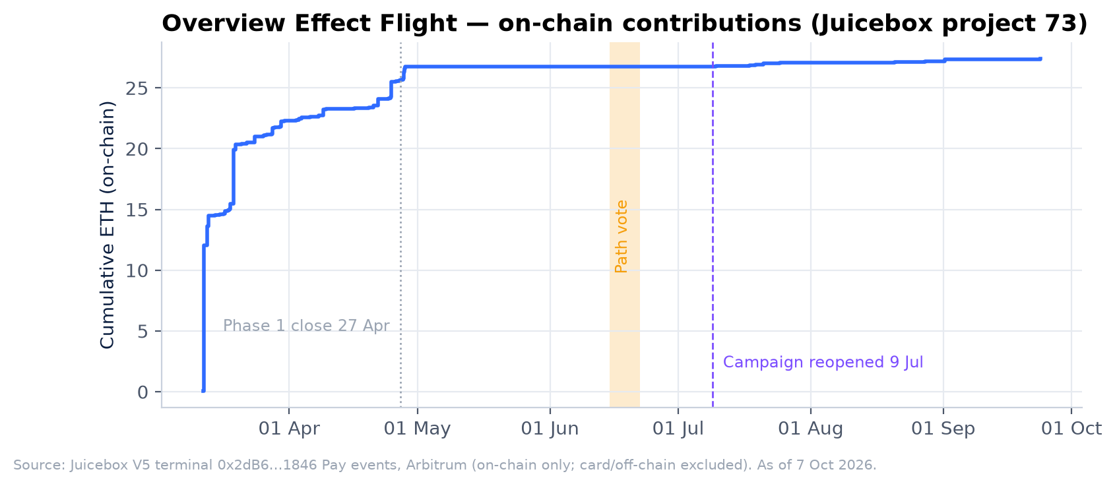
OBJECTIVE 1 · OVERVIEW FLIGHT
You chose to keep fundraising for Frank
PATH VOTE · 15–22 JUNE · 31 VOTERS
B · Keep options open, keep fundraising (22 voters)
92.9%
A · Commit now to a stratospheric balloon (3 voters)
0.2%
C · Refund contributors (2 voters)
0.7%
Abstain (4 voters)
6.2%
Share of 10,444 $OVERVIEW voting weight
27.39 ETH Raised in total
0.64 ETH Since reopening
12 Carriers approached
180 contributions
9 Jul onward · 21 contributions · 16 wallets
Balloon, suborbital, orbital
MoonDAO Town Hall · Executive Branch Final Report, Q2 – Q3 2026 (MDP-249) · Data as of 7 Oct 2026
06 / 13
Notes:
[0:50] On Frank's flight: after Phase 1 closed in April we approached 12 carriers and brought the findings to you. In the June path vote, 92.9% of OVERVIEW voting weight chose to keep options open and keep fundraising. The campaign reopened on July 9 with a single $250k goal. Lifetime it's raised 27.4 ETH from 180 contributions, but re-engaging after a pause is hard: only 0.64 ETH came in after the reopen. [Only if ready to share: agreements are in place for Frank's flight; an announcement is coming.]

Slide 7
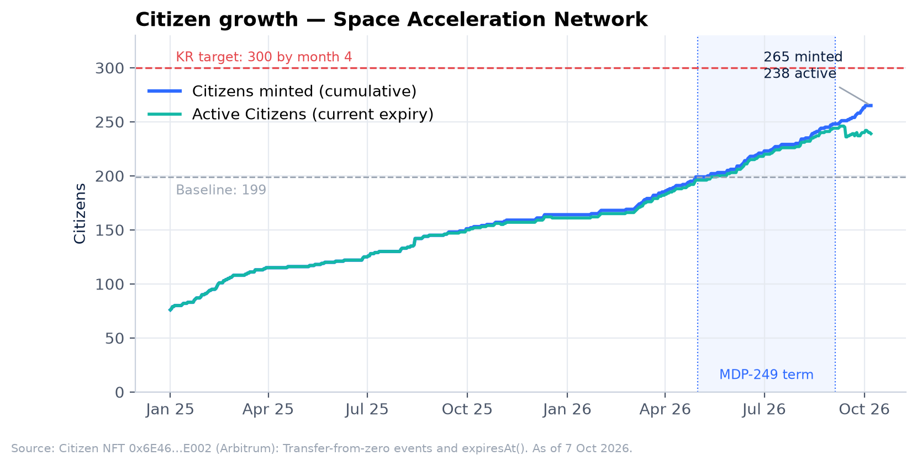
OBJECTIVE 2 · NETWORK GROWTH
Fastest growth on record, short of target
199 → 265
Citizens minted
238 active · target 300
20 → 25
Teams
Target 30
New Teams: Habitat Marte, A Heart for Space, USSRC Education Foundation, Geração de Marte, Zephalto
MoonDAO Town Hall · Executive Branch Final Report, Q2 – Q3 2026 (MDP-249) · Data as of 7 Oct 2026
07 / 13
Notes:
[0:50] Objective 2, the network. Citizens grew from 199 to 265 minted, 66 new Citizens in five months versus 35 in the five before. 238 are currently active, because 27 have lapsed, which is why we shipped renewal prompts. Teams grew from 20 to 25: Habitat Marte, A Heart for Space, the U.S. Space and Rocket Center Education Foundation, Geração de Marte and Zephalto. Both missed their targets of 300 and 30. Those targets assumed a live mid-cycle raise, which was our biggest acquisition engine last time.

Slide 8
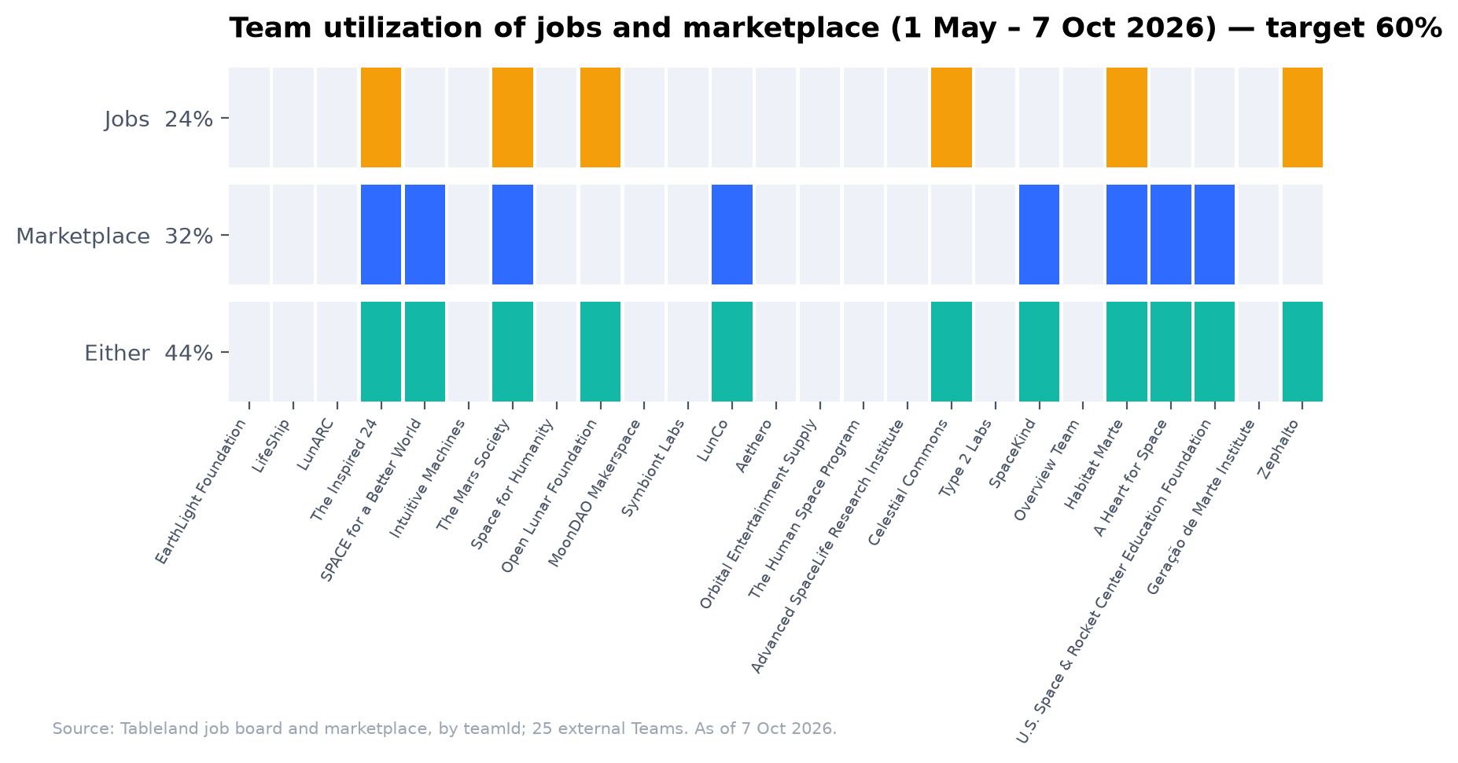
OBJECTIVE 2 · UTILIZATION
Marketplace beat its target; jobs did not
17 / 15
Marketplace listings
Target met
7 / 15
Job listings
Target missed
44%
Teams using a service
6 jobs · 8 marketplace · 3 both
MoonDAO Town Hall · Executive Branch Final Report, Q2 – Q3 2026 (MDP-249) · Data as of 7 Oct 2026
08 / 13
Notes:
[0:40] Utilization. 11 of our 25 Teams, 44%, used at least one service this term against a 60% target. The marketplace beat its goal with 17 new listings, mostly real space experiences: analog missions, zero-g flights, training, MDRS seats. Jobs fell short at 7 new listings. Job posting is concentrated in a few Teams, so the board needs seeding, not just availability.

Slide 9
OBJECTIVE 2 · DISCOVERY
30 calls with 21 Teams, two fixes shipped
~30 calls
Shipped 1 · Richer, shareable listings
with 21 Teams
Full descriptions instead of truncated text, a deep link for every listing, and Team pages visible to non-Citizens so links work for anyone.
Late May – September · ~2 a week
11 IN THE NETWORK
Asked for by The Inspired 24, Habitat Marte, LunCO
LifeShip, LunARC, The Inspired 24, Mars Society, The Human Space Program, Celestial Commons, SpaceKind, Habitat Marte, Space Camp USA, Generation Mars Brazil, Zephalto
Shipped 2 · Card & bank onramp for purchases
10 PROSPECTIVE
Buyers fund a wallet and buy a listing in one flow without holding crypto. Onboarding no longer steers people to a single provider.
Including Lonestar (tentatively agreed) and Stardust (whitelisted)
Asked for by Habitat Marte (international payments), LunARC (crypto hurdles)
MoonDAO Town Hall · Executive Branch Final Report, Q2 – Q3 2026 (MDP-249) · Data as of 7 Oct 2026
09 / 13
Notes:
[0:50] Ryan led about 30 discovery calls with 21 Teams between late May and September, a little over two a week: 11 existing Teams and 10 prospective ones. Two themes came up again and again, and we shipped both. First, Teams wanted to post detailed roles and share them, so listings now show full descriptions and have their own shareable links, and Team pages are visible to everyone. Second, buyers struggled with crypto and international payments, so the marketplace now has a card and bank onramp. On the prospective side, Lonestar has tentatively agreed and Stardust is whitelisted.

Slide 10
OBJECTIVE 3 · OPERATIONS & GOVERNANCE
Most of the operating agenda delivered
· Project system: 100% migrated, then Project System v9 (MDP-267)
· Operational audit: 14 Aug financial disclosure and burn report, live dashboard
· GDPR: Europe opened to browsing; only Citizen creation restricted
· Realistic Goals: delivered as the OKRs of the next EB proposal, MDP-271
Done
· For-profit arm: plan and business case drafted, not yet presented
· Burn reporting: continuous internal dashboard instead of monthly reports
Partly
· Cost reduction: none; AI-tooling costs rose
· Election: nominations and town hall held; Member House vote postponed
Not yet
MoonDAO Town Hall · Executive Branch Final Report, Q2 – Q3 2026 (MDP-249) · Data as of 7 Oct 2026
10 / 13
Notes:
[0:50] Objective 3, operations and governance. Done: the new project system with 100% of initiatives migrated, later refined into Project System v9; the operational audit, published as the August financial disclosure plus a live internal dashboard; GDPR, which opened Europe to browsing while only Citizen creation is restricted; and the Realistic Goals sequencing, which became the objectives in the next EB proposal, MDP-271. Partly done: the for-profit plan is drafted but not yet presented. Not done: no cost reduction, because AI tooling costs rose, and the Executive Lead election vote was postponed; we'll announce the new date.

Slide 11
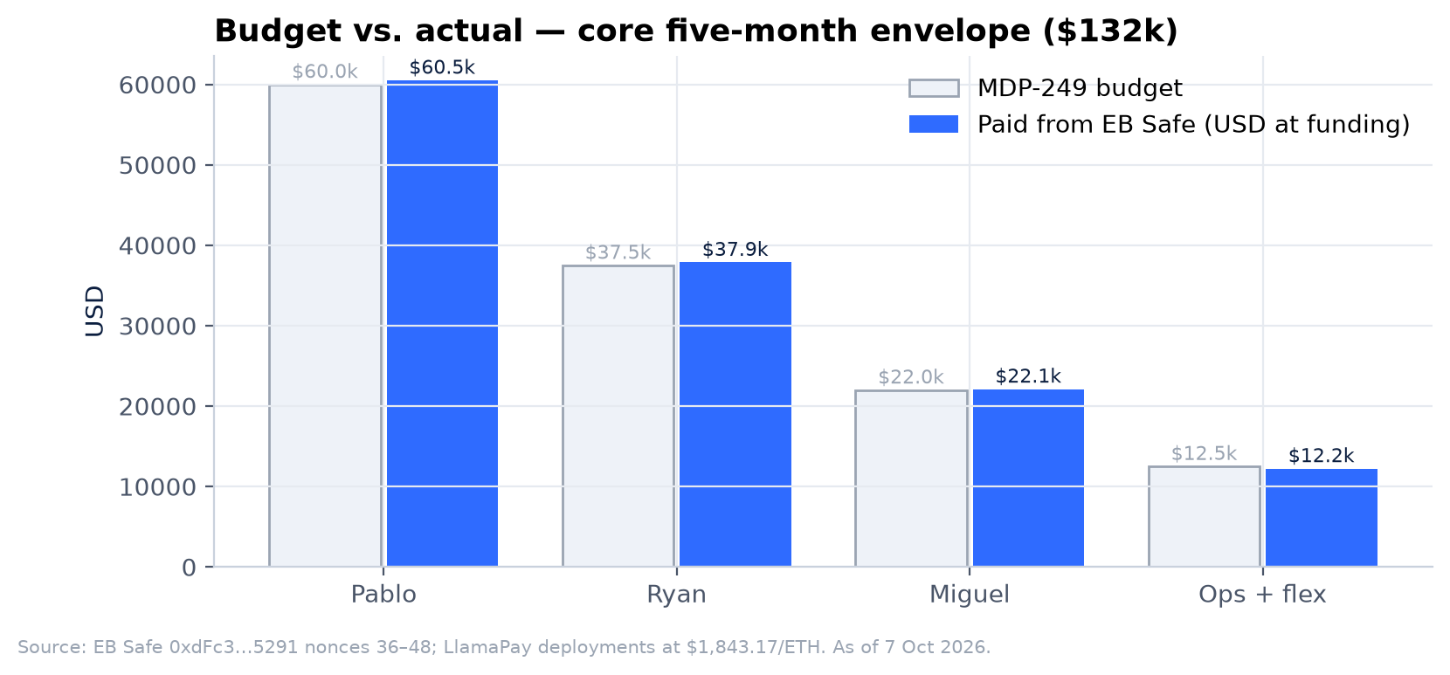
BUDGET & TREASURY
On budget: $132.7k spent of $132k
+0.6%
vs core budget
$120.5k payroll + $12.2k ops & flex
$0
Bonus paid
Of the $24k at-risk pool
≈ $4.3k
On-chain revenue, 12 months
1.67 ETH to the treasury; excludes card/fiat
MoonDAO Town Hall · Executive Branch Final Report, Q2 – Q3 2026 (MDP-249) · Data as of 7 Oct 2026
11 / 13
Notes:
[0:50] The money. We were funded once in USDC for May and once in ETH for the remaining four months. Payroll ran through LlamaPay vesting streams, which cut payroll transactions from about 12 to 2, though it did expose pay to ETH price moves. Total paid: $132,727 against $132,000, within 0.6%. No bonus has been paid. On revenue: the ETH that reaches the treasury on-chain from Citizen and Team subscriptions and Launchpad fees is about 1.67 ETH, roughly $4,300, over the last twelve months. Card and fiat checkouts aren't in that number. Getting to cash-flow sustainability is the core of the next proposal.

Slide 12
SELF-ASSESSMENT
Provisional grades
OBJECTIVE 1
OBJECTIVE 2
OBJECTIVE 3
Frank & DePrize
Network growth
Operations
Meets
Does not meet
Meets (borderline)
Beyond scope on infrastructure; late; no revenue or prototype test yet
Strong growth and discovery done; Citizen, Team and utilization targets missed
Budget, project system, audit, GDPR done; election and cost cuts not
PERFORMANCE BONUS
$0 of the $24,000 pool paid. Of the 10 claimable items, only "project system 100% live" ($1,000) is clearly met. DePrize launch timing and the lunar challenge are judgment calls for the Executive Leads and the Senate.
MoonDAO Town Hall · Executive Branch Final Report, Q2 – Q3 2026 (MDP-249) · Data as of 7 Oct 2026
12 / 13
Notes:
[0:40] How we'd grade ourselves, provisionally. Objective 1, Meets: the infrastructure went beyond scope, but it was late and there's no revenue yet. Objective 2, Does Not Meet: real growth and the discovery calls done, but all three network targets missed. Objective 3, Meets, borderline: operations, budget, the project system and GDPR delivered; the election and cost reduction weren't. On bonuses, nothing has been paid; only the project-system milestone is a clean claim, and anything beyond that is for the Executive Leads and Senate to decide.

Slide 13
LEARNINGS → NEXT TERM
What we're carrying into MDP-271
— Let holders decide. The path vote gave a clear mandate, but DePrize launched without a seed pool.
— Growth follows activity. Our best months had a live campaign; the next term needs a raise.
— Remove payment friction. Teams named payments as the blocker; the onramp is now live.
— Measure cost per outcome. AI doubled throughput but moved spend from salaries to tooling.
Questions?
Full report, data and every transaction link:
moondao.com/project/131
Next EB proposal:
moondao.com/project/153
Thank you to every Citizen, Team and contributor who built with us this term.
Notes:
[0:40] What we learned and where it goes next. Letting OVERVIEW holders decide Frank's path was right, but it meant DePrize launched without a seed pool. Growth follows activity, so the next term needs a live raise. Teams told us payments were the barrier, and we fixed it. And AI moved cost from salaries to tooling, so we should measure cost per outcome. All of this feeds MDP-271, the next EB proposal. The full report with every transaction link is on the project page. Happy to take questions.

