Slide 1
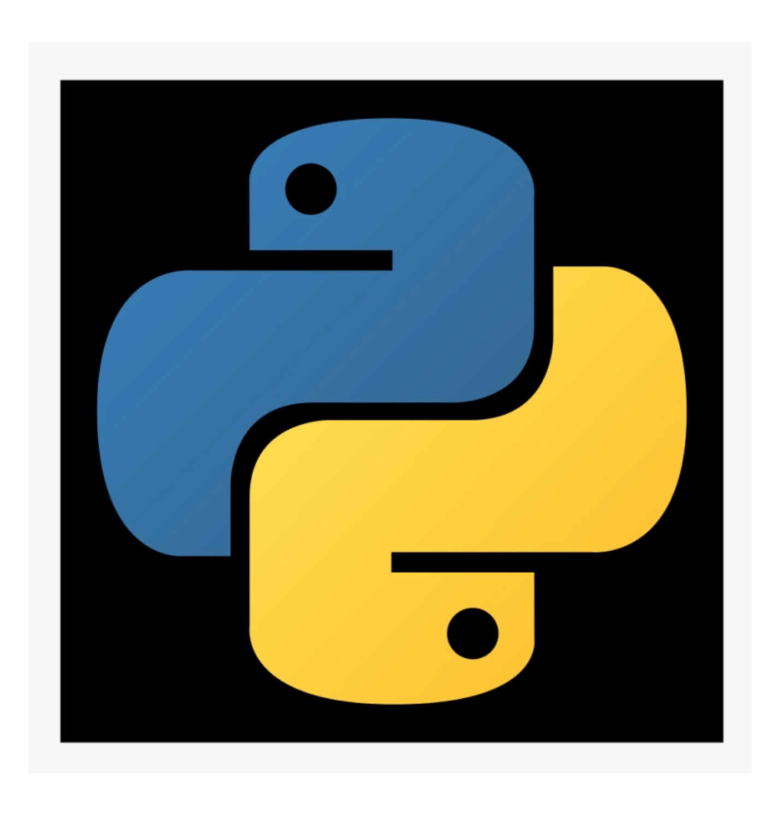
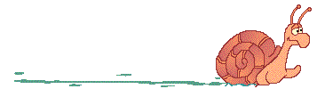
Python
for
Beginners
S. Sharma, UJ
Python for beginners
28/11/2025

Slide 2
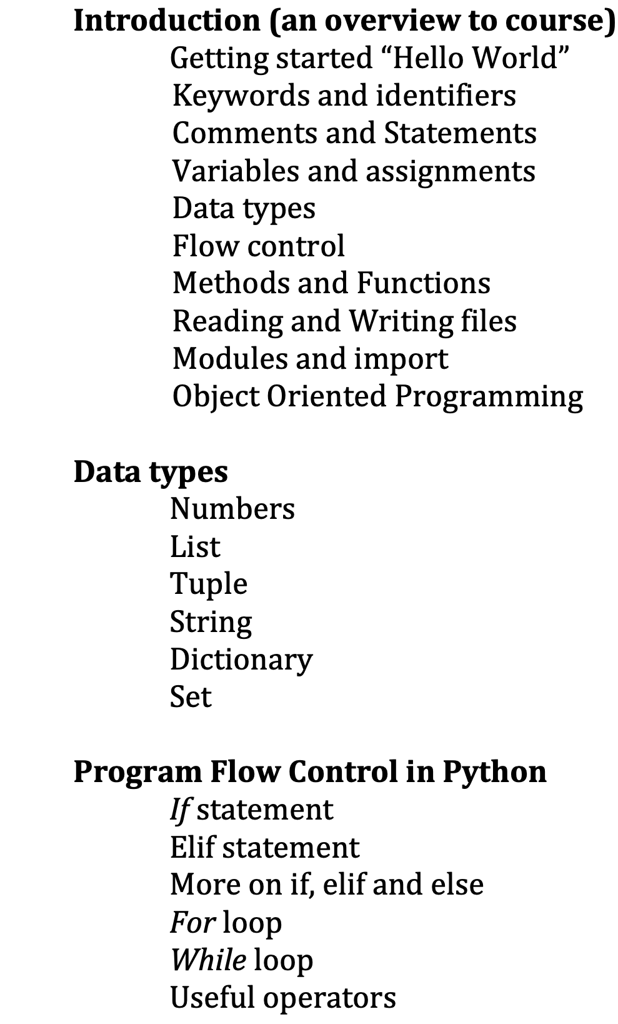
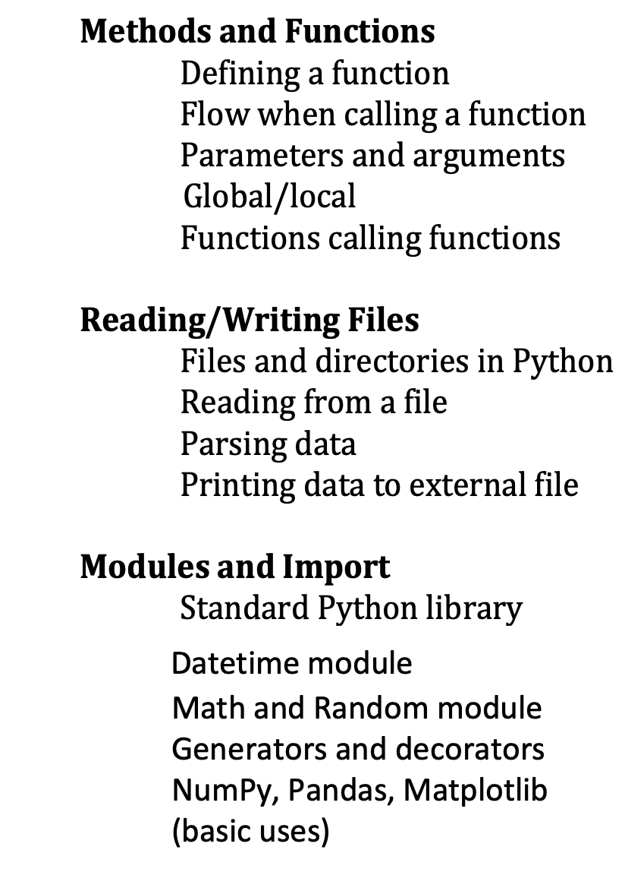


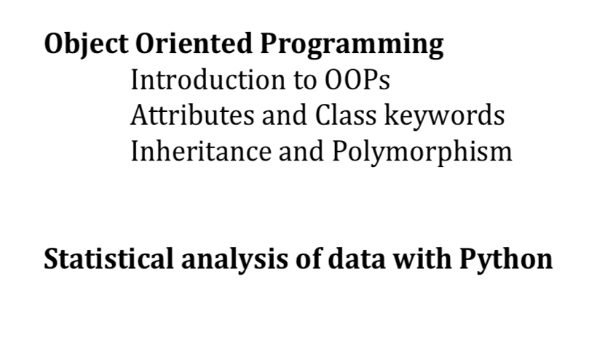

Glimpse of last lecture
S. Sharma, UJ
Python for beginners
28/11/2025

Slide 3
8
Range in for loops
As per documentation, ‘ Range’ represents an immutable sequence of numbers and is
commonly used for looping a specific number of times
Python ranges can be used in multiple forms
ranges(final)
for x in range(11):
ranges(initial,final)
for x in range(4,11):
ranges(initial,final,step)
for x in range(4,11,1):
for x in range(4,11,2):
Steps up / down
for x in range(11,1,-2):
S. Sharma, UJ
Python for beginners
28/11/2025

Slide 4



8
Nested
FOR
Patters using FOR loop
Pattern 1
Pattern 2
Pattern 3
Pattern 4
*****
*****
*****
*****
*****
*
**
***
****
*****
*****
****
***
**
*
1
1 2
1 2 3
1 2 3 4
S. Sharma, UJ
Python for beginners
28/11/2025
Notes:
end="" tells Python not to add a newline after printing (by default print ends with "\n")

Slide 5
8
Nested
FOR
Patters using FOR loop
Pattern 1
Pattern 2
Pattern 3
Pattern 4
*****
*****
*****
*****
*****
*
**
***
****
*****
*****
****
***
**
*
1
1 2
1 2 3
1 2 3 4
S. Sharma, UJ
Python for beginners
28/11/2025

Slide 6
8
Nested
FOR
Patters using FOR loop
Pattern 1
Pattern 2
Pattern 3
Pattern 4
*****
*****
*****
*****
*****
*
**
***
****
*****
*****
****
***
**
*
1
1 2
1 2 3
1 2 3 4
S. Sharma, UJ
Python for beginners
28/11/2025

Slide 7
8
Nested
FOR
Patters using FOR loop
Pattern 1
Pattern 2
Pattern 3
Pattern 4
*****
*****
*****
*****
*****
*
**
***
****
*****
*****
****
***
**
*
1
1 2
1 2 3
1 2 3 4
S. Sharma, UJ
Python for beginners
28/11/2025

Slide 8
8
Nested
FOR
Patters using FOR loop
Pattern 1
Pattern 2
Pattern 3
Pattern 4
*****
*****
*****
*****
*****
*
**
***
****
*****
*****
****
***
**
*
1
1 2
1 2 3
1 2 3 4
S. Sharma, UJ
Python for beginners
28/11/2025

Slide 9
8
Nested
FOR
Patters using FOR loop
Pattern 1
Pattern 2
Pattern 3
Pattern 4
*****
*****
*****
*****
*****
*
**
***
****
*****
*****
****
***
**
*
1
1 2
1 2 3
1 2 3 4
S. Sharma, UJ
Python for beginners
28/11/2025

Slide 10
8
Nested
FOR
Patters using FOR loop
Pattern 1
Pattern 2
Pattern 3
Pattern 4
*****
*****
*****
*****
*****
*
**
***
****
*****
*****
****
***
**
*
1
1 2
1 2 3
1 2 3 4
S. Sharma, UJ
Python for beginners
28/11/2025

Slide 11
8
Nested
FOR
Patters using FOR loop
Pattern 1
Pattern 2
Pattern 3
Pattern 4
*****
*****
*****
*****
*****
*
**
***
****
*****
*****
****
***
**
*
1
1 2
1 2 3
1 2 3 4
S. Sharma, UJ
Python for beginners
28/11/2025

Slide 12
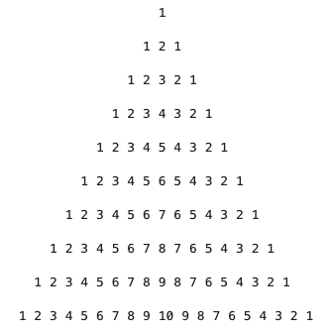
8
Nested loop (Hands-On)
S. Sharma, UJ
Python for beginners
28/11/2025

Slide 13
8
Nested loop (Hands-On)
for loop in range(1,11):
for space in range(10-loop):
print(" ", end = " ")
for numbers in range(1,loop):
print(numbers,end=" ")
for numbers in range(loop,0,-1):
print(numbers,end=" ")
print("\n")
1
2
3
4
5
6
7
8
9
10
S. Sharma, UJ
Python for beginners
28/11/2025

Slide 14

8
While loop
for loop mainly use to iterate the actions through an iterable in a sequence or range .
but sometimes, one needs to iterate actions as long as certain condition is true.
As long as the condition remains true , the sequence of actions inside the loop will
be executed
Once the condition becomes false, the loop terminates.
while <condition>: // Condition can evaluate to True or False
          block_of_code_to_execute
S. Sharma, UJ
Python for beginners
28/11/2025

Slide 15
8
Print numbers between
1 – 10 using while loop
S. Sharma, UJ
Python for beginners
28/11/2025

Slide 16

8
Print numbers between
1 – 10 using while loop
Start
Condition
S. Sharma, UJ
Python for beginners
28/11/2025

Slide 17
8
Print numbers between
1 – 10 using while loop
Start
Condition
Print numbers between
10-1 using while loop
S. Sharma, UJ
Python for beginners
28/11/2025

Slide 18

8
Print numbers between
1 – 10 using while loop
Start
Condition
Print numbers between
10-1 using while loop
S. Sharma, UJ
Python for beginners
28/11/2025

Slide 19
8
Print numbers between
1 – 10 using while loop
Print numbers in the following format
(nested while)
Start
1
1 2
1 2 3
1 2 3 4
1 2 3 4 5
Condition
Print numbers between
10-1 using while loop
S. Sharma, UJ
Python for beginners
28/11/2025

Slide 20
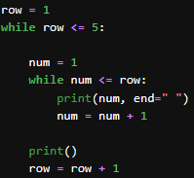
8
Print numbers between
1 – 10 using while loop
Print numbers in the following format
(nested while)
Start
1
1 2
1 2 3
1 2 3 4
1 2 3 4 5
Condition
Print numbers between
10-1 using while loop
S. Sharma, UJ
Python for beginners
28/11/2025

Slide 21
8
Print numbers between
1 – 10 using while loop
Print numbers in the following format
(nested while)
Start
1
1 2
1 2 3
1 2 3 4
1 2 3 4 5
Condition
Print numbers between
10-1 using while loop
1
1 2
1 2 3
1 2 3 4
1 2 3 4 5
?
S. Sharma, UJ
Python for beginners
28/11/2025

Slide 22
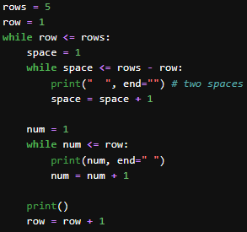
8
Print numbers between
1 – 10 using while loop
Print numbers in the following format
(nested while)
Start
Condition
1
1 2
1 2 3
1 2 3 4
1 2 3 4 5
Print numbers between
10-1 using while loop
S. Sharma, UJ
Python for beginners
28/11/2025

Slide 23
8
- Reproduce using while loop -
1
2
3
4
5
6
7
8
9
10
S. Sharma, UJ
Python for beginners
28/11/2025

Slide 24
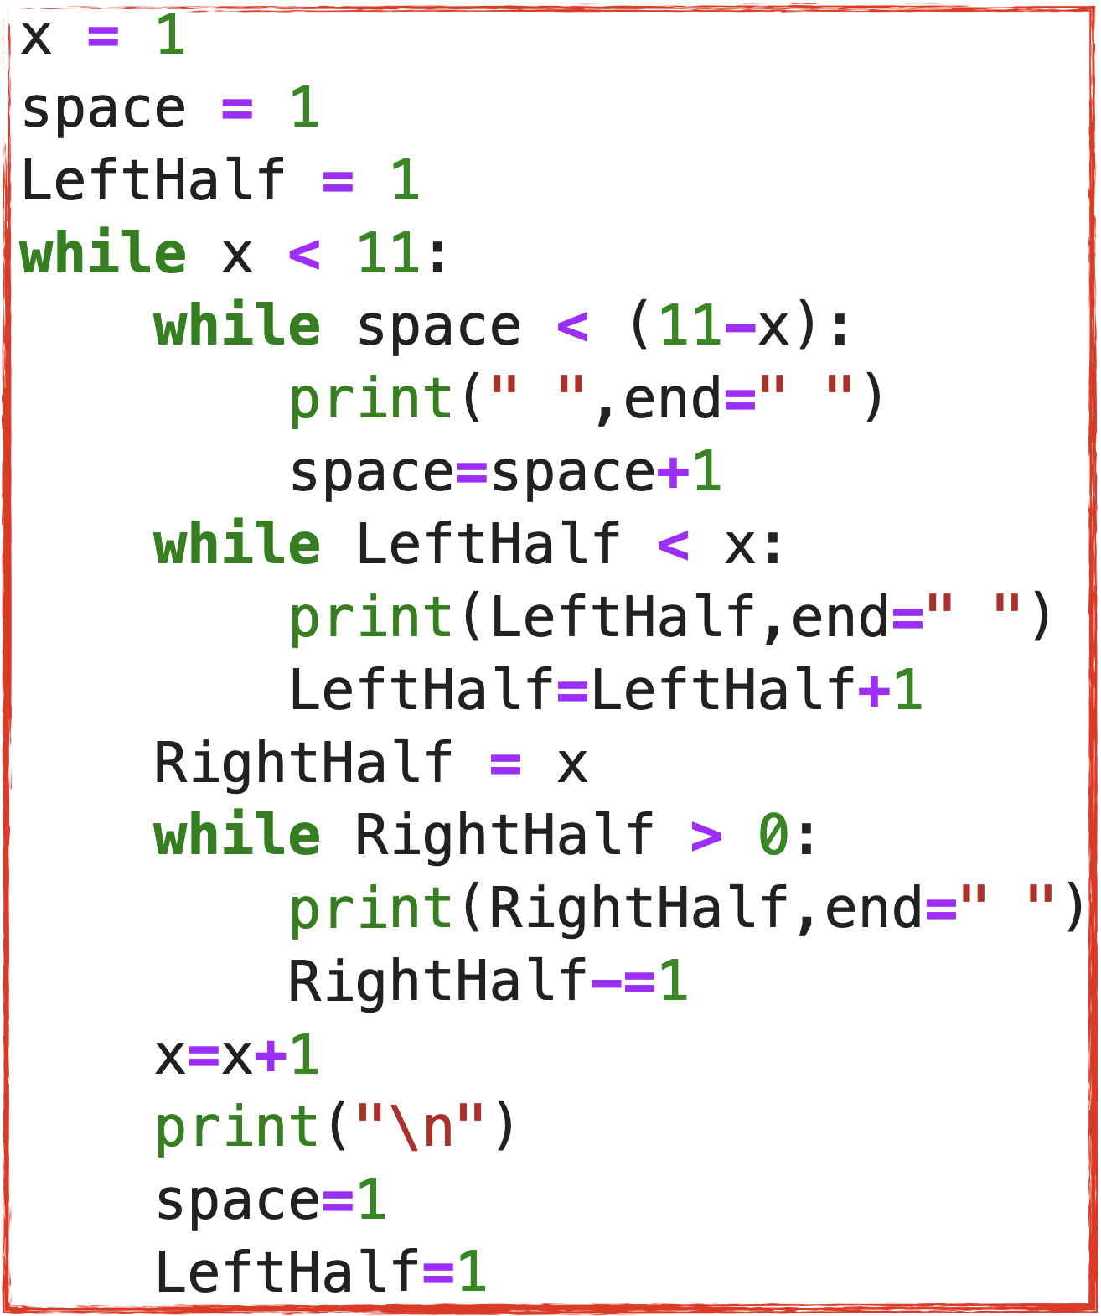
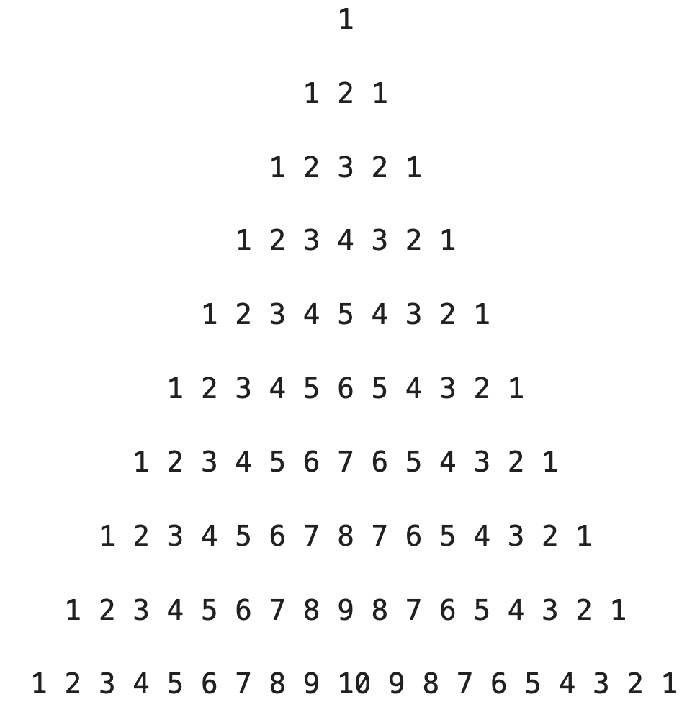
8
- Reproduce using while loop -
One can conclude, while loops are more flexible since
one explicitly set the start and end conditions, but
require more set-up than for loops
S. Sharma, UJ
Python for beginners
28/11/2025

Slide 25

8
- More on while loop -
while loop is frequently used when one cannot determine/know in advance how often
the loop must be executed, however in for loop, each item repeats in pre-determined
range/sequence.
The while loop is especially important and is used when
  Reading data from files where you do not know in advance how much data to process.
  The while loop continue reading until there is no more data, or it terminates when the
  desired condition is met.
S. Sharma, UJ
Python for beginners
28/11/2025

Slide 26
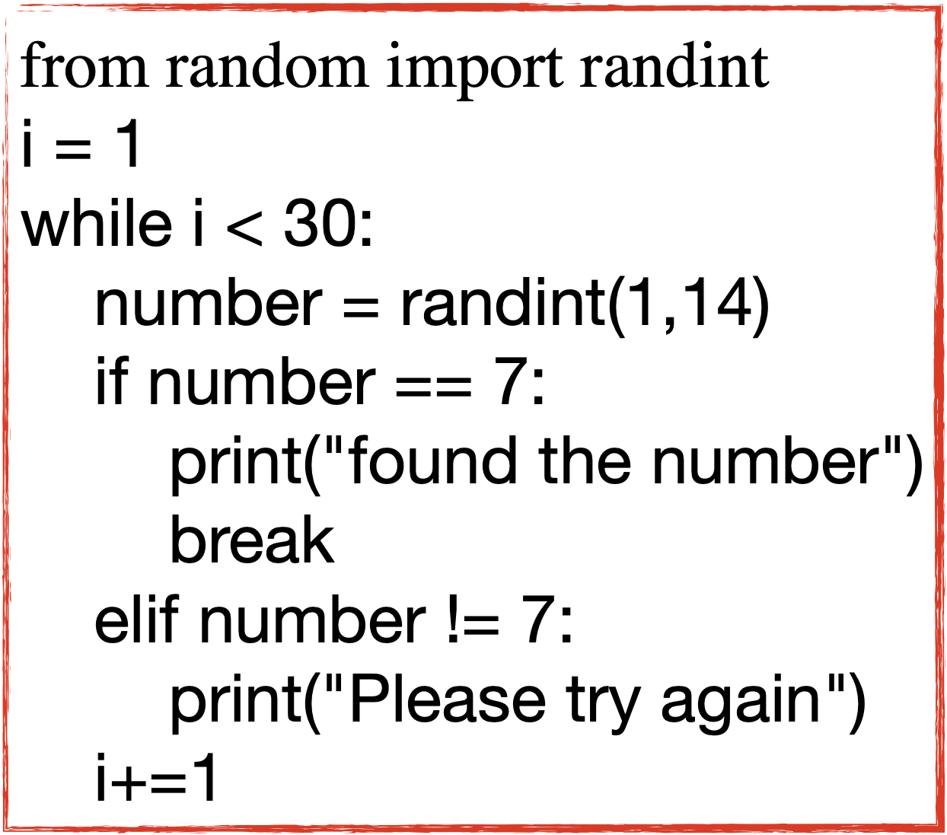

8
-Uses of while loop -
Hands-On
Use a while loop to generate a random number between 1 and
14 until you get the number 7, print some message.
First condition, how many times you want to check
Generate random number and save it to a variable
Check if variable value is equal to 7, print message for
both cases (i) when generate number is 7 or
(ii) generate number is not 7
#Hint:
#How to generate random number from random
import randint
randint(a, b) # Generate random number between a, b
S. Sharma, UJ
Python for beginners
28/11/2025

Slide 27
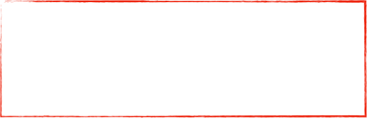



8
- Functions -
Similar to loops, functions also allow to execute the Same Task Several Times
Don’t Repeat Yourself
A function is a block of statements that performs a particular task.
  Functions provide better modularity and a high degree of code reusing (avoid duplicating).
  Functions can be ‘abstracted’ for the other users
e.g. print()
    Define and use the function - (difference between function - method (OOP))
    Interacting with functions (input / output / return)
S. Sharma, UJ
Python for beginners
28/11/2025

Slide 28
8
- Functions -
Similar to loops, functions also allow to execute the Same Task Several Times
Don’t Repeat Yourself
A function is a block of statements that performs a particular task.
  Functions provide better modularity and a high degree of code reusing (avoid duplicating).
  Functions can be ‘abstracted’ for the other users
e.g. print()
    Define and use the function - (difference between function - method (OOP))
    Interacting with functions (input / output / return)
S. Sharma, UJ
Python for beginners
28/11/2025

Slide 29
8
- Functions -
Similar to loops, functions also allow to execute the Same Task Several Times
Don’t Repeat Yourself
A function is a block of statements that performs a particular task.
  Functions provide better modularity and a high degree of code reusing (avoid duplicating).
  Functions can be ‘abstracted’ for the other users
e.g. print()
    Define and use the function - (difference between function - method (OOP))
    Interacting with functions (input / output / return)
S. Sharma, UJ
Python for beginners
28/11/2025

Slide 30



8
- Define the function -
Syntax
Function name
Keyword
Parenthesis
def functionName ( ):
function body
return result
S. Sharma, UJ
Python for beginners
28/11/2025

Slide 31
8
- Define the function -
Syntax
Function name
Keyword
Parenthesis
def sum( ):
result = 10 + 25
print("Value which will return is = ",result)
return result
sum( )
def functionName ( ):
function body
return result
S. Sharma, UJ
Python for beginners
28/11/2025

Slide 32


8
- Passing parameters / arguments -
Parameters : work as placeholders for the values pass to the function. So, they
are like variables which are used to pass the value when one call the
function.
Syntax
Function name
Keyword
Parenthesis
def functionName ( val1, val2):
function body
return result
S. Sharma, UJ
Python for beginners
28/11/2025

Slide 33
8
- Using the functions -
def sum(val1, val2, val3, val4, val5 ):
add = val1 + val2
mul = val3 * val4 * val4
result = add + mul
print("Value which will return is = ",result)
return result
sum( 2, 3, 7, 10.5, 2.5)
def sum(val1,val2 ):
result = val1 + val2
print("Value which will return is = ",result)
return result
sum( 20, 15)
S. Sharma, UJ
Python for beginners
28/11/2025

Slide 34
8
Using function, print the sum of even numbers between 1 - 100
Sum_EvenNumbers=0
null=0
def Num_type(val):
check_num = val % 2
if check_num == 0:
return val
else:
return null
for num in range(1,100):
result = Num_type(num)
SumOfEvenNumbers = SumOfEvenNumbers + result
print("Sum of even numbers = ",SumOfEvenNumbers)
S. Sharma, UJ
Python for beginners
28/11/2025

Slide 35
8
Using function, print the sum of even numbers between 1 - 100
SumOfEvenNumbers=0
null=0
def Num_type(val):
check_num = val % 2
if check_num == 0:
return val
else:
return null
for num in range(1,100):
result = Num_type(num)
SumOfEvenNumbers = SumOfEvenNumbers + result
print("Sum of even numbers = ",SumOfEvenNumbers)
S. Sharma, UJ
Python for beginners
28/11/2025

Slide 36
8
Functions - to be continued
S. Sharma, UJ
Python for beginners
05/12/2022

