Slide 1

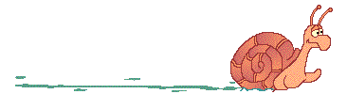
Python
for
Beginners
S. Sharma, UJ
Python for beginners
21/11/2022

Slide 2
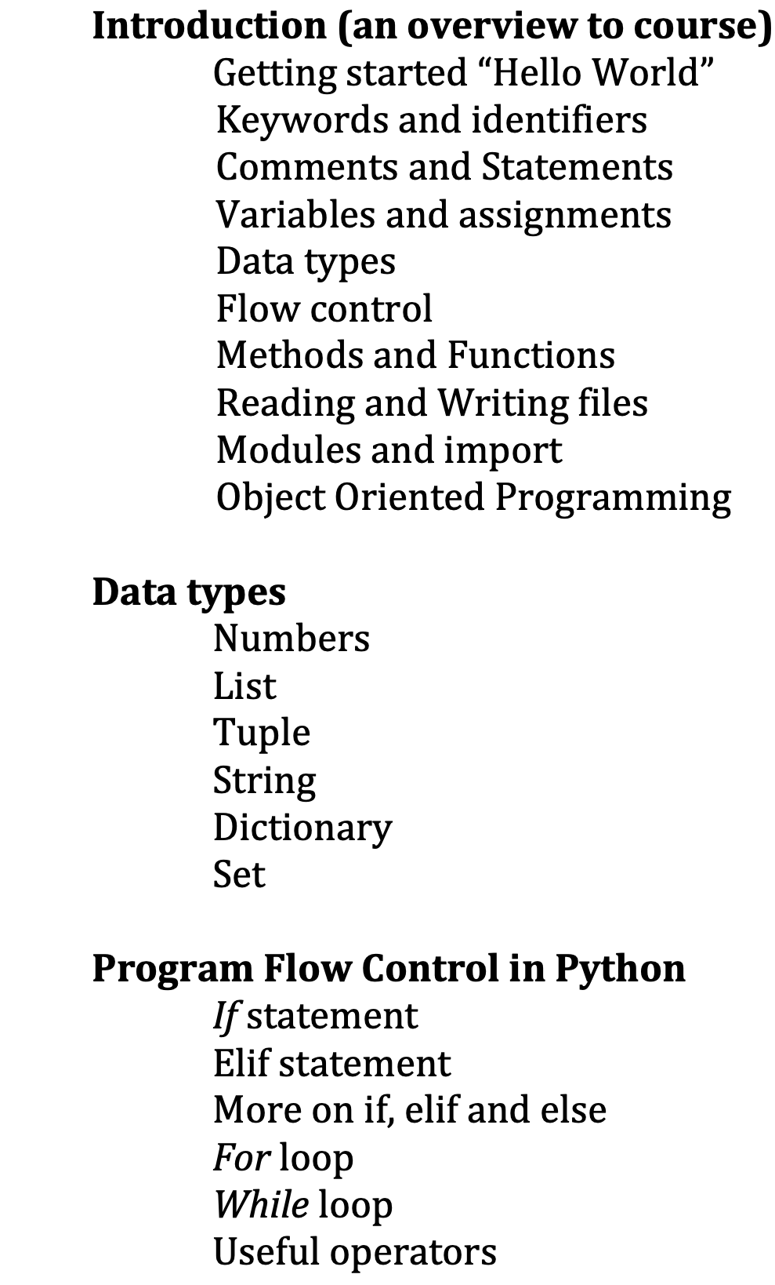
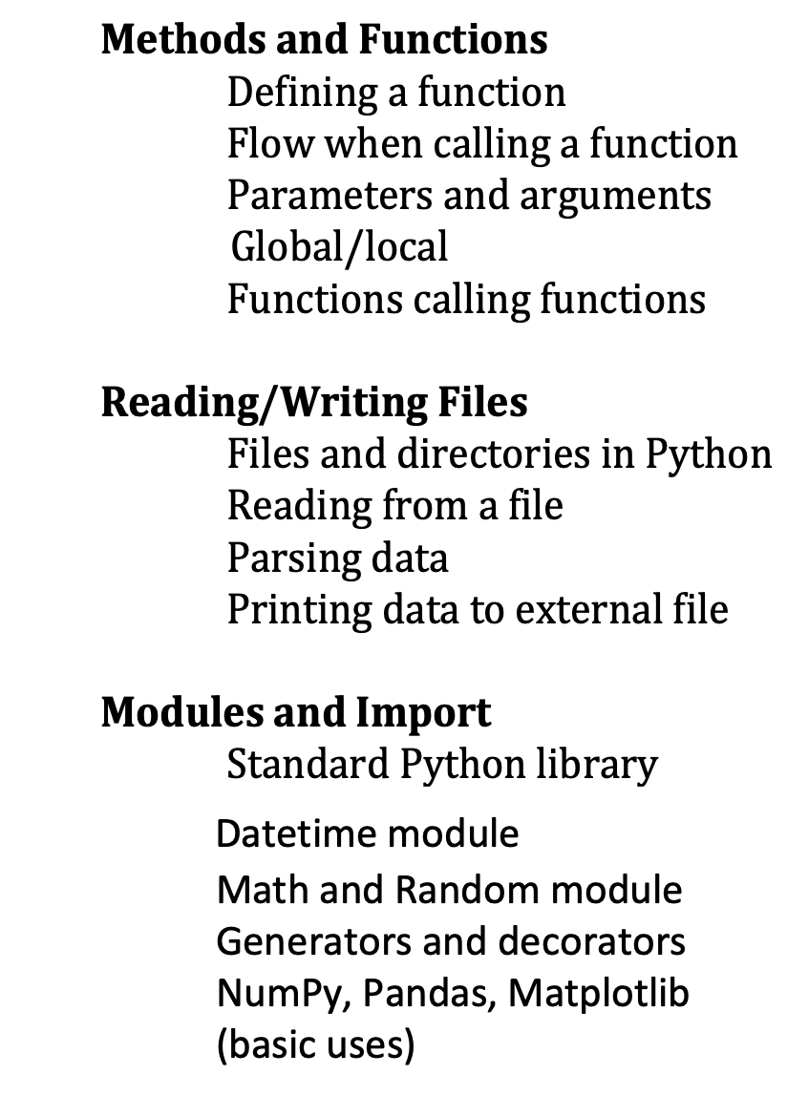


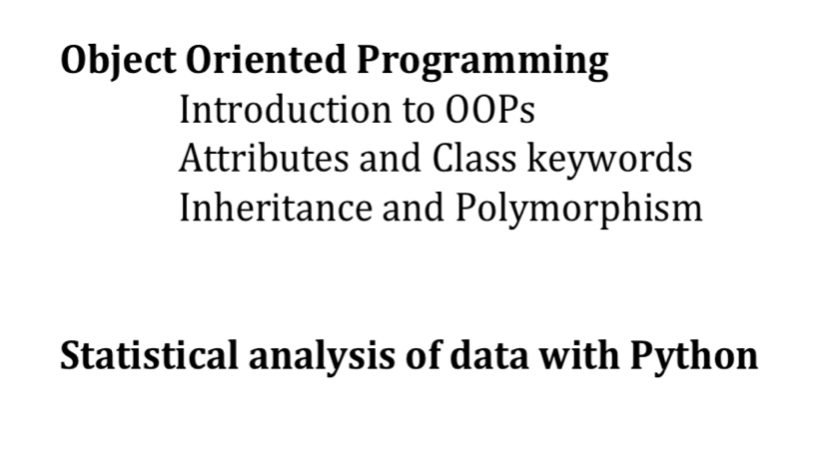
Glimpse of last lecture
S. Sharma, UJ
Python for beginners
21/11/2022
1

Slide 3



8
Sets
‘Set’ in python offers to store unordered collection of elements but without duplicity.
‘Set’ objects also support the basic mathematical functionalists :
union, intersection, difference.
4
6
4
Python equivalent
1
5
A ∪ B
= 1, 3, 4, 5, 2, 6, 9, 10
A | B
2
9
3
10
A ^ B
(in either of them but not in both)
A ∩ B
= 5, 2
A & B
A
B
A - B
= 1, 3, 4
A - B
Hands-On 9
‘Set’ can be constructed using two ways :
  A = {‘Mango’, ‘Banana’, ‘Apple’}
B = {‘tree’, ‘house’, ‘Banana'}
Using set( ) function
A | B
A & B
  x = set(‘Mango’, ‘Banana’, ‘Apple’)
  y = set(‘tree’, ‘house’, ‘Banana’)
SetA= {1,2,3,4,5}
SetB= {2,5,6,9,10}
  Set1 = {‘Mango’, ‘Banana’, ‘Apple’}
Set2 = {‘tree’, ‘house’, ‘Banana'}
A - B
A ^ B
S. Sharma, UJ
Python for beginners
21/11/2022
3

Slide 4
8
Sets
‘Set’ in python offers to store unordered collection of elements but without duplicity.
‘Set’ objects also support the basic mathematical functionalists :
union, intersection, difference.
4
6
4
Python equivalent
1
5
A ∪ B
= 1, 3, 4, 5, 2, 6, 9, 10
A | B
2
9
3
10
A ^ B
(in either of them but not in both)
A ∩ B
= 5, 2
A & B
A
B
A - B
= 1, 3, 4
A - B
Hands-On 9
‘Set’ can be constructed using two ways :
  A = {‘Mango’, ‘Banana’, ‘Apple’}
B = {‘tree’, ‘house’, ‘Banana'}
Using set( ) function
A | B
A & B
  x = set(‘Mango’, ‘Banana’, ‘Apple’)
  y = set(‘tree’, ‘house’, ‘Banana’)
SetA= {1,2,3,4,5}
SetB= {2,5,6,9,10}
  Set1 = {‘Mango’, ‘Banana’, ‘Apple’}
Set2 = {‘tree’, ‘house’, ‘Banana'}
A - B
A ^ B
S. Sharma, UJ
Python for beginners
21/11/2022
4

Slide 5
8
Sets
‘Set’ in python offers to store unordered collection of elements but without duplicity.
‘Set’ objects also support the basic mathematical functionalists :
union, intersection, difference.
4
6
4
Python equivalent
1
5
A ∪ B
= 1, 3, 4, 5, 2, 6, 9, 10
A | B
2
9
3
10
A ^ B
(in either of them but not in both)
A ∩ B
= 5, 2
A & B
A
B
A - B
= 1, 3, 4
A - B
Hands-On 9
‘Set’ can be constructed using two ways :
  A = {‘Mango’, ‘Banana’, ‘Apple’}
B = {‘tree’, ‘house’, ‘Banana'}
Using set( ) function
A | B
A & B
  x = set((‘Mango’, ‘Banana’, ‘Apple’))
  y = set((‘tree’, ‘house’, ‘Banana’))
SetA= {1,2,3,4,5}
SetB= {2,5,6,9,10}
  Set1 = {‘Mango’, ‘Banana’, ‘Apple’}
Set2 = {‘tree’, ‘house’, ‘Banana'}
A - B
A ^ B
S. Sharma, UJ
Python for beginners
21/11/2022
5

Slide 6
8
Frequently used methods on Sets
add( ) | Adds element to the set
clear( ) | Remove all the elements from set
remove( ) | Remove the specified element
difference( ) | Difference b/w two or more sets
intersection( ) | Intersection of two sets (common element)
union( ) | Union of sets
update( )
Try to add list into Sets
S. Sharma, UJ
Python for beginners
21/11/2022
6

Slide 7



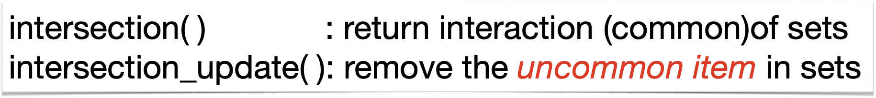

8
Hands-On with sets
How to check if an element/item is in a given set : index, key
Using ‘in’ keyword
my_firstSet = {34, 22, 12, 100, 20000, 1, 2, 5, 8, 213, 35, ‘banana’, ‘mango’, ‘orange’}
print(‘mango’ in my_firstSet)
difference( ) : return the difference between sets
difference_update( ) : removes the same items in two sets
issubset( ) : one set has all elements
of other set with
additional elements
issuperset( ) : opposite to issubset
isdisjoint( ) : return true if no-common item in sets, otherwise false
S. Sharma, UJ
Python for beginners
21/11/2022
7

Slide 8

8
Hands-On with sets
How to check if an element/item is in a given set : index, key
Using ‘in’ keyword
my_firstSet = {34, 22, 12, 100, 20000, 1, 2, 5, 8, 213, 35, ‘banana’, ‘mango’, ‘orange’}
my_secondSet = { 22, 100, 213, ‘banana’}
my_thirdSet = { 34, 100, 213, ‘grapes’}
difference( ) : return the difference between sets
difference_update( ) : removes the same items in two sets
issubset( ) : one set has all elements
of other set with
additional elements
issuperset( ) : opposite to issubset
isdisjoint( ) : return true if no-common item in sets, otherwise false
S. Sharma, UJ
Python for beginners
21/11/2022
8

Slide 9
8
Comparison b/w data types
Based on quotes, braces and brackets : ‘ ’ or “ ”, ( ), { }, [ ]
 | Mutability | Mixed data | Duplicacy | Ordered /Indexing
String (single Or double quotes) | No | No | Yes | Yes
List[ ] | Yes | Yes (list, set, tuple, int and dict.) | Yes | Yes
Tuple( ) | No | Yes (list, set, tuple, int, dict.) | Yes | Yes
Dictionary{ } | Yes Keys are immutable type | Yes Key can be int, str and tuple but values can be of any data type | No | No
Set( ) | No | Yes Only (int, str, tuple) Not (list, set,dict) | No | No
S. Sharma, UJ
Python for beginners
21/11/2022
9

Slide 10
8
Python - statement
A statement can be understood as an instruction that the interpreter (in our case Python interpreter)
can execute.
You have been working with two types of statements : assignment statement , print statement
On contrary, comments are not executed by interpreter.
“Remember: assignment statement doesn’t produce any result”
Python - Expressions
An expression may consists of variables, operators and values, which the Python interpreter evaluates
and give the result.
If, elif, else statements (decision making building blocks in Python)
S. Sharma, UJ
Python for beginners
21/11/2022
29

Slide 11
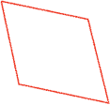
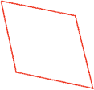


8
If, if-else, elif statements (decision making building blocks in Python)
If-elif Statement
If Statement
If-else Statement
Test
Condition
( if )
False
Test
Condition
False
Test
Condition
( if )
False
True
Block of
statements, expression)
True
Test
Condition
( elif )
False
True
Block of
statements, expression)
Block of
statements, expression)
Block of
statements, expression)
True
Block of
statements, expression)
Block of
statements, expression)
x = 10
If x > 10:
print(“ Number is Greater”)
S. Sharma, UJ
Python for beginners
21/11/2022
29

Slide 12
8
If, if-else, elif statements (decision making building blocks in Python)
If-elif Statement
If Statement
If-else Statement
False
Test
Condition
False
Test
Condition
( if )
False
Test
Condition
( if )
False
True
Block of
statements, expression)
True
Test
Condition
( elif )
False
True
Block of
statements, expression)
Block of
statements, expression)
Block of
statements, expression)
True
Block of
statements, expression)
Block of
statements, expression)
x = 10
If x > 10:
print(“ Number is Greater”)
If x > 10:
print(“Number is Greater”)
else:
print(“Number is smaller”)
S. Sharma, UJ
Python for beginners
21/11/2022
29

Slide 13
8
If, if-else, elif statements (decision making building blocks in Python)
If-elif Statement
If Statement
If-else Statement
Test
Condition
( if )
False
False
Test
Condition
False
Test
Condition
( if )
False
True
Test
Condition
( elif )
False
True
Block of
statements, expression)
Block of
statements, expression)
True
True
Block of
statements, expression)
Block of
statements, expression)
Block of
statements, expression)
Block of
statements, expression)
x = 10
If x > 10:
print(“ Number is Greater”)
If x > 10:
print(“Number is Greater”)
else:
print(“Number is smaller”)
If x > 10:
print(“Number is Greater”)
elif x == 10:
print(“Number is smaller”)
else:
print(“Number is smaller”)
S. Sharma, UJ
Python for beginners
21/11/2022
29

Slide 14
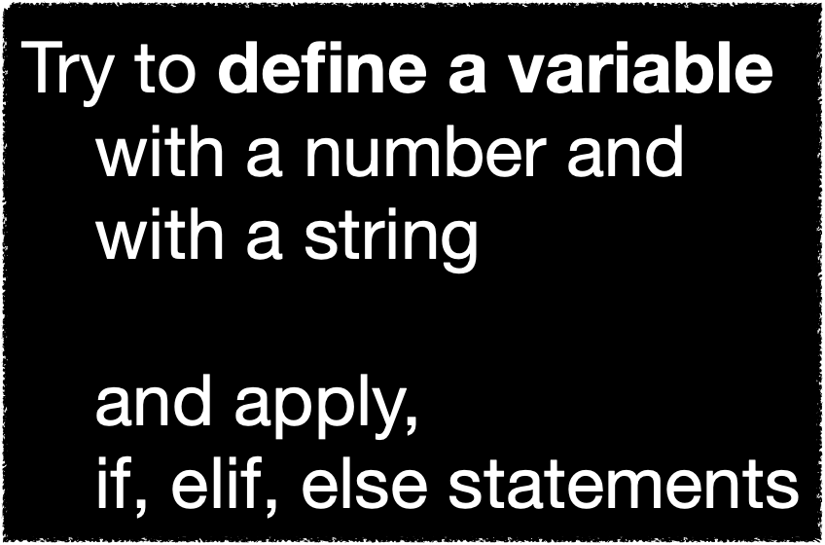
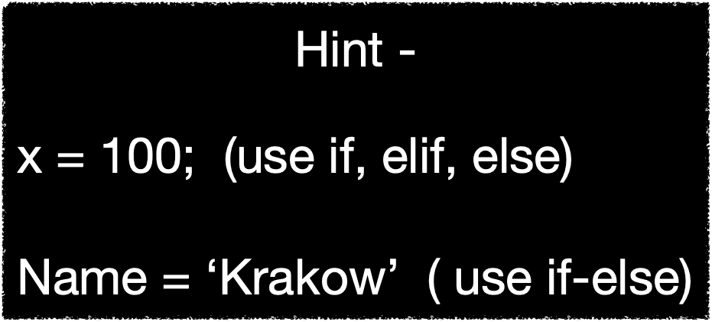
8
If, if-else, elif statements (decision making building blocks in Python)
Hands-On
S. Sharma, UJ
Python for beginners
21/11/2022
9

Slide 15

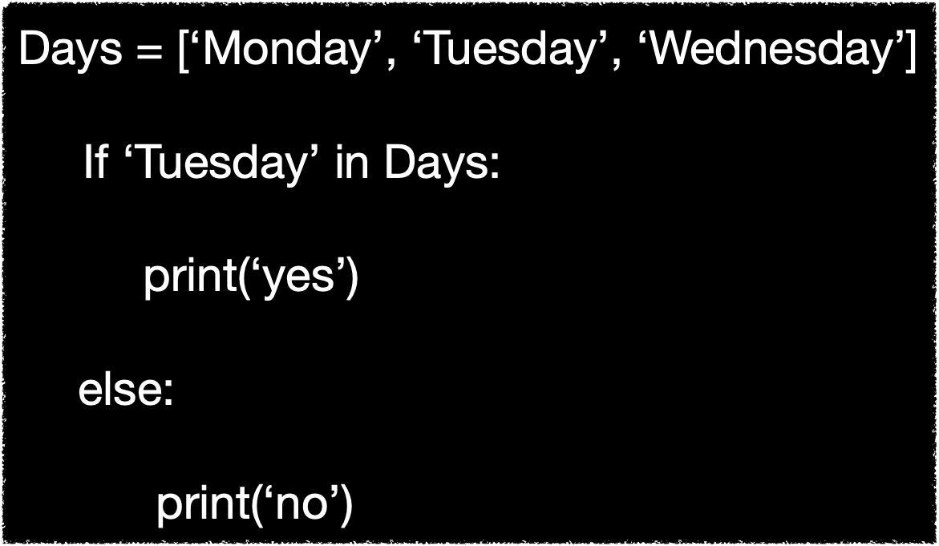

8
If, if-else, elif statements (decision making building blocks in Python)
Hands-On
S. Sharma, UJ
Python for beginners
21/11/2022
10

Slide 16
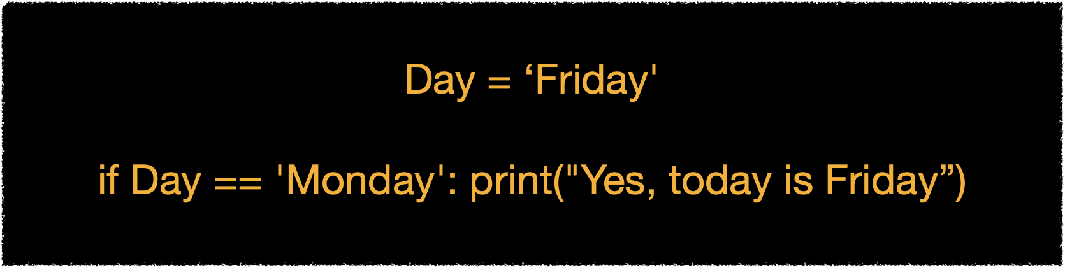
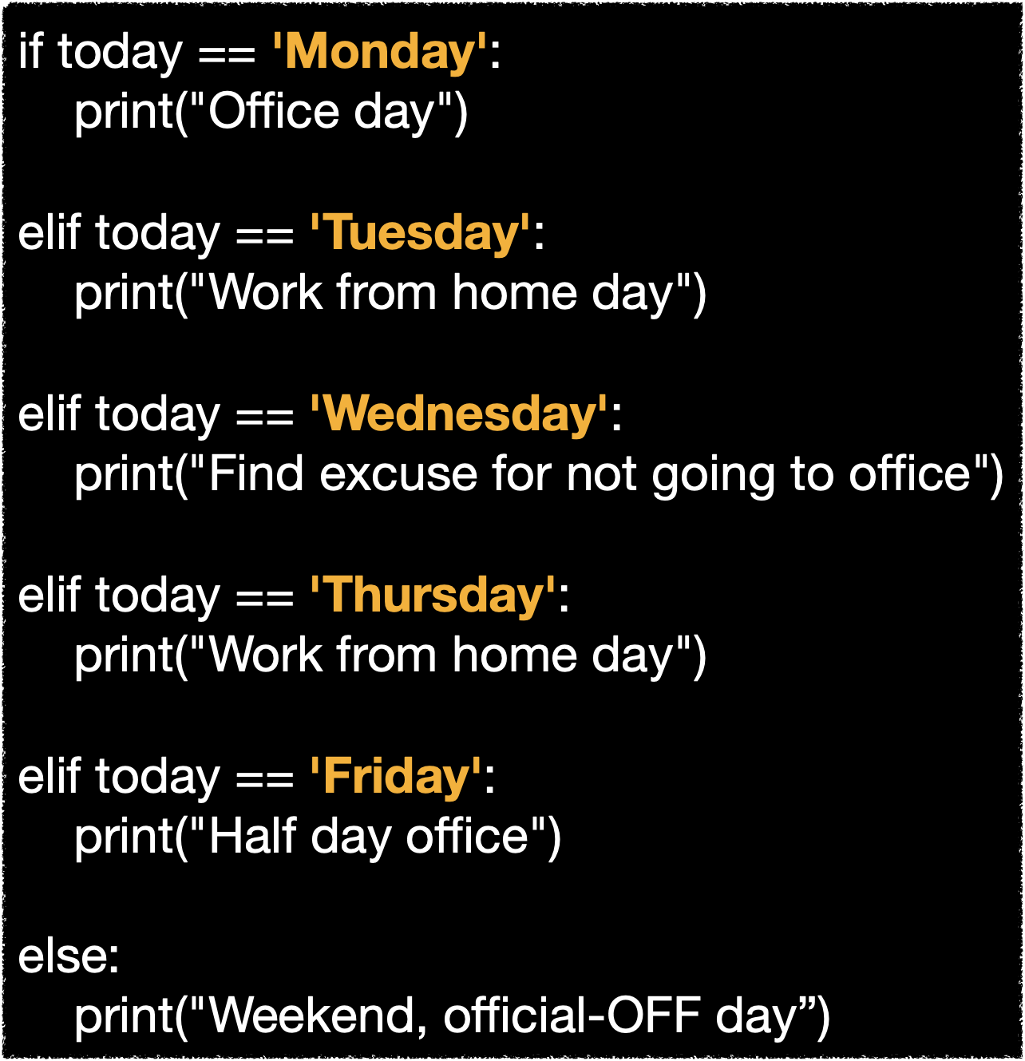
8
If, if-else, elif statements (decision making building blocks in Python)
Hands-On
Single line conditional statement
Multiple conditional statement using elif :
Nested if-else statements
S. Sharma, UJ
Python for beginners
21/11/2022
11

Slide 17

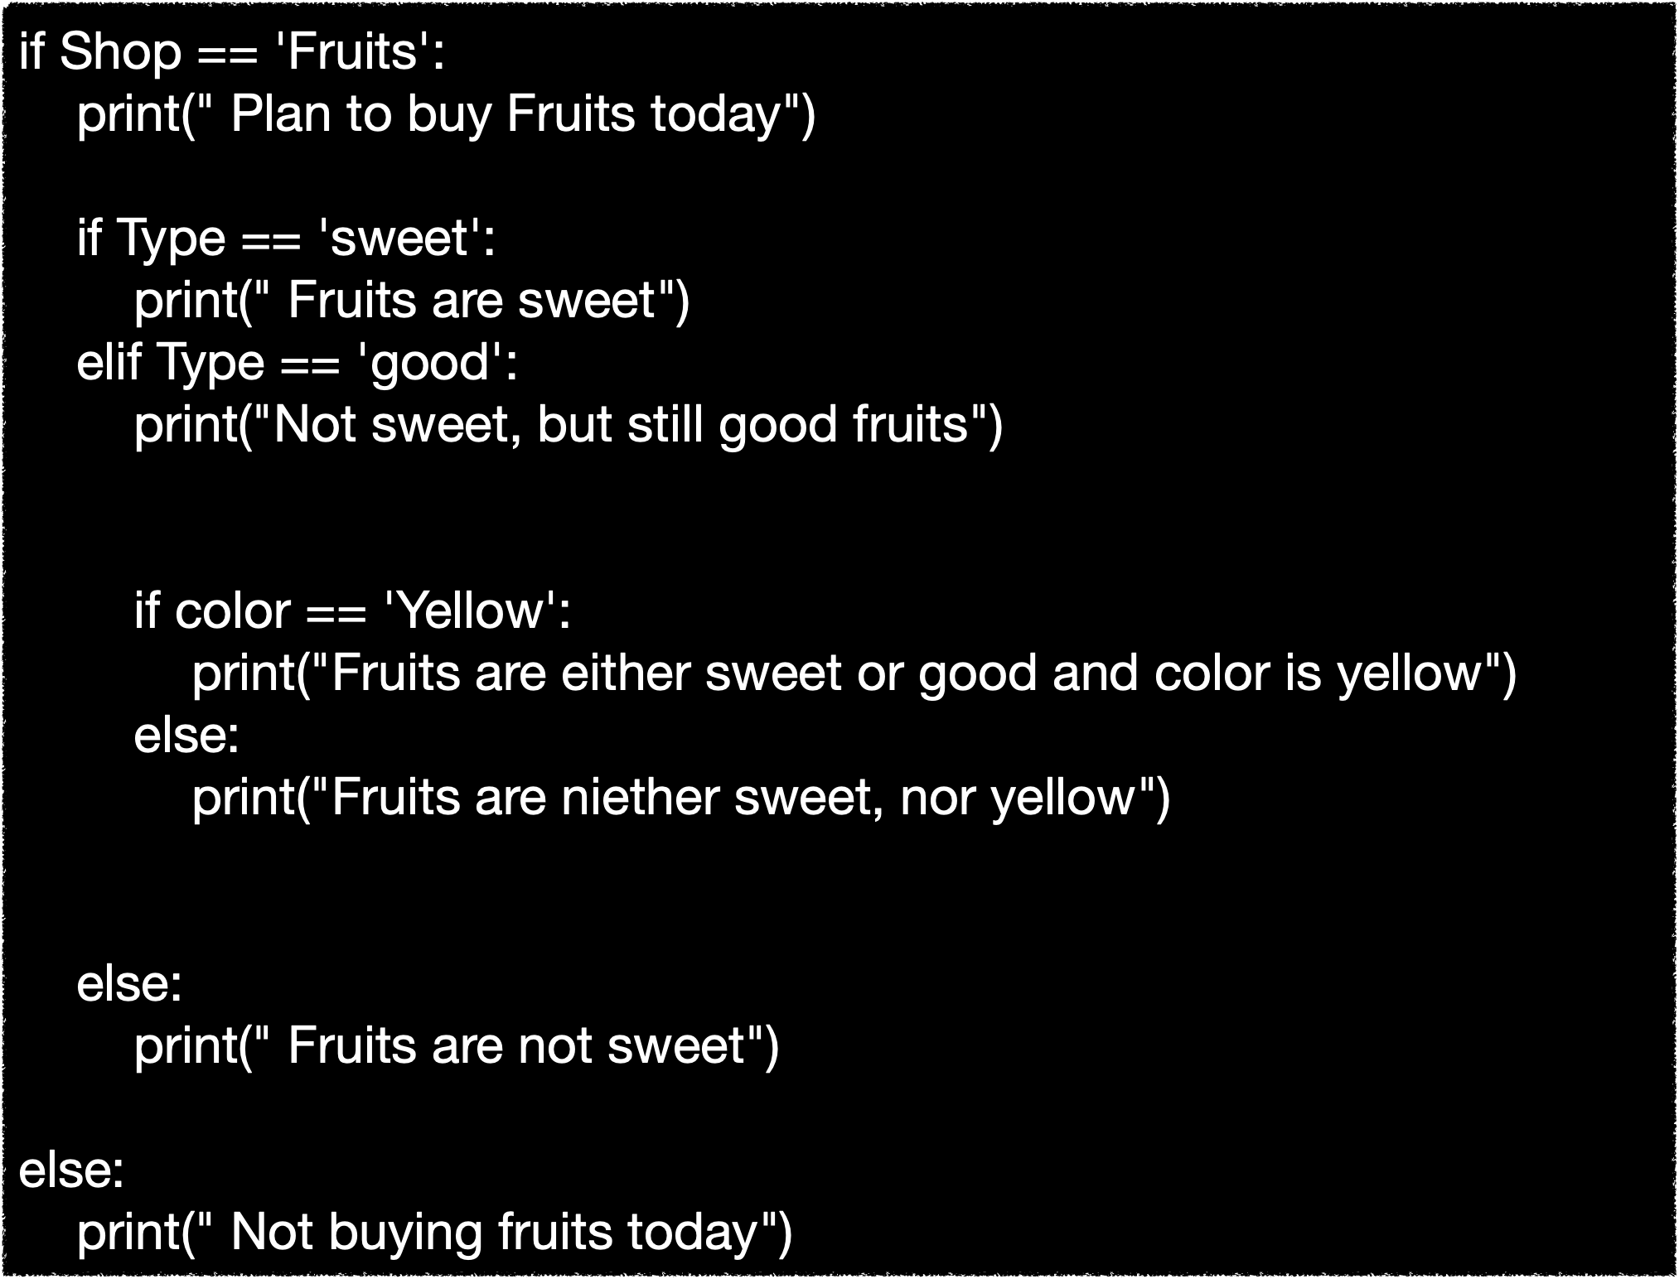
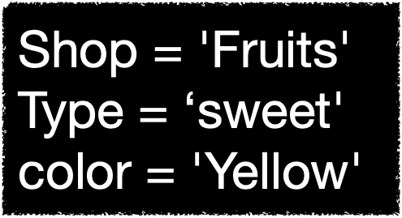
8
If, if-else, elif statements (decision making building blocks in Python)
Hands-On
Nested if-else conditions
Initial inputs
Hint: Nested to last elif, indentation gives the clue
Change inputs
values and try to
guess the expected
answers
S. Sharma, UJ
Python for beginners
21/11/2022
12

Slide 18
8
Python - Operators
Operators allow to perform operations on operands
Variables or values of variables
In Python,
Operators are divided in the following groups
Arithmetic operators
Assignment operators
Comparison operators
Logical operators
Identity operators
Membership operator
Bitwise operator
S. Sharma, UJ
Python for beginners
21/11/2022
29

Slide 19
8
Operators
In Python,
Operators are divided in the following groups
Arithmetic operators
Allow to apply mathematical operations with num. values :
x = 9 , y = 2
Assignment operators
Addition ( + )
Subtraction ( - )
Multiplication ( * )
Division ( / )
Modulus ( % )
Exponent ( ** )
Floor division ( // )
Adding the operands
x + y
Comparison operators
Subtracts R.H.S operand from L.H.S
x - y
Multiply the operands
x * y
Logical operators
Divide L.H.S by R.H.S operand
x / y
Identity operators
Divide L.H.S by R.H.S, return remainder
x % y
Membership operator
Divide L.H.S by R.H.S, return remainder
x ** y
Divide L.H.S by R.H.S, round-up the
quotient to nearest integer
x // y
Bitwise operator
Pl
Tr
Try to execute these
Statements with
x = 13, y = 3
S. Sharma, UJ
Python for beginners
21/11/2022
29

Slide 20
8
Operators
In Python,
Operators are divided in the following groups
Arithmetic operators
Allow to assign variables to variables; lets
x = 9 , y = 2
Assignment operators
( = )
( += )
( -= )
( *= )
( /= )
( %/= )
( **= )
( //= )
x = y
Comparison operators
x += y
Logical operators
x -= y
x *= y
Identity operators
x /= y
Membership operator
x %= y
Bitwise operator
x **= y
x //= y
Try to answer —
S. Sharma, UJ
Python for beginners
21/11/2022
29

Slide 21
8
Operators
In Python,
Operators are divided in the following groups
Arithmetic operators
Comparison operators allow to compare two operands; lets
x = 9 , y = 2
Assignment operators
Equal to ( == )
Not equal to ( != )
Greater than ( > )
Smaller than ( < )
Greater or equal ( >= )
Smaller or equal ( <= )
Comparison operators
x == y
x != y
Logical operators
x > y
Identity operators
x < y
Membership operator
x >= y
x <= y
Bitwise operator
Try to answer —
S. Sharma, UJ
Python for beginners
21/11/2022
29

Slide 22
8
Operators
In Python,
Operators are divided in the following groups
Arithmetic operators
Allow to combine multiple conditional statement :
x = 9 , y = 2
Assignment operators
Comparison operators
and
x > 5 and y < 4
Both statements should true to return True
Logical operators
or
x > 5 or y < 2
If one of the statements is true, return True
Identity operators
not
not (result)
not(x > 5 and y < 4)
Reverse the state of result:
False->Ture, True->False
Membership operator
Bitwise operator
S. Sharma, UJ
Python for beginners
21/11/2022
29

Slide 23
8
Operators
In Python,
Operators are divided in the following groups
Arithmetic operators
Allow to compare the memory location of objects :
Assignment operators
string, list[ ],…
Comparison operators
Logical operators
is
x is y
True, if both variables/object are same
Identity operators
is not
x is not y
True, if both variables/object are not same
(not values, but locations)
Membership operator
Bitwise operator
x = "'little','big'"
y = "'little','big'"
z = x
x == y
Try to answer —
S. Sharma, UJ
Python for beginners
21/11/2022
29

Slide 24
8
Operators
In Python,
Operators are divided in the following groups
Arithmetic operators
Allows to test if a strings, lists or tuples are members of other
sequence (string, list or tuples)
Assignment operators
Comparison operators
Logical operators
in
Day in x
True, if Day(sequence) is in x
Identity operators
not in
Day2 in x
True, if Day2(sequence) is in x, otherwise false
Membership operator
Bitwise operator
x = [‘Sunday’, ‘Monday’, ‘Tuesday’, ‘Wednesday’]
Day = ‘Monday’
Day2 = [‘Thursday’, ‘Friday’, ‘Saturday’]
S. Sharma, UJ
Python for beginners
21/11/2022
29

Slide 25
8
Operators
  .. 32 16
  8 4 2 1
  .. ..
  0 0 0 0
For 0
In Python,
Operators are divided in the following groups
  0 1 1 1
For 7
  1 1 1 1
For 15
Arithmetic operators
Assignment operators
a & b AND
a | b OR
a ^ b XOR
~ b NOT
a << n left shift
a >> n right shift
Bitwise and
Comparison operators
Bitwise or
Logical operators
Identity operators
Bitwise exclusive
Membership operator
Bitwise not
Bitwise operator
shift a left by n(2) bits
shift a right by n(2) bits
S. Sharma, UJ
Python for beginners
21/11/2022
5

Slide 26
8
Operators
  .. 32 16
  8 4 2 1
  .. ..
  0 0 0 0
For 0
In Python,
Operators are divided in the following groups
  0 1 1 1
For 7
  1 1 1 1
For 15
Arithmetic operators
Lets take few variables a = 60, b = 13
Assignment operators
a & b AND
a | b OR
a ^ b XOR
~ b NOT
a << n left shift
a >> n right shift
Bitwise and
Comparison operators
Bitwise or
Logical operators
Identity operators
Bitwise exclusive
Membership operator
Bitwise not
Bitwise operator
shift a left by n(2) bits
shift a right by n(2) bits
S. Sharma, UJ
Python for beginners
21/11/2022
6

Slide 27
8
Operators
  .. 32 16
  8 4 2 1
  .. ..
  0 0 0 0
For 0
In Python,
Operators are divided in the following groups
  0 1 1 1
For 7
  1 1 1 1
For 15
Arithmetic operators
Lets take few variables a = 60, b = 13
a = ( 1 1 1 1 0 0 )2
Assignment operators
a & b AND
a | b OR
a ^ b XOR
~ b NOT
a << n left shift
a >> n right shift
b = ( 0 0 1 1 0 1 )2
Bitwise and
Comparison operators
Bitwise or
Logical operators
Identity operators
Bitwise exclusive
Membership operator
Bitwise not
Bitwise operator
shift a left by n(2) bits
shift a right by n(2) bits
S. Sharma, UJ
Python for beginners
21/11/2022
7

Slide 28
8
Operators
  .. 32 16
  8 4 2 1
  .. ..
  0 0 0 0
For 0
In Python,
Operators are divided in the following groups
  0 1 1 1
For 7
  1 1 1 1
For 15
Arithmetic operators
Lets take few variables a = 60, b = 13
a = ( 1 1 1 1 0 0 )2
Assignment operators
a & b AND
a | b OR
a ^ b XOR
~ b NOT
a << n left shift
a >> n right shift
b = ( 0 0 1 1 0 1 )2
Bitwise and
0 0 1 1 0 0
= 12
Comparison operators
Bitwise or
1 1 1 1 0 1
= 61
Logical operators
Identity operators
Bitwise exclusive
1 1 0 0 0 1
= 49
Membership operator
Bitwise not
1 1 0 0 1 0
Bitwise operator
shift a left by n(2) bits
shift a right by n(2) bits
S. Sharma, UJ
Python for beginners
21/11/2022
8

Slide 29












8
Operators precedence follow in Python
**
Exponential or raise to power
~, +, -
Complement, unary plus, unary minus
*, /, %, //
Multiply, divide, modulus, floor division
+, -
Addition and subtraction
>>, <<
Bitwise : right , left
&
Bitwise : AND
^, |
Bitwise : exclusive OR , OR
<=, <, >, >=
Comparison operators
=, %=, /=, //=, -=, +=, *=, **=
Assignment operators
is, is not
Identity operators
in, not in
Membership operator
not, or, and
Logical operators
A = 20, B = 10, C = 15, D = 2
( ( A + B ) * ( C / D )) ** D ?
S. Sharma, UJ
Python for beginners
21/11/2022
9

Slide 30
8
Looping in Python
After decision making,
      LOOPs are another fundamental part of any fundamental language, that allows
      to execute the the same action several times.
Print integer numbers between 1 to 10 ?
print(1)
1
print(2)
2
print(3)
3
.
.
.print(10)
10
S. Sharma, UJ
Python for beginners
21/11/2022
10

Slide 31
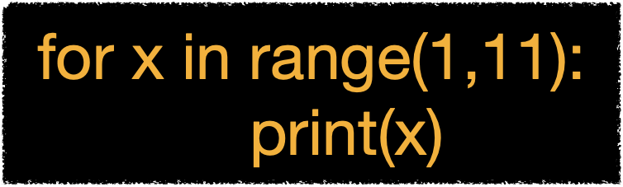
8
Looping in Python
After decision making,
      LOOPs are another fundamental part of any fundamental language, that allows
      to execute the the same action several times.
Print integer numbers between 1 to 10 ?
Using LOOP :
print(1)
1
print(2)
2
print(3)
3
.
.
.print(10)
10
Print only odd / Even numbers ?
S. Sharma, UJ
Python for beginners
21/11/2022
11

Slide 32

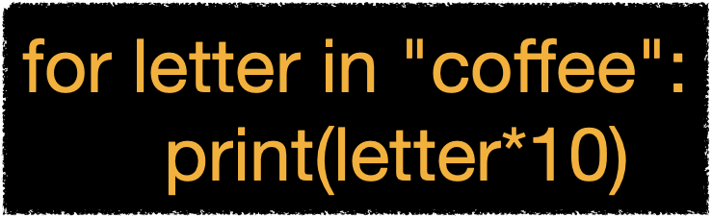
8
Looping in Python
After decision making,
      LOOPs are another fundamental part of any fundamental language, that allows
      to execute the the same action several times.
Print integer numbers between 1 to 10 ?
Using LOOP :
print(1)
1
print(2)
2
print(3)
3
.
.
.print(10)
10
Print only odd / Even numbers ?
What it does ?
S. Sharma, UJ
Python for beginners
21/11/2022
12

Slide 33
8
Looping in Python
After decision making,
      LOOPs are another fundamental part of any fundamental language, that allows
      to execute the the same action several times.
Print integer numbers between 1 to 10 ?
Using LOOP :
print(1)
1
print(2)
2
print(3)
3
.
.
.print(10)
10
Print only odd / Even numbers ?
What it does ?
S. Sharma, UJ
Python for beginners
21/11/2022
13

Slide 34
8
Range in for loops
As per documentation, ‘ Range’ represents an immutable sequence of numbers and is
commonly used for looping a specific number of times
Python ranges can be used in multiple forms
ranges(final)
for x in range(11):
ranges(initial,final)
for x in range(4,11):
ranges(initial,final,step)
for x in range(4,11,1):
for x in range(4,11,2):
Steps up / down
for x in range(11,1,-2):
S. Sharma, UJ
Python for beginners
21/11/2022
14

Slide 35

8
Hands - On
What are expected numbers generated by the following range ?
range(2,19) ?
What are expected numbers generated by the following range ?
range(5) ?
What are expected numbers generated by the following range ?
for x in range(18,0,-3):
print(x)
Write a code using for loop to add odd/even numbers from range 1-100
Modify code to print only odd numbers divisible by 3 from range 1-100
Modify code to print only number which give remainder 1 after dividing by 4 from
range 1-100
S. Sharma, UJ
Python for beginners
21/11/2022
15

Slide 36
8
while loops
With while loop, one can do almost all actions which for loops can do, with additional features.
As the name suggests, it invoke the conditional statement
Syntax:
  while conditional_statement:
  Block_of_statements,
  unless conditional statement become false
Difference between while and for loop
x = 1
While x <11:
  print(x)
  x+=1
for x in range(1,10):
print(x)
S. Sharma, UJ
Python for beginners
21/11/2022
16

Slide 37
8
Hands-On
Print only, when num is even
for num in range(1,11):
print("\U0001f332")
Print only, when num is odd
Print both, even and odd
Print
for num in range(1,21):
if num % 2 == 0:
print(" \U0001f936\t \U0001f936\t \U0001f936\t\n".expandtabs())
else: print("\U0001f385\t\U0001f385\t\U0001f385\n".expandtabs())
S. Sharma, UJ
Python for beginners
21/11/2022
17

Slide 38






8
Hands-On - print
\U0001f385
\U0001f936
for num in range(1,11):
if num % 2 == 0:
print(" \U0001f936\t\t\U0001f936\t\t\U0001f936\t\t\U0001f936\t\t".expandtabs(4))
elif num%2 ==1: print("\U0001f385\t\U0001f385\t\U0001f385\t\U0001f385\t".expandtabs())
S. Sharma, UJ
Python for beginners
21/11/2022
18

Slide 39
8
Hands-On - print
\U0001f385
\U0001f936
for num in range(1,11):
if num % 2 == 0:
print(" \U0001f936\t\t\U0001f936\t\t\U0001f936\t\t\U0001f936\t\t".expandtabs(4))
elif num%2 ==1: print("\U0001f385\t\U0001f385\t\U0001f385\t\U0001f385\t".expandtabs())
S. Sharma, UJ
Python for beginners
19

Slide 40
8
Thank you !!!
S. Sharma, UJ
Python for beginners
25/11/2022

