Slide 1

Python
for
Beginners
S. Sharma
Assistant Professor,
Department of Theory of Nuclear system
http://koza.if.uj.edu.pl/staff/ssharma

Slide 2
Programming languages
To instruct the computers to perform some sort of actions

Slide 3
Programming languages
To instruct the computers to perform some sort of actions
Low-level
high-level

Slide 4
Programming languages
To instruct the computers to perform some sort of actions
Low-level
high-level
Machine language(M.L):
written in binary numbers or bits, that computer can understood

Slide 5
Programming languages
To instruct the computers to perform some sort of actions
Low-level
high-level
Machine language(M.L):
written in binary numbers or bits, that computer can understood
Assembly language(A.L):
Based on the human-readable mnemonics codes for instructions, which can be converted into machine learning language (0,1), using the assemblers.
“like M.L, A.L also requires knowledge of internal computer architecture”

Slide 6
Programming languages
To instruct the computers to perform some sort of actions
Low-level
high-level
Machine language(M.L):
written in binary numbers or bits, that computer can understood
Assembly language(A.L):
Based on the human-readable mnemonics codes for instructions, which can be converted into machine learning language (0,1), using the assemblers.
“like M.L, A.L also requires knowledge of internal computer architecture”
In HLL, programs can be written independent to the details of the computer. They are called high level as they are close to human languages.

Slide 7
Programming languages
To instruct the computers to perform some sort of actions
Low-level
high-level
Machine language(M.L):
written in binary numbers or bits, that computer can understood
Assembly language(A.L):
Based on the human-readable mnemonics codes for instructions, which can be converted into machine learning language (0,1), using the assemblers.
“like M.L, A.L also requires knowledge of internal computer architecture”
In HLL, programs can be written independent to the details of the computer. They are called high level as they are close to human languages.
FORTRAN (formula translation)
COBOL (common business oriented language)
SQL (Structured Query Language)
……..

Slide 8
Programming languages
To instruct the computers to perform some sort of actions
Low-level
high-level
Machine language(M.L):
written in binary numbers or bits, that computer can understood
Assembly language(A.L):
Based on the human-readable mnemonics codes for instructions, which can be converted into machine learning language (0,1), using the assemblers.
“like M.L, A.L also requires knowledge of internal computer architecture”
In HLL, programs can be written independent to the details of the computer. They are called high level as they are close to human languages.
FORTRAN (formula translation)
COBOL (common business oriented language)
SQL (Structured Query Language)
……..
Object-Oriented Language
C++, C#, Java, Python

Slide 9
Programming languages
To instruct the computers to perform some sort of actions
Low-level
high-level
Machine language(M.L):
written in binary numbers or bits, that computer can understood
Assembly language(A.L):
Based on the human-readable mnemonics codes for instructions, which can be converted into machine learning language (0,1), using the assemblers.
“like M.L, A.L also requires knowledge of internal computer architecture”
In HLL, programs can be written independent to the details of the computer. They are called high level as they are close to human languages.
FORTRAN (formula translation)
COBOL (common business oriented language)
SQL (Structured Query Language)
……..
Object-Oriented Language
C++, C#, Java, Python

Slide 10
Why Python(3) ?

Slide 11
Why Python(3) ?
Key features:
Interpreted language
(no compilation required before execution)
Interactive
(direct interaction with python prompt)
Object Oriented Programming supported
(apart from structured and functional approach)

Slide 12
Why Python(3) ?
Characteristics and
applications
Key features:
Interpreted language
(no compilation required before execution)
Interactive
(direct interaction with python prompt)
Object Oriented Programming supported
(apart from structured and functional approach)

Slide 13

Why Python(3) ?
Characteristics and
applications
Key features:
Support structured, functional and OOP
Interpreted language
(no compilation required before execution)
Interactive
(direct interaction with python prompt)
Object Oriented Programming supported
(apart from structured and functional approach)

Slide 14
Why Python(3) ?
Characteristics and
applications
Key features:
Support structured, functional and OOP
Scripted language (eg., PERL, …)
Interpreted language
(no compilation required before execution)
Interactive
(direct interaction with python prompt)
Object Oriented Programming supported
(apart from structured and functional approach)

Slide 15
Why Python(3) ?
Characteristics and
applications
Key features:
Support structured, functional and OOP
Scripted language (eg., PERL, …)
Easily integrated with other languages: C, C++, Java,..
Interpreted language
(no compilation required before execution)
Interactive
(direct interaction with python prompt)
Object Oriented Programming supported
(apart from structured and functional approach)

Slide 16
Why Python(3) ?
Characteristics and
applications
Key features:
Support structured, functional and OOP
Scripted language (eg., PERL, …)
Easily integrated with other languages: C, C++, Java,..
Easy to learn, read and maintain
Interpreted language
(no compilation required before execution)
Interactive
(direct interaction with python prompt)
Object Oriented Programming supported
(apart from structured and functional approach)

Slide 17
Why Python(3) ?
Characteristics and
applications
Key features:
Support structured, functional and OOP
Scripted language (eg., PERL, …)
Easily integrated with other languages: C, C++, Java,..
Easy to learn, read and maintain
Code writing faster and shorter, supported by tons of dedicated Python libraries (data visualization, machine learning, data science, web development,..)
Interpreted language
(no compilation required before execution)
Interactive
(direct interaction with python prompt)
Object Oriented Programming supported
(apart from structured and functional approach)

Slide 18
Why Python(3) ?
Characteristics and
applications
Key features:
Support structured, functional and OOP
Scripted language (eg., PERL, …)
Easily integrated with other languages: C, C++, Java,..
Easy to learn, read and maintain
Code writing faster and shorter, supported by tons of dedicated Python libraries (data visualization, machine learning, data science, web development,..)
Portable (same interface for various platform)
Interpreted language
(no compilation required before execution)
Interactive
(direct interaction with python prompt)
Object Oriented Programming supported
(apart from structured and functional approach)

Slide 19
Why Python(3) ?
Characteristics and
applications
Key features:
Support structured, functional and OOP
Scripted language (eg., PERL, …)
Easily integrated with other languages: C, C++, Java,..
Easy to learn, read and maintain
Code writing faster and shorter, supported by tons of dedicated Python libraries (data visualization, machine learning, data science, web development,..)
Portable (same interface for various platform)
GUI Programming ,
Interpreted language
(no compilation required before execution)
Interactive
(direct interaction with python prompt)
Object Oriented Programming supported
(apart from structured and functional approach)

Slide 20
Why Python(3) ?
Characteristics and
applications
Key features:
Support structured, functional and OOP
Scripted language (eg., PERL, …)
Easily integrated with other languages: C, C++, Java,..
Easy to learn, read and maintain
Code writing faster and shorter, supported by tons of dedicated Python libraries (data visualization, machine learning, data science, web development,..)
Portable (same interface for various platform)
GUI Programming ,
and many more.......
Interpreted language
(no compilation required before execution)
Interactive
(direct interaction with python prompt)
Object Oriented Programming supported
(apart from structured and functional approach)

Slide 21
What we will cover in this course

Slide 22
What we will cover in this course

Slide 23
What we will cover in this course
Datetime module
Math and Random module
Generators and decorators
NumPy, Pandas, Matplotlib
(basic uses)

Slide 24
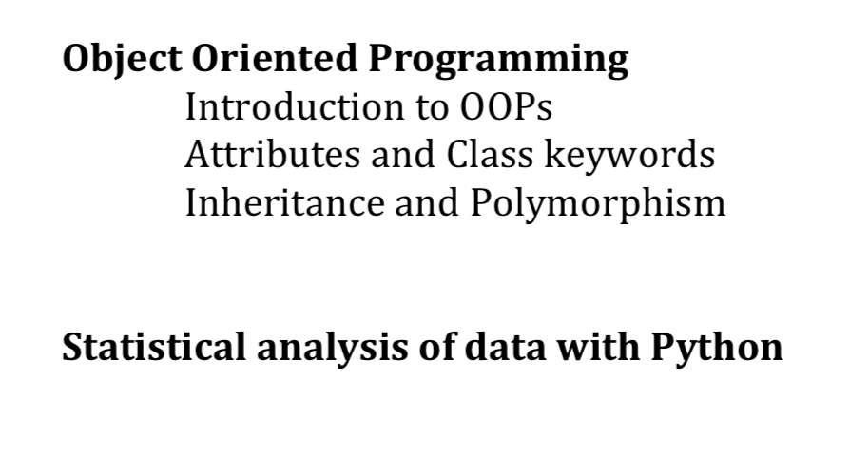
What we will cover in this course
Datetime module
Math and Random module
Generators and decorators
NumPy, Pandas, Matplotlib
(basic uses)

Slide 25
What we will cover in this course

Slide 26
What we will cover in this course
Identifiers: is a name, to identify variable, function,
module….
Keywords: predefined words, that has specific
meaning and can’t be use as
constants, variables or other identifier
names.
Variables:

Slide 28
DATA
types & structure

Slide 29

NUMBERS
DATA
types & structure

Slide 30
NUMBERS
STRING
DATA
types & structure

Slide 31
NUMBERS
STRING
DATA
types & structure
LIST

Slide 32
NUMBERS
STRING
DATA
types & structure
LIST
DICTIONARY

Slide 33
NUMBERS
STRING
DATA
types & structure
LIST
DICTIONARY
TUPLE

Slide 34
NUMBERS
STRING
DATA
types & structure
LIST
DICTIONARY
TUPLE
SET

Slide 36
NUMBERS
Numeric values (e.g., Integers, real numbers, complex)

Slide 37
NUMBERS
Numeric values (e.g., Integers, real numbers, complex)
STRING
Contiguous set of characters in quotation marks (‘Hello’)

Slide 38
NUMBERS
Numeric values (e.g., Integers, real numbers, complex)
STRING
Contiguous set of characters in quotation marks (‘Hello’)
Compound data type : composed of items in square bracket[], separated by commas [‘abc’, 5, 10.5, ‘xyz’]
LIST

Slide 39
NUMBERS
Numeric values (e.g., Integers, real numbers, complex)
S
E
Q
U
E
N
C
E
STRING
Contiguous set of characters in quotation marks (‘Hello’)
type
Compound data type : composed of items in square bracket[], separated by commas [‘abc’, 5, 10.5, ‘xyz’]
LIST
Similar to the list, however, tuples are enclosed within parenthesis ( ‘abc’, 786, 2.23, ‘john’ )
TUPLE

Slide 40
NUMBERS
Numeric values (e.g., Integers, real numbers, complex)
S
E
Q
U
E
N
C
E
STRING
Contiguous set of characters in quotation marks (‘Hello’)
type
Compound data type : composed of items in square bracket[], separated by commas [‘abc’, 5, 10.5, ‘xyz’]
LIST
Similar to the list, however, tuples are enclosed within parenthesis ( ‘abc’, 786, 2.23, ‘john’ )
TUPLE
DICTIONARY
Dictionaries consist of key-value pairs {1001: "John", 1002: "Jane”}

Slide 41
NUMBERS
Numeric values (e.g., Integers, real numbers, complex)
S
E
Q
U
E
N
C
E
STRING
Contiguous set of characters in quotation marks (‘Hello’)
type
Compound data type : composed of items in square bracket[], separated by commas [‘abc’, 5, 10.5, ‘xyz’]
LIST
Similar to the list, however, tuples are enclosed within parenthesis ( ‘abc’, 786, 2.23, ‘john’ )
TUPLE
DICTIONARY
Dictionaries consist of key-value pairs {1001: "John", 1002: "Jane”}
SET
Collection of unordered data type : iterable, mutable/changeable, without duplicacy

Slide 42
NUMBERS
Numeric values (e.g., Integers, real numbers, complex)
S
E
Q
U
E
N
C
E
STRING
Contiguous set of characters in quotation marks (‘Hello’)
type
Compound data type : composed of items in square bracket[], separated by commas [‘abc’, 5, 10.5, ‘xyz’]
LIST
Similar to the list, however, tuples are enclosed within parenthesis ( ‘abc’, 786, 2.23, ‘john’ )
TUPLE
DICTIONARY
Dictionaries consist of key-value pairs {1001: "John", 1002: "Jane”}
SET
Collection of unordered data type : iterable, mutable/changeable, without duplicacy
Boolean
True (T) or False (F)

Slide 43
Program Flow Control in Python

Slide 44
Program Flow Control in Python
Decision
making
false
if
true
Evaluate
expressions

Slide 45
Program Flow Control in Python
Decision
making
Loops: sequentially evaluation of
block of code multiple times
false
not satisfies
if
condition
true
Evaluate
expressions
satisfies
block of code

Slide 46
Program Flow Control in Python
Decision
making
Loops: sequentially evaluation of
block of code multiple times
false
not satisfies
if
condition
true
Evaluate
expressions
satisfies
block of code
Control statements:
break, continue, pass

Slide 47
Program Flow Control in Python
Decision
making
Loops: sequentially evaluation of
block of code multiple times
false
not satisfies
if
condition
true
Evaluate
expressions
satisfies
block of code
Control statements:
break, continue, pass
operators

Slide 48
Program Flow Control in Python
Decision
making
Loops: sequentially evaluation of
block of code multiple times
false
not satisfies
if
condition
true
Evaluate
expressions
satisfies
block of code
Control statements:
break, continue, pass
Arithmetic operators (+, - , * , / , % , ….)
operators
Assignment operators (=, +=, -=,*=,……)
Comparison operators (==, !=, >, <,…….)
Logical operators (and, or, not ),…..

Slide 49
Methods and Functions
Datetime module
Math and Random module
Generators and decorators
NumPy, Pandas, Matplotlib
(basic uses)

Slide 50
Methods and Functions
A Function is a block of reusable code, which can be called to perform certain actions (multiple times).
Datetime module
Math and Random module
Generators and decorators
NumPy, Pandas, Matplotlib
(basic uses)

Slide 51
Methods and Functions
A Function is a block of reusable code, which can be called to perform certain actions (multiple times).
Two types:
Built-in functions e.g., print ()
user-defined functions
Datetime module
Math and Random module
Generators and decorators
NumPy, Pandas, Matplotlib
(basic uses)

Slide 52
Reading and Writing files
Datetime module
Math and Random module
Generators and decorators
NumPy, Pandas, Matplotlib
(basic uses)

Slide 53
Reading and Writing files
While working with computers, users interact with computer by giving some inputs and obtaining results.
In this course, we will cover how to read data from files, and write to files
Datetime module
Math and Random module
Generators and decorators
NumPy, Pandas, Matplotlib
(basic uses)

Slide 54
Reading and Writing files
While working with computers, users interact with computer by giving some inputs and obtaining results.
In this course, we will cover how to read data from files, and write to files
Moreover, we will work with data formatted in CSV (comma-separated values) or JSON (JavaScript object notation),
two common formats that modules in Python’s standard library handles.
Datetime module
Math and Random module
Generators and decorators
NumPy, Pandas, Matplotlib
(basic uses)

Slide 55
Modules and Import
Datetime module
Math and Random module
Generators and decorators
NumPy, Pandas, Matplotlib
(basic uses)

Slide 56
Modules and Import
Python modules/libraries are similar to functions
Datetime module
Math and Random module
Generators and decorators
NumPy, Pandas, Matplotlib
(basic uses)

Slide 57
Modules and Import
Python modules/libraries are similar to functions
Functions are useful if one needs to rereat set of actions
within same program.
Datetime module
Math and Random module
Generators and decorators
NumPy, Pandas, Matplotlib
(basic uses)

Slide 58
Modules and Import
Python modules/libraries are similar to functions
Functions are useful if one needs to rereat set of actions
within same program.
However, if one would like to use same set of actions in multiple programs, one can create a dedicated library,
which can be accessed by all programs, and in python it is
termed as Modules.
Datetime module
Math and Random module
Generators and decorators
NumPy, Pandas, Matplotlib
(basic uses)

Slide 59
Modules and Import
Python modules/libraries are similar to functions
Functions are useful if one needs to rereat set of actions
within same program.
However, if one would like to use same set of actions in multiple programs, one can create a dedicated library,
which can be accessed by all programs, and in python it is
termed as Modules.
Python comes with a large number of modules and has
several advantages, which will be discussed in dedicated
lecture on modules
Datetime module
Math and Random module
Generators and decorators
NumPy, Pandas, Matplotlib
(basic uses)

Slide 60
Modules and Import
Python modules/libraries are similar to functions
Functions are useful if one needs to rereat set of actions
within same program.
However, if one would like to use same set of actions in multiple programs, one can create a dedicated library,
which can be accessed by all programs, and in python it is
termed as Modules.
Python comes with a large number of modules and has
several advantages, which will be discussed in dedicated
lecture on modules
Apart from Python standard library, a large number of
modules available on Python package index
(https://pypi.org), can be accessed using import
Datetime module
Math and Random module
Generators and decorators
NumPy, Pandas, Matplotlib
(basic uses)

Slide 61
Object Oriented Programming
This is a bit advanced topic. In the framework of this course, We will learn the basic concepts following the simple implementation

Slide 62
Python scope and setup
There are several editors/IDS (Integrated Development Environment)/Jupyter Notebook

Slide 63





Python scope and setup
There are several editors/IDS (Integrated Development Environment)/Jupyter Notebook
Visual studio
Sublime
Text
>>>IDLE
editor with light
weight environment
ATOM
PyCharm
Python IDE

Slide 64


Python scope and setup
There are several editors/IDS (Integrated Development Environment)/Jupyter Notebook
Visual studio
Sublime
Text
>>>IDLE
Google colab /Jupyter is a web application that lets you run:
Live codes,
Embedded visualizations,
Explanatory texts
much more functionality
all in one place.
editor with light
weight environment
ATOM
PyCharm
https://colab.research.google.com/
Python IDE

Slide 65
Python scope and setup
There are several editors/IDS (Integrated Development Environment)/Jupyter Notebook
Visual studio
Sublime
Text
>>>IDLE
Google colab /Jupyter is a web application that lets you run:
Live codes,
Embedded visualizations,
Explanatory texts
much more functionality
all in one place.
editor with light
weight environment
ATOM
PyCharm
https://colab.research.google.com/
IP[y]: Ipython
Interactive Computing
Python IDE
https://ipython.org

Slide 66
Google Colab
Google Colab is free, cloud-based Jupyter notebook environment.
Offers built-in support for GPUs, powerful tool for computation.
Great for data science and machine learning
Installation : not needed (Go to https://colab.research.google.com and work)

Slide 67
Google Colab
Google Colab is free, cloud-based Jupyter notebook environment.
Offers built-in support for GPUs, powerful tool for computation.
Great for data science and machine learning
Installation : not needed (Go to https://colab.research.google.com and work)
IPython
IPython, an interactive shell for Python (for quick computation and testing)
Provides rich toolkit for interactive computing.
Allow shell syntax, tab completion, and magic commands
To use IPython use ‘ pip install IPython ’ (in terminal or command prompt)

Slide 68
Comparison between Google Colab and IPython
Environment : Colab is cloud-based while IPython is local
Setup/install : Colab requires no installation, Ipython needs pip
GPU support : Colab has GPT/TPU (limited access), IPython doesn’t.
File Handling : Colab integrates with Google drive; Ipython uses local files
Collaboration : Colab supports real-time collaboration; IPython doesn’t
Media support: Colab supports inline media better than Ipython
Magic commands: IPython supports magic commands, Google Colab doesn’t

Slide 69
Using Google Colab
Colab allows to create two types of cells:
Code and Text (use # to add comment in code cell)
To execute a cell: shift+enter or play button
Import common libraries (numpy , pandas),
directly.
import numpy as np
Use “ !pip install <library_name> ” to install additional
!pip install matplotlib
Google Colab allows to upload files
Directly from computer:
from google.colab import files
uploaded = files.upload() # will open upload box
filename= “temp.txt” # assuming temp is uploaded file name
with open(filename, “r”) as file:
content = file.read()
print(content)
Mounting google drive:
from google.colab import drive
drive.mount(‘content/drive/path_to_file/filename.txt’)
Saving files:
with open(‘example.txt’, ‘w’) as f:
f.write(“Coab testing”)
files.download(‘example.txt’)
Using an in-built GPU :
First enable GPU –
In Colab, got to Runtime>Change runtime type > GPU
import tensorflow as tf
if tf.test.gpu_device_name():
print(‘GPU is available’)
else:
print(‘No GPU found’)
Perform basic calculations in code cells
a,b = 10, 2
print(‘sum is :’ ,a+b)
print(‘a div b is:’ , a/b)
Taking inputs from keyboard:
num 1 = float(input(‘Enter first number:’))
num2 = float(input(‘Enter second number:’))
print(‘Sum is :’ , num1+num2)

Slide 70
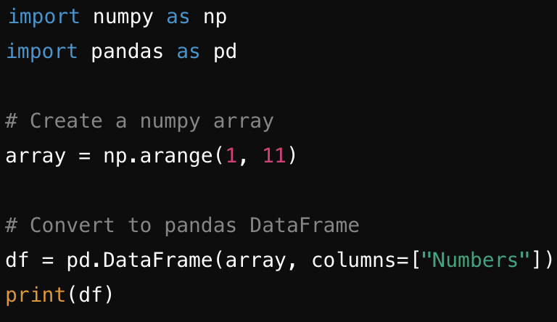
Getting familiar in using Colab
Notes:
Upload file from computer: After running this code, a file upload dialog box will appear. You can select a file from your computer to upload. Once uploaded, you can access the file by its filename (as a string key) in the uploaded dictionary.

Slide 71
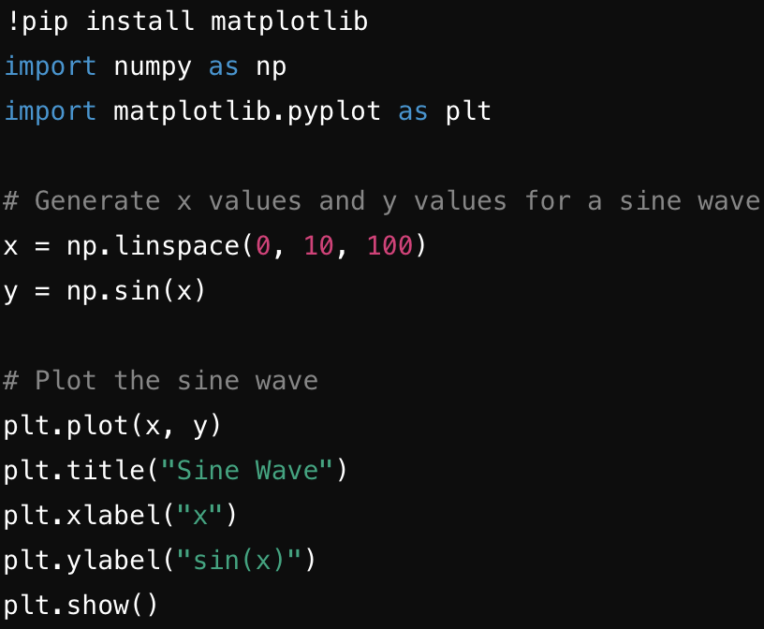
Getting familiar in using Colab
Lets assume, we would like plot 2D data using matplotlib, which is not installed in Colab environment
Notes:
Upload file from computer: After running this code, a file upload dialog box will appear. You can select a file from your computer to upload. Once uploaded, you can access the file by its filename (as a string key) in the uploaded dictionary.

Slide 72

Tutorials
satyam.tiwari@doctoral.uj.edu.pl

