Slide 1

ET AI HACKATHON 2026 / PROBLEM STATEMENT 7
AI-SOC
AI-Driven Cyber
Resilience
for Critical Infrastructure
Abhinav Singh, Yash Virulkar and Shrikant Shingare
DETECTS / EXPLAINS / RESPONDS
Notes:
Good afternoon, judges. What you're looking at is AI-SOC — an AI Security Operations Center built for critical national infrastructure. In one line: it detects, it explains, and it responds to cyberattacks, and it shows its work at every step. Over the next few minutes we'll walk through why that matters, what we built, and what it actually does live.

Slide 2
Public infrastructure keeps getting hit
02
1.59M
Cybersecurity incidents handled by CERT-In in 2023 — a volume that continues to surge.
70%
Of public & government entities still run critical workloads on end-of-life IT infrastructure.
RECENT TARGETS
AIIMS Delhi (2022) / CBSE (2024, 2026)
India's vital public institutions remain highly vulnerable and under continuous exploit pressure.
Source: CERT-In (2023) / public incident reporting
Notes:
Let's start with why this exists. CERT-In alone handled over one point five nine million cybersecurity incidents in 2023, and that number keeps climbing. AIIMS Delhi, CBSE — India's public institutions keep getting hit, and more than seventy percent of government entities are still running end-of-life infrastructure. This isn't a hypothetical threat model. It's already happening, at scale.

Slide 3
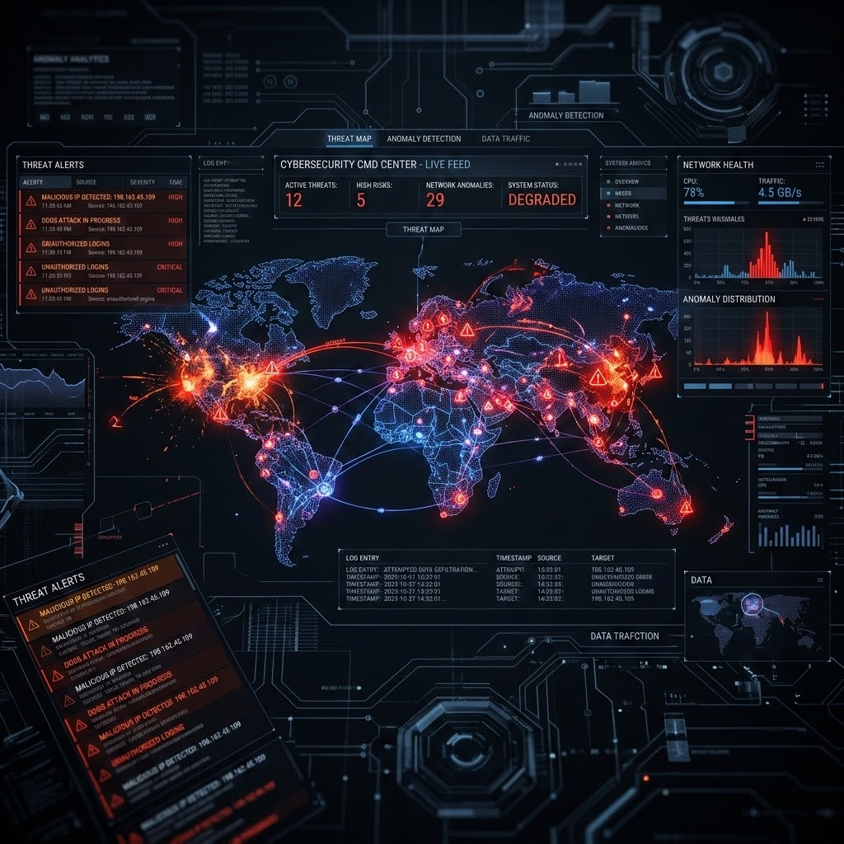
03
The failure isn't alerts.
It's detection speed.
SIGNATURE-BASED LIMITATION
Signature-based tools can't see an advanced persistent threat that never matches a known signature and deliberately moves low-and-slow.
BEHAVIORAL INTELLIGENCE LAYER
What's missing is a behavioral intelligence layer — one that correlates weak signals across a kill chain and acts fast enough that response happens in hours, not weeks.
AI-SOC 2026
Notes:
So why isn't this solved already? Because the failure was never a lack of alerts — it's detection speed. Signature-based tools simply can't see an advanced persistent threat that never matches a known signature and deliberately moves low and slow. What's actually missing is a behavioral intelligence layer — something that notices "this isn't how this host normally behaves," and acts fast enough that response happens in hours, not weeks. That's the gap we built to close.

Slide 4
Three agents. Not one dashboard.
04
Detection, attribution, and response are wired end-to-end, feeding a live dashboard.
01Detection
02Attribution
03Response
04Dashboard
Isolation Forest, unsupervised — no signatures anywhere.
Learns "normal," flags what isn't.
RAG over ATT&CK, CVE, CERT-In — cited, never invented.
Maps anomaly to technique + next stage.
Policy-driven, human-approval gate above a blast-radius threshold.
Hash-chained audit, SSE live stream.
Live feed, MITRE map, attack-path graph, approvals, audit trail, metrics.
Consolidates and visualizes all upstream telemetry in real-time.
OUTPUT →
anomaly_event
OUTPUT →
enriched_incident
OUTPUT →
containment_action
AI-SOC 2026
Notes:
Here's what we built: three coordinating agents, not one dashboard. A Detection Agent learns normal traffic and flags deviations — no signatures involved. An Attribution and Prediction Agent takes that anomaly and maps it to a cited MITRE ATT&CK technique. A Response Orchestrator decides what to do about it, behind a human-approval gate. And everything feeds a live dashboard so you can watch it happen. Let's look at each agent in turn.

Slide 5
Learns "normal." Flags what isn't.
05
An unsupervised Isolation Forest, fit only on normal UNSW-NB15 traffic, scores live flows and reports human-readable feature deviations.
NO SIGNATURES
01
Normal-only training split; labels used for evaluation only, never fed to the model.
02
Scores live flows; reports deviations in human-readable features, not a raw anomaly score alone.
03
Lives in engine/ — trained, saved (scaler + model), and replay-tested against live traffic.
UNSW-NB15
AI-SOC 2026
The model learns only what "normal" traffic looks like — it flags deviation, not a match.
Notes:
First, detection. This is an unsupervised Isolation Forest, trained only on normal UNSW-NB15 traffic — it never sees a labelled attack during training. It scores live flows and reports the human-readable features that made a flow look abnormal, not just a bare anomaly score. That's deliberate: no signature-matching anywhere in this loop, because signature matching is exactly what lets a slow-moving attacker slip through.

Slide 6
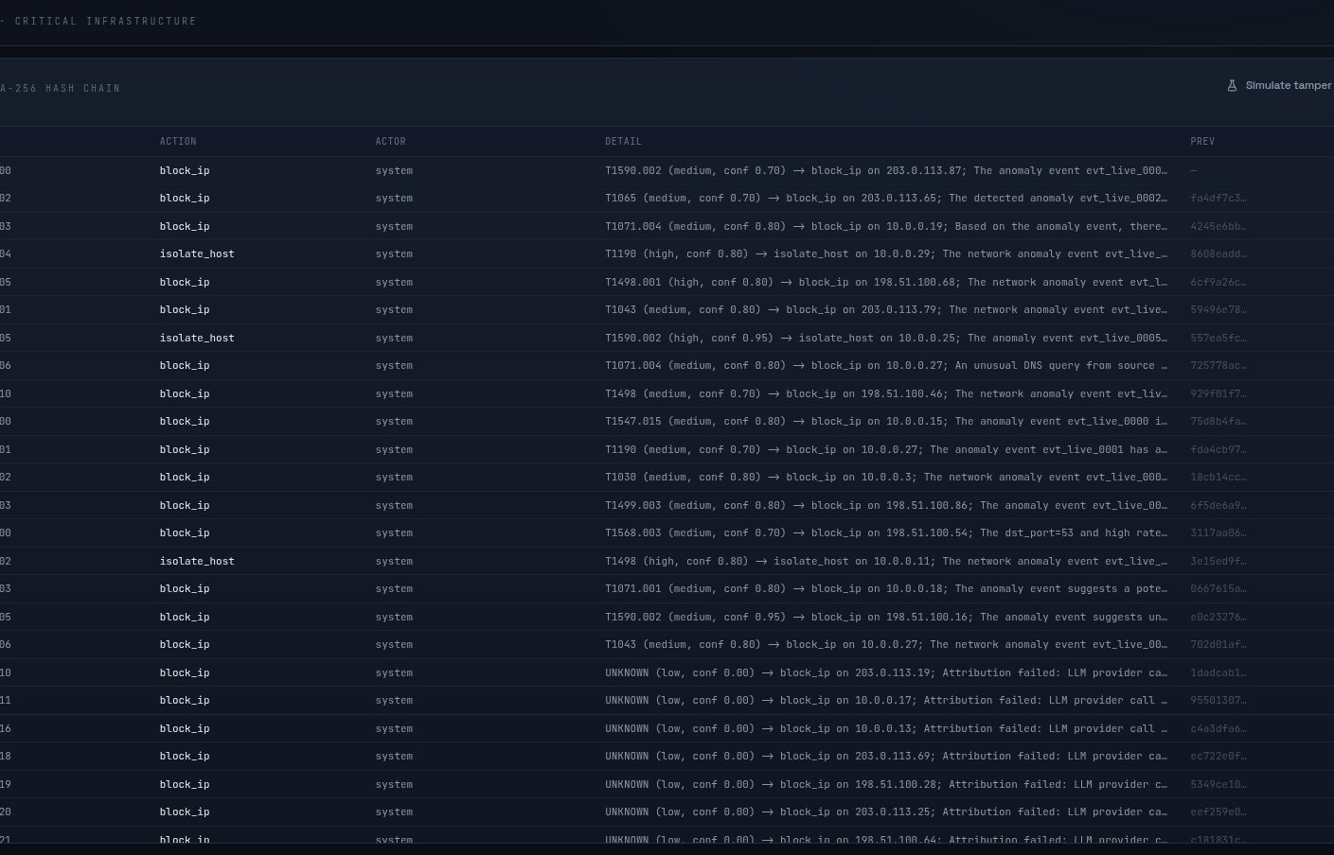
Retrieve first. Cite always.
06
A tool-calling agent maps each anomaly to a cited MITRE ATT&CK technique and CVE/CERT-In references — it never invents a technique ID.
01
Retrieval-grounded
Over a Chroma index of MITRE ATT&CK STIX + NVD CVE + CERT-In advisories.
02
Calibration over Guessing
Low retrieval → lower stated confidence, not a confident guess.
03
Predictive Capability
Predicts the likely next attack stage alongside the current technique.
04
Intel-First Integration
Lives in intel/ — the key differentiator versus a plain ML dashboard.
MITRE-MAPPED AUDIT TRAIL — LIVE
AI-SOC 2026
Notes:
Once something looks anomalous, the Attribution Agent takes over — and this is the differentiator against a plain ML dashboard. It retrieves from a Chroma index built on MITRE ATT&CK, NVD CVE, and CERT-In advisories, and it never states a technique ID it can't ground in a retrieved source. If retrieval comes back thin, the confidence score drops honestly instead of guessing. What you're seeing on the right is that agent's actual output — a MITRE-mapped audit trail, live.

Slide 7
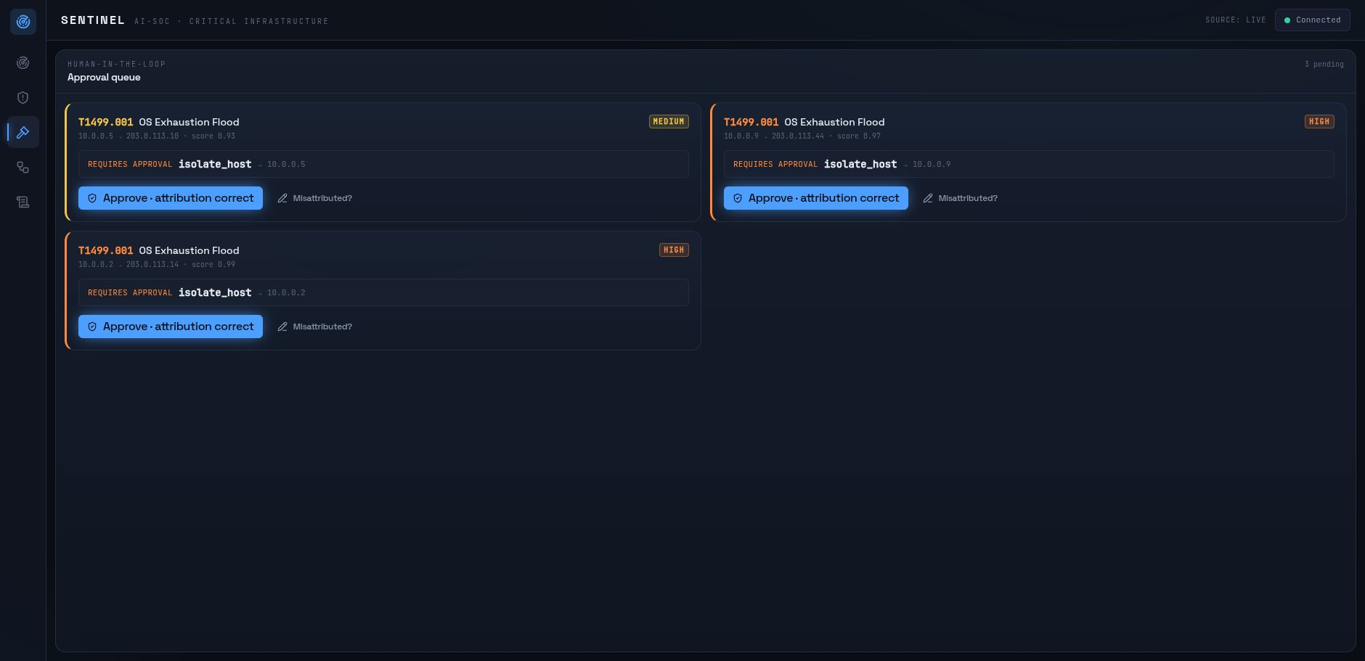
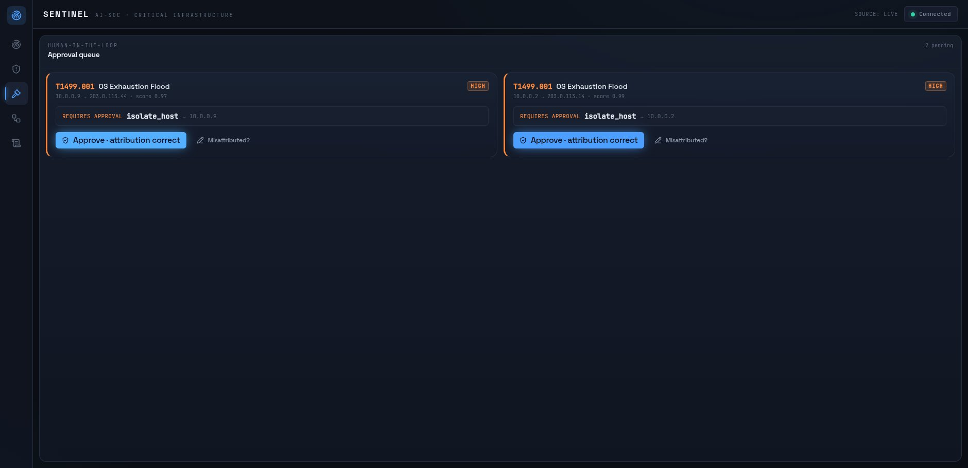
The policy decides. Not the model.
07
PENDING APPROVAL
AFTER APPROVAL — CONTAINED
CONDITIONACTIONAPPROVAL?
TAMPER-EVIDENT AUDIT
entry_hash = sha256( prev_hash + entry)
Re-verified client-side; every playbook logs simulated_success.
severity critical/high & score≥0.9 isolate_host ✓ required
score 0.7 – 0.9 block_ip auto
score < 0.7 monitor auto
AI-SOC 2026
Notes:
Then the Response Orchestrator decides what happens next — and importantly, the policy decides, not the model. `policy.py` is the one authority mapping anomaly score and severity to an action. High-blast-radius actions like isolating a host sit at pending-approval until a human clicks approve — that's the before-and-after you see here. And every single action is hash-chained into the audit log, so it's genuinely tamper-evident, not just logged.

Slide 8
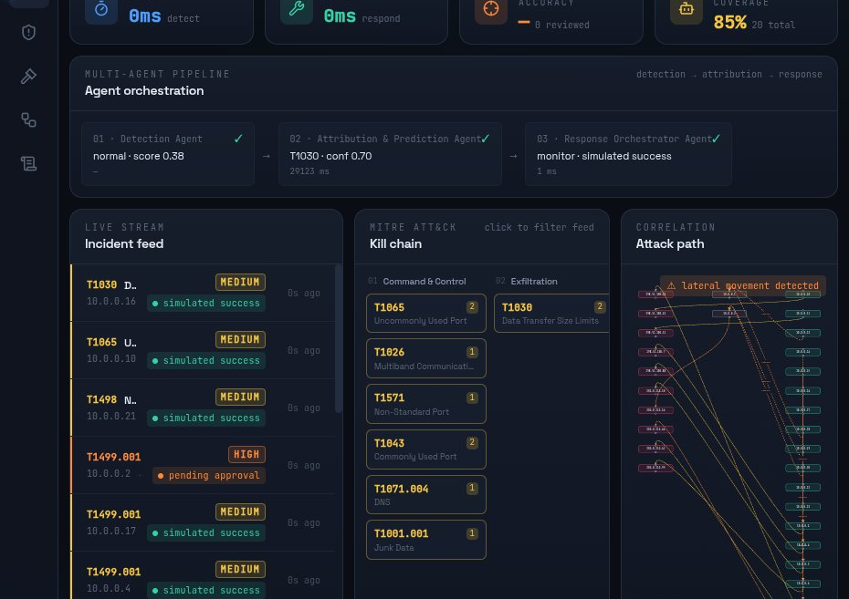
One screen, the whole pipeline
08
The live incident feed proves the pipeline runs end-to-end.
GET /stream
(SSE) — built first, proves the pipe.
PIPELINE CAPABILITIES
MITRE grid
Incident detail
Risk-ranked queue
Audit view
LIVE INCIDENT FEED — DASHBOARD
AI-SOC 2026
Notes:
All of that surfaces on one screen. This live incident feed is subscribed over server-sent events, and we built it first — before anything else — because it's the proof the whole pipeline actually runs end to end. What you're looking at isn't a mockup; it's the same feed running right now.

Slide 9
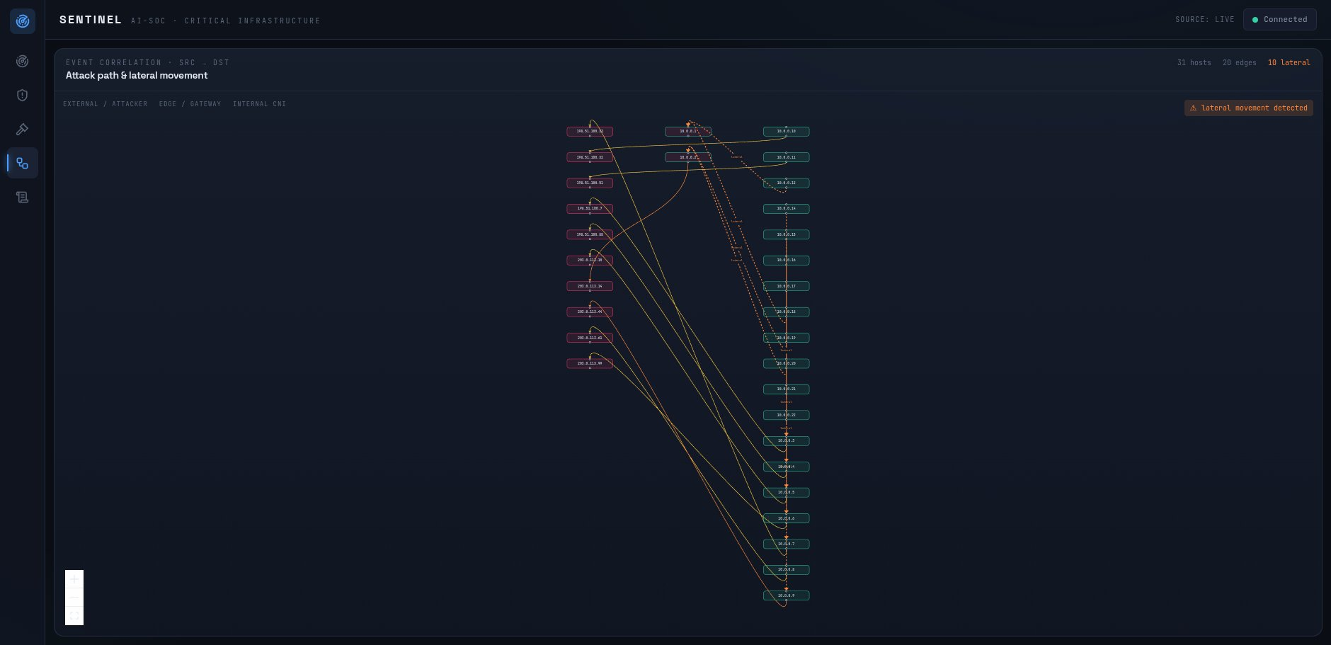
A real knowledge graph, not a grid
09
Correlating events by host into a src → dst graph surfaces lateral movement — the knowledge-graph capability the brief asks for.
01
NetworkX Correlation
Detects crucial east-west lateral movement patterns dynamically across hosts.
02
STIX Relationship Edges
Backs network paths with real-world ATT&CK technique relationships.
03
Live UI Dashboard
Renders the entire correlation map in real-time directly on the analyst's screen.
REAL-TIME CORRELATION VIEW
Interactive attack paths and east-west movement visualization.
ATTACK-PATH / LATERAL-MOVEMENT GRAPH
Notes:
One more capability worth calling out on its own: this is a real knowledge graph, not just a grid. We correlate events by host into a source-to-destination graph, and that surfaces lateral movement — the kind of east-west traffic an attacker uses to move deeper into a network. The edges come from real MITRE ATT&CK STIX relationships, so this isn't decoration — it's a legitimate graph capability.

Slide 10
Four things a dashboard alone can't do
10
The differentiator is the reasoning + citation + auto-containment layer, not the model itself.
report01
No signatures
Flags deviation, not a known pattern.
search02
Retrieve-then-cite
Never a confident guess on a technique ID.
gavel03
Policy decides
The agent's suggestion is advisory only.
lock04
Human loop
High-impact actions wait for approval — required, not optional.
AI-SOC 2026
Notes:
So, why isn't this just an ML dashboard with extra steps? Four reasons. No signatures — it flags deviation, not a known pattern. Retrieve-then-cite, always — never a confident guess on a technique ID. Policy decides, not the LLM — the model's suggestion is advisory only. And human-in-the-loop above blast-radius thresholds — required, not optional. Take any one of those away and you're back to a dashboard.

Slide 11
Three contracts. Nothing drifts.
11
Three frozen JSON contracts, mirrored as Pydantic models — the seam every pillar imports.
Anomaly Event
Enriched Incident
Containment Action
event_id
attack_technique
action
"evt_0001"
cited MITRE ATT&CK id
isolate_host / block_ip /
monitor
anomaly_score
confidence / severity
0.93 — threshold-free
low retrieval → lower stated
status
confidence
pending_approval →
top_features
approved → simulated_success
human-readable, not a
cve_refs / certin_refs
column index
grounded citations
requires_human_approval
true above blast-radius
raw_features
suggested_action
real numbers the agent
advisory only
reasons over
src_ip + dst_ip = graph edges
AI-SOC 2026
Notes:
Underneath all three agents sits one seam: three frozen JSON contracts, mirrored as Pydantic models. The anomaly event, the enriched incident, and the containment action. Every pillar imports the same schema file, so nothing can drift quietly out of sync — if a contract changes, we bump the version and every consumer knows.

Slide 12
A defensible number, not perfection
12
Unsupervised, fit on normal traffic only, evaluated on held-out normal plus every attack class.
insights01
ROC-AUC
threshold-free
0.867
adjust02
Recall
@ balanced pt
0.749
at 10.0% FPR
track_changes03
Recall
@ high-recall
0.820
at 20.3% FPR
gps_fixed04
Precision
@ balanced pt
0.981
optimum threshold
Source: engine/RESULTS.md / Isolation Forest, UNSW-NB15
Notes:
Let's talk numbers, because a hackathon pitch without them isn't worth much. Fit entirely on normal traffic, evaluated on held-out normal plus every attack class: ROC-AUC of point eight six seven. Recall of point seven four nine at a ten percent false-positive rate, or point eight two at a higher-recall operating point with twenty percent FPR. Precision of point nine eight one at the balanced point. These are defensible numbers, not a claim of perfection.

Slide 13
Scored on the judges' own terms
13
JUDGE ASKS FOR
THIS REPO'S ANSWER
Anomaly detection rate / FPR
ROC-AUC 0.867, recall/FPR table
APT attribution accuracy at ATT&CK technique level
Labelled eval set; retrieve-then-cite, no invented IDs
Incident-response automation coverage
autonomous_steps / total_steps, live on dashboard
MTTD/MTTR vs. baseline SOC
deviation decision simulated containment
Full auditability of every automated action
Hash-chained JSONL audit log, re-verified client-side
AI-SOC 2026
Notes:
And mapping directly onto what the brief actually asks judges to score: detection rate and FPR, attribution accuracy at the technique level, automation coverage, MTTD and MTTR improvement, and full auditability. Every one of those has a direct, named answer in this repository — not a promise, an answer.

Slide 14
15
The turn this pipeline makes
The same 1.59 million incidents a year, met by a pipeline that goes from deviation to decision in seconds.
DEVIATION / 01
1.59 Million
Annual Incidents
The baseline scale of noise and alerts processed by the pipeline at ingestion.
DECISION / 02
Seconds
vs. Weeks of SOC
Decisioning happens instantly in the pipeline, completely bypassing manual investigation delays.
CONTAINMENT / 03
Verified
Hash-Chained Trust
Every processing second is cryptographically chained and independently re-verifiable.
AI-SOC 2026
Notes:
Which brings us to the turn this pipeline actually makes. The same one point five nine million incidents a year, but now met by a pipeline that goes from deviation to decision in seconds — not the weeks a manual SOC needs. And every one of those seconds is hash-chained and independently re-verifiable, so speed never comes at the cost of trust.

Slide 15
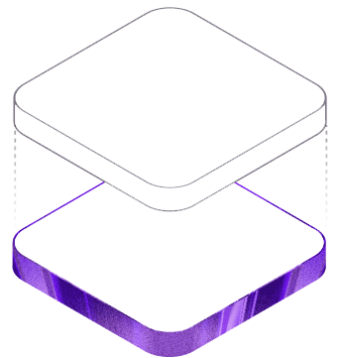
STATUS REPORT
This already runs end-to-end. Today. Not slideware.
Detection, attribution, orchestration, and dashboard pillars are built and wired end-to-end.
01 / DETECT
Detection
Real-time threat detection and anomaly identification engine.
02 / ATTRIBUTE
Attribution
Grounded MITRE ATT&CK technique mapping and refs.
03 / ORCHESTRATE
Orchestration
Instant containment pipelines running autonomously.
04 / VISUALIZE
Dashboard
Live unified interface presenting clean decision metrics.
ET AI HACKATHON 2026 / PROBLEM STATEMENT 7
Abhinav Singh, Yash Virulkar, Shrikant Shingare
Notes:
So here's where we'll leave it. This already runs end to end, today — detection, attribution, orchestration, and the dashboard are built and wired together, not slides promising a future build. Thank you — this was built for ET AI Hackathon 2026 by OfficialAbhinavSingh and Viscous106.

