Slide 1
Module 2 : Git Assignment

Slide 2


Slide 3
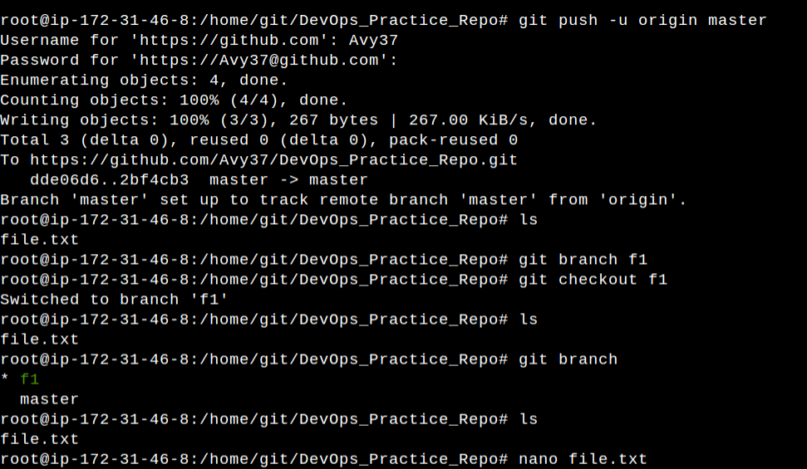

Slide 4
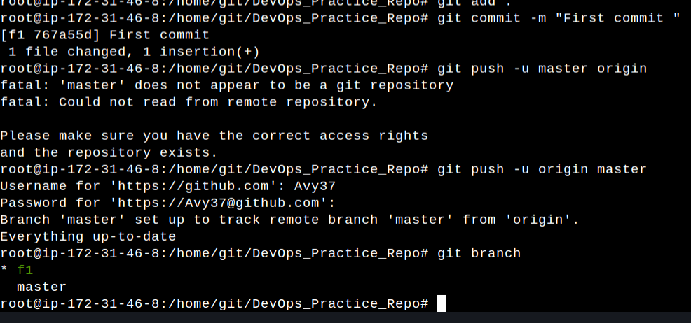

Slide 5
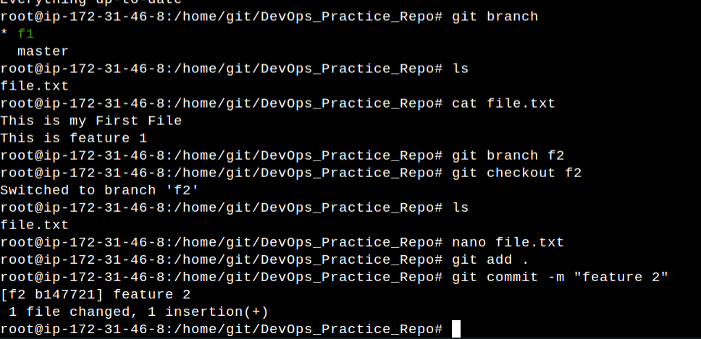

Slide 6



Slide 7
Github – profile link
https://github.com/Avy37/DevOps_Practice_Repo.git

