Slide 1
Thinking in Events
June Blender Technology Evangelist Sapien Technologies, Inc juneb@Sapien.com, @juneb_get_help

Slide 2


SAPIEN USB Drive
Contains complete and latest versions of all SAPIEN products
Lasts for 10 calendar days after activation (use it or lose it)
Must be activated before the last day of this month.
Questions about license keys or buying software? Contact sales@sapien.com
Questions about products? Contact me (juneb@sapien.com) or SAPIEN Trial Forum.

Slide 3
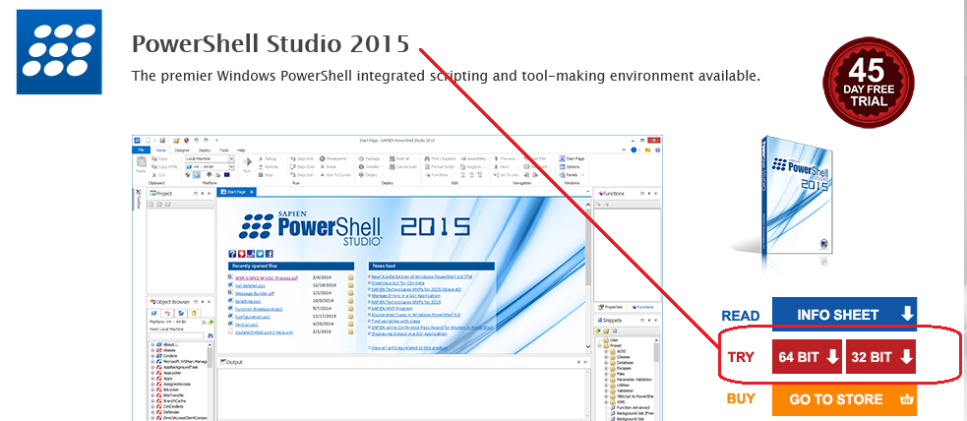
PowerShell Studio 2015
Go to: www.sapien.com/software/powershell_studio

Slide 4
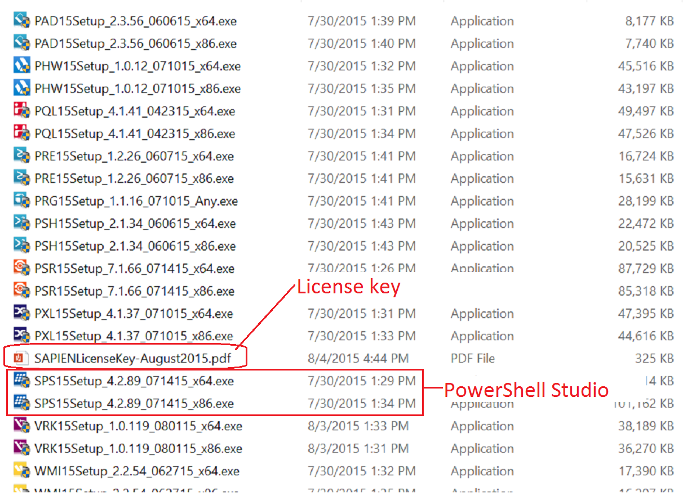
SAPIEN USB Key

Slide 5
Creating GUI Tools
GUI → Scripting → GUI
→Efficiency→

Slide 6
GUI Application
A GUI application consists of an unordered collection of event handlers.
The order in which the code in the event handlers runs is determined by the end-user.

Slide 7
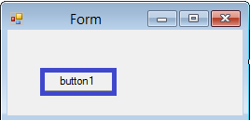
In a GUI, you control the display
If the button gets objects, they go to the pipeline ... not displayed
You have to display standard output and errors.
Managing Errors in a GUI Application
Displaying Output in a GUI Application

Slide 8
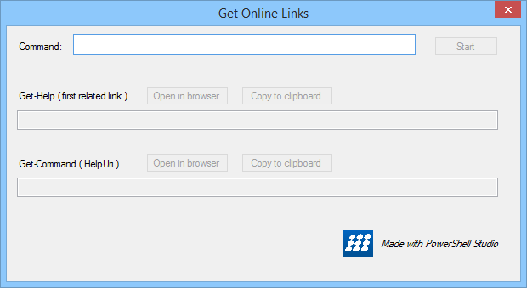
Controlling the Order of Operations
Linear scripts that start at line 1 and run to the end of the script
Non-linear GUIs are driven by end-users.
Direct the user by placement: top → bottom; left → right
Enable controls only when you have the required data.

Slide 9
Windows Forms: System.Windows.Forms
The form elements are objects with properties, methods, and events.
Event handler: A function that is called when the event happens ("is raised").
Form has a Load event
Button has an Click event

Slide 10
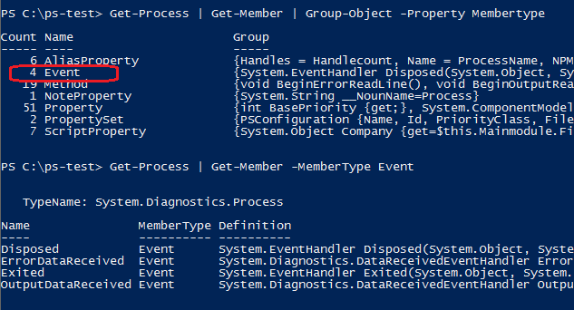
An event is a member

Slide 11


An event handler...
... is code that runs when an event happens ("is raised")
$House.Fire
function Firefighter {}
Register the event handler
Map the event to an event handler

Slide 12


An event handler...
... is code that runs when an event happens ("is raised")
$buttonClose Click event
$buttonClose_Click = { $Form.Close() }
Register the event handler
Map the event to an event handler
$buttonClose.add_Click($buttonClose_Click)

Slide 13

An event handler...
... is code that runs when an event happens ("is raised")
Button.Click
$buttonClose_Click = { $Form.Close() }
Register the event handler
Map the event to an event handler
$buttonClose.add_Click($buttonClose_Click)

Slide 14
Terminating / Non-Terminating Errors
Non-Terminating Errors : Less serious errors. By default, write an error and continue.
Terminating Errors : Serious errors. By default, write and error and stop the pipeline.

Slide 15
Terminating / Non-Terminating Errors
Non-Terminating Errors :
if (-not (Get-Service -ServiceName foo `
–ErrorAction SilentlyContinue)) { <Handle the error }
Terminating Errors : try { Get-Service -ComputerName foo } catch { <Handle the error>}

Slide 16
Make a non-terminating error terminate
Non-Terminating Errors :
try { Get-Service -ServiceName foo ` -ErrorAction Stop } catch { <Handle the error }

Slide 17
Subexpression $(…)
Evaluates the statements in parentheses
Includes the output in the result.
Required for multiple statements and properties of an object.
Avoids intermediate variable
Try It!
"Hello from (Get-Service WinRM).DisplayName"
"Today's date is Get-Date."

Slide 18
Important properties and methods
Text: display
Name: internal name, typically (type<Name>)
-------------------
Button:
DialogResult: Predetermines behavior. To control, set to None.
Textbox, RichTextBox:
Multiline
ReadOnly

Slide 19
GUI CheatSheet:
Think in events: Place the code in the event that should trigger it.
Control the output: You manage the display
Control errors: You manage the display : Use msgbox, $error[0].Exception.Message
Dialog result button property: To control the button, set it to None.
To format strings, use Out-String (converts objects into a single string)
To display properties as strings, use subexpression $(...)
To display monospace font in a textbox: Right-Click → Apply Property Set / Apply Console Font

Slide 20
Part 1: Simple GUI -> Out-GridView
Input : Textbox, Buttons
Processing: Script
Output: Out-GridView
Notes:
Show

Slide 21
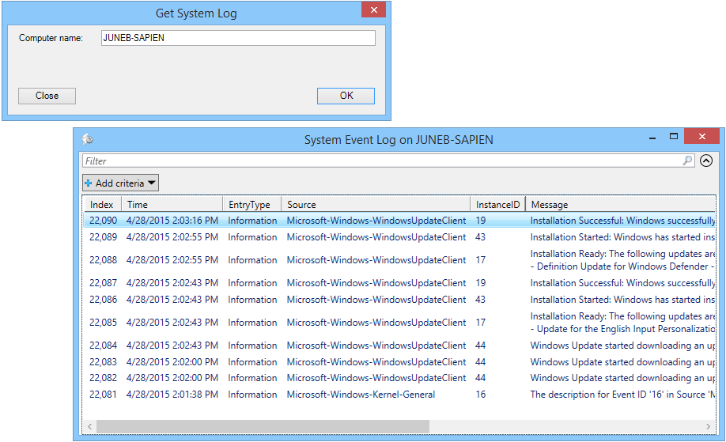
Simple GUI -> Out-GridView
Notes:
Get-Service.psf

Slide 22
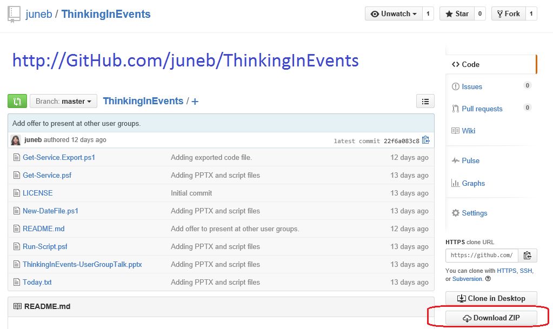
Slides & Code: http://GitHub.com/juneb/ThinkingInEvents

Slide 23
References: Thinking in Events
GUI App Tutorials and Basics
Creating a Basic GUI
Displaying Output in a GUI Application
Managing Errors in a GUI Application
Understanding Streams, Redirection, and Write-Host (update July 4, 2015)
Passing and Returning Values Using Forms
Creating a GUI for CSV Data
Adding Auto-Complete to an Input Textbox
Copy to Clipboard in a GUI Application Typing Enter Pushes a Button Scope in a PowerShell GUI App
The Methods That Register Events
PowerShell GUI Debugging Tip: Duplicate Event Handlers
About Face: The Essentials of Interactive Design (Sept. 2014)

Slide 24
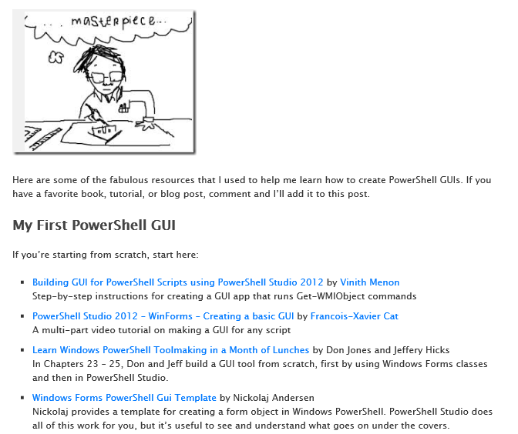
PowerShell GUIs: Where do I start?
https://www.sapien.com/blog/2015/07/16/powershell-guis-where-do-i-start/

Slide 25
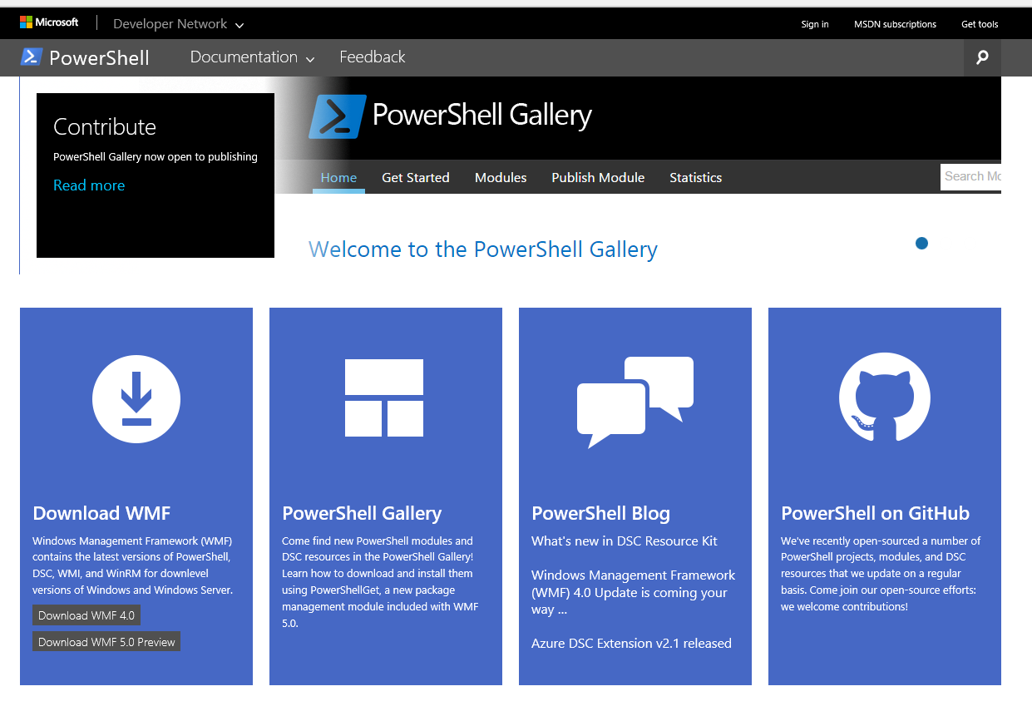
PowerShell Page in MSDN http://msdn.microsoft.com/PowerShell
NEW!

Slide 26
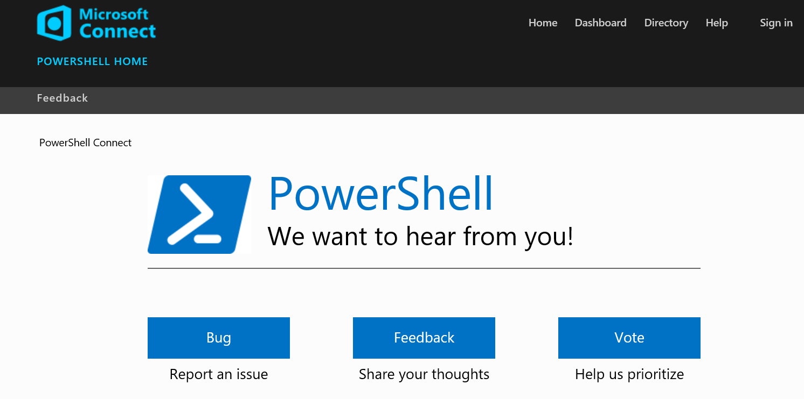
File a Bug – Suggest a Change Microsoft Connect: http://Connect.Microsoft.com/PowerShell

Slide 27
Thinking in Events
June Blender Technology Evangelist Sapien Technologies, Inc juneb@Sapien.com, @juneb_get_help

