Slide 1
Thinking in Events
June Blender Technology Evangelist Sapien Technologies, Inc Windows PowerShell MVP juneb@Sapien.com, @juneb_get_help

Slide 2
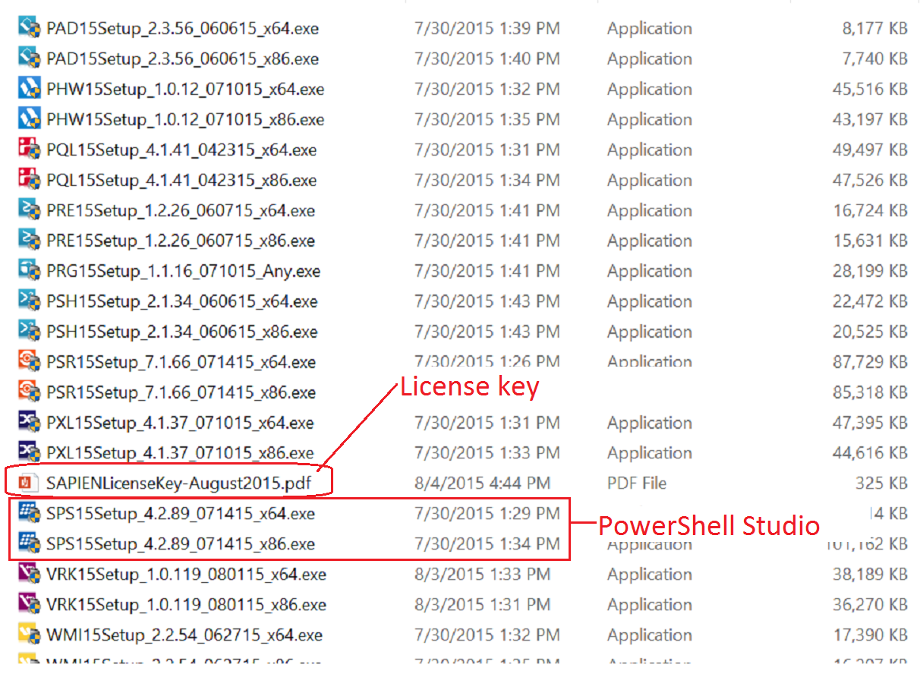


SAPIEN USB Key

Slide 3
SAPIEN USB Drive
Contains complete and latest versions of all SAPIEN products
Lasts for 10 calendar days after activation (use it or lose it)
Must be activated before the last day of this month.
Questions about license keys or buying software? Contact sales@sapien.com
Questions about products? Contact me (juneb@sapien.com) or SAPIEN Trial Forum.

Slide 4
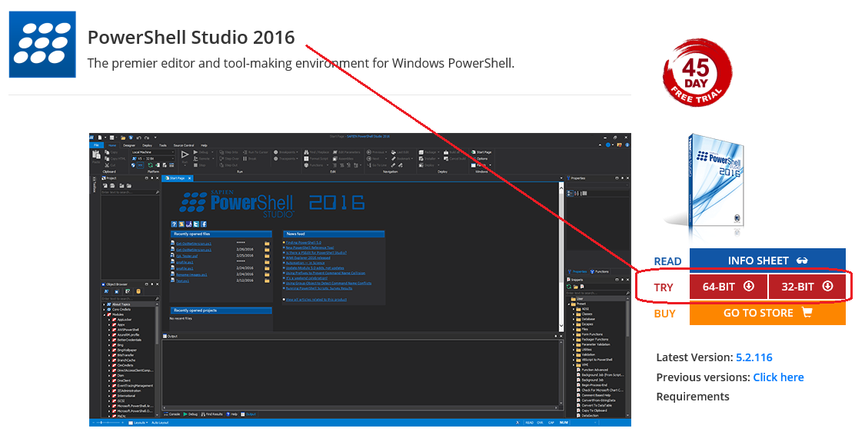
PowerShell Studio 2016
Go to: www.sapien.com/software/powershell_studio

Slide 5

Creating GUI Tools
GUI → Scripting → GUI
→Efficiency→

Slide 6
GUI applications are different
The script for a GUI application consists of an unordered collection of event handlers.
The order in which the code in the event handlers runs is determined by the end-user.
Why think in events?

Slide 7
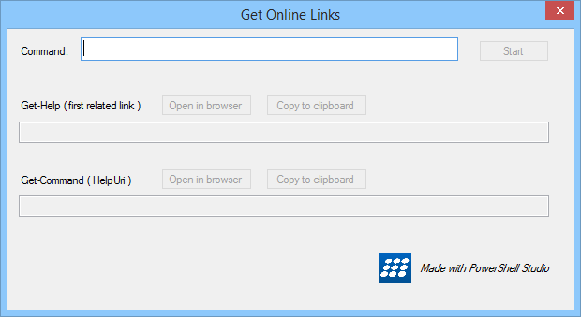
User controls the order of operations
Linear scripts that start at line 1 and run to the end of the script
Non-linear GUIs are driven by end-users.
Direct the user by placement: top → bottom; left → right
Enable controls only when you have the required data.

Slide 8
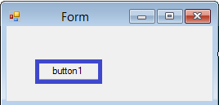
You must control the display
If the button gets objects, they go to the pipeline ... not displayed
You have to display standard output and errors.
Managing Errors in a GUI Application
Displaying Output in a GUI Application

Slide 9
Windows Forms: System.Windows.Forms
The form elements are objects with properties, methods, and events.
Event handler: A function that is called when the event happens ("is raised").
Form has a Load event
Button has an Click event

Slide 10
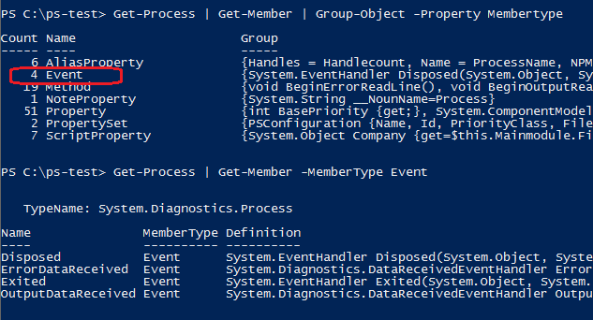
An event is a member

Slide 11


An event handler...
... is code that runs when an event happens ("is raised")
$House.Fire
function Firefighter {}
Register the event handler
Map the event to an event handler

Slide 12

An event handler...
... is code that runs when an event happens ("is raised")
$buttonClose Click event
$buttonClose_Click = { $Form.Close() }
Register the event handler
Map the event to an event handler
$buttonClose.add_Click($buttonClose_Click)
The Methods that Register Events

Slide 13
Terminating / Non-Terminating Errors
Non-Terminating Errors : Less serious errors. By default, write an error and continue.
Terminating Errors : Serious errors. By default, write and error and stop the pipeline.
Dealing with Errors by Keith Hill

Slide 14
Terminating / Non-Terminating Errors
Non-Terminating Errors :
if (-not (Get-Service -ServiceName foo `
–ErrorAction SilentlyContinue)) { <Handle the error }
Terminating Errors : try { Get-Service -ComputerName foo } catch { <Handle the error>}

Slide 15
Make a non-terminating error terminate
Non-Terminating Errors :
try { Get-Service -ServiceName foo ` -ErrorAction Stop } catch { <Handle the error }

Slide 16
Subexpression $(…) of strings
Evaluates the statements in parentheses
Includes the output in the result.
Required for multiple statements and properties of an object.
Try It!
"Today's date is (Get-Date).DayOfWeek."
"Today's date is $((Get-Date).DayOfWeek)."

Slide 17
Important properties and methods
Text: display
Name: internal name, typically (type<Name>)
-------------------
Button:
DialogResult: Predetermines behavior. To control, set to None.
Textbox, RichTextBox:
Multiline
ReadOnly

Slide 18
GUI CheatSheet:
Think in events: Place the code in the event that should trigger it.
Control the output: You manage the display
Control errors: You manage the display : Use msgbox, $error[0].Exception.Message
Dialog result button property: To control the button, set it to None.
To format strings, use Out-String (converts objects into a single string)
To display properties as strings, use substring $(...)
To display monospace font in a textbox: Right-Click → Apply Property Set / Apply Console Font

Slide 19
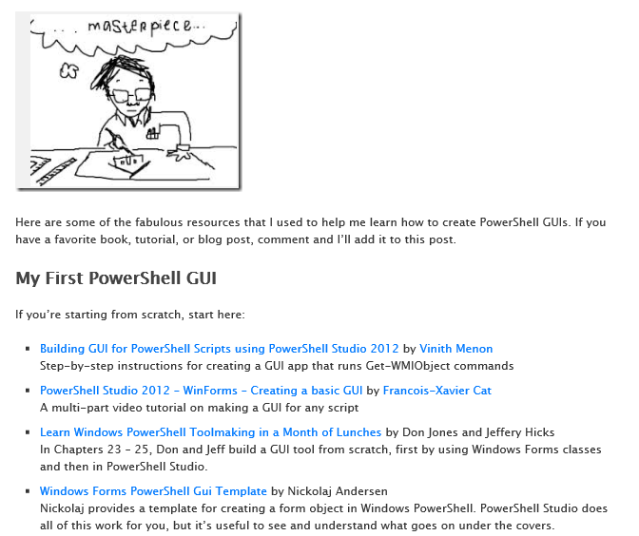
PowerShell GUIs: Where do I start?
https://www.sapien.com/blog/2015/07/16/powershell-guis-where-do-i-start/

Slide 20
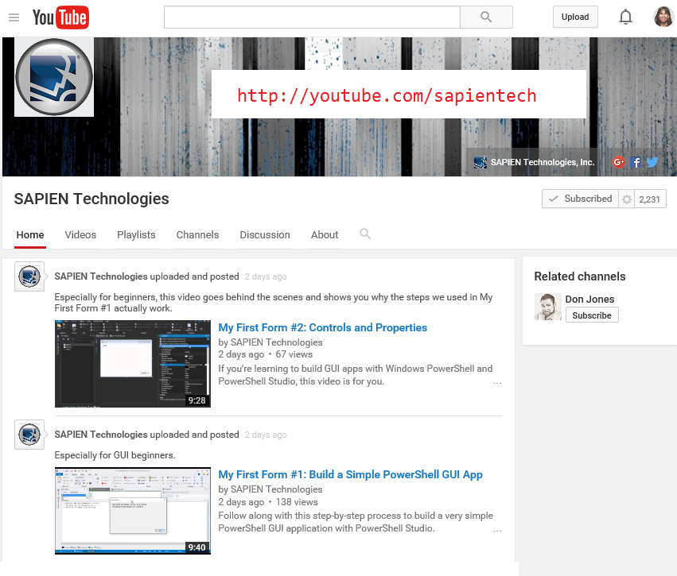

Slide 21
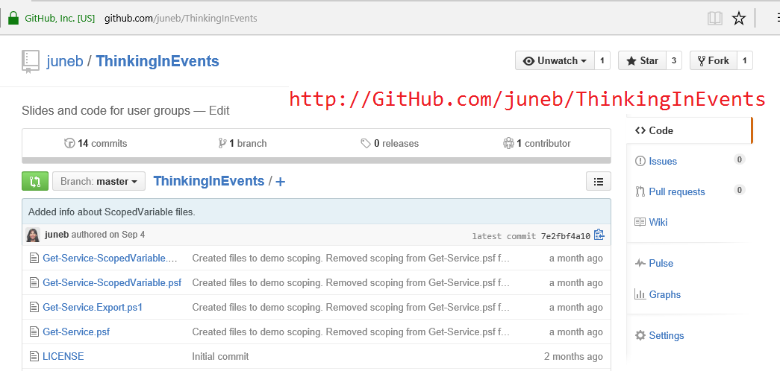

Slide 22
Thinking in Events
June Blender Technology Evangelist Sapien Technologies, Inc Windows Powershell MVP juneb@Sapien.com, @juneb_get_help

