Slide 1
Cubic S (Smart Surveillance System) with Motion Tracting

Slide 2
Introduction
WHAT is Smart Surveillene System
WHY
it needs to be looked into
WHEN is it called Smart Surveillence system

Slide 3
What is Smart Surveillence System
A surveillence system capable of
Recording a feed
Extract a face in frame
Run Face recognition technique
Classify person respectively

Slide 4
Why is it needed
To uphold the law strictly
To identify criminal in public
To assist in police investigations
To provide more secure environment
To decrease criminl activities

Slide 5
When is it Smart Surveillence System
If a system can learn on its own
If a system can adapt to changes
If a system can provide more features then other existing systems

Slide 6
Methodology
The Research was conducted as :
Start
Implment selected algorithm, research on it
Collecting info from different servey and research papers
Select algorithm that can be stacked on with previous algorithm
Accurate enough?
N
Stack the new algorithm design the overall flow of the prototype
Selecting an algorithm that can be build on
Y
Build on the algorithm/algorithms, Create a prototype
Stop
Algorithm suitable ?
Y
Observe the behaviour of the prototype and carry out various test
Collect all the findings and conclude the research
N

Slide 7
Methodology
Domains involved for prototype:
Database
Image Processing
Machine Learing
Neural Network
Networking
Algorithms used for prototype:
Viola Jones Algorithm for face detection
Eigen Face for Identification of face from database
Local Binary Pattern Histogram for identification
Back Propagation Algorithm for increasing accuracy
The Overall prototype was developed on the time span of
3 months, Which has helped shape various data for this research paper
Softwares used for prototype:
Python for programming
MySQL for database management
IPCam for accessing feed from mobile devices

Slide 8
Design of Prototype
Prototype (Black box)
Feed
Final output feed with labels of persons

Slide 9
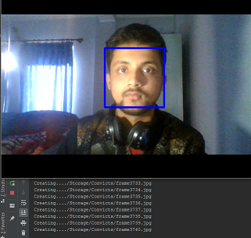
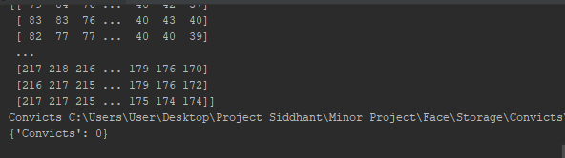
Findings
Step 1: Data Entry Process
Step 2: Machine Learning Process

Slide 10
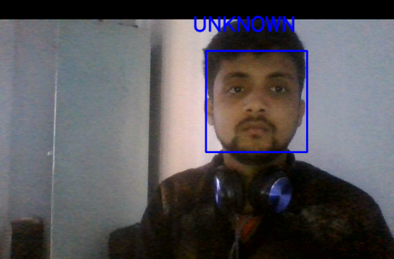
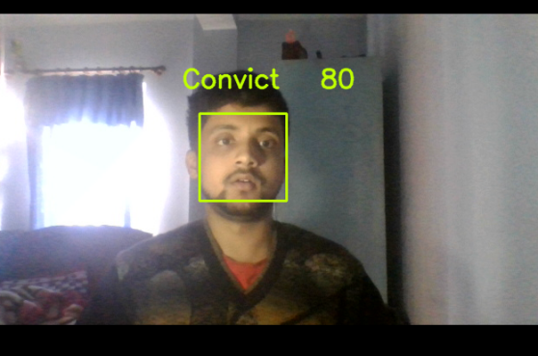
Findings
Step 3: Face Detection Process
Step 4: Face Detection and Recognition
For detection: 2.12 seconds | Confidence level: 78%
Using LPBH algorithm, Eigen face algorithm with back propagation | For detection:3.01 For recognition:2.01 | Confidence level:75%-95%

Slide 11
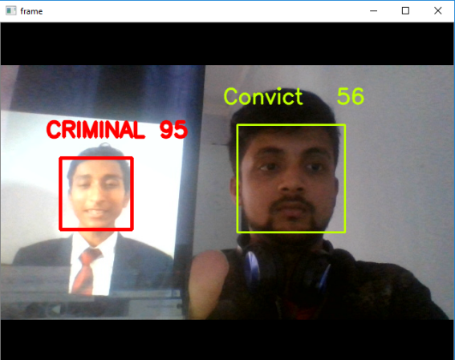
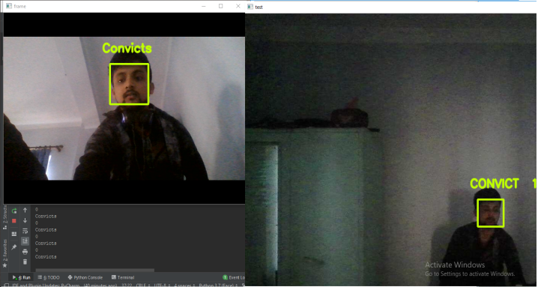
Findings
Step 5: Multiple Face Detection and Recognition Process
Step 6: Face Detection and Recognition using Multiple Devices
For detection:4seconds | Confidence level: 50-95
Using LPBH algorithm, Eigen face algorithm with back propagation | For detection:3.01 For recognition:2.01 | Confidence level:75%-95%

Slide 12
Hardware
Microcontroller (Arduino) is used to control the camera to track the person through serial communication from python program.
Servo motor is used for this project since it can be fed precise angle.

Slide 13
Limitations
Smart Surveillence System has the biggest limitations of Accuracy
Large number of dataset is required for proper trainning of a model
Different orientation of faces and simple disguises can trick the machine

Slide 14
Conclusion
The System can be scaled to national level
The System has its necessity right now more then ever
Further more Research can and should be done on Surveillence Systems
“No system of mass surveillance has existed in any society that we know of to this point that has not been abused.” -Edward Snowden

