Slide 1

HCMC UNIVERSITY OF TECHNOLOGY AND EDUCATION
FACULTY FOR HIGH QUALITY TRAINING
SUBJECTS: COMPUTER ORGANIZATION AND ARCHITETURE
REPORT: 8051 MICROCONTROLLER PROGRAMMING USING C PROGRAMMING LANGUAGE INTERRUPT COMUNICATION AND COMUNICATION (UART)
LECTURER: Ph.D PHẠM VĂN KHOA

Slide 2
GROUP MEMBER:
Nguyễn Tiến Đạt 20119125
Mai Xuân Hoài 20119131
Nguyễn Minh Mẫn 20119142
Vũ Văn Đức 20119128
Nguyễn Hồng Đăng 20119127

Slide 3
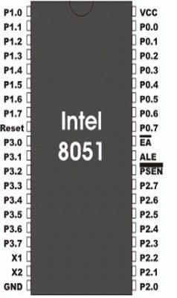
1. INTRODUCTION TO THE 8051 MICROCONTROLLER
The 8051 microcontroller is
A basic microcontroller.
First introduced by the ‘Intel Corporation’ since 1970.
Developed by the 8086 processor architecture.
A family of the microcontroller.
Developed by different manufacturers such as Philips, Atmel, dalls, and so on.
Used in lots of embedded products from small children’s toys to large automotive systems.
2014

Slide 4
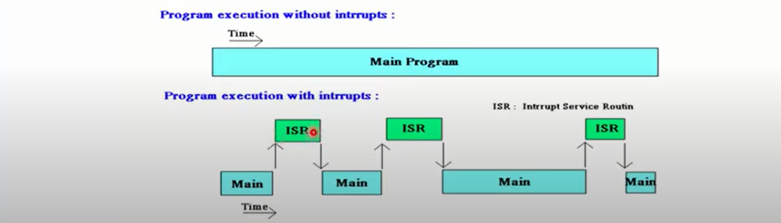
2. INTRODUCTION INTERRUPT
2014
Interrupt is number of emergency event inside or outside the microcontroller that occur, forcing the microcontroller to pause the implement of current program, serve immediately the task that interrupts the request- this task called the Interrupt Service Routine (ISR)

Slide 5
2.2 INTERRUPT IN 8051
*Six interrupts in the 8051:
2014
+ Reset.
+ Two interrupts are set aside for the timers: one for Timer 0 and one for Timer1
+ Two interrupts are set aside for hardware external hardware interrupts: The interrupt INT0 and INT1
+ Serial communication
INTERRUPTS | ADDRESS LOCATION
RESET | 0000h
TIMER 0 | 0003h
TIMER1 | 000Bh
INT0 | 0013h
INT1 | 001Bh
SERIAL | 0023h

Slide 6
2.2 INTERRUPT IN 8051
* The service interrupted
2014
Interrupt | FLAG | ADDRESS LOCATION | ODER NUMBER INTERRUPTED
Reset | _ | 0000h | _
INT 0 | IE0 | 0003h | 0
Timer 0 | TF0 | 000Bh | 1
INT 1 | IE1 | 0013h | 2
Timer 1 | TF1 | 001Bh | 3
UART | RI/TI | 0023h | 4

Slide 7
2.3 PROGRAMMING SERVICE OF INTERRUPT
void name (void ) interrupt X;// (X is the order number interrupt)
{
// program for the interrupt
}
Example:
void No1 () interrupt 1;// timer 0
{
P3_0=~P3_0;
Delay(1000);
}

Slide 8
2.4 The process when performing an interrupt:
The process when performing an interrupt:
When activating a microcontroller, perform the following steps:
2014
It completes the command that is executed and saved the address of the next command to the stack.
It also saves the current situation of all interrupts.
It jumps to a fixed position in memory called the interrupt vector table, which stores the address of an interrupt service.
The microcontroller receives the ISR address from the interrupt vector table and jumps there. It starts to perform the interrupt service to the final command of ISR and returns to the main program from interrupt.
When the microcontroller returns to where it is interrupted. First, it receives the address of the PC program counter from the stack by pulling 02 bytes on the top of the PC stack.Then start executing commands from that address.

Slide 9
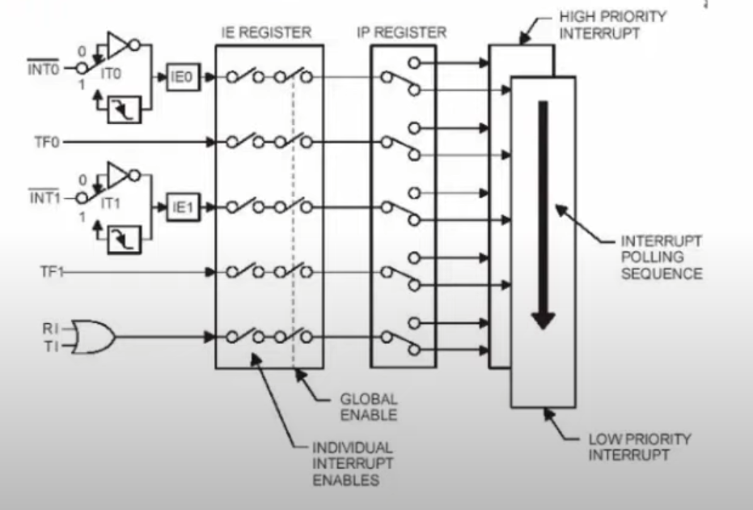
2.5 INTERRUPT CONTROL REGISTER
Interrupt control register:
TCON (Timer Control): Contains Timer interrupt flags, external interrupt flags, and bit options.
Serial Control: Contains serial interrupted interrupt flag
IE register (Interrupt Enable): The register allows interrupt
IP register (interrupt priority): priority register

Slide 10
2.5 INTERRUPT CONTROL REGISTER
BIT | NAME | ADDRESSS | FUNCTION
7 | EA | AFh | Global Interrupt Enable/Disable
6 | _ | AEh | Undefined
5 | _ | ADh | Undefined
4 | ES | ACh | Enable Serial Interrupt 3
3 | ET1 | ABh | Enable Timer 1 Interrupt
2 | EX1 | AAh | Enable Timer 1 Interrupt
1 | ET0 | A9h | Enable Timer 0 Interrupt
0 | EX0 | A8h | Enable External 0 Interrupt

Slide 11
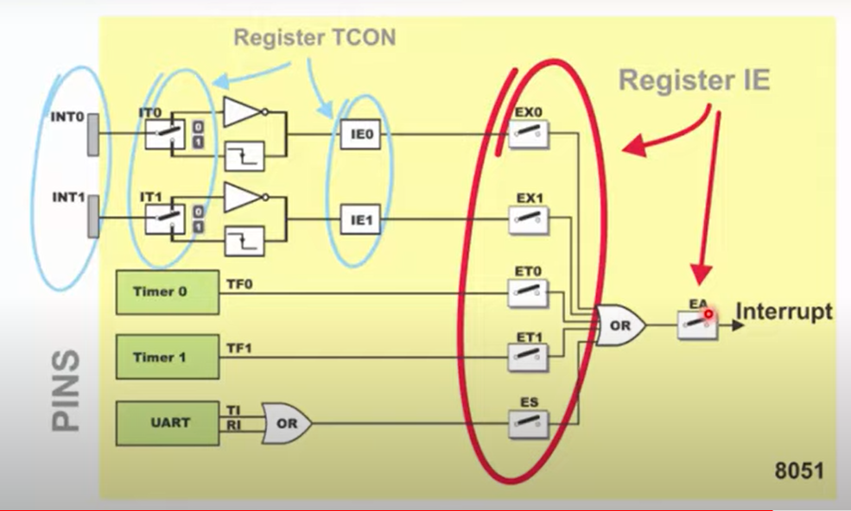
2.6 STEP IN ENABLE AN INTERRUPT

Slide 12
2.7 Interrupt Priorities
RESET
Interrupt INT0
interrupt timer 0
UART
interrupt timer1
Interrupt INT1

Slide 13
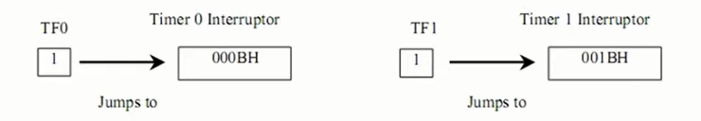
3. PROGRAMING INTERRUPT
3.1. INTERRUPT TIMER 0

Slide 14

Communication

Slide 15
Introduction
Serial communication means to transfer data bit by bit serially at a time,
whereas in parallel communication, the number of bits that can be transferred
at a time depends upon the number of data lines available for communication.

Slide 16
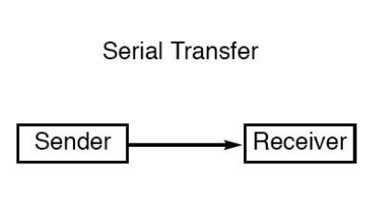
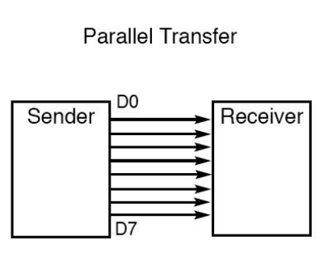
Explain Serial – Parallel Transfer
 | Serial Transmission | Parallel Transmission
1 | In Serial transmission, data(bit) flows in bi-direction. | In Parallel transmission, data flows in multiple lines.
2 | Serial transmission is cost-efficient. | Parallel transmission is not cost-efficient.
3 | In Serial transmission, one bit transferred at one clock pulse. | In Parallel transmission, eight bits transferred at one clock pulse.
4 | Serial transmission is slow in comparison of Parallel transmission. | Parallel Transmission is fast in comparison of Serial transmission.
5 | Generally, Serial transmission is used for long-distance. | Generally, Parallel transmission is used for short distance.
6 | The circuit used in Serial transmission is simple. | The circuit used in Parallel transmission is relatively complex.

Slide 17
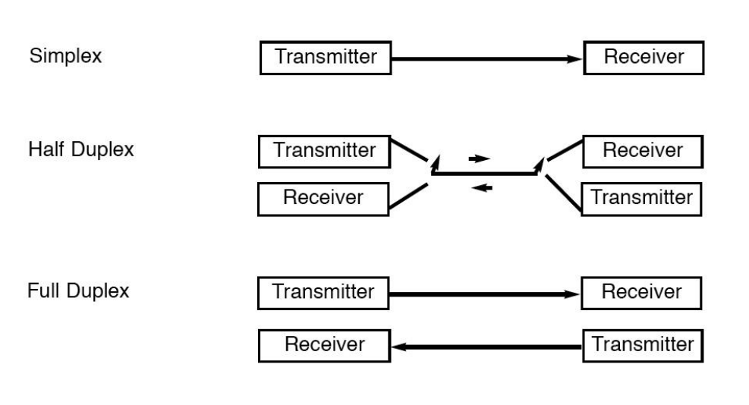
Explain Types of Data Transmission.

Slide 18

Methods of serial communication
Synchronous Communication: Transfer of bulk data in the framed structure at a time
Asynchronous Communication: Transfer of a byte data in the framed structure at a time

Slide 19
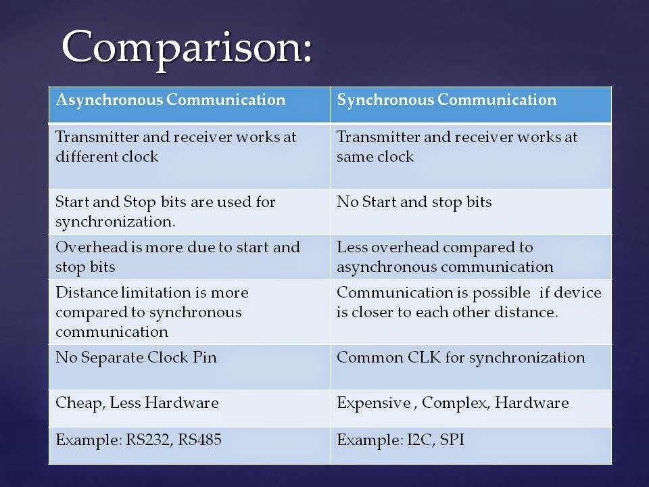

Slide 20
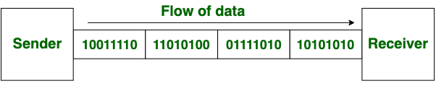
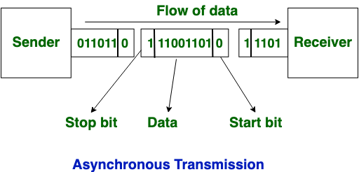

Serial communication with UART

Slide 21
Asynchronous communication
The serial port is full-duplex (it can transmit and receive simultaneously).
8051 has built-in UART with:
PORT3.0 is RXD (serial data receive pin)
PORT3.1 is TXD (serial data transmit pin)

Slide 22
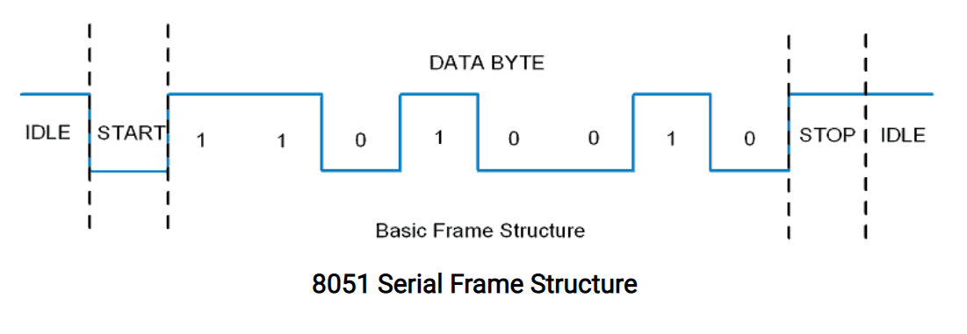
Asynchronous communication
Frame structure in Asynchronous communication:
START bit: It is a bit with which serial communication starts and it is always low.
Data bits packet: Data bits can be 5 to 9 bits packet. Normally we use 8 data bit packet, which is always sent after the START bit.
STOP bit: This is one or two bits. It is sent after the data bits packet to indicate the end of the frame. The stop bit is always logic high.

Slide 23
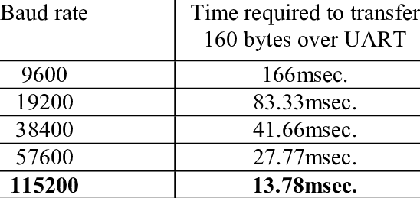
Data transmission rate
The data transmission rate is measured in bits per second (bps). In the binary system, it is also called a baud rate. Standard baud rates supported are 1200, 2400, 4800, 19200, 38400, 57600, and 115200. Normally most of the time 9600 bps is used when speed is not a big issue.

Slide 24
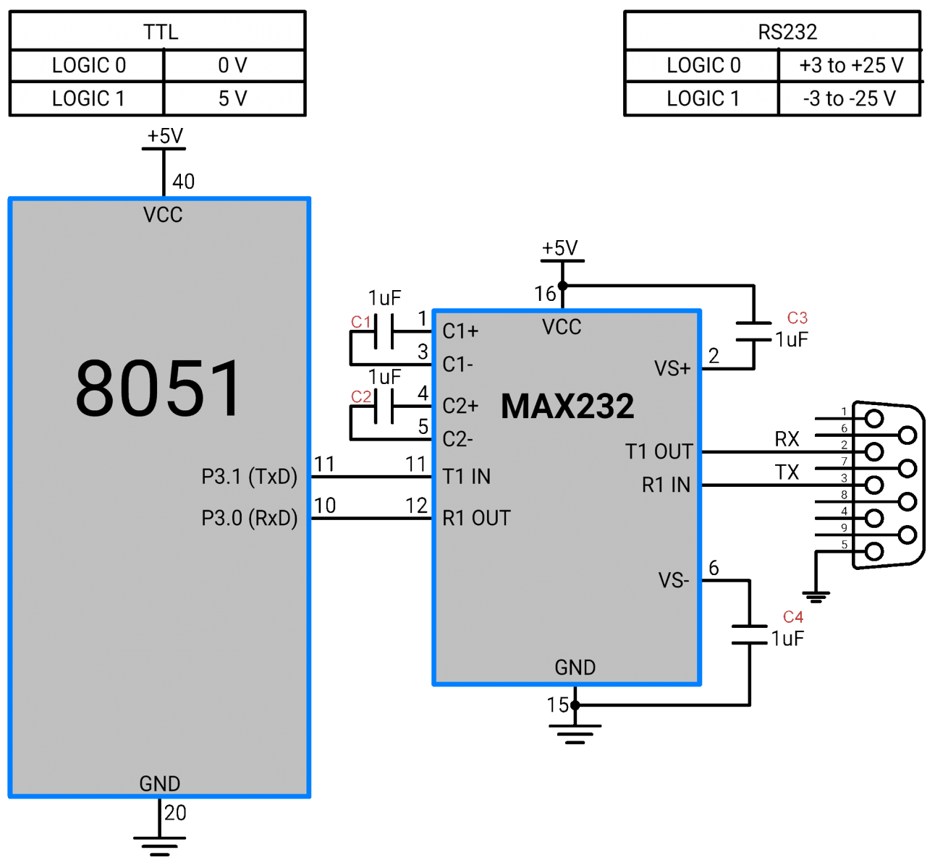
Interface standard
8051 serial communication has TTL voltage level which are 0 v for logic 0 and 5 v for logic 1.
In computers and most of the old devices for serial communication, RS232 protocol with DB9 connector is used. RS232 serial communication has different voltage levels than 8051 serial communication. +3V to +25V for logic zero and -3V to -25V for logic 1 => we need to use a voltage level converter like MAX232 IC.

Slide 25
Conclusion
1. 8051 is a chip manufactured by intel.
2. Basic Knowledge about interruption and comunication.
3. Comunication using Asynchronous transmition method.
4. 8051 use Full-duplex communication method.
Thank you for your attention !

