Slide 1

AstroSage
Sales Analysis
BY Vishal Ratnakar

Slide 2
ABOUT ASTROSAGE
AstroSage is a trusted platform for both astrological guidance and advanced research.
It addresses a wide range of needs—from daily life concerns to specialized astrological queries.
The goal is to support individuals and promote well-being through the power of astrology.
Founded in 2000 by Pt. Punit Pandey, AstroSage brings astrological wisdom to the modern world.
Pt. Pandey, an expert in KP, Lal Kitab, and Nadi astrology, leads a team of skilled astrologers from various traditions.

Slide 3
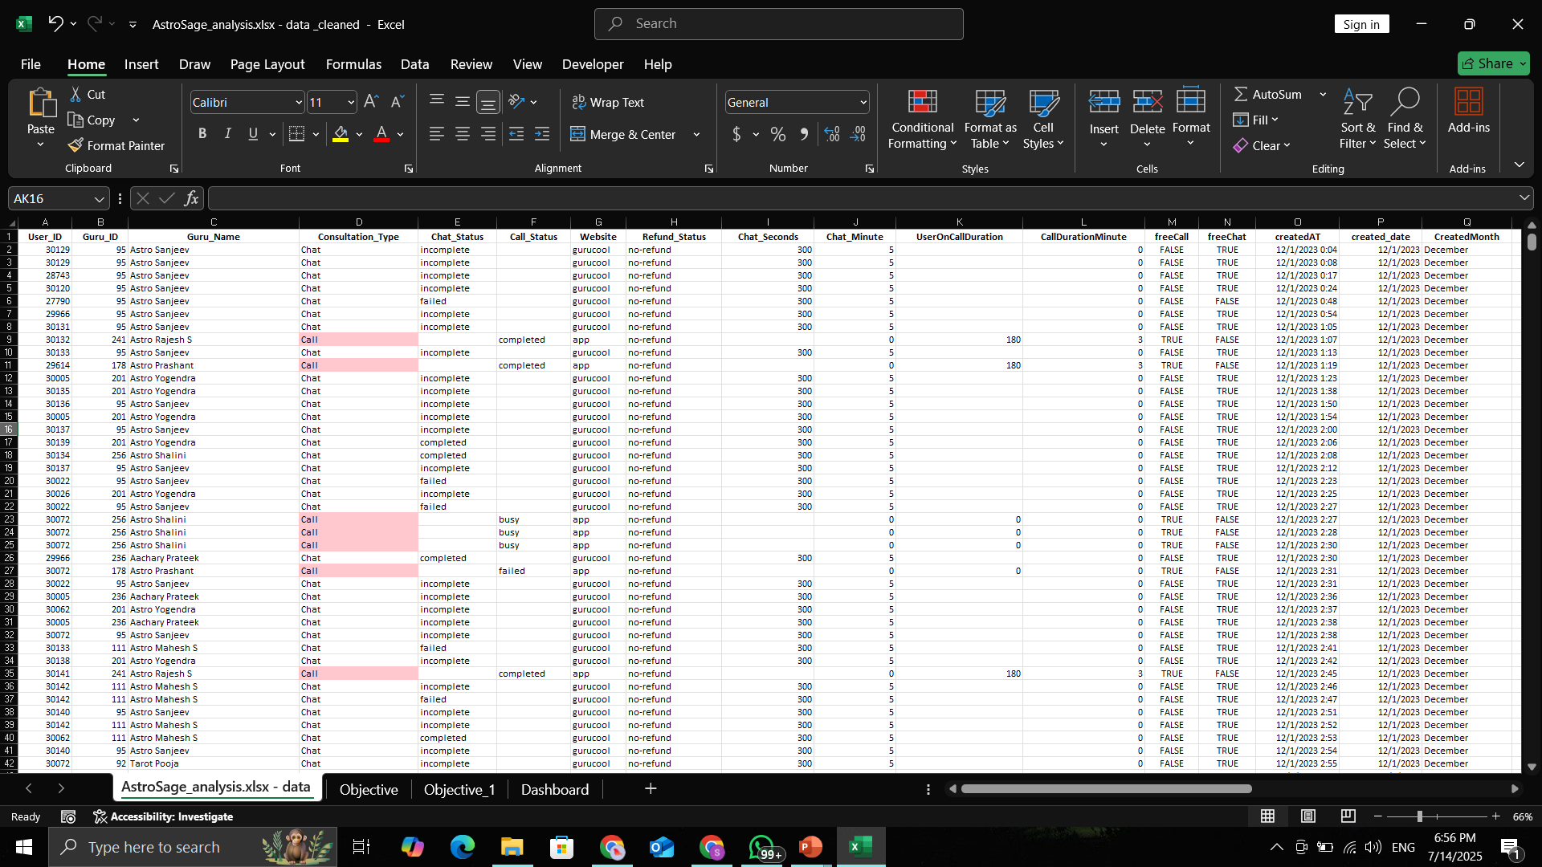
PROBLEM STATEMENT
AstroSage has received a 1 crore investment and aims to optimize its call center operations. The goal is to determine how to allocate this investment to maximize operational efficiency, customer satisfaction, and profitability.
The analysis will consider historical call data, performance metrics, and market trends to make informed decisions.

Slide 4
DATA OVERVIEW
_id: Unique identifier for each record.
chatStatus: Status of the chat (e.g., incomplete, failed, completed).
guru: Unique identifier for the guru.
guruName: Name of the guru.
gid: Guru ID.
uid: User ID.
consultation Type: Type of consultation (e.g., Chat, Call).
website: Source of the consultation (e.g., gurucool).
chat Seconds: Duration of the chat in seconds.
CreatedAT: Original creation date and time.
callChannel: Channel used for the call.
calIvrType: IVR type used during the call.
callStatus: Status of the call.
CallSid: Unique identifier for the call session.
amount: Amount charged for the session.
astrologerCallStatus: Status of the astrologer during the call.
astrologerOnCallDuration: Duration of the astrologer's call.
astrologersEarnings: Earnings of the astrologer from the session.
netAmount: Net amount after deductions.
region: Region of the user.
userCallStatus: Status of the user's call.
userOnCallDuration: Duration of the user's call.
rating: Rating assigned based on the session's status.

Slide 5
METHODOLOGY
Data Cleaning & Data Enrichment
  Utilized functions and Remove Duplicates to ensure data consistency and accuracy across the dataset. By using IF/ELSE logic effectively cross-referencing external data sources for deeper insights.
Descriptive Analysis
  Leveraged Pivot Tables to summarize key performance metrics and identify correlations and patterns across product categories and KPIs.
Customer Segmentation
  Applied SORT and FILTER functions to categorize customers based on consultant type and interaction duration, enabling targeted strategy development.
Data Visualization
  Developed dynamic dashboards and interactive charts, allowing stakeholders to explore data visually and derive actionable insights efficiently.

Slide 6
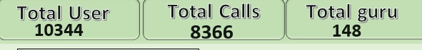
=COUNTIF() and =COUNTA() for counting calls and unique agents
=AVERAGE(), =COUNTA(DISTINCT()) (or Power Pivot)
Calculations for per-day and per-agent stats
OPERATIONAL EFFICIENCY
Total Calls Analyzed: 8,366
Filtered by Consultation_Type = "Call“
Number of Agents (Gurus): 148
(Unique astrologers who handled calls)
Number of Operational Days: 34
(Based on unique created dates)
Average Calls per Day = 8366 / 34 ≈ 249.73
Average Calls per Agent per Day = 249.73 / 148 ≈ 1.68
Insight: Each agent handled fewer than 2 calls per day on average, indicating low utilization.
Suggests scope for load balancing, optimized shift planning, or fewer idle resources.
Suggestions:
  Optimize staff usage and load balancing
  Consider reducing idle resources

Slide 7
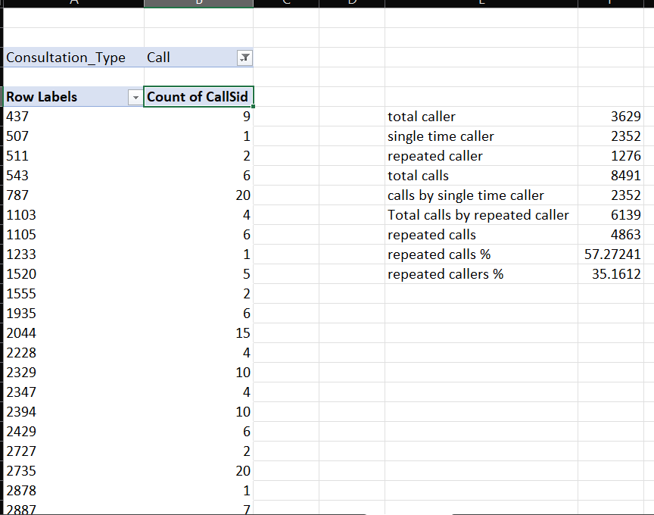
=COUNTIF() and =COUNTA() for counting calls and unique agents
=AVERAGE(), =COUNTA(DISTINCT()) (or Power Pivot)
Calculations for per-day and per-agent stats
REPEAT CALLER BEHAVIOR
Total Unique Callers: 3,629
Total Repeat Callers: 1,276
(Users who made more than one call)
Repeat Callers % of Total Users = (1276 / 3629) * 100 = 35.16%
Total Calls by Repeat Users: 6,139
Exact Repeated Call Except first call = 6139 – 1276 = 4863
Contribution to Total Calls = (4863 / 8491) * 100 = 57.27%
Insight:
A small segment of loyal users (35%) is generating the majority of business (57% of calls).
  This highlights the importance of retention strategies, loyalty programs, and quality service for repeat customers.
Use Case:
Helps target marketing, support, and upselling efforts towards loyal users.

Slide 8
=COUNTIF() and =COUNTA() for counting calls and unique agents
=AVERAGE(), =COUNTA(DISTINCT()) (or Power Pivot)
Calculations for per-day and per-agent stats
REVENUE GENERATION
Total revenue from Call services: ₹1,68,442.04
Total revenue from Chat services: ₹45,494.68
Combined revenue (Call + Chat): ₹2,13,936.72
Operational cost (Astrologer payout for December 2023): ₹99,146.57
Revenue distribution:
  Calls contribute 78.71% of total revenue
  Chats contribute 21.29% of total revenue
Key Insight:
Call services generate the majority of income.
To improve profitability, optimization should focus on improving call handling, reducing drop-offs, and managing astrologer payouts efficiently.

Slide 9
CALL VOLUME
Total Duration Analyzed: 34 Days (Dec 2023 – Jan 2024)
Average Daily Call Volume: ~249 calls/day
Peak Day: 10 Dec 2023 – 430 Calls
Lowest Day: 03 Jan 2024 – 107 Calls
Highest Monthly Call Volume – December 2023 – 8,073 calls
Lowest Monthly Call Volume – January 2024 – 418 calls
Use Case: Understanding high-traffic periods helps in staffing, scheduling, and resource planning.
Suggestions
  Align resources and agent shifts with peak periods
  Launch promotions in high-engagement windows
  Review low days to identify operational or engagement gaps
  Use averages & spikes for future workload forecasting

Slide 10
REVENUE BREAKDOWN
Key Pointers:
Calls contribute ~ 79% of total revenue; Chats only ~21%
Focus on improving call handling, reducing drop-offs
Revamp chat services to increase monetization (UI / UX + AI chatbots)
Recommendations:
Since Calls contribute ~ 79% of total revenue, prioritize:
  Reducing dropped/missed calls
  Improving agent availability
Evaluate why Chats underperform (UI, response time, platform issues).
Consider bundling services to push chat sales (e.g., "Chat + Call" packages).

Slide 11
AVERAGE RATING
Key Pointers:
Average ratings dropped from Dec (2.9) to Jan (2.7)
Top-rated astrologers: Astro Pujaa Rai, Tarot Mystical
Provide targeted training to low-rated astrologers
Monitor ratings over time to ensure quality improvement
Recommendations:
Identify low-rated astrologers and provide targeted training.
Track rating changes post-training for impact analysis.
Note: Longer calls ≠ better ratings. Focus on call quality, not duration.

Slide 12
CALL STATUS
Key Pointers:
Only ~ 40.77% of booked calls are completed
High drop – off rate signals need for UI fixes and reminder systems
Assign backup astrologers to reduce missed call loss
Recommendations:
Only ~ 41% of booked calls are completed
  → major efficiency gap.
Improve UI / UX of call booking flow to reduce drop – offs.
Use IVR reminders and backup astrologers for missed sessions.

Slide 13
CONSULTATION TYPE
Key Pointers:
Calls generate more revenue ,
  Chats have higher volume
Upgrade Gurucool chat UI to improve satisfaction and retention
Introduce AI bots to handle basic queries instantly

Slide 14
HOURLY CALL VOLUME
Key Pointers:
Peak traffic hours must guide staffing decisions
Balance load to avoid burnout and long wait times
Recommendations:
Use this to optimize agent scheduling.
Introduce freelancers or part – timers during peak hours.
Cross-reference with satisfaction to avoid quality dips during rush periods.

Slide 15
MONTHLY CALL VOLUME
Key Pointers:
Call volume peaked in December 2023
  (8,073 calls)
Sharp drop in January 2024 (418 calls) requires investigation
Use trends to guide promotions and hiring cycles

Slide 16
WEBSITE
Key Pointers:
Most traffic comes from Gurucool, which has low satisfaction ratings
Redesign Gurucool's UX to boost chat satisfaction
Track performance of changes through engagement & rating metrics
Recommendations:
If Gurucool dominates traffic but has low ratings, it’s a critical UI/UX upgrade target.
Improve loading speed, error handling, and user flow on top platforms.
A / B test UI changes to measure impact on conversion and satisfaction.

Slide 17
=COUNTIF() and =COUNTA() for counting calls and unique agents
=AVERAGE(), =COUNTA(DISTINCT()) (or Power Pivot)
Calculations for per-day and per-agent stats
CUSTOMER SATISFACTION
Average customer rating (December 2023): 2.9
Average customer rating (January 2024): 2.7
Satisfaction ratings were mostly concentrated between 2 and 4 stars
Correlation between call duration and customer rating is weak
  Longer calls do not guarantee better ratings
Top-rated astrologers (based on average rating):
    Astro Pujaa Rai
    Tarot Mystical
Lowest-rated astrologer:
    Tarot Rittika
Insight:
  Performance-based differentiation shows need for targeted training and feedback sessions.
  Ratings should be monitored continuously to maintain service quality.

Slide 18
=COUNTIF() and =COUNTA() for counting calls and unique agents
=AVERAGE(), =COUNTA(DISTINCT()) (or Power Pivot)
Calculations for per-day and per-agent stats
INVESTMENT STRATEGY
1. Technology Upgrade – ₹40 Lakhs (40%)
  69.62% of users use chat services, mainly on Gurucool, which has a low average rating of 2.72
  Recommendations:
    Upgrade the chat platform (UI/UX redesign)
    Introduce AI chatbots for instant resolution
    Improve backend performance to reduce age / crashes
  Expected Outcome:
    Improved chat satisfaction, higher retention, and reduced operational delays
2. Agent Training Program – ₹25 Lakhs (25%)
  Only 40.77% of booked calls are completed, despite calls contributing 78.69% of revenue
  Recommendations:
    Monthly training on soft skills, upselling, and technical handling
    Use performance data to coach underperforming agents
  Expected Outcome:
    Increase in successful calls, better customer experience, and improved satisfaction
3. Support Infrastructure, Data Security & Customer Care Tools – ₹35 Lakhs (35%)
  Recommendations:
    Hire freelance/part-time agents to manage peak hours and reduce wait times
    Invest in infrastructure and data protection (e.g., cloud backups, system stability)
    Set up automated feedback tools (post-call surveys, follow-ups)
  Expected Outcome:
    Faster response during peak hours, improved customer support, and stronger data security

Slide 19
=COUNTIF() and =COUNTA() for counting calls and unique agents
=AVERAGE(), =COUNTA(DISTINCT()) (or Power Pivot)
Calculations for per-day and per-agent stats
CONCLUSION
Summary of Key Insights:
  Call services generate the majority of revenue (78.69%) but only 40.77% of booked calls are completed — indicating a strong need for operational improvement.
  Repeat callers make up just 35% of users but contribute over 72% of total calls — a vital segment for customer retention strategies.
  Chat services have low satisfaction (average rating 2.72), especially on Gurucool — showing urgent need for platform upgrade.
  Agent productivity is low, averaging only 1.68 calls per agent per day — suggesting underutilization and shift optimization potential.
Strategic Recommendations:
  Prioritize investment in technology upgrades, agent training, and support infrastructure, as outlined in the ₹1 crore allocation strategy.
  Use a real-time dashboard to monitor daily operations, agent performance, and satisfaction metrics.
  Launch targeted loyalty programs for repeat users to increase retention and average revenue per user.
  Address service drop-offs by improving scheduling, system stability, and customer feedback loops.

Slide 20
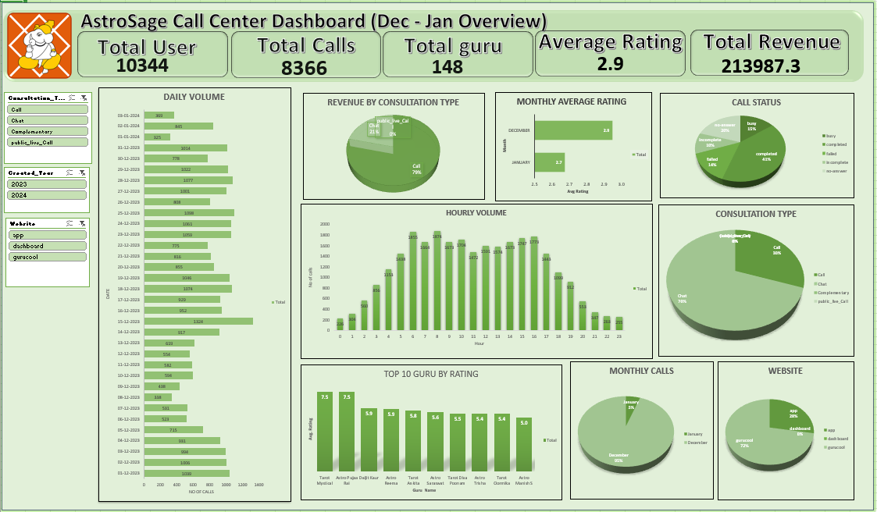
DASHBOARD

Slide 21
Thank you

