Slide 1
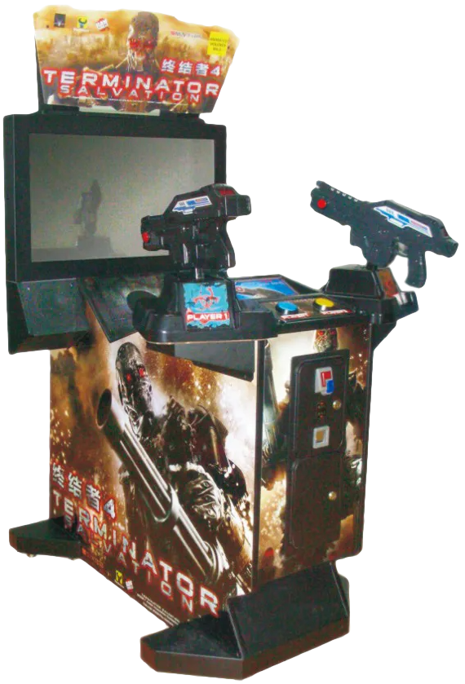
IOT
Top-down shooter

Slide 2
Table of Contents
project idea and game-loop
goals + milestones
system architecture draft
work packages

Slide 3
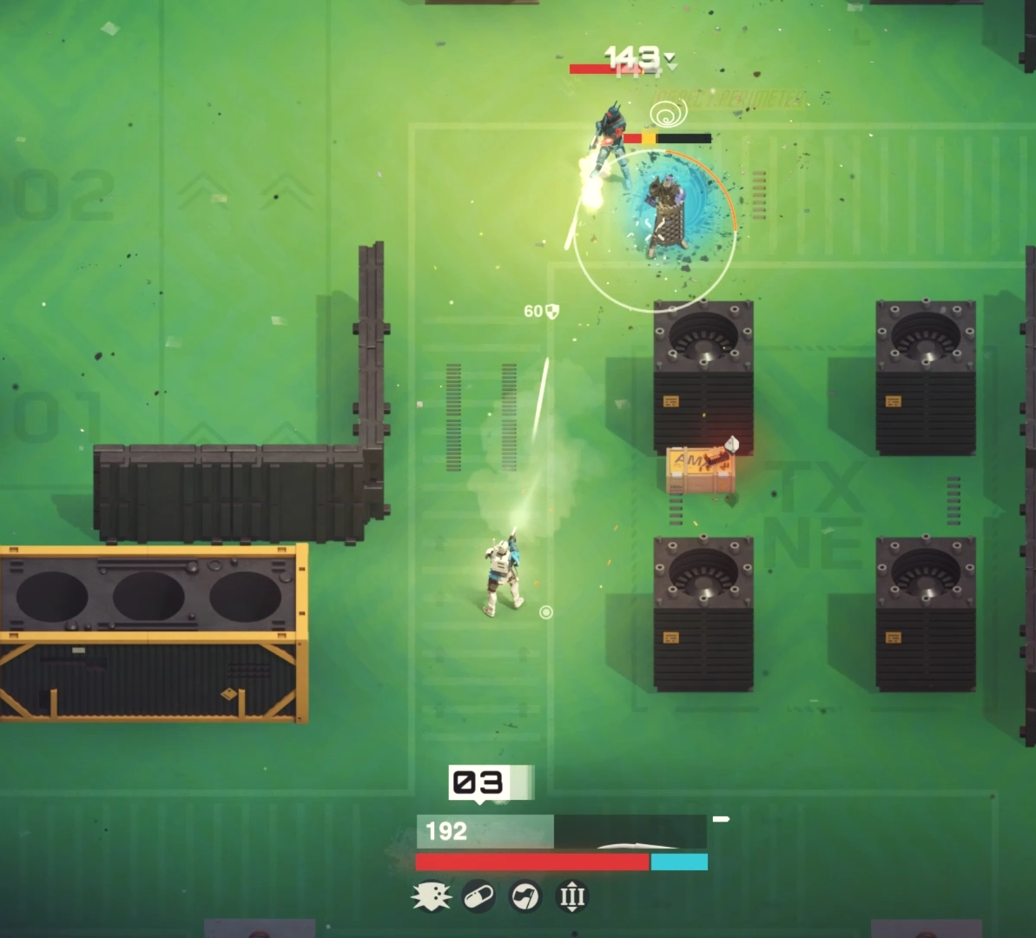
Project Idea and Game-Loop
Top-Down shooter
physical weapon
defend waves of enemies
game from scratch

Slide 4
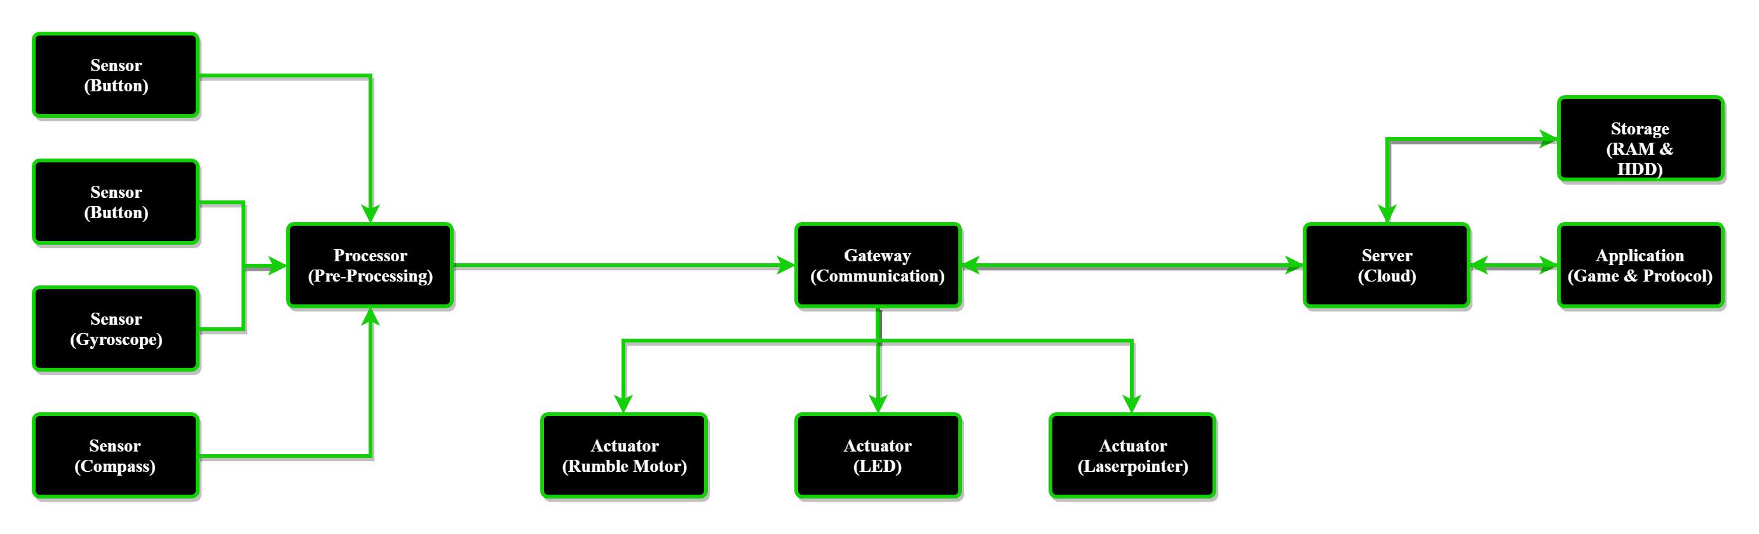
System Architecture

Slide 5
Goals and Milestones
Goals:
Develop full game in Python3 (PyGame)
track movement of weapon and send to server with UDP
server sends Data to weapon using MQTT
→ Full game that can be controlled using a physical weapon (arcade style)
Milestones:
have a working game
make sure that the movement is properly tracked
preprocess to data before sending to server
build the actual weapon
ensure the game is controlled with the weapon

Slide 6
Work Packages
Game Development (Rene)
engine
textures
level design
Weapon Design (Fabian + Rene)
3D Model
Build Process
Server Setup (Fabian)
Docker Container
connection test
Documentation (Fabian + Rene for individual parts)
test runs
documentation
preparation presentation

Slide 7
Thank you!

