Slide 1
E-Commerce Sales Forecasting
Using Machine Learning
Predicting monthly revenue with time-series regression
Samarth Singh
Aspiring Data Analyst
E-Commerce Sales Forecasting Using Machine Learning

Slide 2
The Problem
Retail businesses need a read on next month's revenue to plan inventory, staffing, and budgets. Without it, decisions become reactive instead of proactive.
Before (Without forecasting)
After (With forecasting)
Reactive decisions based on guesswork
Inventory mismatches — overstock or stockouts
Budgets set without a data-backed baseline
Proactive planning using historical patterns
Inventory aligned to seasonal demand
Forecasts feed directly into budget planning
E-Commerce Sales Forecasting Using Machine Learning

Slide 3
The Dataset
Superstore e-commerce transaction records, 2014–2017
9,994
21 → 11
4 years
0
Transactions
Columns after cleaning
2014 – 2017 span
Duplicate & Null records
Customer Segments
Consumer — 5,191 orders (52%)
Corporate — 3,020 orders (30%)
Home Office — 1,783 orders (18%)
Dropped non-predictive identifiers: Row ID, Customer ID, Postal Code, Ship Date, Ship Mode, and others
E-Commerce Sales Forecasting Using Machine Learning

Slide 4
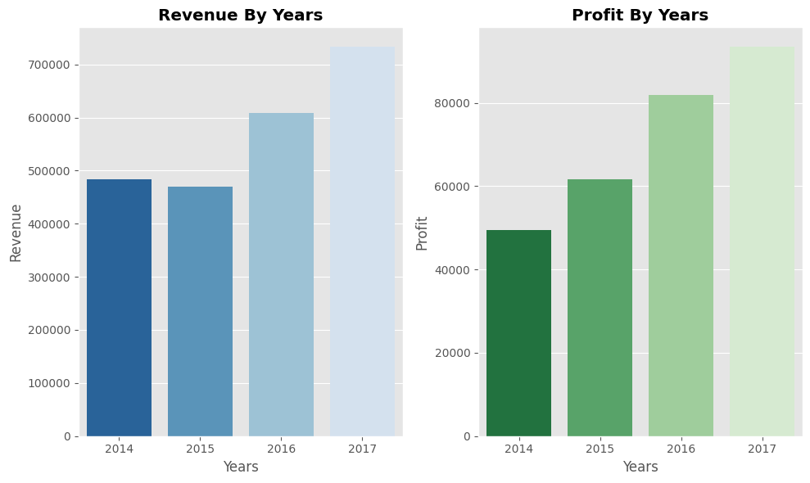
Revenue is growing year over year
Revenue and profit both climbed every year from 2014 to 2017, with the steepest jump between 2016 and 2017 — the underlying growth trend the model needs to pick up on.
E-Commerce Sales Forecasting Using Machine Learning

Slide 5
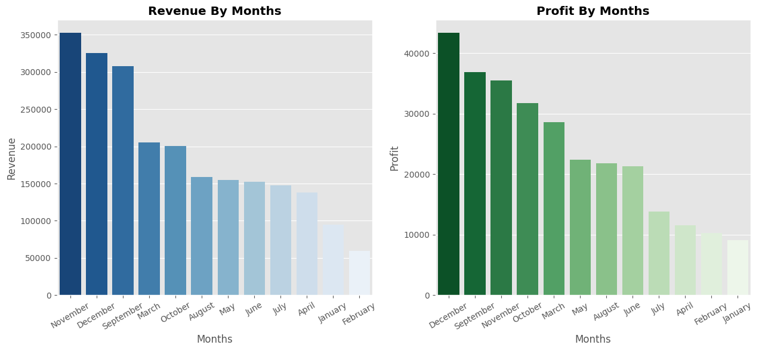
Sales peak sharply at year-end
November, December, and September consistently outperform every other month — a clear, repeatable seasonal pattern the forecast needs to capture.
E-Commerce Sales Forecasting Using Machine Learning

Slide 6
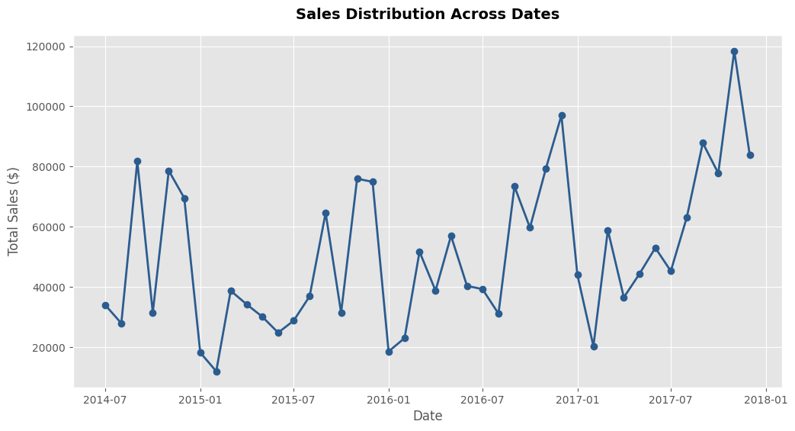
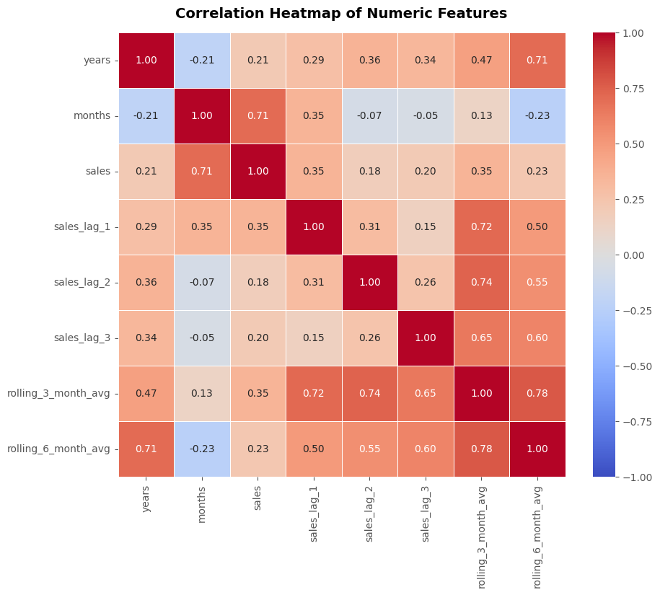
Giving the model memory
Aggregated daily transactions into 48 monthly totals
Added lag features: sales from 1, 2, 3 months ago
Added 3-month and 6-month rolling averages
Dropped early NaN rows — 42 usable months remain
Rolling averages and lag features correlate strongly with sales
:- exactly what we want from engineered features.
E-Commerce Sales Forecasting Using Machine Learning

Slide 7
Modeling approach
Jul 2014
Mar 2017
Dec 2017
Split chronologically, not randomly — order matters in time series
Scaled lag and rolling features with StandardScaler
One-hot encoded month to let the model learn seasonality
Trained three models to compare: Linear, Ridge, Lasso
Train · 33 months
Test · 9 months
42 usable months, split 80 / 20 along the timeline
E-Commerce Sales Forecasting Using Machine Learning

Slide 8
Linear-Regression wins
Model | MAE | RMSE | MAPE | R²
Linear Regression | 12,054.68 | 14,026.52 | 18.62% | 0.684
Ridge | 15,820.27 | 20,300.11 | 21.28% | 0.338
Lasso | 12,054.03 | 14,029.06 | 18.62% | 0.684
Linear and Lasso perform almost identically and best overall. Ridge underperformed — likely due to inconsistent feature scaling, a known and fixable limitation.
E-Commerce Sales Forecasting Using Machine Learning

Slide 9
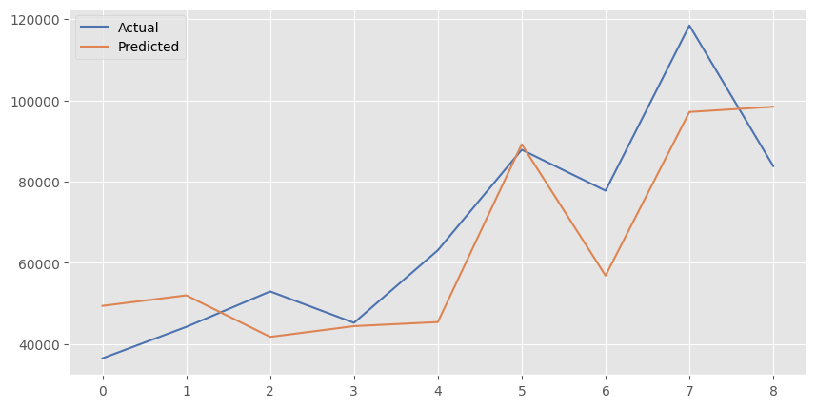
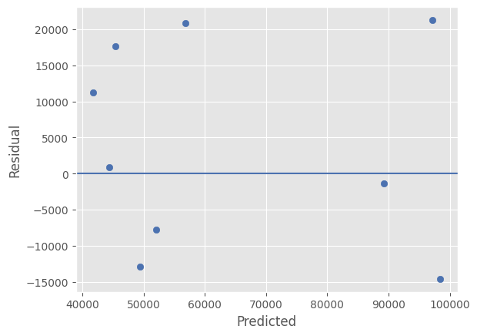
How well does it actually predict?
Predicted values track the overall trend closely across the test months.
Residuals center near zero with no strong pattern, though a few peak months see larger error.
E-Commerce Sales Forecasting Using Machine Learning
Notes:
If asked about Ridge's weak R²: it's likely because the 'years' feature wasn't scaled while lag/rolling features were — Ridge penalizes coefficient magnitude, so inconsistent scaling distorts it. Linear and Lasso aren't affected the same way. If asked about test set size: only 9 months in the test set, so results carry meaningful variance — frame as a known limitation, not a flaw.

Slide 10
What everybody should know
Long-term upward sales trends across the 4 year period.
Strong, repeatable monthly seasonality – certain months(Sept, Nov, Dec).
Model gives a reasonable revenue estimate for budgeting and inventory planning.
Recommendation: Increase inventory ahead of historically strong months
Recommendation: Use monthly forecasting as a budgeting input, not a hard guarantee
E-Commerce Sales Forecasting Using Machine Learning

Slide 11




What this means for the business
Steady growth
Strong seasonality
Stock smarter
Use as a planning input
Revenue grew every year from 2014 to 2017.
Sept, Nov, and Dec consistently outperform.
Increase inventory ahead of historically strong months.
Treat forecasts as budgeting guidance, not a guarantee.
E-Commerce Sales Forecasting Using Machine Learning

Slide 12
Limitations & next steps
Limitations
Next steps
Test set is only 9 months — results carry real variance
Model underestimates extreme monthly spikes
Add promotions, holidays, and marketing spend as features
Compare against SARIMA or Prophet for seasonality
Thank you
GitHub: github.com/OfficialSamarthsingh
LinkedIn: linkedin.com/in/samarth-singh-062371215
Portfolio: samarthsinghportfolio.netlify.app
E-Commerce Sales Forecasting Using Machine Learning

