Slide 1
Laptop Price Prediction
Using Machine Learning
Predicting laptop prices from real-world multi-source data using regression
Samarth Singh
Aspiring Data Analyst
Notes:
Introduce yourself and the project. Mention this is Project 08 in your portfolio — a regression project focused on data engineering and end-to-end ML pipeline building.

Slide 2

The Problem
Laptop prices vary dramatically across brands, specs, and regions — yet buyers and businesses often lack a systematic way to estimate fair value.
Before
After
Prices compared manually — time-consuming
No benchmark for fair market value
Buyers overpay for equivalent specs
Instant price estimate from specs alone
Data-driven benchmark for any configuration
Transparent, explainable predictions
Laptop Price Prediction Using Machine Learning
Notes:
Explain the practical gap this project addresses. Laptop pricing is opaque — this model gives anyone a data-backed estimate from specs alone.

Slide 3
Data Collection
Four real-world Kaggle datasets merged after rejecting a 1.2M-row synthetic dataset detected during validation.
Source
Key Features
Rows
Currency
Status
ds01 — laptop_price01
Brand, Processor, RAM, Storage, GPU, OS
885
INR
✓ Used
ds02 — laptop_price02
Brand, Processor, RAM, Storage, GPU, OS, Price
886
INR
✓ Used
ds03 — laptop_price03
Company, CPU, Memory, GPU, OpSys, Weight
1,270
EUR→INR
✓ Used
ds04 — laptop_price04
Brand, Processor, RAM, Storage, GPU, OS
1,013
INR
✓ Used
Laptop Price Prediction Using Machine Learning
Notes:
Walk through each data source briefly. Emphasise the synthetic dataset rejection — this shows real data engineering judgment, not just running code.

Slide 4
Data Cleaning Pipeline
Each dataset cleaned independently before merging — ETL approach: Extract → Transform → Load.
Per-Source Cleaning
Data Quality Fixes
Schema Merge
Fixed encoding artifacts (Unicode â, superscript ᵉ)
Extracted numeric RAM/Storage from strings ('8GB DDR4' → 8)
Standardized OS into 8 clean categories
Dropped 23 corrupt rows (data-shift in storage/OS columns)
Corrected DDR6 → DDR5 (non-existent standard)
Fixed 1000 GB → 1024 GB TB notation
Aligned 4 different schemas to 9 common columns
EUR → INR currency conversion (ds03)
Removed 135 exact duplicates post-concat
Laptop Price Prediction Using Machine Learning
Notes:
The key message here is that cleaning happened per-source, not on the merged dataset. This is the industry-standard ETL approach and shows data engineering maturity.

Slide 5
Master Dataset — Final State
3,918
10
4
135
0
Total Rows
Columns
Sources Merged
Duplicates Removed
Null Values
Final Schema
Price Range
brand
Categorical
Laptop manufacturer
processor
Text → extracted
₹8,000
Raw CPU string
gpu
Text → extracted
Raw GPU string
ram_gb
Numeric (int)
Minimum
RAM in GB
ram_type
Categorical
₹6,64,425
DDR4 / DDR5 / LPDDR5 / Unknown
storage_gb
Numeric (int)
Storage in GB
storage_type
Categorical
Maximum
SSD / HDD / eMMC
os
Categorical
Operating system
Median: ₹74,390
price
Numeric (INR)
Target variable
source
Metadata
Dropped before modeling
Laptop Price Prediction Using Machine Learning
Notes:
The 3,918 rows represents a clean, real-world dataset. Emphasise that 0 nulls and 0 duplicates was the result of careful per-source cleaning, not luck.

Slide 6
EDA — Key Findings
Price is Right-Skewed
RAM is the Strongest Predictor
01
02
Skewness = 2.08. Most laptops cluster in ₹30K–₹1.5L, with a long premium tail. Log-transform required before modeling.
Correlation r = 0.56 with price. Every RAM tier step (8→16→32 GB) shows a consistent, monotonic price jump.
Brand Drives Significant Premium
Storage Type Matters More Than Size
03
04
Razer, Apple, and Microsoft command 2–4× the median price of budget brands like AXL or Primebook.
SSD vs HDD creates a larger price gap than doubling storage capacity — type is a stronger signal than quantity.
OS and Brand Are Correlated
Outliers Are Real Premium Products
05
06
macOS = Apple exclusively. Including both causes multicollinearity — addressed in feature engineering.
IQR outliers are Razer/Apple workstations, not data errors. Kept all; log-transform handles their leverage.
Laptop Price Prediction Using Machine Learning
Notes:
Pick 2–3 findings to elaborate on verbally. The skewness and brand premium findings tend to resonate most with interviewers.

Slide 7
Feature Engineering
Transformed 10 raw columns into 44 model-ready features.
cpu_brand
Intel / AMD / Apple / Qualcomm / MediaTek
Encoding Strategy
from: processor string
brand
Target encoding
cpu_tier
i3 / i5 / i7 / i9 / Ryzen 3–9 / Apple Silicon
os
One-hot (8 cats)
from: processor string
storage_type
One-hot (3 cats)
gpu_type
Dedicated (NVIDIA/AMD) vs Integrated
ram_type
One-hot (6 cats)
from: gpu string
gpu_type
One-hot (2 cats)
cpu_brand
One-hot (6 cats)
brand_encoded
Median log-price per brand → 1 dense numeric column
cpu_tier
One-hot (11 cats)
from: brand (target encoding)
44 total features
after encoding
price_log
log1p(price) — reduces skewness from 2.08 → 0.04
from: price
Laptop Price Prediction Using Machine Learning
Notes:
The key decision to highlight is target encoding for brand — it avoids 36 sparse dummy columns and directly encodes the brand's price positioning as a single dense numeric.

Slide 8
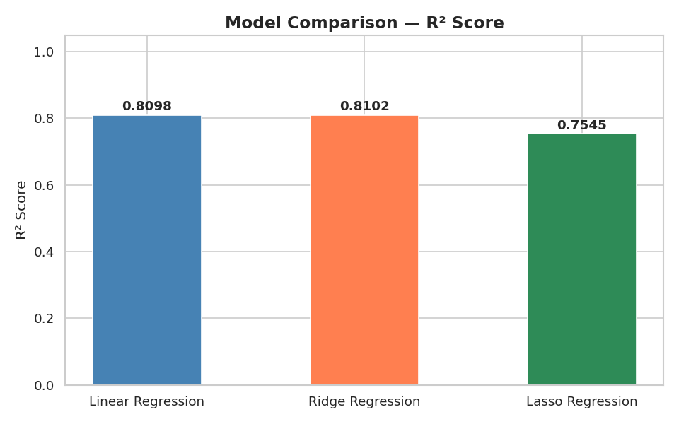
Model Results
Model
R²
MAE (INR)
Linear
0.8098
₹23,557
Ridge ★
0.8102
₹23,560
Lasso
0.7545
₹27,069
Ridge is the best model
R² = 0.8102 — explains 81% of
price variance on test set.
MAE ≈ ₹23,500 in practice
Average prediction error on a
₹74K median price laptop.
Lasso over-eliminated features
L1 penalty removed columns
still contributing real signal.
Laptop Price Prediction Using Machine Learning
Notes:
The R² difference between Linear and Ridge is <0.001 — the data is not severely overfitting. Ridge wins as the production model because it is more robust on unseen data even when the training advantage is marginal.

Slide 9
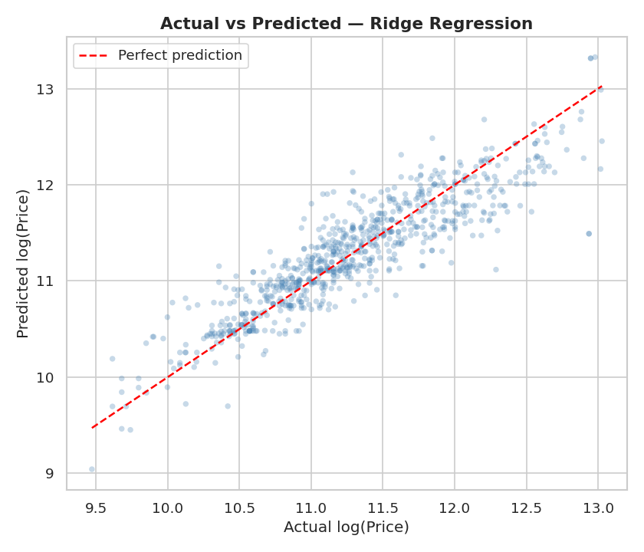
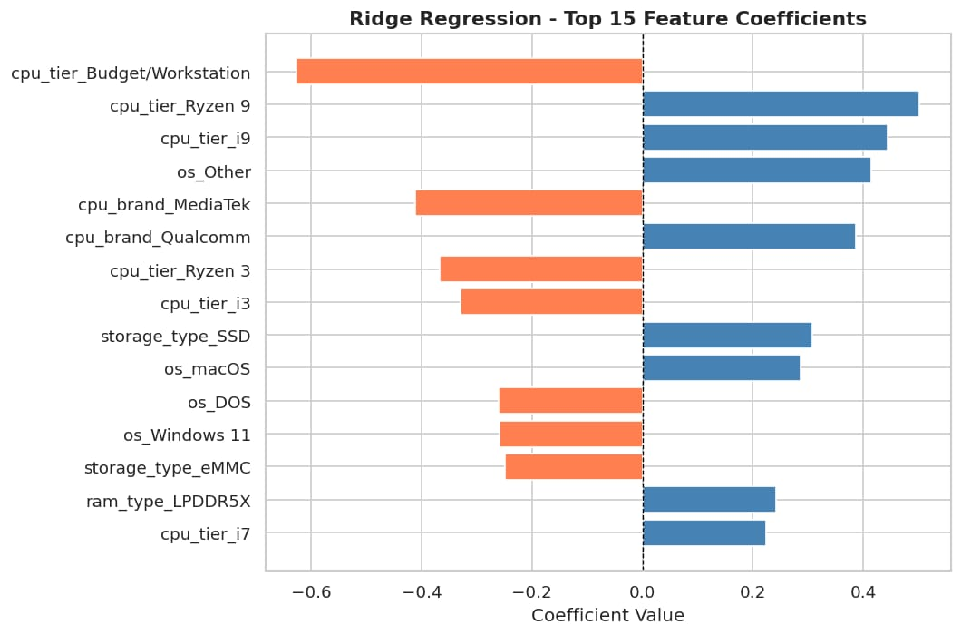
Ridge Regression — Deep Dive
Points hug the diagonal → strong predictive accuracy across all price tiers
cpu_tier_Ryzen 9 & i9 = strongest positive price drivers
cpu_tier_Budget/Workstation = largest negative coefficient (price penalty)
SSD storage type adds consistent positive premium over HDD
Laptop Price Prediction Using Machine Learning
Notes:
The actual vs predicted scatter shows the model performs well across the full price range. Mention that the few outlier points at the extremes are niche high-end configurations with limited training examples.

Slide 10
Key Takeaways
Data Engineering is the Real Work
Feature Extraction > Raw Encoding
5 datasets evaluated, 4 merged, 1 rejected after systematic validation. ETL pipeline built per-source before combining.
Reduced 400+ unique processor/GPU strings to 3 clean columns. Target encoding for brand avoided 36 sparse dummies.
Ridge Regression Wins — R² = 0.81
Log-Transform is Non-Negotiable
81% of price variance explained on a real-world merged dataset — without display size, battery, or weight data.
Price skewness of 2.08 would have severely biased linear models. log1p reduced skewness to near-zero.
Notes:
Wrap up by connecting the takeaways back to the problem statement. The model is production-ready as a pricing benchmark tool for buyers or e-commerce platforms.

Slide 11



Thank You
Laptop Price Prediction Using ML
github.com/OfficialSamarthsingh
linkedin.com/in/samarth-singh-official
samarthsinghportfolio.netlify.app
Open to Data Analyst internship and entry-level opportunities
Notes:
End with the GitHub link so interviewers can explore the full project — EDA notebook, feature engineering, modeling scripts, and the cleaned master CSV.

