Slide 1
Customer Churn Analysis
Telco Communications | 7,043 customer records
26.54%
1,869
0-12 mo.
overall churn rate
customers churned
highest-risk tenure group
Prepared by Mandela Offonry
01

Slide 2
Churn is concentrated in a few actionable segments
The analysis points to specific retention levers rather than a broad customer problem.
42.71%
47.44%
41.89%
month-to-month churn
first-year churn
fiber optic churn
These groups sit far above the 26.54% baseline and should define the first retention campaign.
02

Slide 3
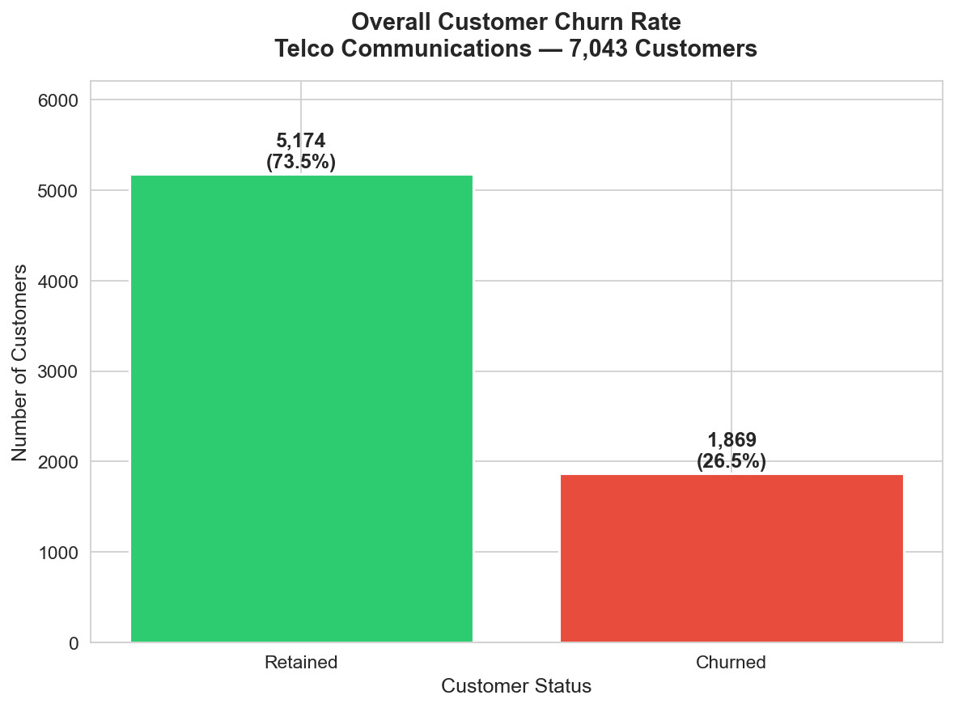
More than one in four customers left
The 26.54% churn rate is the benchmark for judging every segment.
- 5,174 customers were retained.
- 1,869 customers churned.
- Every segment above 26.54% deserves retention attention.
03

Slide 4
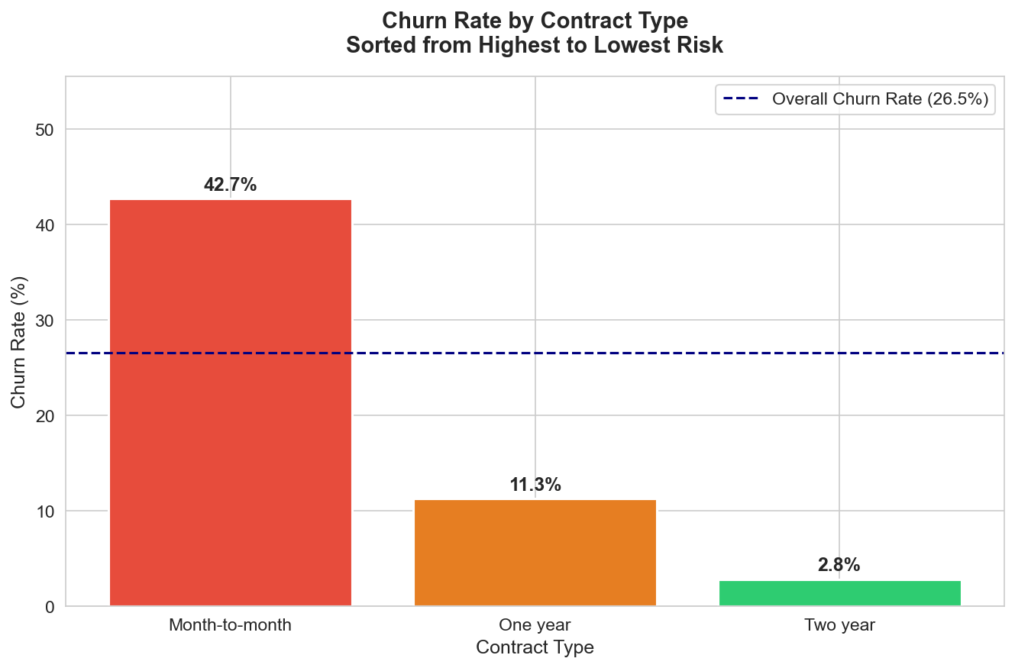
Contract length is the clearest retention lever
Month-to-month customers churn nearly 15 times more than two-year customers.
Implication
The fastest churn-reduction move is converting short-contract customers into annual or two-year plans through targeted incentives.
04

Slide 5
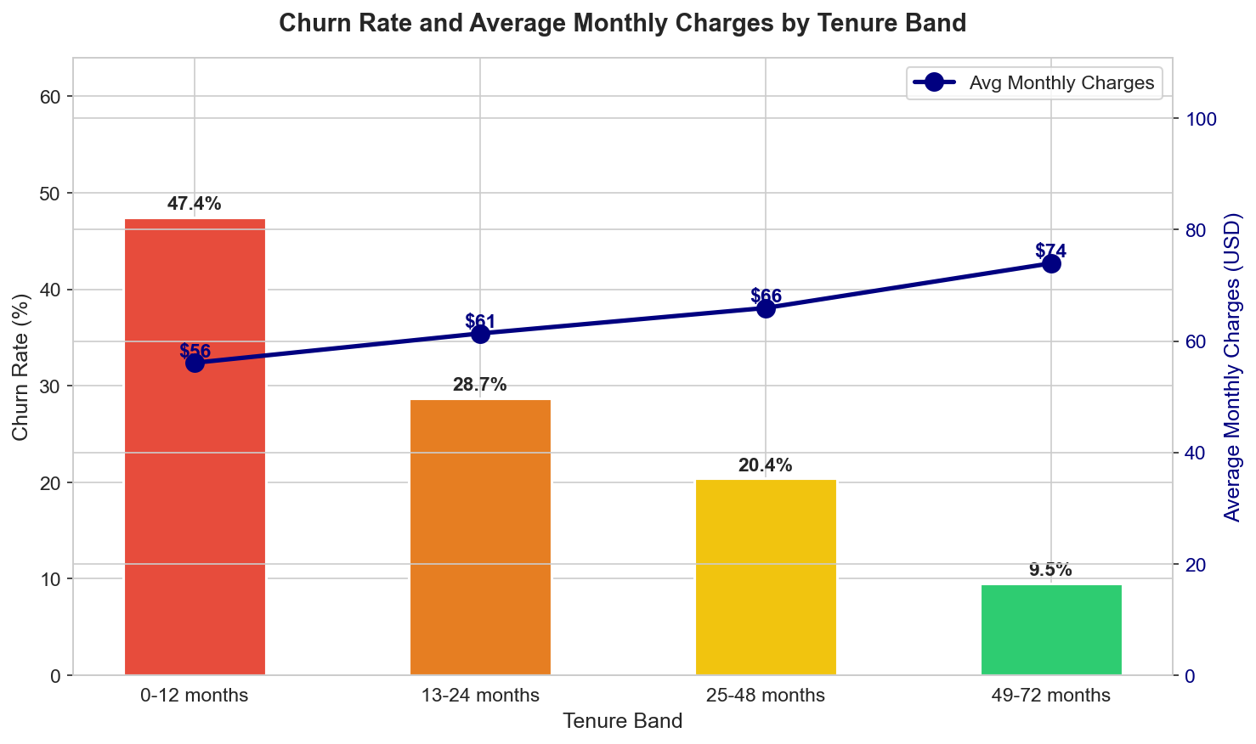
The first year is the danger zone
Churn falls sharply as customers move from early tenure into long-term loyalty.
- 0-12 months: 47.44% churn.
- 13-24 months: 28.71% churn.
- 49-72 months: 9.51% churn.
- Retention should start before the customer has time to disengage.
05

Slide 6
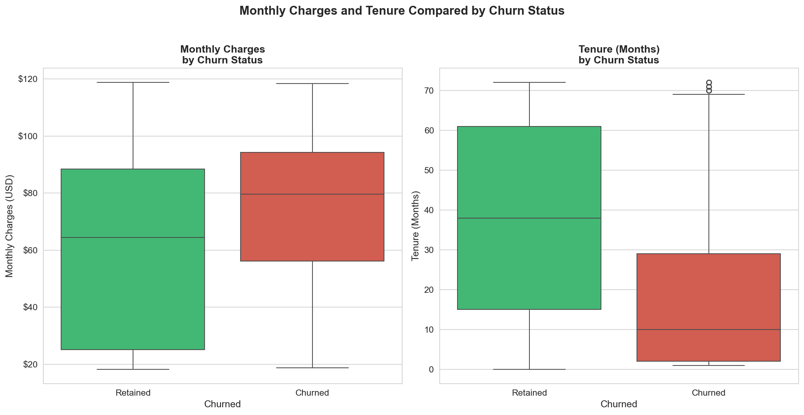
Churned customers are newer and pay more each month
Short tenure plus higher monthly charges is the riskiest customer profile.
Average profile
Churned: 18.0 months tenure, USD 74.44 monthly charges.
Retained: 37.6 months tenure, USD 61.27 monthly charges.
06

Slide 7
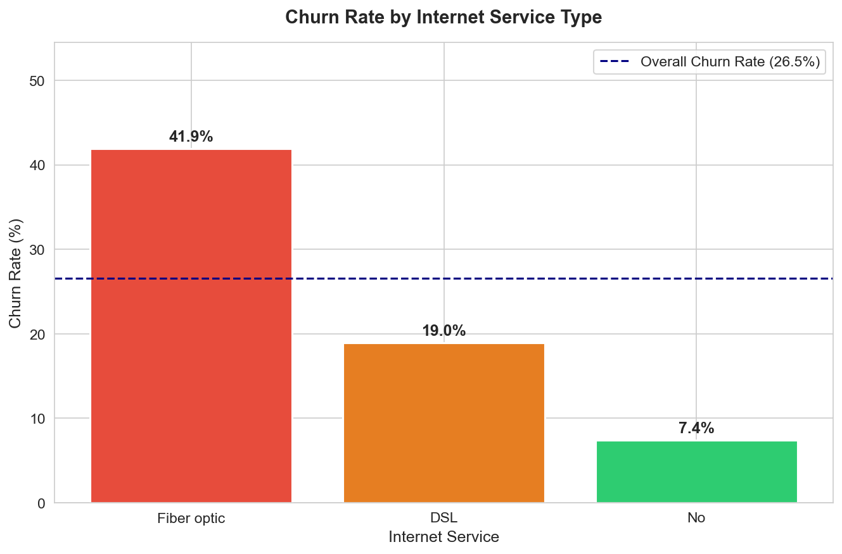
Fiber optic and electronic check customers need attention
Service experience and billing behavior both signal elevated churn risk.
Payment method churn
Electronic check: 45.29%
Mailed check: 19.11%
Bank transfer: 16.71%
Credit card: 15.24%
Move high-risk customers toward automatic billing while investigating fiber optic value and reliability.
07

Slide 8
Retention should start with three focused actions
The strongest findings are specific enough to become an operating plan.
1
2
3
Convert contracts
Protect year one
Fix premium risk
Offer targeted incentives to move month-to-month customers into longer commitments.
Use onboarding, 30/60/90-day check-ins, and early loyalty rewards for new customers.
Survey fiber optic customers and test pricing, reliability, and value interventions.
08

