Slide 1
Windows Azure SQL Databases
Introduction and deep-dive on transient fault handling
Rob Moore
Senior Consultant, Readify
rob.moore@readify.net
@robdmoore
June Tabadero
Principal Consultant, Ignia
june.tabadero@ignia.com.au
@jtabadero
Matt Davies
Team Leader, Curtin University
matthew.davies@curtin.edu.au
@mdaviesnet

Slide 2

Tonight’s event sponsored by:
application development specialists

Slide 3

Overview
What is it?
What are the pros/cons/differences?
Considerations and best practices
Transient fault handling deep-dive
When should I use it?
Live demonstration

Slide 4
What is it?

Slide 5

The Basics
SQL Database
MSSQL-as-a-service hosted in Azure
Fully Managed:
Updates
Vertical scaling
Server and disk management
Configuration and optimisation
High-availability – 3 copies
99.9% uptime SLA
SQL Azure => Azure SQL Database

Slide 6
A Server Is Not A Machine
SQL Server
A Machine
SQL Database Server
A TDS Endpoint
Notes:
While Windows Azure SQL Database is MSSQL, we do not interact with them in the same physical manner. In an on-premises environment, we typically have physical access to the actual SQL Server server whereas in Windows Azure, we do not have physical access to the actual server.
In the background Microsoft is running physical server with SQL Server 2012 Enterprise Edition, but you talk to a TDS endpoint and the implementation of that endpoint is hidden from you in order to provide a high-availability, scalable, fully-managed service.
It’s worth noting that there is a logical concept in SQL Azure called a server that you create your databases under, but this doesn’t mean that the databases you create under that server will be hosted on the same machine – it’s just used as a grouping for security purposes.

Slide 7
How It Works
Client Layer
PHP
SQL Server
Applications
and Tools
WCF Data Services
Architecture
Client Layer - Used by application to communicate directly with SQL Database.
Services Layer – Gateway between Client layer and Platform layer.
Platform Layer – Includes physical servicers and services that support the Services layer.
Infrastructure Layer – IT administration of the physical HW and OS.
ODBC
ADO.NET
Tabular Data Stream (TDS)
TDS+SSL
Services Layer
Provisioning
Provisioning
Provisioning
…
Billing and Metering
Billing and Metering
Billing and Metering
…
Connection Routing
Connection Routing
Connection Routing
…
Platform Layer
SQL Server
SQL Server
SQL Server
…
SQL Database Fabric
SQL Database Fabric
SQL Database Fabric
…
Management Services
Management Services
Management Services
…
Infrastructure Layer

Slide 8
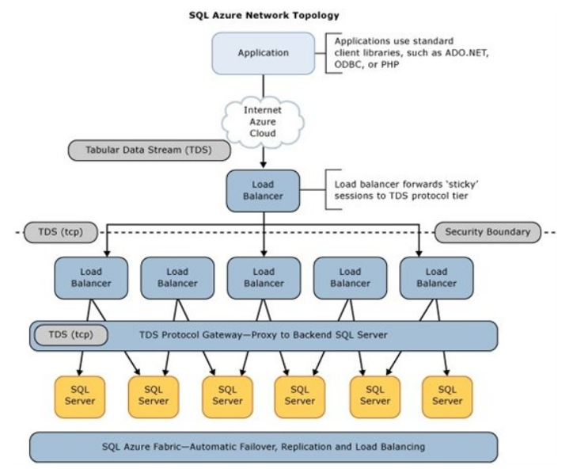
Architecture

Slide 9
SQL Database Billing Rates (As of February 2012)
Database Size | Price Per Database Per Month
0 to 100 MB | Flat $4.995
> 100 to 1 GB | Flat $9.99
> 1GB to 10 GB | $9.99 for first GB, $3.99 per additional GB
> 10 GB to 50 GB | $45.954 for first 10 GB, $1.998 for each additional GB
> 50 GB to 150 GB | $145.874 for first 50 GB, $0.999 for each additional GB
Based on graduated rate based on database size
Charged at monthly rate per database
Amortized over month -> calculated on daily basis
No Transaction Charges
Data Transfers
North America and Europe regions $0.05 - $0.12 per GB outbound
Asia Pacific region $0.12 - $0.19 per GB outbound
All inbound data transfers are at no charge.

Slide 10
What are the pros / cons / differences?

Slide 11
Pros
Latest version of SQL Server
Quick to provision
Managed service – ops taken care of
State-of-the-art datacentre and security
Highly available and backed by SLA
Rich programmatic management / provisioning
DoS protection

Slide 12
Pros
Pay for use (don’t need to buy a license)
Ability to scale data use over time
Federations for easy horizontal scaling
SQL Azure Data Sync provides easy way of syncing data to/from on-premise
You can store backups in Blob storage on the other side of the world easily
Existing tools / libs can connect to it

Slide 13
Differences
No use command – one database per connection
No distributed transactions
No distributed views
No service Broker
No Common Language Runtime (CLR)
No SQL Agent
No Native Encryption (TDE)

Slide 14
Differences
Different backup / restore
No transactional replication or log shipping
Must have single clustered index on all tables
Subset of system views available
Connections will be automatically closed
No SSIS
No integrated security

Slide 15
Cons
Max 150 GB
Pay for data not computation – no guarantee of resources
Upper limit for vertical scaling of throughput
Need to deal with transient errors
More advanced use cases not supported (broker, agent, TDE, DTC etc.)

Slide 16
Cons
Long-running queries and transactions will get terminated
Backups can be a pain point
The I/O performance won’t be extreme

Slide 17
Considerations and best practices

Slide 18
When to provision new servers / DBs
Todo
Server: single set of firewall rules, single set of user accounts, single data centre
Use single db if you are multi-tenanting or you use schemas to separate between applications

Slide 19
Which DB edition to use?
Todo
Start with web (cheaper) since you can change it quickly (and programmatically if needed)

Slide 20
Connection String
Connecting To SQL Database
TDS (Tabular Data Stream) protocol over TCP/IP
SSL required
SQL server authentication only
Remember to add your IP address / the IP of your server to the firewall rules if it’s outside Azure
<connectionStrings>
<add name="AdventureWorks" connectionString="
Data Source=tcp:[server].database.windows.net;
Initial Catalog=ProductsDb;
User Id=[login]@[server];
Password=[password];
Trusted_Connection=False;
Encrypt=true;"
providerName="System.Data.SqlClient" />
</connectionStrings>
Notes:
Slide Objectives:
Highlight application connectivity requirement, considerations and best practices to SQL Database.
Transition:
While connecting to SQL Database is fairly straight forward, there are some general considerations and recommended coding practices when developing Windows Azure SQL Database applications.
Speaking Points:
Login:
Idle connections terminated after 30 minutes
Long running transactions terminated after 24 hours
DoS guard terminates suspect connections with no error message
Failover events terminate connections
Throttling may generate errors…which leads to:
Implement Connection Pooling and Retry logic to handle transient failures
Latency introduced for updates due to HA replicas
No cross-database dependencies: resultsets from different database must be combined in the application tier (Fan out queries)
Notes:

Slide 21
Backups
Todo
third party tools
bcp (not transactionally consistent)
create gatabase as copy (charges a whole day)

Slide 22
Schema Management
todo
Use migrations so you get the usual benefits of that, but also helps avoid connecting directly to the database (helps with risk of having less regular db backups and no transaction logs)

Slide 23
Security
Todo
Firewall
User accounts with privileges
server admin vs other
Encrypt on connection string
Encrypted config when deploying / password safe for password

Slide 24
Scaling
todo
Vertical (size) => multi-tenancy for cost cutting
Horizontal (size and throughput) => federations or manual
If you need more size or throughput than SQL Database can handle:
Azure Table Storage (or hybrid between two)
IaaS VM with SQL server

Slide 25
Transient Fault Handling

Slide 26
What are transient faults?
todo

Slide 27
Why does it give transient faults?
todo

Slide 28
Transient Fault Handling library
todo

Slide 29
NHibernate.SqlAzure library
todo

Slide 30
When should I use it?

Slide 31
When should I use it?
Basic use cases (just a relational DB); or
You don’t have a high load; or
The number of databases you need isn’t too high or you can re-architect for multi-tenancy; or
You need a web-scale relational DB, you can re-architect for federations and you can afford the number of databases required; or
You don’t have operations staff with SQL Server xp.

Slide 32
Creating A SQL Database Server
Demo
Notes:
Demo – Creating a SQL Database server DB through the Management Portal

Slide 33
Transient Fault Handling
Demo
Notes:
Demo – Creating a SQL Database server DB through the Management Portal

Slide 34
Thank You…
Questions?

Slide 35
Further Reading
http://social.technet.microsoft.com/wiki/contents/articles/995.windows-azure-sql-database-faq.aspx
http://social.technet.microsoft.com/wiki/contents/articles/3507.windows-azure-sql-database-performance-and-elasticity-guide.aspx
http://msdn.microsoft.com/en-us/library/windowsazure/ee730906.aspx

