Slide 1





SELF-DIRECTED DESIGN EXERCISE
Reading Weapon Balance in
Deep Rock Galactic
What 24 weapons' published stats can and can't tell you about which options are matched fairly, and what I'd do about the one that isn't.
Driller
Engineer
Gunner
Scout
Puneet Pandit Game & Systems Designer punitp59@gmail.com

Slide 2
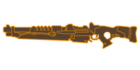
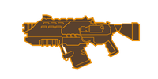
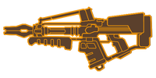



THE QUESTION
Players ask which gun is best. The better question is smaller.
1
Four classes, two slots each. Every class carries a Primary (main weapon) and a Secondary (sidearm).
Example: the Scout
PRIMARY — PICK ONE
2
You pick 1 of 3 per slot. Before each mission you choose one of three options for each slot.
Marksman
rifle
Assault
rifle
Plasma
carbine
SECONDARY — PICK ONE
3
So the real choice is twice, not once. It is never "best of all 24." It is "which of these three," made twice. That is the only comparison the stats can fairly judge.
Crossbow
Sawed-off
shotgun
Dual
SMGs
Two real decisions per mission. Multiply by four classes and you get 24 weapons, but never a 24-way comparison.

Slide 3



METHOD
How I read the data
Compare like with like
One honest yardstick
Damage is not crowd control
Each weapon is judged only against the other two options in its own class and slot, the real either/or choice a player makes.
A single comparable number: shots-per-second damage = fire rate x damage per hit, worked out the same way for all 24 weapons.
Freeze, stun and slow are tracked in their own column, never folded into the damage score. A low-damage weapon can still earn its slot.

Slide 4
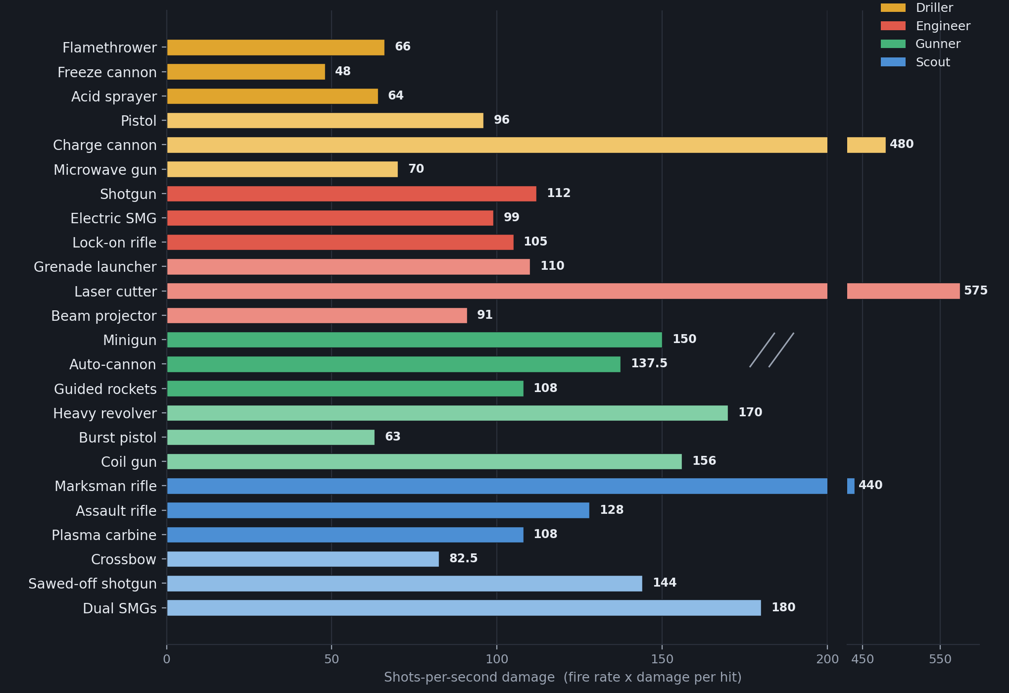
WHAT THE NUMBERS SHOW
Most weapons cluster. Only three break away.
Why the three outliers don't mean what they look like
Charge cannon, laser cutter and marksman rifle are all charge- or burst-fire weapons.
The formula assumes they fire flat out, which they physically can't, so it overrates them. That is the main reason a single damage score is a poor way to judge balance.

Slide 5
FINDINGS
The eight slots fall into three groups
A
B
C
THE FINDING
Looks balanced
Looks dominant, but the number lies
One genuinely leads
Most slots
Charge cannon · Laser cutter
Scout marksman rifle
Three genuine choices. The options differ by role, range and crowd control, not by raw power.
Measurement artifacts. The huge gap mostly vanishes once you correct for how these weapons actually fire.
Still ahead even after correcting for the same effect. This slot has a default pick, not a real choice.

Slide 6

THE REAL PROBLEM
The Scout's primary slot has a default, not a choice
Marksman rifle M1000 Classic
440
Even after discounting the inflated figure, it still leads on damage per shot, reach and reliability.
shots/sec
Assault rifle Deepcore GK2
128
A solid all-rounder but offers no clear reason to pick it over the rifle.
shots/sec
Plasma carbine DRAK-25
108
SCOUT
Sustained damage over time yet trails badly on the headline number.
shots/sec
The fix: increase the GK2 and DRAK-25's effective output rather than nerf the M1000. Keep its precision identity. Confirm against pick-rate data before shipping.

Slide 7
RECOMMENDATIONS
If I owned the balance pass
1
Fix the Scout primary slot first
The only slot where the data points to a genuine problem. Buff the two alternatives' effective output instead of nerfing the marksman rifle, and pull pick-rate and kill data before shipping anything.
2
Investigate the electric SMG, don't yet touch it
It matches its slot-mates on damage (99 vs 105 and 112) yet feels weakest. When damage is fine but the weapon feels weak, the cause is usually elsewhere: look at its effect and ammo, not its damage.
3
Leave the other six slots alone
They are either balanced or only look skewed because of the measurement quirk. Changing them would fix a problem that isn't there. Knowing when not to act is part of the job.

Slide 8


HONEST LIMITS
Stats are a starting point, not a verdict
What the stats can't see
What I'd pull with telemetry
Accuracy and spread
Charge and wind-up time
Hitting enemy weak points
Bonus damage to frozen enemies
Ammo across a full mission
How players actually use each gun
Weapon pick-rates by slot
Average damage and kills per weapon, per mission
New-player vs experienced-player splits
That data would confirm or kill every hypothesis here.
Puneet Pandit Game & Systems Designer punitp59@gmail.com linkedin.com/in/puneet-pandit-gamedesigner

