Slide 1
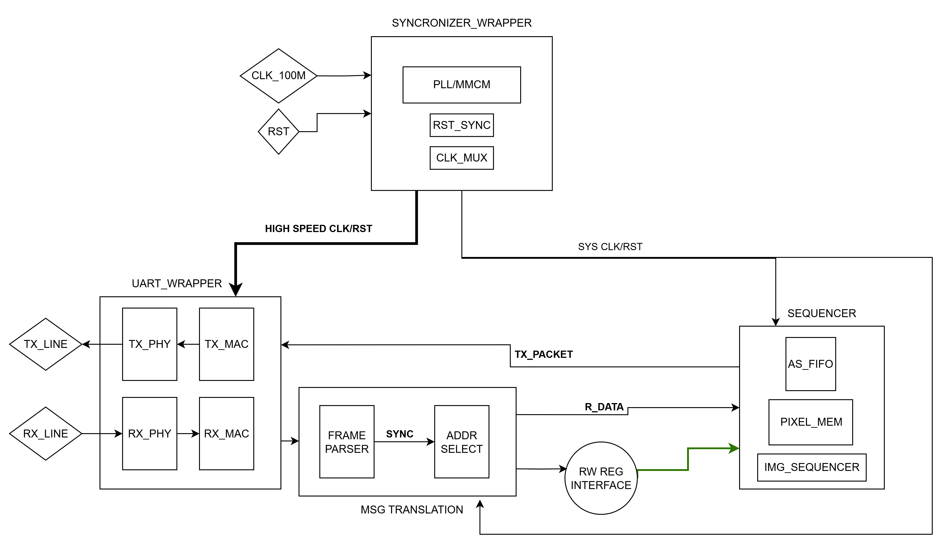
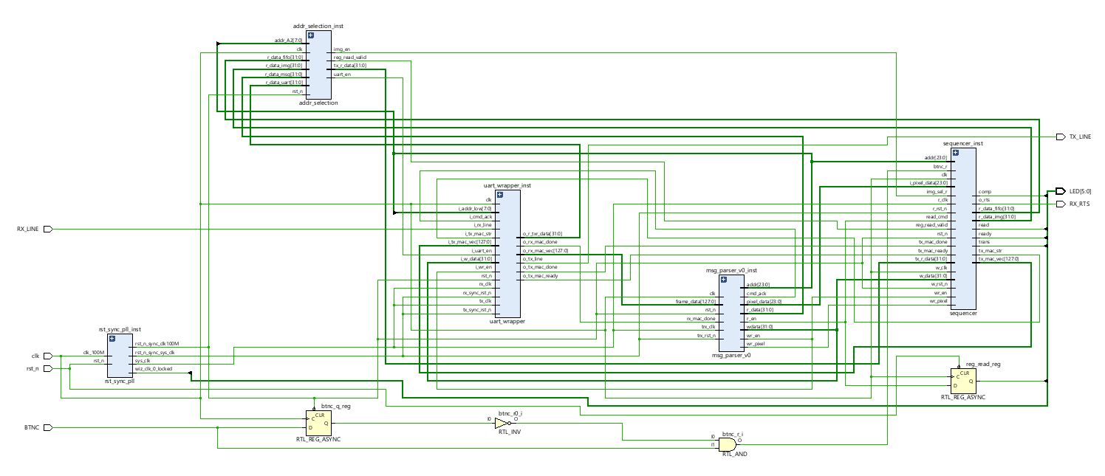
Design process
Block diagram of the system
I/O:
UART – TRX lines using to write img to the internal SRAM memory and display the img on the PC.
Blocks:
UART_wrapper – using MAC-PHY blocks for each line to handle the data transfer properly
Sequencer – the main controller of the system responsible of managing the states and the operation of the other components
Msg_parser – our translator and cmd generator according to the packets received from the RX line.
Rst_sync_pll – creating the High clk for faster data transition from/to UART and sycn the rst to our new clk.
Addr_selection – responsible for the data in/out of the control registers in out system.

Slide 2
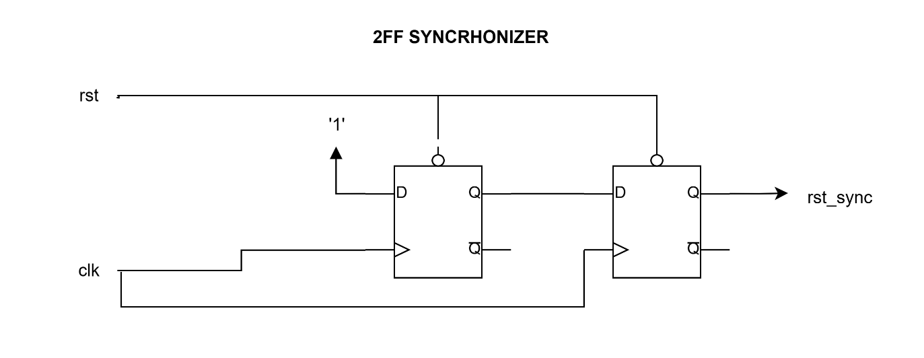

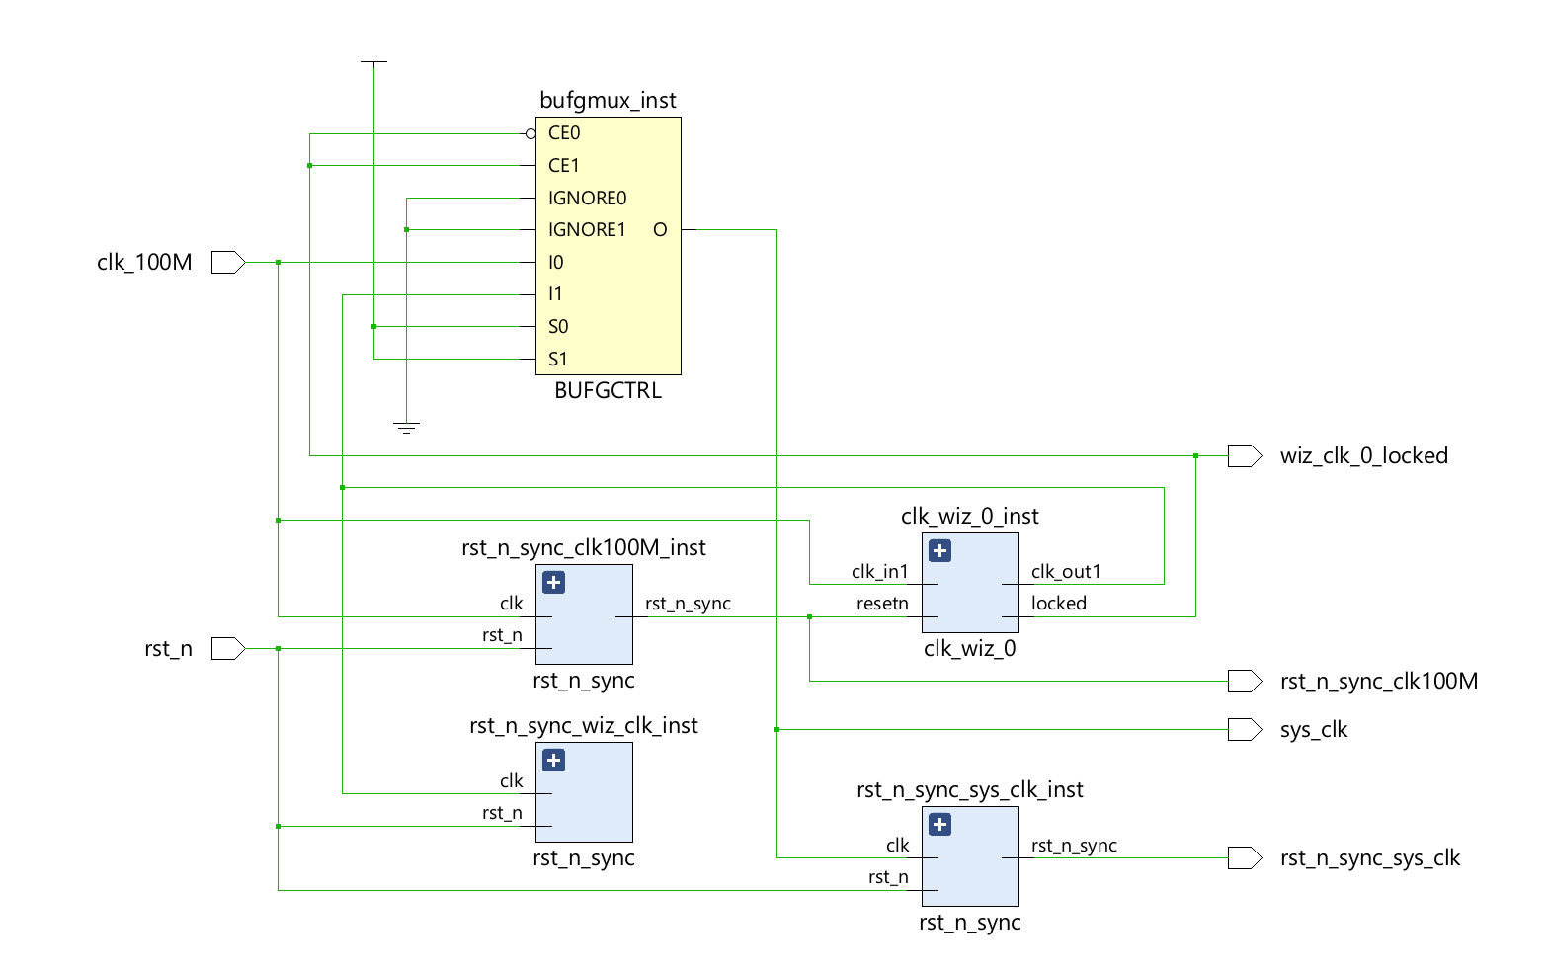
Rst_sync_pll
In the real world we must take care of the release of the async rst_n because if we release it too close to the setup time we would have timing violations and because off that we are sync with 2FF the rst_n signal
When we are working with 2 different clocks and we want to have the ability to change our performance in real time we must use a clk_mux free glitches to keep the system in a valid state and make the transition clear.
We can see that the transition will create a window in which the output would be zero for 2 clk cycles of the clk we are using now before we are moving to the next clk.
Here I’m using a Xilinx component that replacing the clk_mux component because I had a clk recognization issues in vivado.

Slide 3
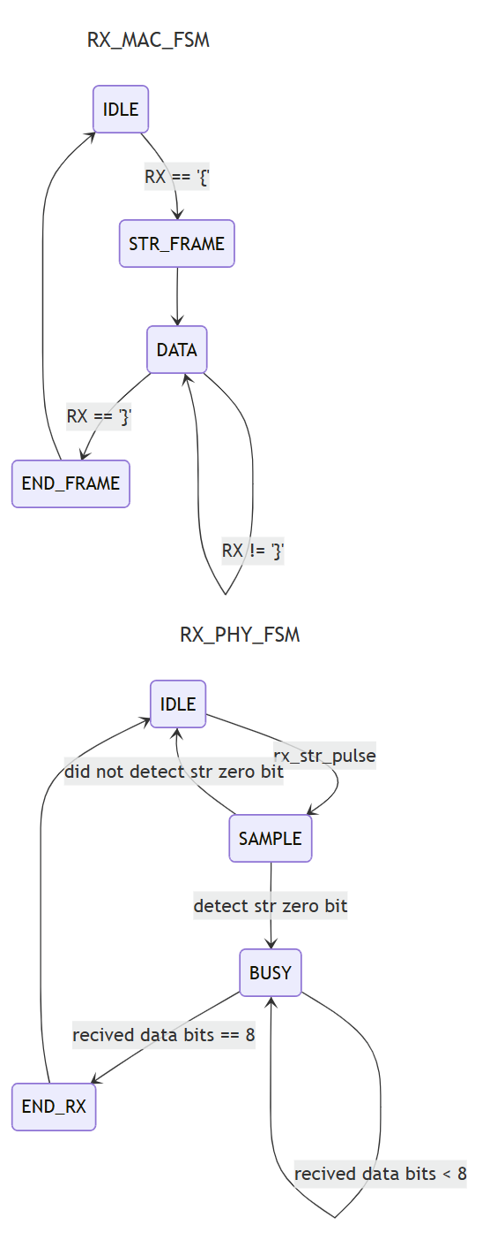
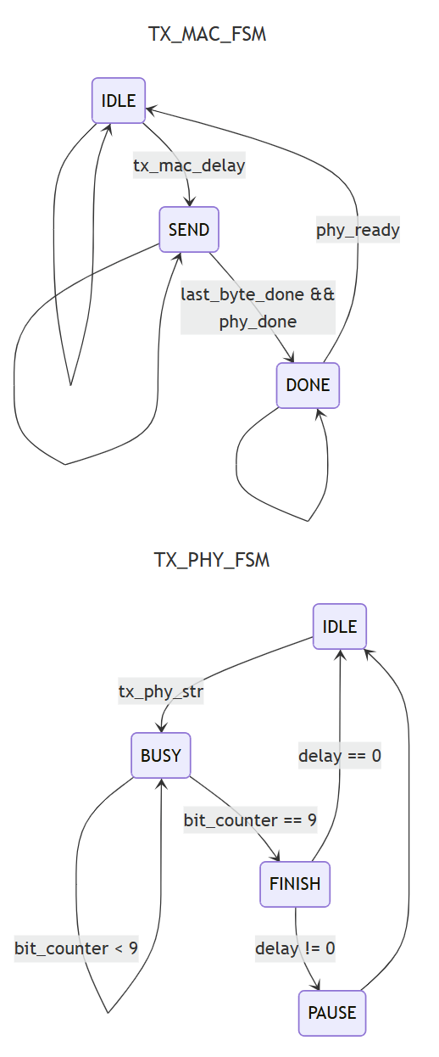
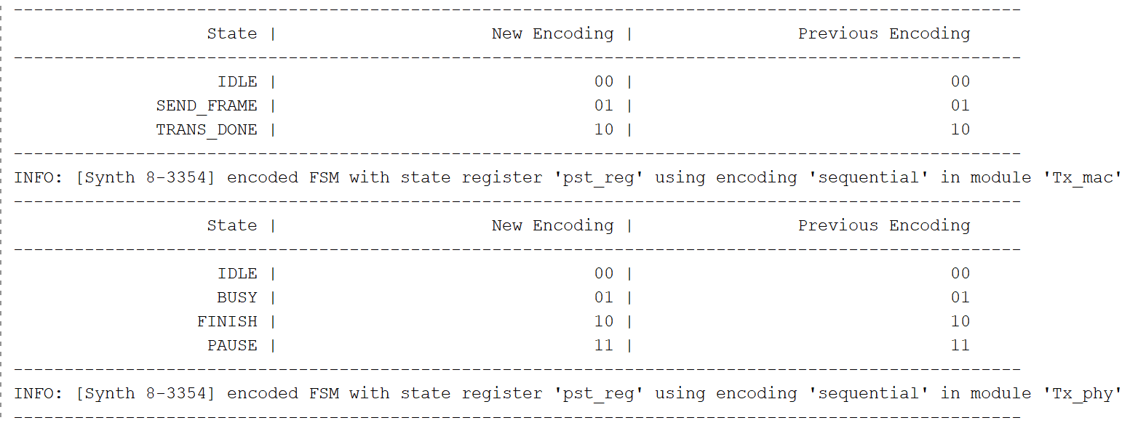
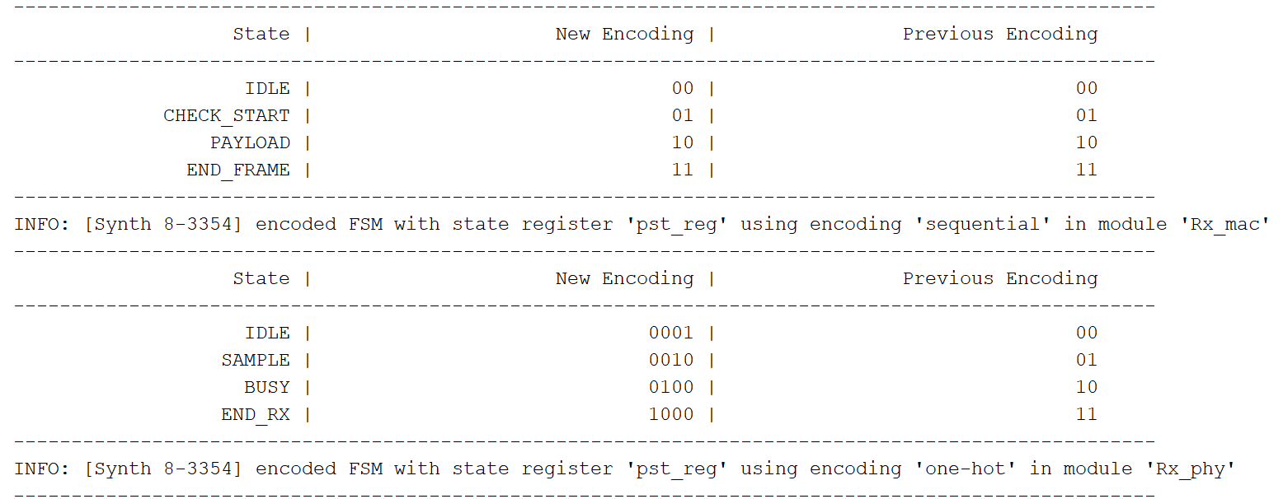
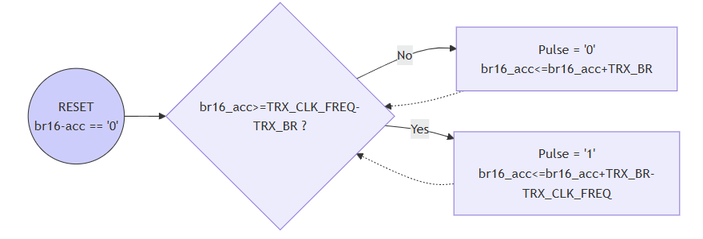
Component design
UART block
Our UART is working with MAC-PHY configuration as FSM inside FSM.
the MAC responsible for the data packet and control the PHY transmitting/receiving.
Our PHY responsible to transmitting/receiving the data bit by bit using with Baud Rate of 5M
In order to sample correctly the Rx line (async line) we sampled it 16x faster than our BR and by that we can be sure we have high precision of the data received.
I'm using a Fractional_acc because of my system settings, my system works with 200MHz high clk our highest int divider of 200Mhz is 100Mhz so our calculation of choosing the BR need to consider that and BR16 should be smaller than 100Mhz I chose 5Mbps but because 100Mps/80Mps its not an int we should accumulate the differences each time. We that we can keep the jitter would be minimal and the frequency be precise over time.

Slide 4
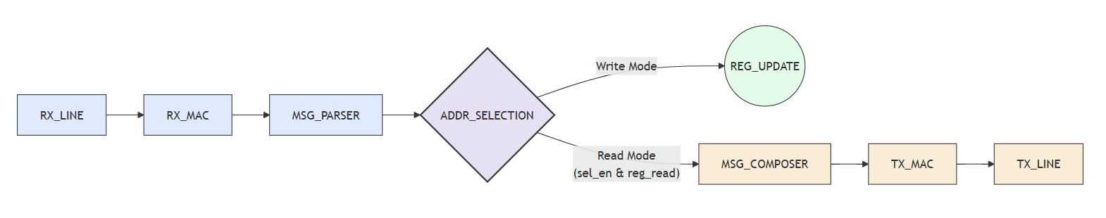
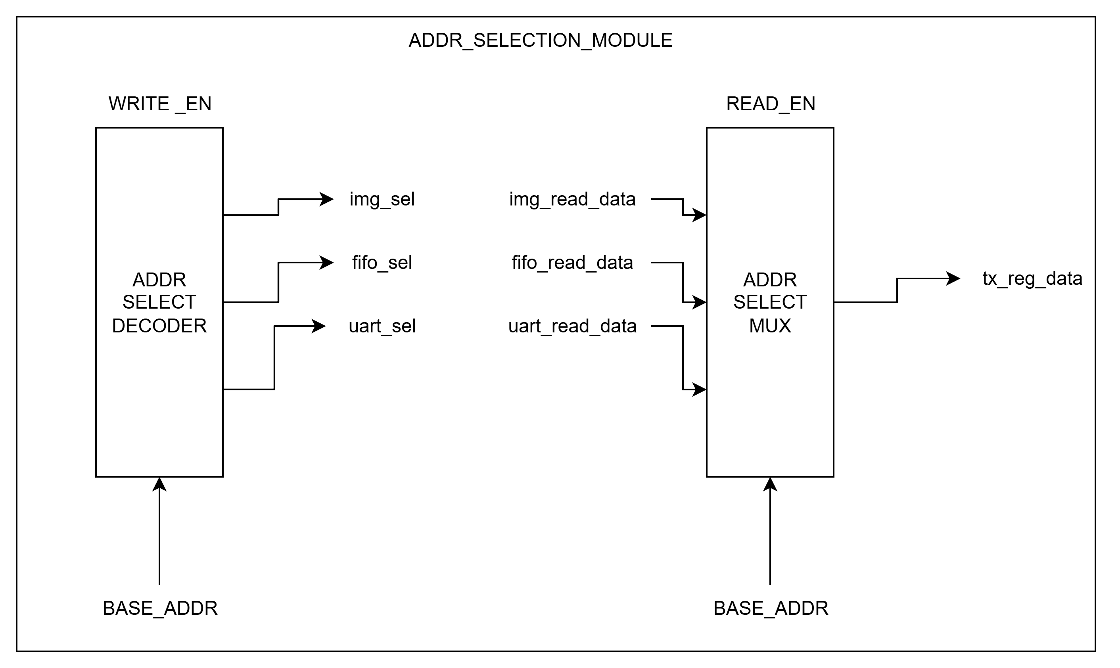
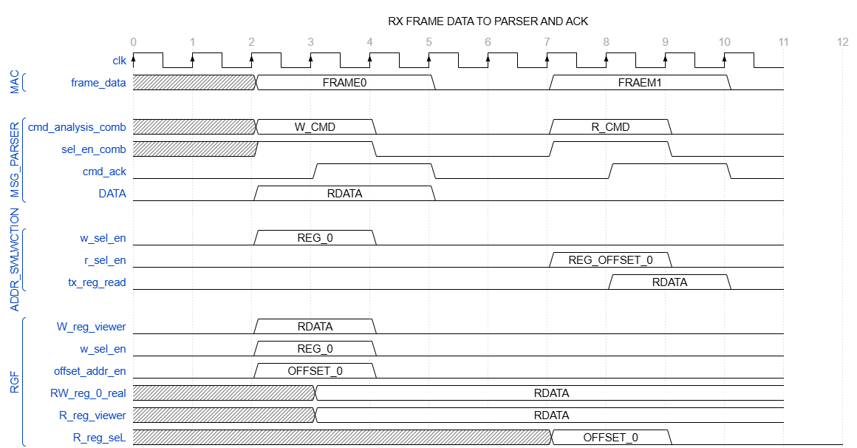
Reg R/W access
Read/write of control register flow
addr selection module diagram
Read/write operation timing flow

Slide 5
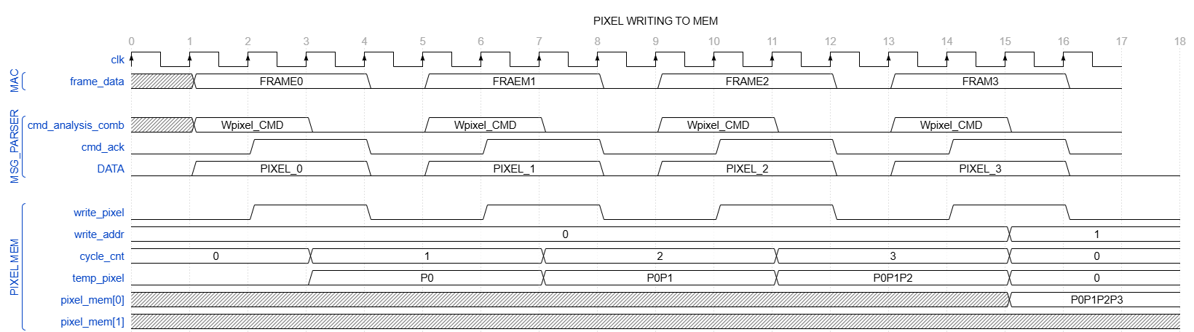
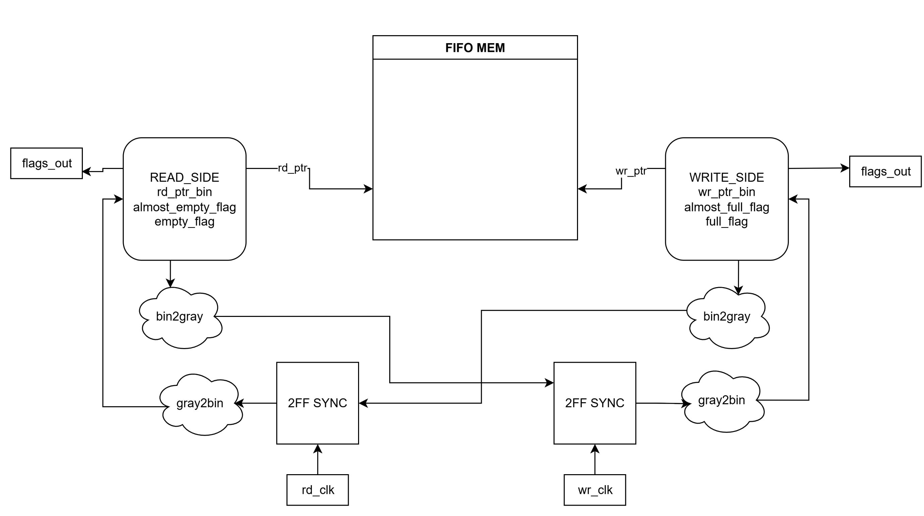
Memory read/write
Async FIFO
System Purpose & FIFO Mechanism
Clock Domain Crossing (CDC): The system utilizes an Asynchronous FIFO because it operates with different clock domains transmitting data to one another.
Memory Buffer: A memory buffer is implemented to ensure bug-free transmission and provide status indicators to external components for proper read/write operations.
Pointer Synchronization: Read and write pointers must be compared only after synchronization due to the asynchronous nature of the two clocks.
Overflow Prevention: The "Almost Full" flag is used as a mechanism to avoid overriding memory within the FIFO.
Data Rates & Transmission Calculations
Loading Speed: The FIFO is loaded at a frequency of 100MHz.
Reading Speed: Data is read at a rate of operations per second.
Image Specifications: The image resolution is 256x256 pixels ,Each packet transmits exactly one pixel.The estimated total time to transmit the image to the PC is 2 seconds.
Load Analysis & Flow Control
Transmission Frequency: The calculation determines the transmission frequency.
FIFO Buffering: While a single packet is being transmitted, the pixel memory can fill the FIFO with 200 pRGB pixel data.(5Mbps/(16[bytes]*10[bit]) = 31250[packet/sec] => 100MHz/31250Hz = 3200 while we are transmitting 1 packet through the UART we can fill the fifo with 3200 new packets and we don’t want to start creating new BRAM of the img.
Operational Conclusion: Precise control of the data flow from the pixel memory to the TX UART is mandatory to maintain data validity and prevent memory overrides.

Slide 6
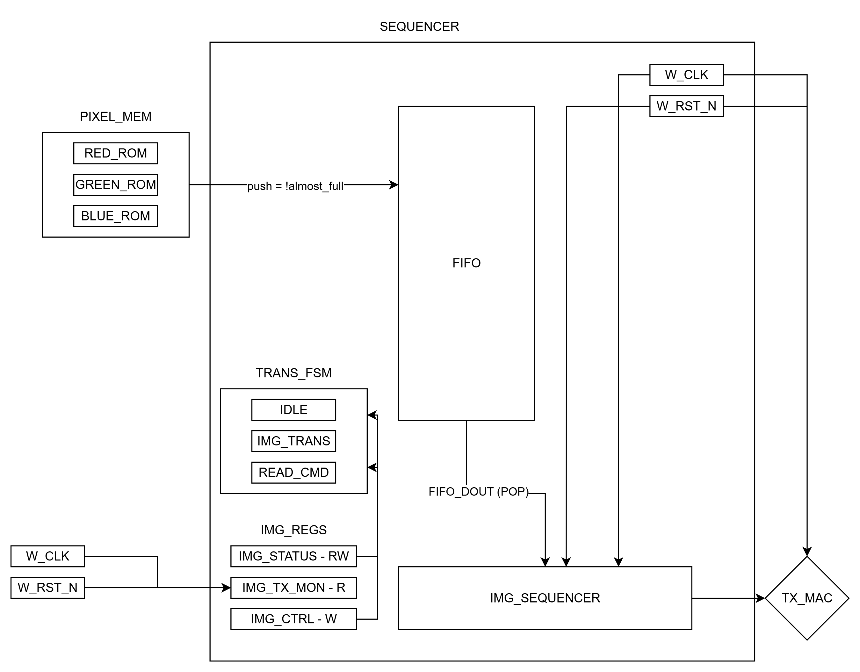
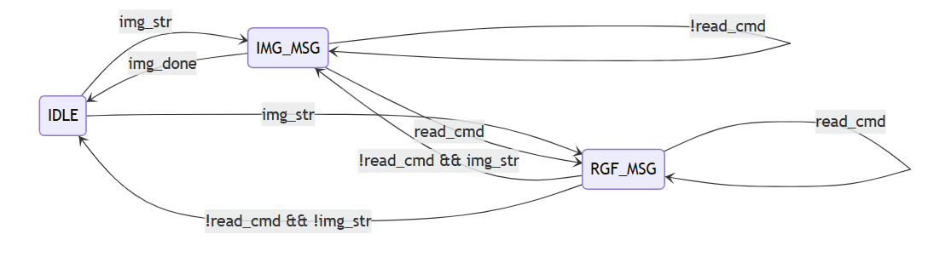
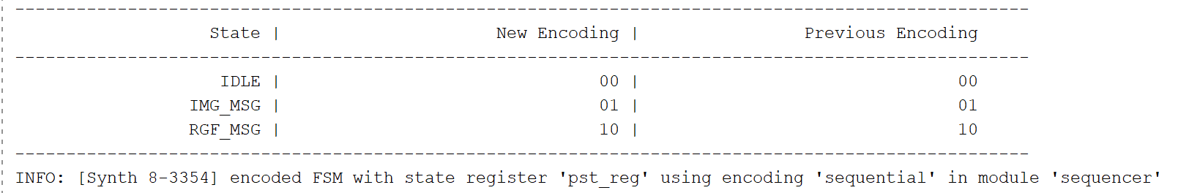
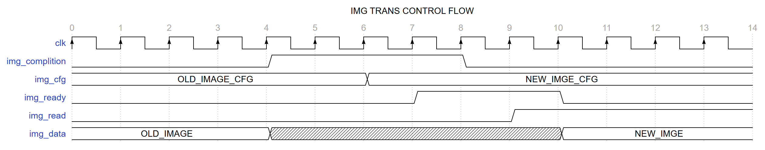
Sequencer design
Sequencer Operations and Data Formatting
A dedicated sequencer manages the Clock Domain Crossing (CDC) for the reading block, synchronizing high-speed operations with the core 100MHz system clock. Its primary responsibility is to regulate image data flow through register control and to time outgoing messages based on cmd priority. Additionally, the sequencer handles the proper filling of the FIFO by aggregating data from three RGB memories into a standardized 32-bit format (8'h00 followed by the RGB data).
Msg composer FSM inside the sequencer
img data represent the tx_data_out when we are in IMG_MSG state of the FSM

Slide 7
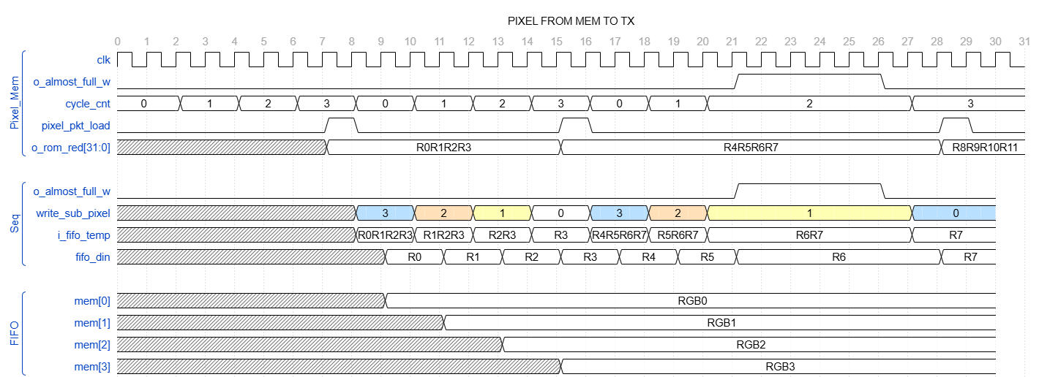
RGF – register file
Module RGF | Base Addr | Reg Name | Offset Address | Type | Fields | Size | Default Value | Description
SEQ | 0x04 | IMG STATUS | 0x0000 | RW | Reserved | [31:21] | 0 | padding to zero
 |  |  |  |  | img_ready | [20] | 0 | str trans the img with Tx
 |  |  |  |  | img_width | [19:10] | 256 | this field is constant val
 |  |  |  |  | img_height | [9:0] | 256 | this field is constant val
 |  | IMG TX MONITOR | 0x0004 | R | Reserved | [31:22] | 0 | padding to zero
 |  |  |  |  | img_trans_err | [21] | 0 | trans err
 |  |  |  |  | img_trans_complition | [20] | 0 | img trans done
 |  |  |  |  | col_cnt | [19:10] | 0 | col index
 |  |  |  |  | row_cnt | [9:0] | 0 | row index
 |  | IMG CTRL | 0x0008 | W | Reserved | [31:1] | 0 | padding to zero
 |  |  |  |  | img_read | [0] | 0 | strting the img trans
UART | 0x03 | RX_CNT | 0x0000 | R | Rx_bytes_cnt | [31:0] | 0 | Rx bytes recived counter
 |  | TX_CNT | 0x0004 | R | Tx_bytes_cnt | [31:0] | 0 | Tx bytes recived counter
FIFO | 0x06 | FIFO CTRL | 0x0000 | RW | Reserved | [31:2] | 0 | padding to zero
 |  |  |  |  | af_mod | [1] | 0 | 3/4 from full fifo (0) , 7/8 from full fifo (1)
 |  |  |  |  | ae_mod | [0] | 0 | 1/4 from full fifo (0) , 1/8 from full fifo (1)
Img data flow

Slide 8
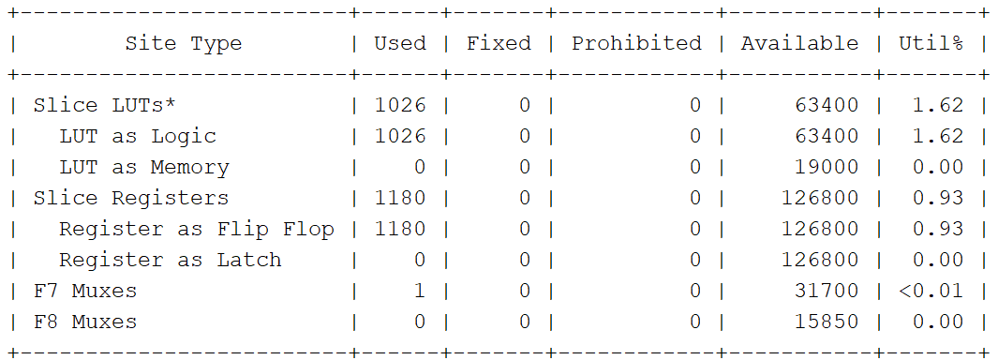
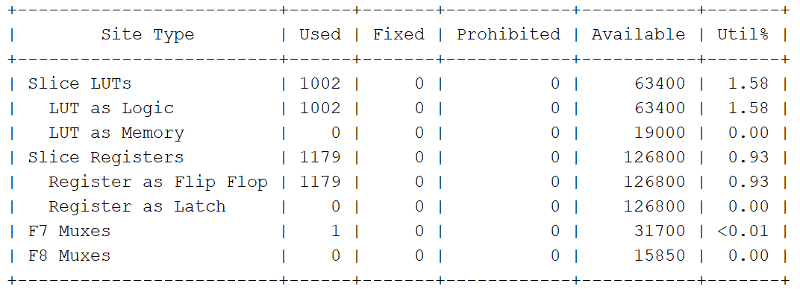
Design resources comparison
FF expected vs actual
Module | Total Registers | Expected FF | Actual FF | Opt Out | Replicated | Partial | Explanation
mux_sync | 5 | 67 | 0 | 5 | 0 | 0 | Dead Module.
Tx_phy | 9 | 51 | 23 | 2 | 0 | 1 | Half of the logic removed (mainly pause counter).
fifo_async | 12 | 113 | 32 | 4 | 0 | 6 | FIFO Output was deleted!
msg_parser | 17 | 210 | 156 | 3 | 0 | 1 | Color calculations (RGB) removed due to lack of consumer.
pixel_mem | 16 | 232 | 228 | 3 | 2 | 4 | Address replication + output removal.
Rx_phy | 15 | 71 | 62 | 0 | 1 | 2 | Minor optimizations and replication for timing.
sequencer | 19 | 336 | 226 | 1 | 0 | 4 | Removal of unused vectors.
Rx_mac | 6 | 323 | 242 | 0 | 0 | 3 | Trimming of empty frame fields.
Tx_mac | 10 | 180 | 172 | 1 | 0 | 1 | Functional / Intact.
rst_n_sync | 2 | 6 | 5 | 0 | 0 | 1 | Functional / Intact.
uart_wrapper | 1 | 32 | 32 | 0 | 0 | 0
top | 2 | 2 | 2 | 0 | 0 | 0
TOTAL | - | 1623 | 1180 | 19 | 3 | 23
Synthesis report
Implementation report

Slide 9
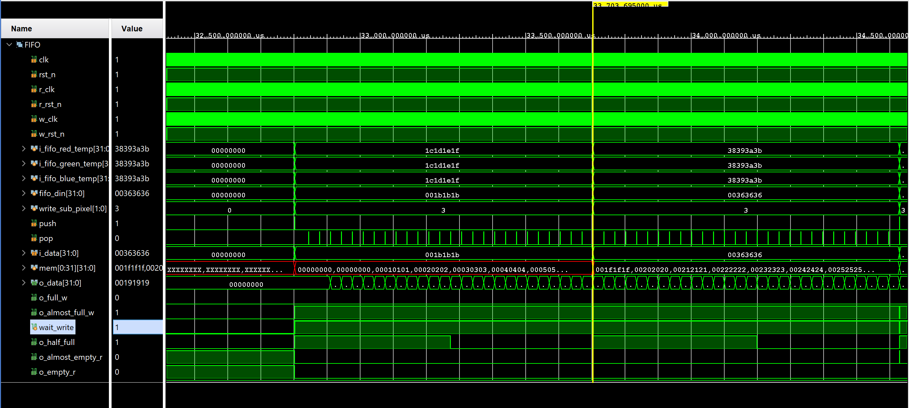
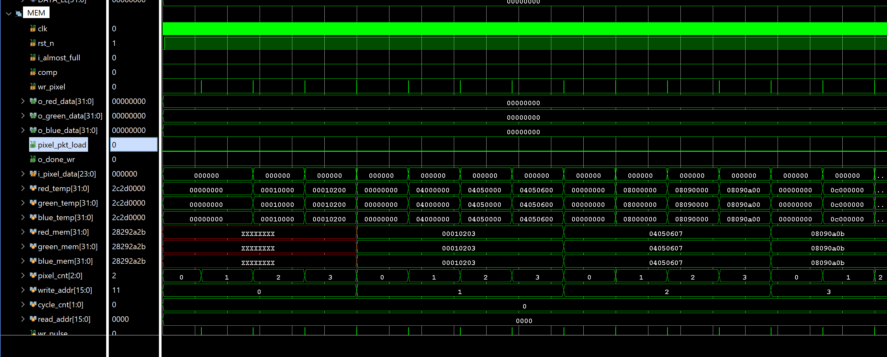
Simulation
FIFO writing
Pixel Memory writing

Slide 10
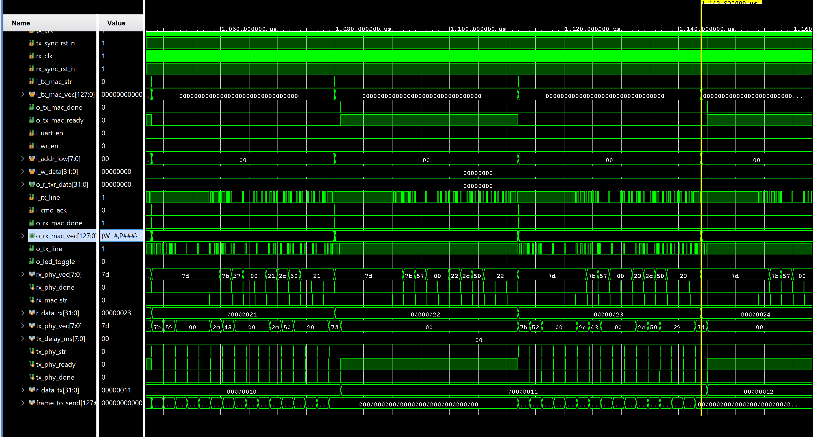
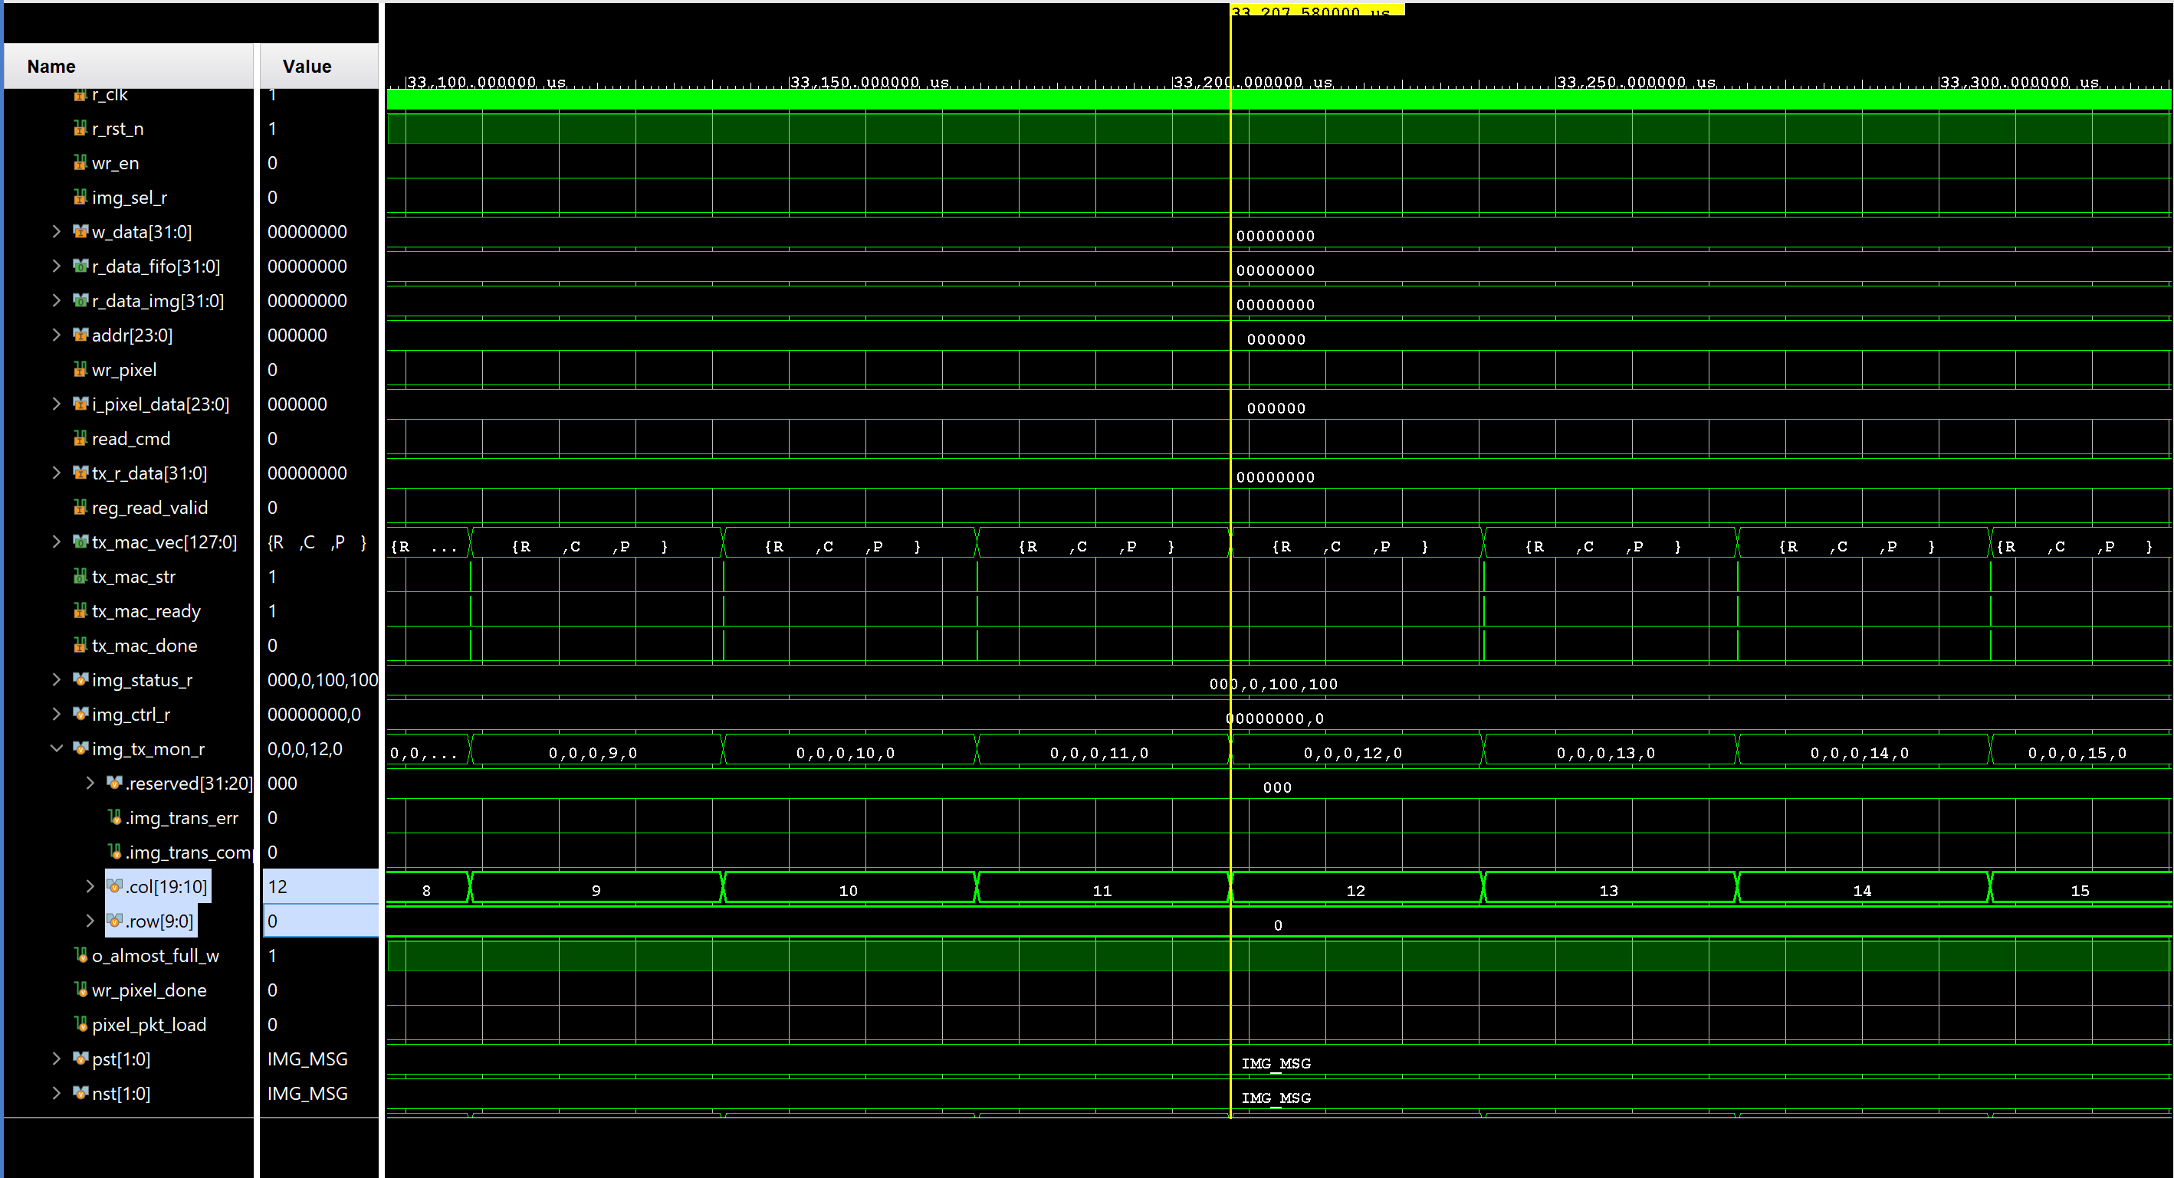
Simulation
UART transmition
SEQ image transmition

