Slide 1
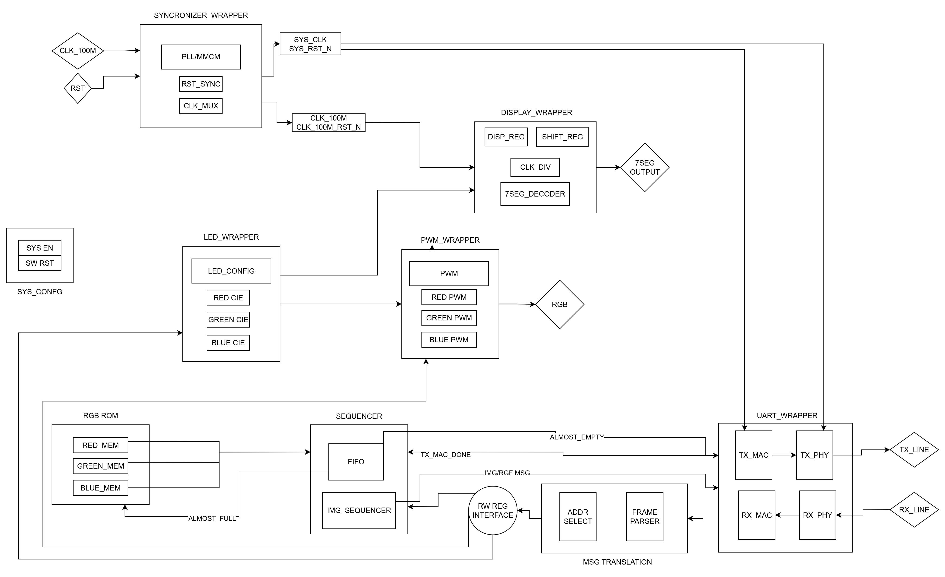
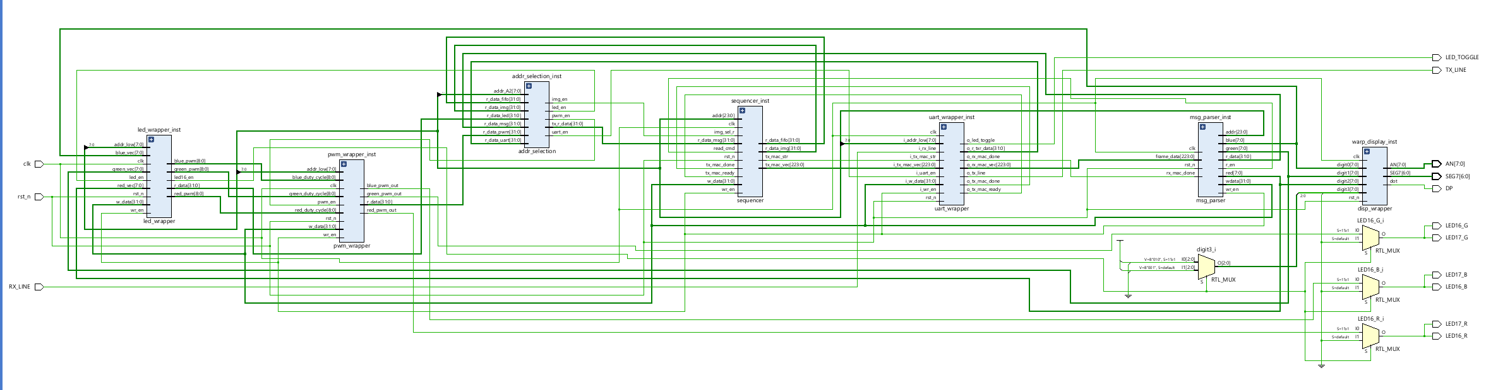
Design process
Block diagram of the system
I/O:
7SEG_DISPLAY for the RGB leds values.
RGB leds – config state indicators.
RX LINE – receiving the PC cmd.
TX LINE – transmit the R_data requested by the PC.
Blocks:
UART_wrapper – responsible of the MAC-PHY of the RX,TX.
Sequencer – responsible to the timing between the reading from the pixel_mem and transmitting pixels to the pc using Tx line.
Msg_parser – analysis the cmd received and convert it to signals.
Syncronizer -
Addr_selection – enabling the WR RFG according to the cmd addres and mux between the r_data.
Display_wrapper– responsible for the 7 segment configuration.
LED_wrapper – containing the RGB leds config and the cie of each led 16/17.
PWM_wrapper – converting the raw data of the LED_wrapper into pwm output.

Slide 2
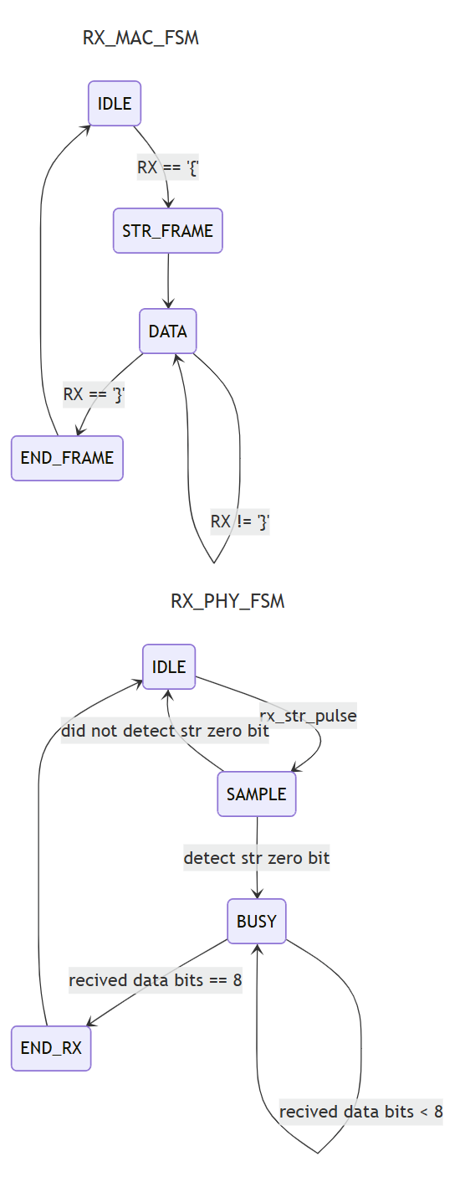
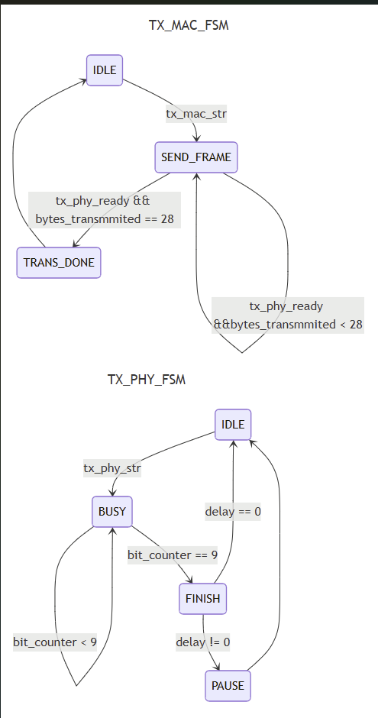
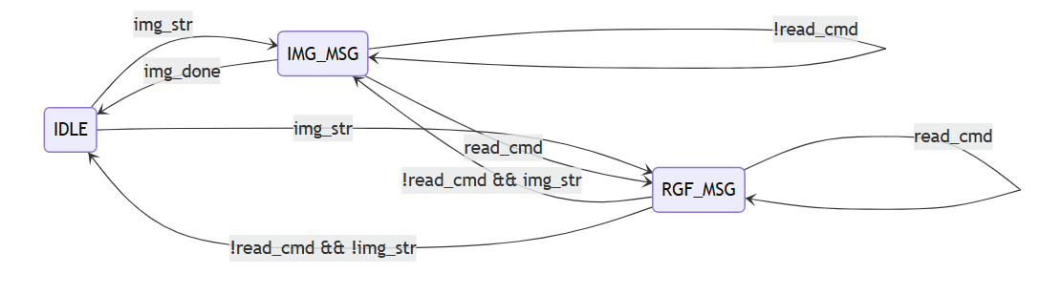
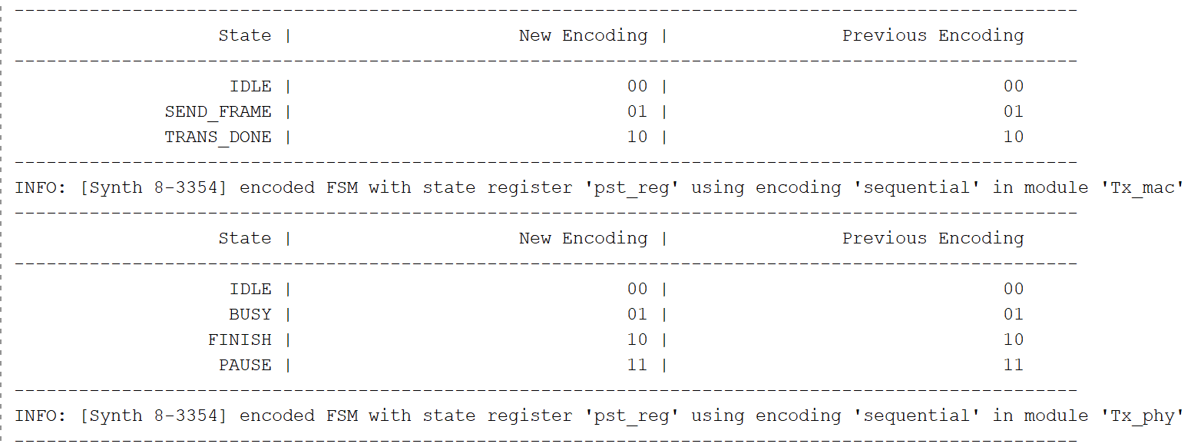
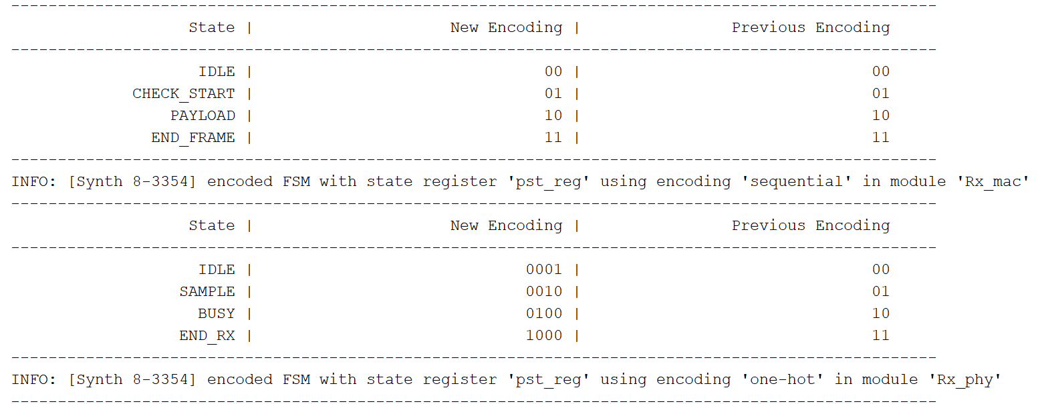
FSM design
mac_fsm
Msg composser
Tx_fsm_ff
Rx_fsm_ff

Slide 3
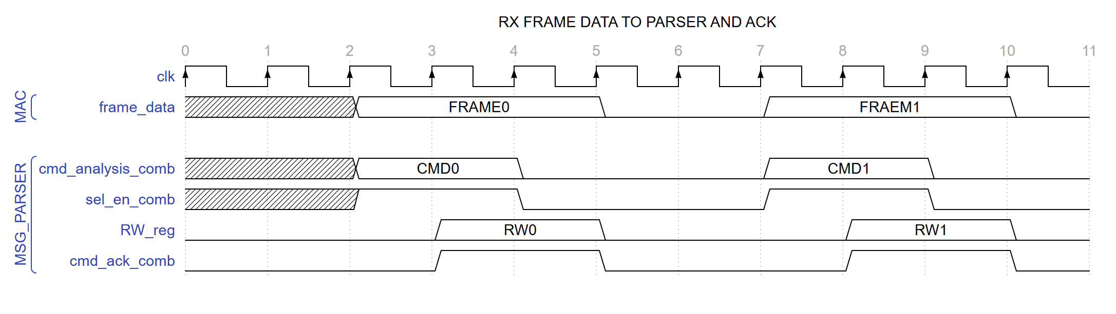
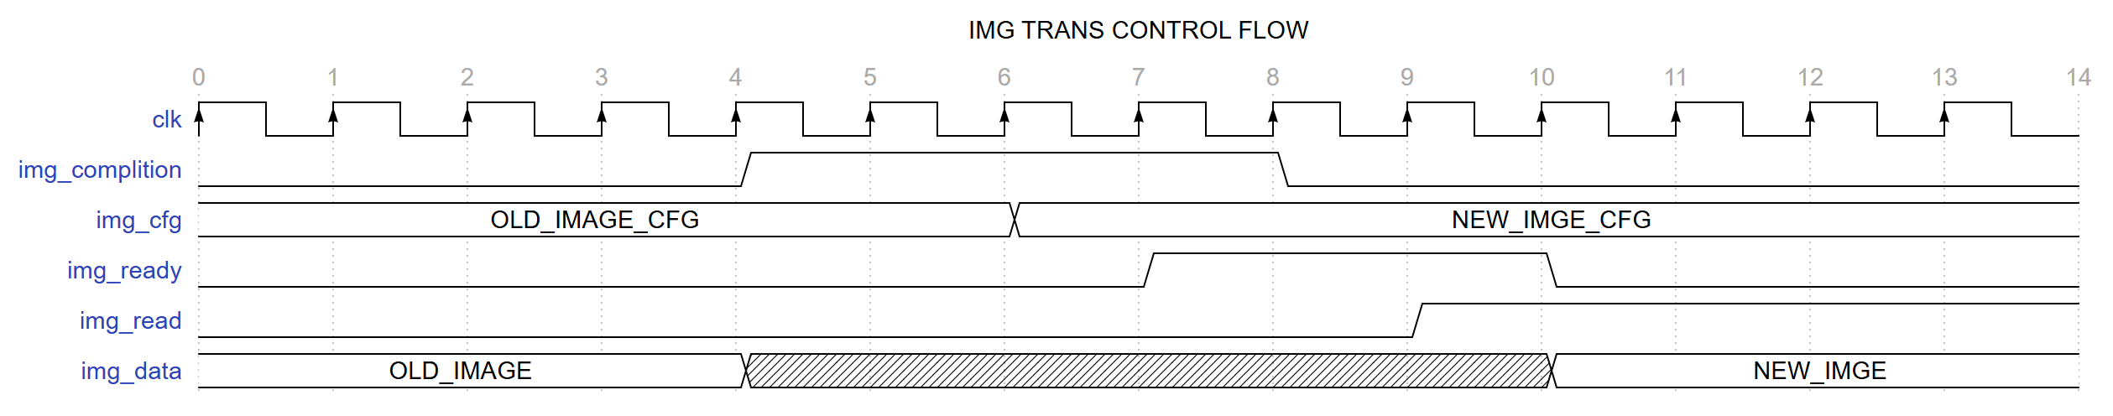
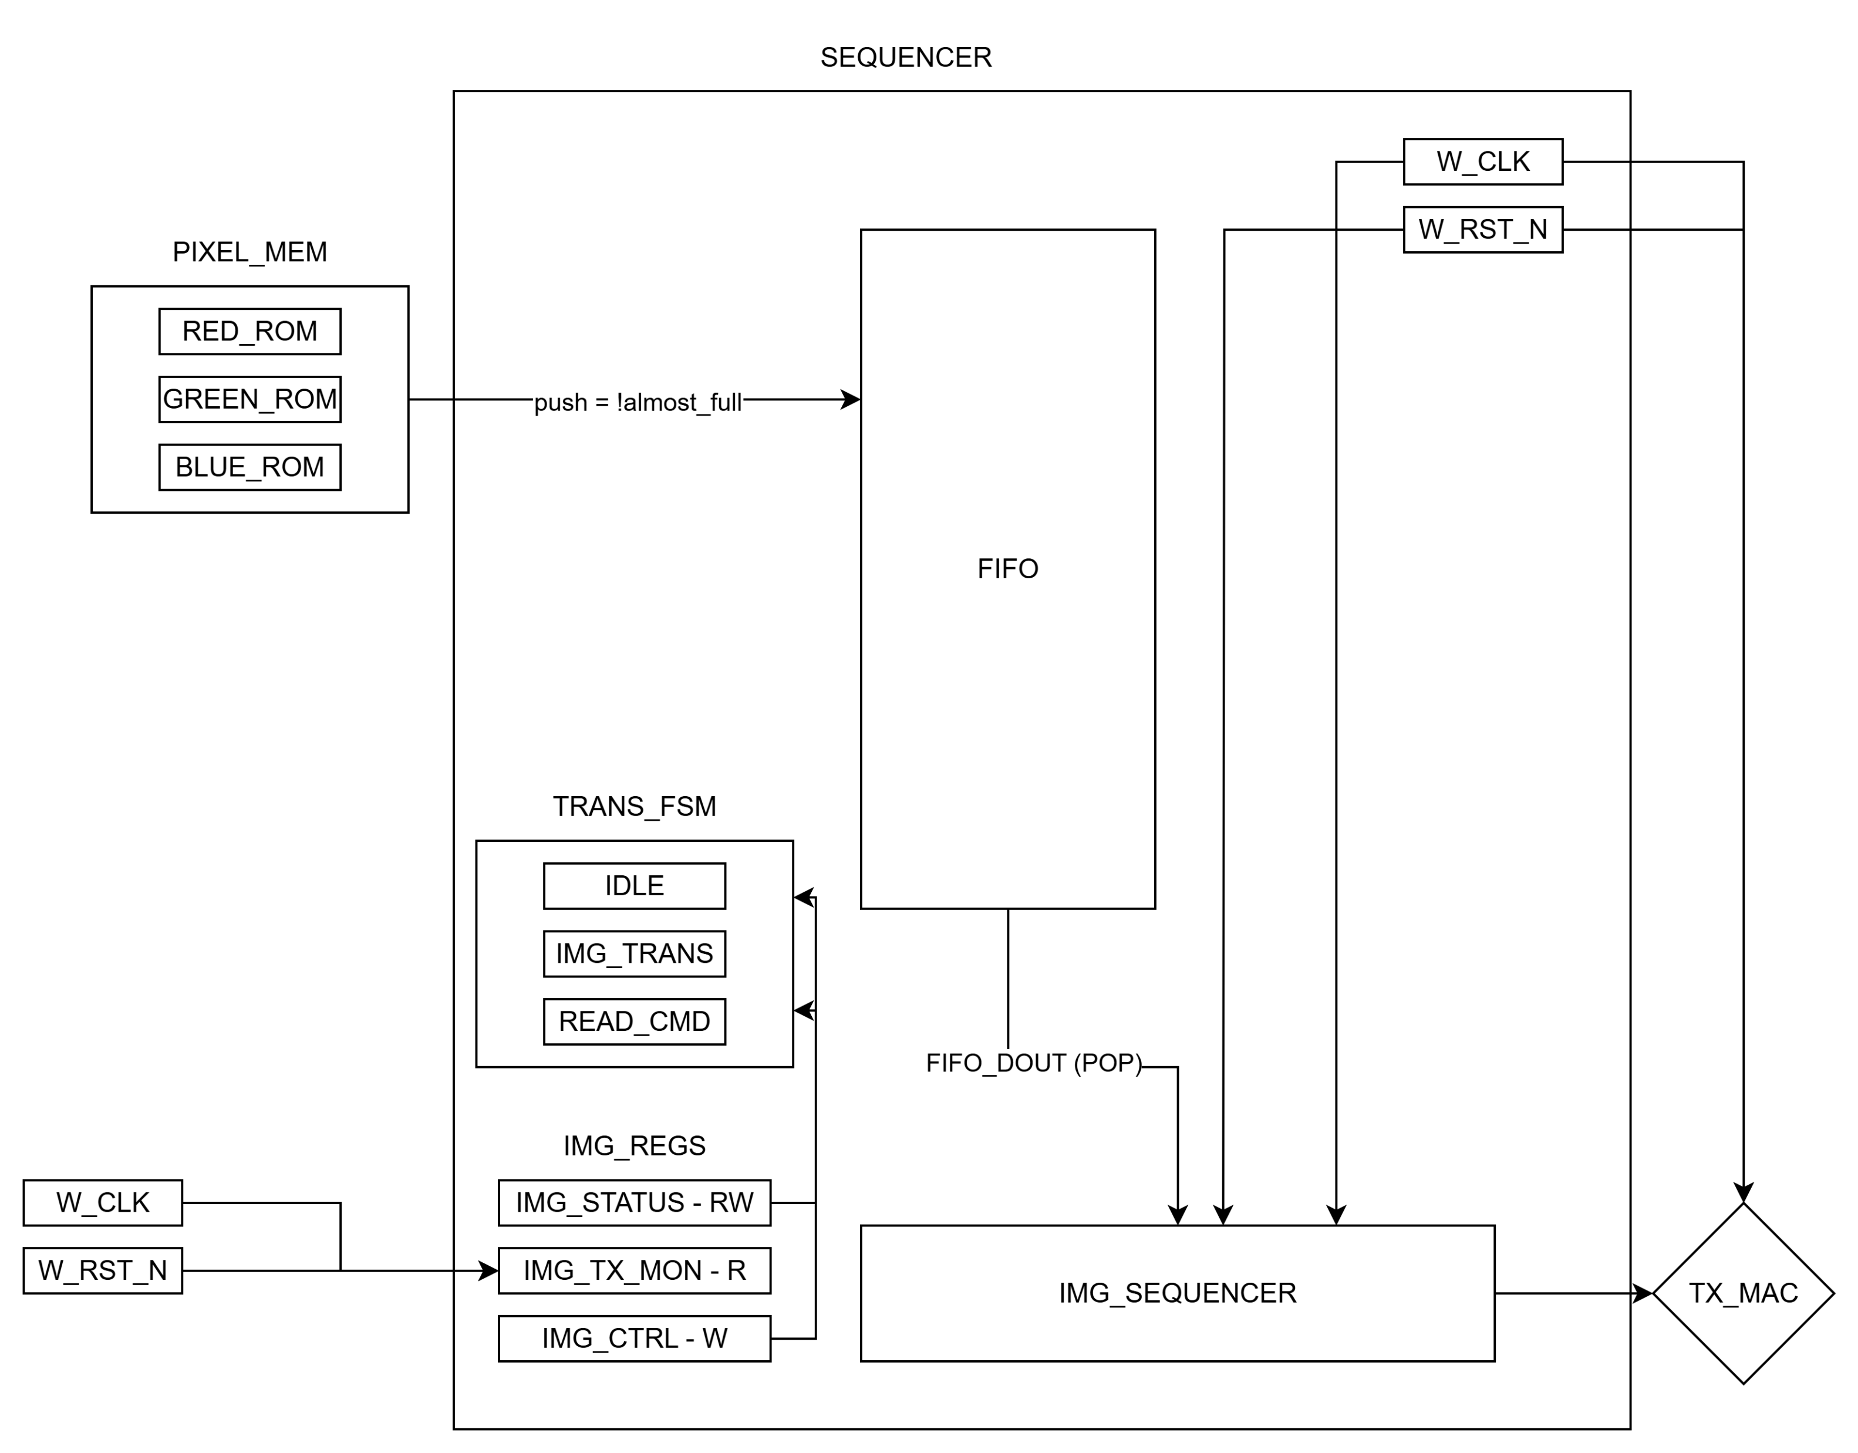
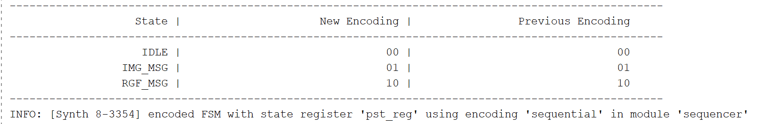
Seqencer design
IMG_TX_MON_R clk port connected to the w_clk because he should update in real time how many pixels already transsmited
Seq_fsm_ff

Slide 4
Design resources comparison
FF expected vs actual
Module | Register | Planned_RTL | Actual_Synthesis | Status
Rx_mac | frame_data | 136 | 104 | Partial Opt
Rx_mac | temp_frame | 136 | 104 | Partial Opt
Rx_mac | write_ptr | 32 | 29 | Partial Opt
Rx_phy | br16_acc | 29 | 20 | Partial Opt
Rx_phy | pst | 2 | 4 | FSM/Logic Expansion
Rx_phy | temp_rx_vec | 10 | 8 | Partial Opt
TOP | sys_cfg_r | 32 | 0 | Optimized Out
Tx_mac | frame_to_send | 136 | 129 | Partial Opt
Tx_mac | o_tx_mac_ready | 1 | 0 | Optimized Out
Tx_phy | led_toggle | 1 | 0 | Optimized Out
Tx_phy | tx | 10 | 8 | Partial Opt
blue_pwm | pwm_counter | 13 | 0 | Optimized Out
blue_pwm | pwm_out | 1 | 0 | Optimized Out
disp_reg | hex_disp_vec | 32 | 26 | Partial Opt
fifo_asycn | fifo_ctrl_r | 32 | 0 | Optimized Out
fifo_asycn | o_data | 32 | 0 | Optimized Out
fifo_asycn | r_gray_meta | 6 | 0 | Optimized Out
fifo_asycn | r_ptr_bin | 6 | 0 | Optimized Out
fifo_asycn | r_ptr_gray | 6 | 0 | Optimized Out
fifo_asycn | r_ptr_gray_sync | 6 | 0 | Optimized Out
fifo_asycn | w_gray_meta | 6 | 0 | Optimized Out
fifo_asycn | w_ptr_bin | 6 | 0 | Optimized Out
fifo_asycn | w_ptr_gray | 6 | 0 | Optimized Out
fifo_asycn | w_ptr_gray_sync | 6 | 0 | Optimized Out
fifo_asycn | wait_write | 1 | 0 | Optimized Out
fifo_async | mem | 0 | 1 | Inferred / Generated
fifo_async | r_gray_meta | 0 | 5 | Inferred / Generated
fifo_async | r_ptr_bin | 0 | 4 | Inferred / Generated
fifo_async | r_ptr_gray | 0 | 5 | Inferred / Generated
fifo_async | r_ptr_gray_sync | 0 | 5 | Inferred / Generated
fifo_async | w_gray_meta | 0 | 5 | Inferred / Generated
fifo_async | w_ptr_bin | 0 | 5 | Inferred / Generated
fifo_async | w_ptr_gray | 0 | 5 | Inferred / Generated
fifo_async | w_ptr_gray_sync | 0 | 5 | Inferred / Generated
fifo_async | wait_write | 0 | 1 | Inferred / Generated
green_pwm | pwm_counter | 13 | 0 | Optimized Out
green_pwm | pwm_out | 1 | 0 | Optimized Out
led | blue_out | 0 | 9 | Inferred / Generated
led | blue_scale_in | 0 | 10 | Inferred / Generated
led | green_out | 0 | 9 | Inferred / Generated
led | green_scale_in | 0 | 10 | Inferred / Generated
led | red_out | 0 | 9 | Inferred / Generated
led | red_scale_in | 0 | 9 | Inferred / Generated
led16 | blue_out | 9 | 0 | Optimized Out
led16 | blue_scale_in | 10 | 0 | Optimized Out
led16 | green_out | 9 | 0 | Optimized Out
led16 | green_scale_in | 10 | 0 | Optimized Out
led16 | red_out | 9 | 0 | Optimized Out
led16 | red_scale_in | 10 | 0 | Optimized Out
led17 | blue_out | 9 | 0 | Optimized Out
led17 | blue_scale_in | 10 | 0 | Optimized Out
led17 | green_out | 9 | 0 | Optimized Out
led17 | green_scale_in | 10 | 0 | Optimized Out
led17 | red_out | 9 | 0 | Optimized Out
led17 | red_scale_in | 10 | 0 | Optimized Out
led_4 | blue_out | 0 | 9 | Inferred / Generated
led_4 | blue_scale_in | 0 | 10 | Inferred / Generated
led_4 | green_out | 0 | 9 | Inferred / Generated
led_4 | green_scale_in | 0 | 10 | Inferred / Generated
led_4 | red_out | 0 | 9 | Inferred / Generated
led_4 | red_scale_in | 0 | 9 | Inferred / Generated
pixel_mem | addr | 16 | 39 | FSM/Logic Expansion
pixel_mem | o_blue_data | 32 | 0 | Optimized Out
pixel_mem | o_green_data | 32 | 24 | Partial Opt
pixel_mem | o_red_data | 32 | 0 | Optimized Out
pwm | pwm_counter | 0 | 13 | Inferred / Generated
pwm | pwm_out | 0 | 1 | Inferred / Generated
pwm_2 | pwm_counter | 0 | 13 | Inferred / Generated
pwm_2 | pwm_out | 0 | 1 | Inferred / Generated
pwm_3 | pwm_counter | 0 | 13 | Inferred / Generated
pwm_3 | pwm_out | 0 | 1 | Inferred / Generated
pwm_wrapper | pwm_blue_r | 32 | 15 | Partial Opt
pwm_wrapper | pwm_green_r | 32 | 15 | Partial Opt
pwm_wrapper | pwm_red_r | 32 | 15 | Partial Opt
red_pwm | pwm_counter | 13 | 0 | Optimized Out
red_pwm | pwm_out | 1 | 0 | Optimized Out
rst_n_sync | ff0_sync | 0 | 1 | Inferred / Generated
rst_n_sync | rst_n_sync | 0 | 1 | Inferred / Generated
rst_n_sync_0 | ff0_sync | 0 | 1 | Inferred / Generated
rst_n_sync_0 | rst_n_sync | 0 | 1 | Inferred / Generated
rst_n_sync_1 | ff0_sync | 0 | 1 | Inferred / Generated
rst_n_sync_1 | rst_n_sync | 0 | 1 | Inferred / Generated
rst_n_sync_clk100M | ff0_sync | 1 | 0 | Optimized Out
rst_n_sync_clk100M | rst_n_sync | 1 | 0 | Optimized Out
rst_n_sync_sys_clk | ff0_sync | 1 | 0 | Optimized Out
rst_n_sync_sys_clk | rst_n_sync | 1 | 0 | Optimized Out
rst_n_sync_wiz_clk | ff0_sync | 1 | 0 | Optimized Out
rst_n_sync_wiz_clk | rst_n_sync | 1 | 0 | Optimized Out
scaling_factor | pipeline | 0 | 9 | Inferred / Generated
scaling_factor | scale_factor_out | 0 | 9 | Inferred / Generated
scaling_factor_5 | pipeline | 0 | 8 | Inferred / Generated
scaling_factor_5 | scale_factor_out | 0 | 8 | Inferred / Generated
scaling_factor_6 | pipeline | 0 | 9 | Inferred / Generated
scaling_factor_6 | scale_factor_out | 0 | 9 | Inferred / Generated
scaling_factor_7 | pipeline | 0 | 8 | Inferred / Generated
scaling_factor_7 | scale_factor_out | 0 | 8 | Inferred / Generated
scaling_factor_blue | pipeline | 40 | 0 | Optimized Out
scaling_factor_blue | scale_factor_out | 18 | 0 | Optimized Out
scaling_factor_green | pipeline | 40 | 0 | Optimized Out
scaling_factor_green | scale_factor_out | 18 | 0 | Optimized Out
sequencer | fifo_din | 32 | 8 | Partial Opt
sequencer | i_fifo_blue_temp | 32 | 0 | Optimized Out
sequencer | i_fifo_red_temp | 32 | 0 | Optimized Out
sequencer | img_tx_mon_r | 34 | 21 | Partial Opt
sequencer | r_col_latched | 16 | 10 | Partial Opt
sequencer | r_row_latched | 16 | 10 | Partial Opt
sequencer | tx_mac_vec | 136 | 77 | Partial Opt
top | sys_cfg_r | 0 | 2 | Inferred / Generated
 | === TOTAL === | 2055 | 1538

Slide 5
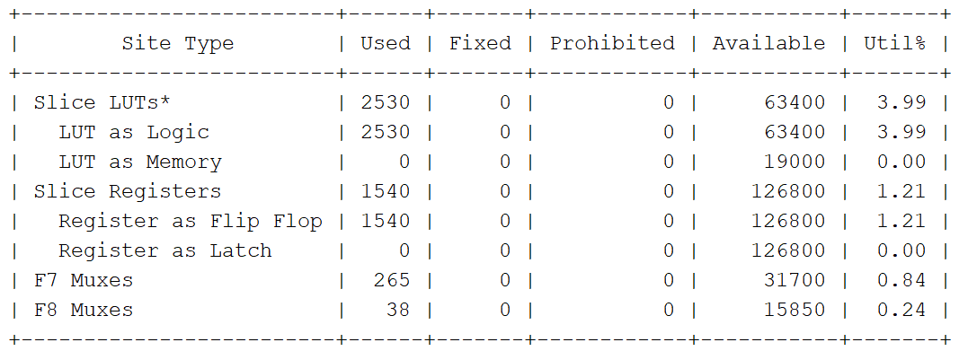
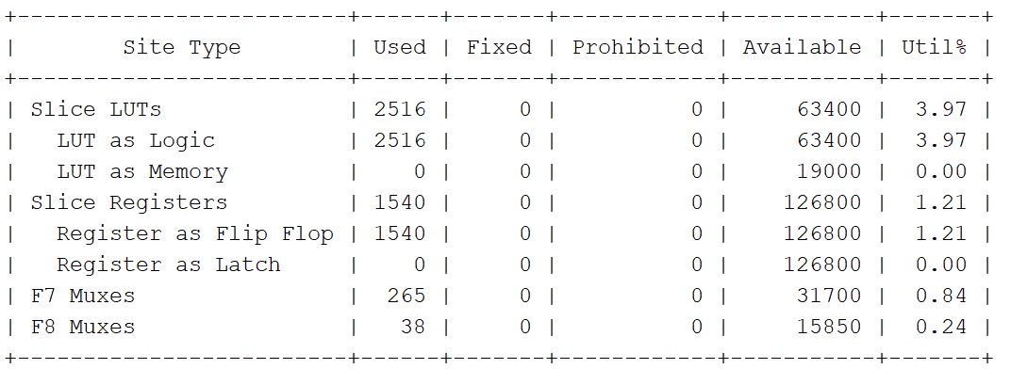
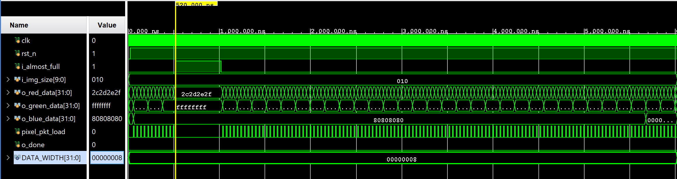
Synthesis
Implementation
Simulation
Pixel_mem simulation

