Slide 1
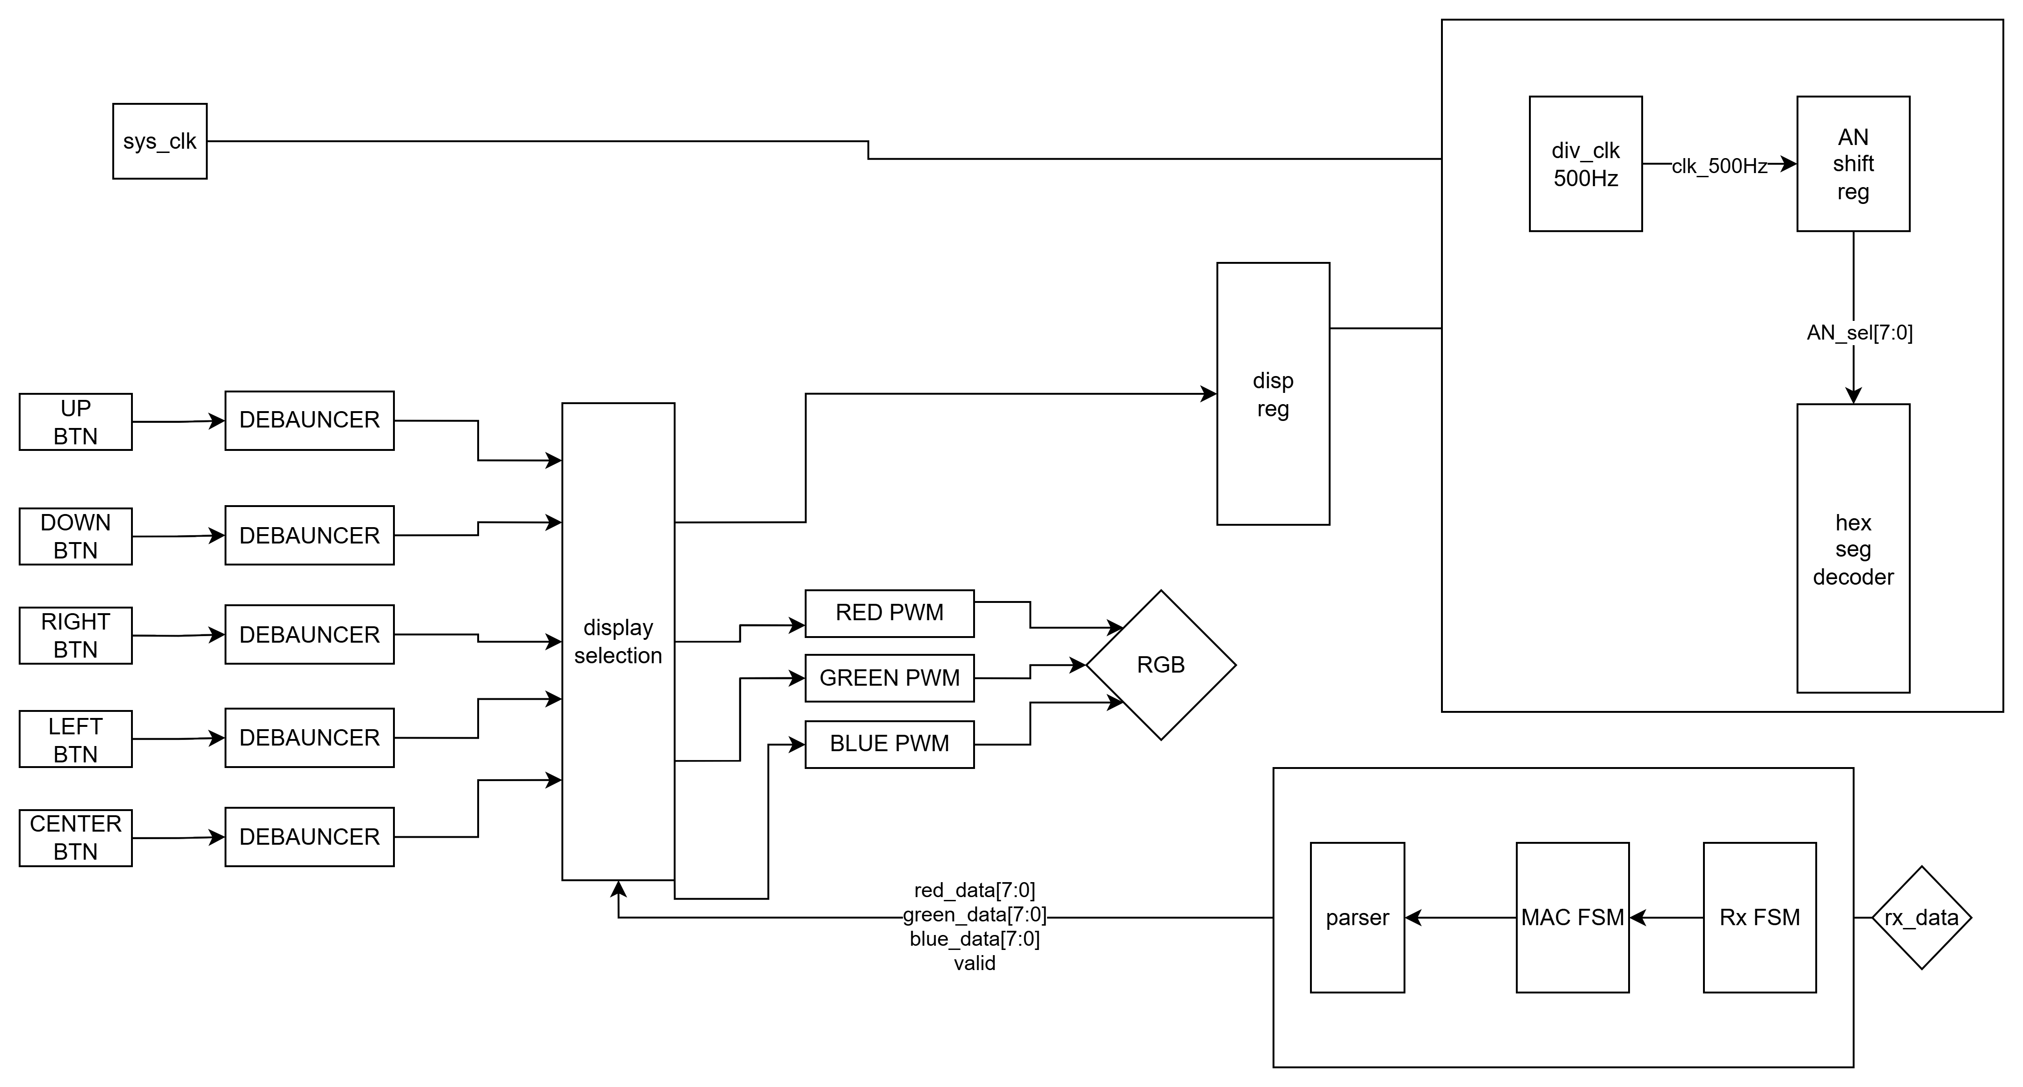
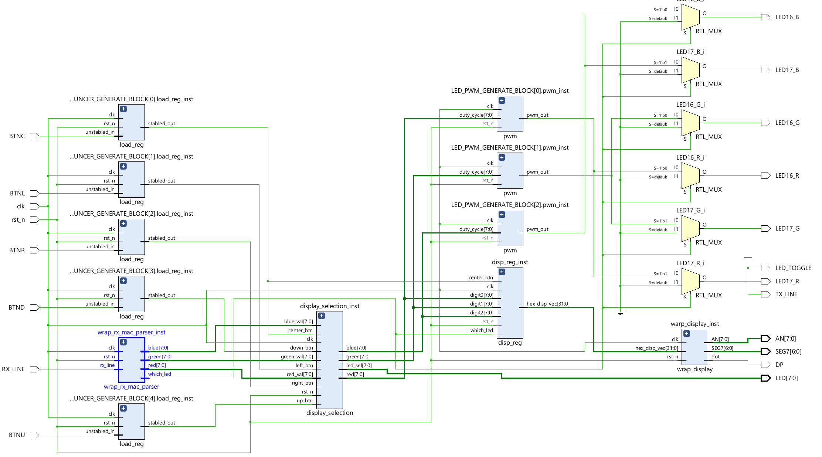
Design process
Block diagram of the system
I/O:
BTNC – loading and Data.
BTNL/BTNR – moving between config states.
SEG7/DP – seven segment display output.
AN – digit shift register output.
LED – config state indicators.
RX LINE – the Rx serial data from the computer.
RGB – out pwm output we control with the Rx input and BTNS.
Blocks:
Load_reg– debouncer for the BTNS.
Wrap_Rx_Mac_Parser – including all the data received path components
Disp_reg – conducting the 7 segment display value in hex for presentation as a 32bit vector.
Wrap_display – displaying the disp register value in the 7 segment (clk_div, shift_reg, disp_decoder).

Slide 2
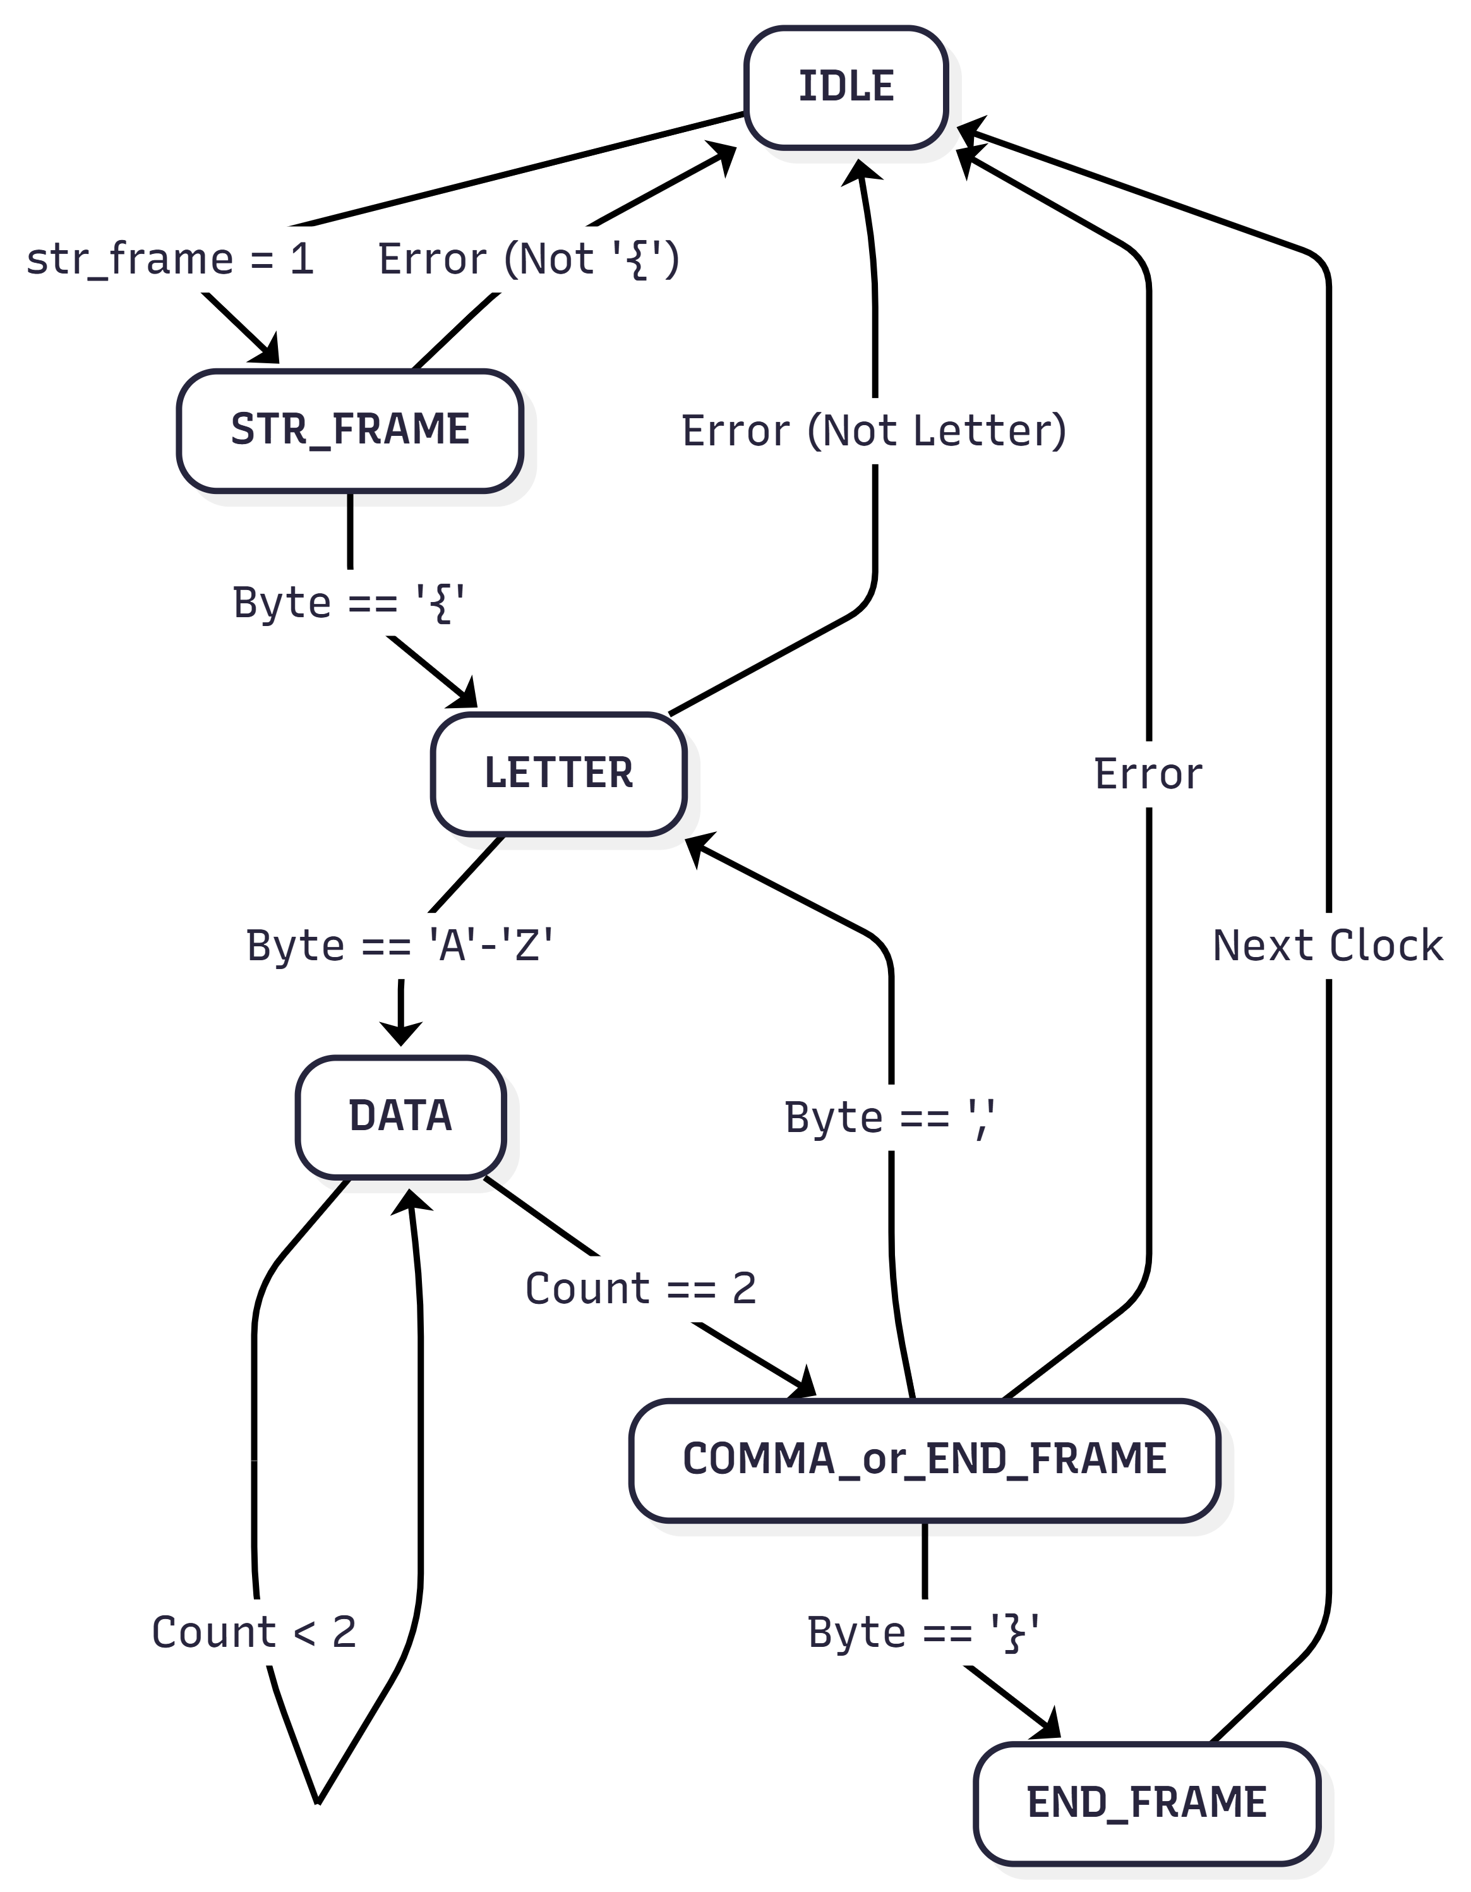
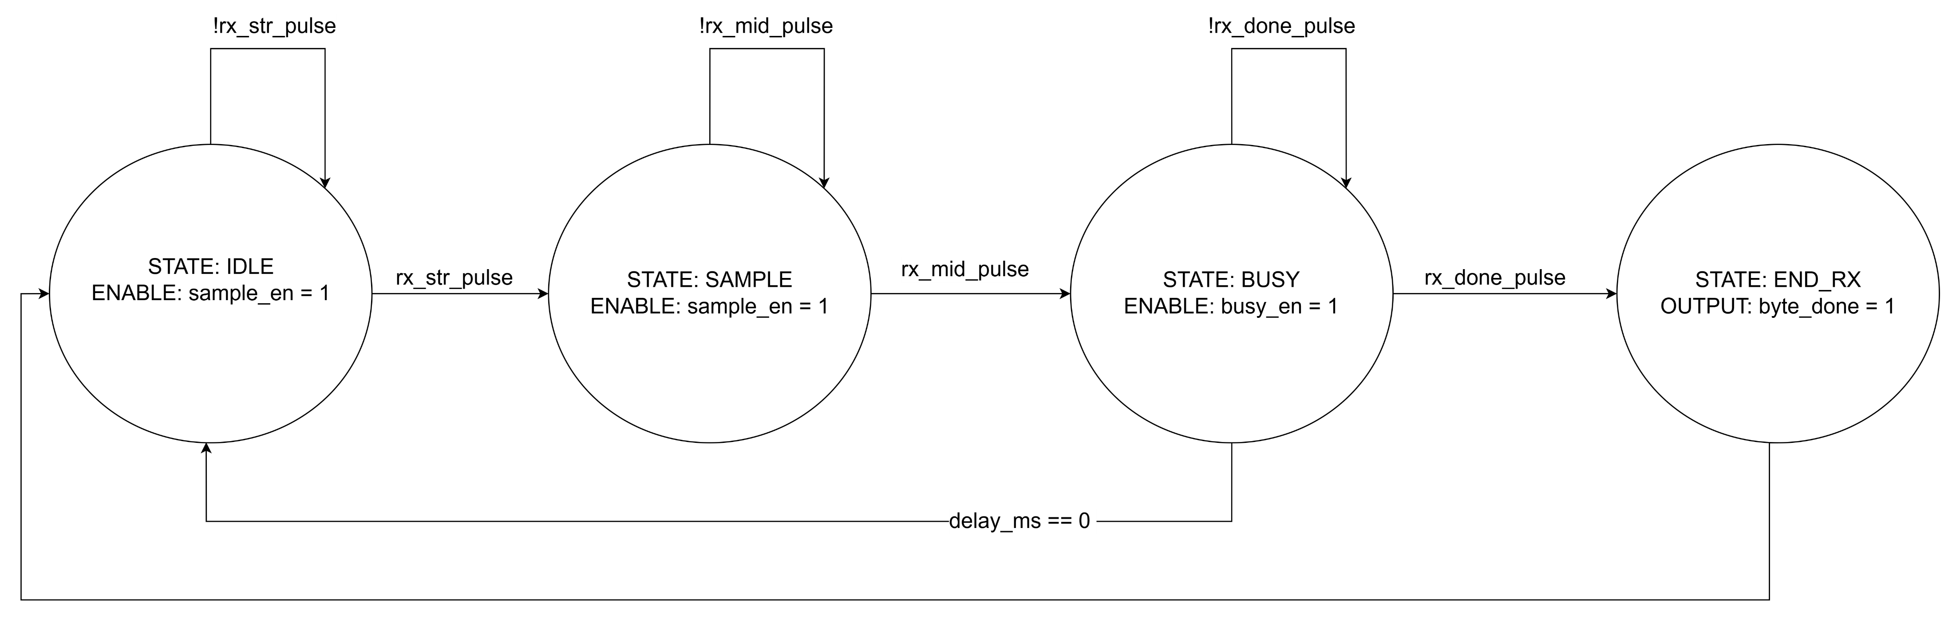
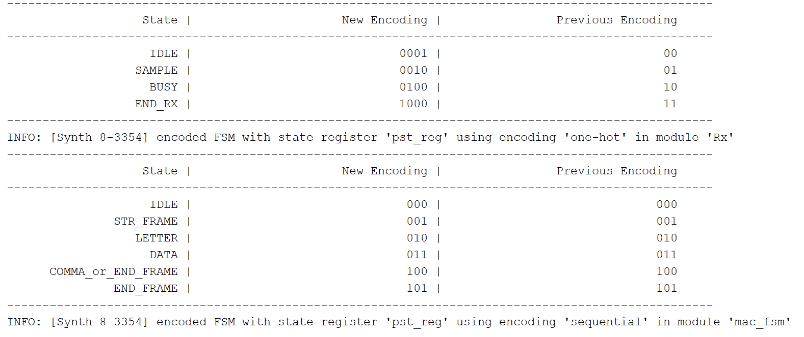
FSM design
mac_fsm
Rx_fsm
Rx_fsm_ff

