Slide 1
Verification Planning Mid Pro

Slide 2
Project Overview & scope
DUT Timer Summery
We are verifying a Timer DUT its main use is to countdown a programable Number loaded with automatic reload operation, the Timer control is achieved with req&gnt interface to control registers.
Verification Objectives
Timing correctness
Data integrity
Functional accuracy behavior
In Scope
Read/Write interface operation
Timer behavior reset/reload_en
Out Scope
Power consumption
Other corner cases not mention
Open questions
What is the internal register use?
Do we need to check all the other option of the Timer?
Does the START bit should posedge in order to restart the count?

Slide 3
Requirements Extraction & RTM
# | Metrics for Success (Exit Criteria)
1. | 100% of Functional Coverage targets met.
2. | All critical and major bugs fixed and verified.
3. | No regression failures for 48 hours.
4. | All tests in the Test Plan are passing.
Req ID | Requirement | Verification Method | Planned Artifact
R1 | Write mod: req -> gnt #3 clk | Assert | Assertion
R2 | Read mod: Rdata -> gnt | Assert | Assertion
R3 | Read/Write bus interface | coverage | Bus interface
Verification Strategy
Strategy Area | Approach
Methodology: | SystemVerilog object-oriented testbench architecture.
Stimulus Strategy: | Constrained-Random, with some Directed tests for corner cases (like Loading zero).
Checking Strategy: | Data checker for the expected results and SVA for the protocol operation
Coverage Strategy: | Coverage of the input/operation mode
Regression/Automation: | Creating a regression/automation baselined tests
Exit Criteria | Code Coverage (100% line/toggle) and Functional Coverage (100% of defined coverpoints).

Slide 4
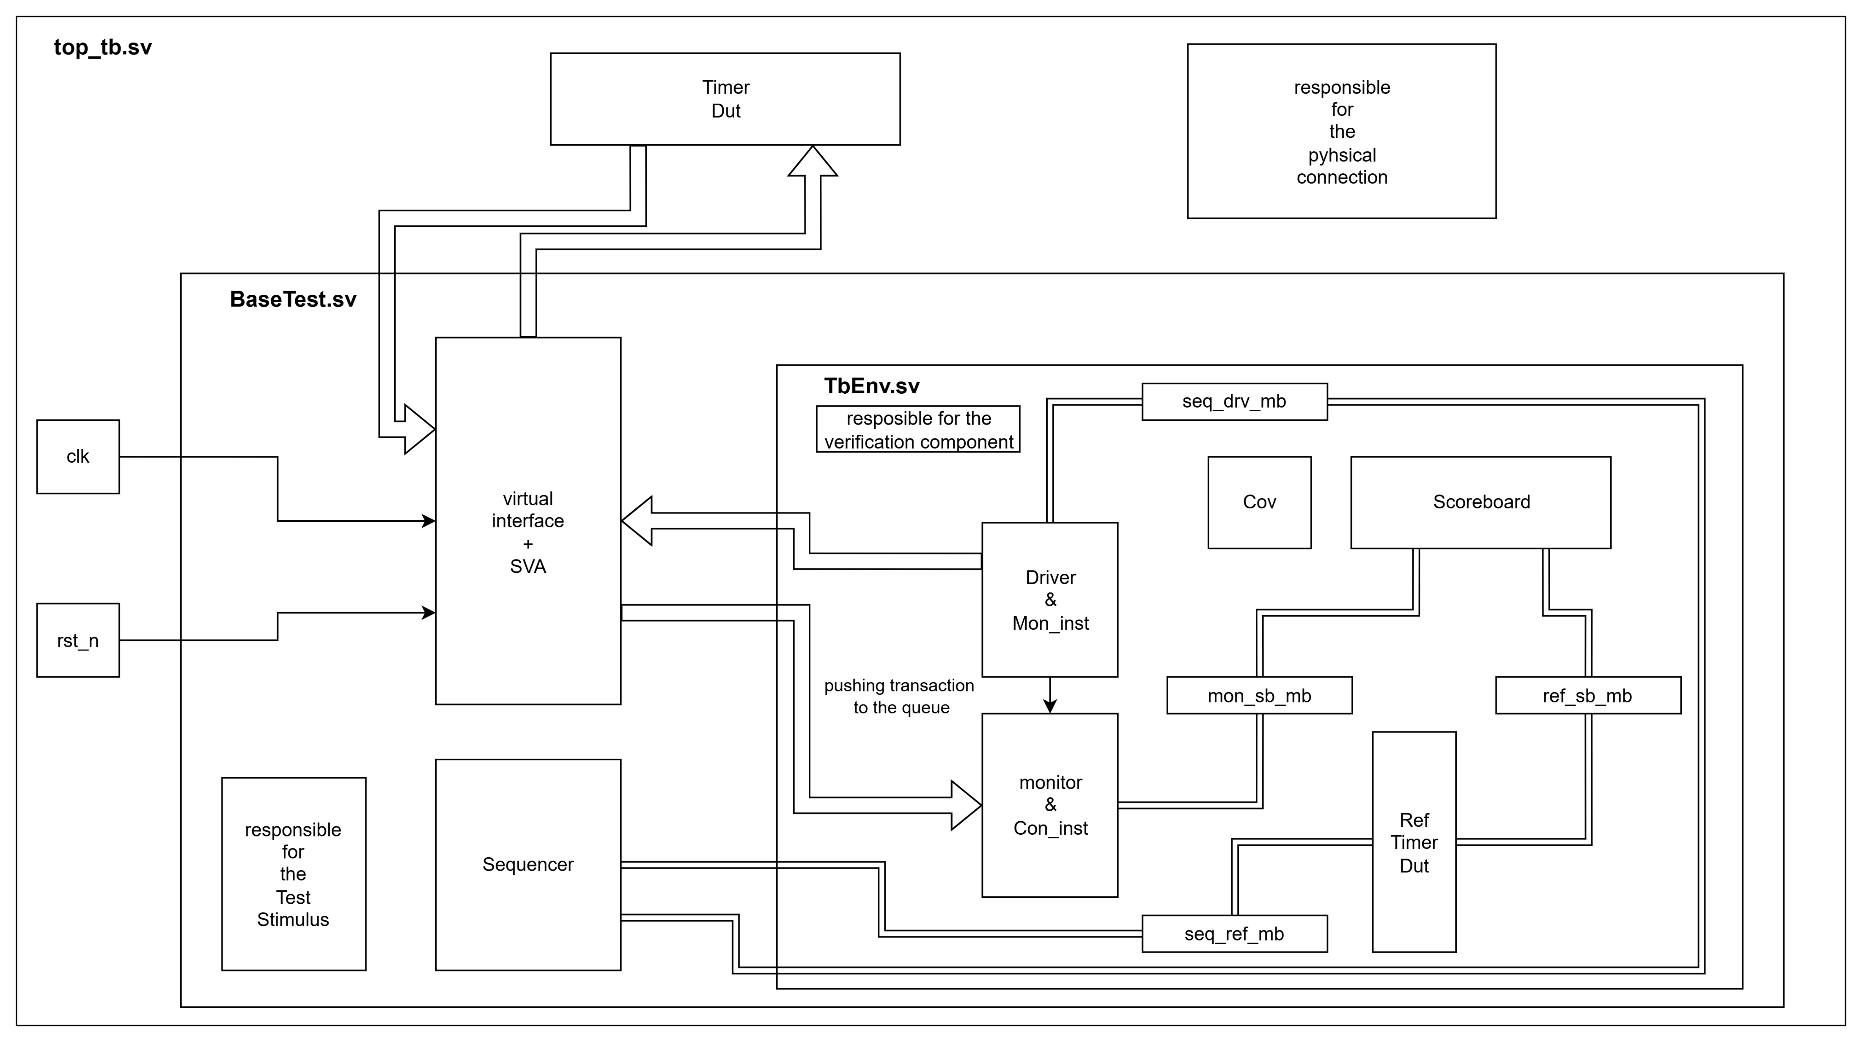
Phase 3 - TB architecture
Sequencer – creating the transactions according to our TB scenarioes
REF_Model – our funvtional module that represent the behave of the DUT as we understand it from the designers.
Driver – drives the transaction though the interface to the DUT.
Monitor - getting the DUT outputs and convert it to transaction and pass it to the SB.
Scoreboard – matching between the REF expected output and the actual output of the DUT.
Timer_dut – out device unit test.
TB – connecting between the physical and the dynamic parts.
Environment – gathering all the dynamic classes into one class as properties.
BaseTest – making test scenarios by a sequence of the sequencer methods.

Slide 5
Phase 4 – covPlan & test scenarios
Timer
START – countdown.
DUT commands
Read/Write.
Nothing.
Cross
Unmapped address.
Corner cases
Reload enable = high/low.
Loading zero.
Start before countdown goes to zero.
Writing while reading mode.
Reloading enable high while countdown.
Reset operation.
Test name | Type | Purpose
Basic operation | Random | Loading valid data and str countdown should stop at the end.
Reset operation | directed | Should stop any operation and get to the ideal state
Reload_en | directed | Should state all over the countdown at the end with STR signal
Unmapped address | Random | Should continue without changing
WR while RD mode | directed | Should ignore the input data
Loading zero | directed | Should load 1 as default
Str while countdown | directed | Should str the countdown all over

Slide 6
Phase 5 – Stimulus Planning
Sequence name | description | Parameters / constraints
seq_load | Basic Write => read transaction | Addr within valid range, Wr_en
Seq_str_II | STR while countdown

Slide 7
Phase 6 – Closure & Reporting strategy
Metric | Target | Justification
Code coverage |  | Why this level is sufficient
Functional coverage |  | Base on coverage goals
Assertion coverage |  | Which properties must trigger
Bug rate/ severity |  | Threshold for tape-out readiness
Reflection
Which req was the hardest to make measurable?
Where could randomization help u close coverage faster?
What assumptions did u have to make about the DUT?

