Slide 1
Empty
Rival
Player

Slide 2
Empty
Rival
Player

Slide 3
Empty
Rival
Player

Slide 4
Empty
Rival
Player

Slide 5








8
Alpha:8
Beta:$∞$
MAX:
MIN:
5
Alpha:5
Beta:$5$
8
Alpha:8
Beta:$8$
MAX:
5
$$∞$$
8
Alpha:8
Beta:$∞$
$$∞$$
Alpha:8
Beta:8
Alpha:5
Beta:$∞$
Alpha:5
Beta:$∞$
5
1
2
9
4
8
7
9

Slide 6






MAX
I
II
$$h=5$$
$$h=6$$
MIN
LEAF
$$u=5$$
$$u=6$$
$$u=4$$
$$u=10$$

Slide 7







$$u=2$$
MAX
MIN
$$u=2$$
$$u=1$$
LEAF
$$u(s_{1})=3$$
$$u(s_{2})=2$$
$$u(s_{3})=1$$
$$u(s_{4})=4$$

Slide 8

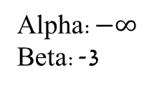

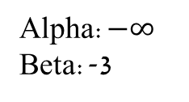


Alpha:$−∞$
Beta:-3
MAX
Alpha:$−∞$
Beta:-3
MIN
LEAF
$$h=−3$$
$$h=2$$
$$h=1$$
$$u=−1$$

Slide 9
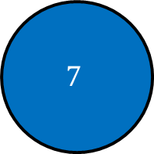
A
MAX:
a3
a1
a2
C=5
CHANCE:
B=2.2
D=6.7
0.3
0.4
0.7
0.4
0.2
0.1
0.9
5
1
2
3
9
4
$$7$$
MIN:

