Slide 1

Hackathon 2021
Amit Zohar , Ofir Nahshoni
Strategy:
3 Modules in Verilog. Only hardware. Read from C file and Mem file.
Difficulties:
Read data from Mem file.
Using arrays in Verilog.

Slide 2
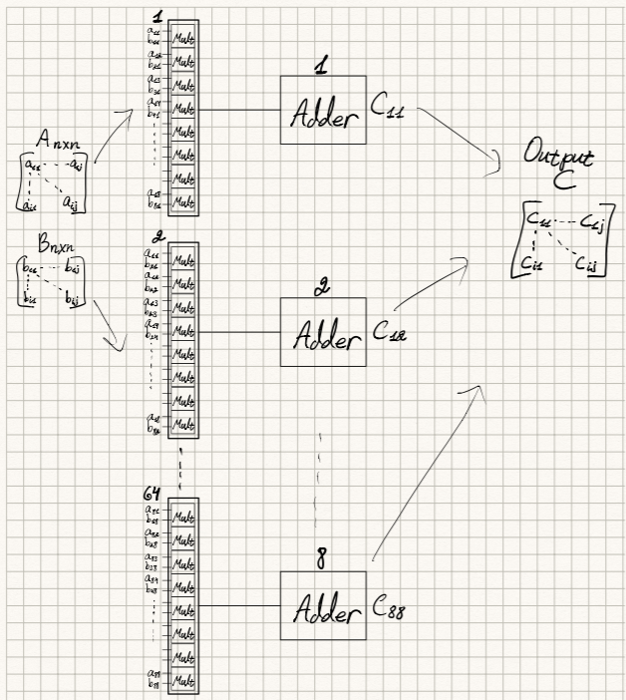
Electric Diagram

Slide 3
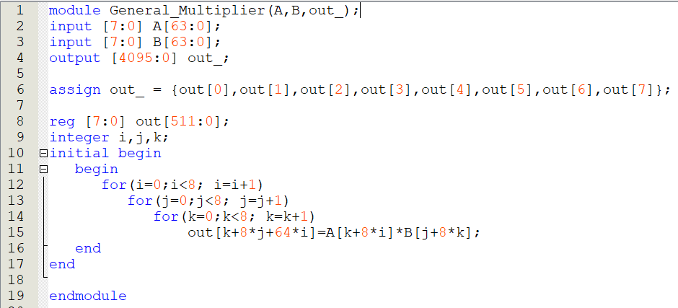
Module – General_Multiplier.v

Slide 4
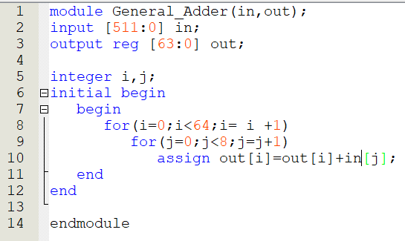
Module – General_Adder.v

Slide 5
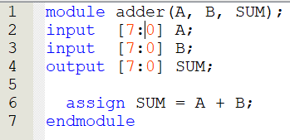
Module – adder.v

