Slide 1

AI Smart Security
Video Violence Detection
A machine-learning model for detecting violence in videos
Machine Learning Final Project, 2026
Institution: HIT | Lecturer: Shimon Turchak
Team: Ofir Duek · Michael Yehoshua · Aviv Meir · Rotem Aloni · Yarin Guberman
Machine Learning Final Project 2026 | AI Smart Security
01

Slide 2



The Human Bottleneck in Scale Surveillance
PROBLEM
Large video volumes create missed detections and delayed responses.
⚠
Missed Events
The Input: Scale
The Filter: Human Limit
Failure to detect a violent incident when it matters
1000+
Cameras
Massive 24/7 video feeds
More streams than humans can inspect
Operator Fatigue
Delayed Response
Limited attention over long shifts
High cognitive load in crowded scenes
Late detection increases operational and public-safety risk
Machine Learning Final Project 2026 | AI Smart Security
02

Slide 3




AI Smart Security: Automated Violence Detection
SOLUTION
Deep learning transforms massive video feeds into actionable, real-time insights.
Validated Accuracy
The Decider: Human Operator
Precisely classifies violent vs. routine behavior, ensuring critical incidents are never missed.
The Input: Scale
The Filter: AI Model
1000+
Cameras
ALERT
Tireless Automation
Focused Verification
Massive 24/7 video feeds
More streams than humans can inspect
Continuous 24/7 video processing using MViT.
Filters out 99% of routine video data.
Operators review only AI-flagged events. Retaining final authority with zero cognitive overload.
Real-Time Alerts
Immediate notifications sent to security forces, enabling rapid response and minimizing risk to human life.
AI does not replace judgment; it reduces the search space and highlights high-risk clips.
Machine Learning Final Project 2026 | AI Smart Security
03

Slide 4
Project Goal
GOAL
Developing a high-accuracy, vision-only deep learning architecture for raw video classification.
Vision-Only Features
Raw Video
Input
100% reliance on spatial-temporal frame sequences. Zero audio dependency.
High-Accuracy Model
Deep Learning
Architecture
Processing raw video segments to extract complex behavioral patterns using advanced neural networks.
Strict Binary Classification
The Output
Classifying the video segment into one of two absolute states:
Non-violence
Violence
Machine Learning Final Project 2026 | AI Smart Security
04

Slide 5
Project Scope & Boundaries
SCOPE
Defining the technical and operational limits of the current implementation.
IN SCOPE
OUT OF SCOPE
Short Video Analysis: Processing and analyzing pre-recorded, short-duration video segments.
Strict Binary Classification: Categorizing footage exclusively as "Violence" or “Non-violence".
Advanced Architecture: Evaluating and implementing Vision Transformer models (MViT v2).
Offline Datasets: Training and validating the model using established, pre-collected video databases.
Real-Time Live Streaming: Direct integration with live edge-camera feeds or CCTV systems.
Granular Categorization: Identifying specific types of violence (e.g., weapons, robbery, riots).
Full End-User Application: Developing a complete Graphical User Interface (GUI) or client-facing dashboard.
Machine Learning Final Project 2026 | AI Smart Security
05

Slide 6
AI-Assisted Security Workflow
SYSTEM
The model prioritizes suspicious clips; humans remain in the decision loop.
1. Camera Input
2. Preprocessing
3. AI Analysis Engine
4. Human Review
Short video segments are collected from surveillance footage.
Clips are sliced, sampled, resized, and normalized for model input.
Feature extraction and violence detection
Security staff reviews prioritized alerts and makes the operational decision.
Machine Learning Final Project 2026 | AI Smart Security
06

Slide 7
Dataset Overview & Distribution
DATA
A robust, perfectly balanced video dataset for unbiased violence detection.
4,700
Filtered labeled clips
Non-violence
50/50
Balanced labels
Violence
Massive Scale: Training and evaluating the model on a comprehensive dataset of over 4,700 short video clips.
Perfectly Balanced: Exactly 50/50 split between "Violence" and "Routine" classes, eliminating model bias.
Diverse Environments: Footage includes indoor/outdoor scenes, day/night settings, and varying lighting conditions to maximize real-world robustness.
Dynamic Split: Data is programmatically divided into Training (80%), Validation (10%), and Testing (10%) sets.
Machine Learning Final Project 2026 | AI Smart Security
07

Slide 8
Dataset Labeling Criteria
DATA
Establishing strict visual parameters to prevent data noise and preserve model accuracy.
Non-violence
Non-violence
Targeted Aggression
Excluded to Preserve Accuracy
Hand-to-Hand Combat: Punching, forceful pushing, kicking, and extended physical struggles.
Active Weapon Use: Actively discharging a firearm or directly aiming a weapon at an individual.
Violence
Violence
Severe verbal arguments (undetectable without audio).
Sharp gestures without contact.
Ambiguous situations without physical action.
Passive weapon carriage: Armed personnel routinely holding weapons without aiming.
Machine Learning Final Project 2026 | AI Smart Security
08

Slide 9
Preprocessing Pipeline: Raw Video to Model Input
PIPELINE
The same deterministic steps must be applied in training and evaluation.
1. Video Slicing
2. Frame Sampling
3. Resize & Normalize
4. Tensor Packaging
5. Label Mapping
OpenCV extracts exactly 16 uniform frames from each clip, capturing the critical motion dynamics required for the transformer.
Frames are resized to a strict 224x224 pixel resolution and normalized to match the input requirements of deep learning architectures.
The 16 individual frames are stacked into an ordered spatio-temporal tensor, enabling the neural network to process motion and sequential logic.
Clip labels are mapped directly to strict binary targets: 0 (Non-violence) and 1 (Violence) for supervised training.
Audio is stripped. Videos are sliced into uniform 3-second clips to reduce compute load while maintaining consistent temporal context.
Fixed preprocessing parameters are kept identical across training, validation, and final evaluation.
Machine Learning Final Project 2026 | AI Smart Security
09

Slide 10
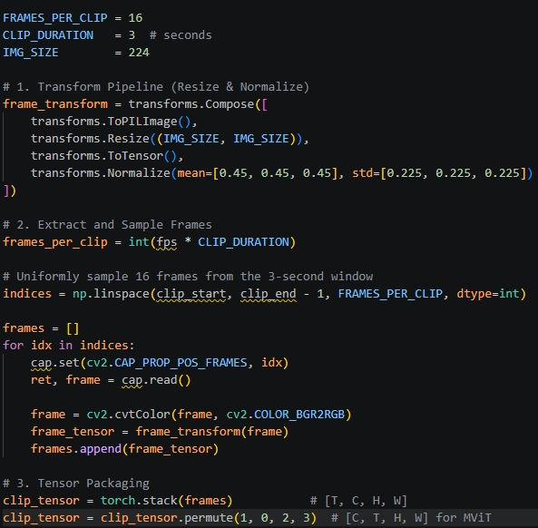
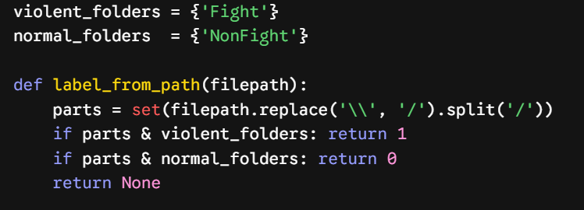
Pipeline Implementation in PyTorch
PIPELINE
Translating the conceptual blocks into deterministic tensor operations.
1. Video Slicing
3. Resize & Normalize
2. Frame Sampling
4. Tensor Packaging
5. Label Mapping
Machine Learning Final Project 2026 | AI Smart Security
10

Slide 11
Baseline Architecture: ResNet50 + LSTM
BASELINE
Establishing the performance floor and identifying temporal limitations.
Video input
ResNet50
LSTM
Classification
The Hybrid Approach
The Structural Limitation
Separating spatial feature extraction from temporal learning causes the model to lose critical dynamic movement context, forcing it to rely on static artifacts rather than true motion.
Utilizing ResNet50 to extract spatial features frame-by-frame, passing them into an LSTM network to capture time-series context.
Machine Learning Final Project 2026 | AI Smart Security
11

Slide 12
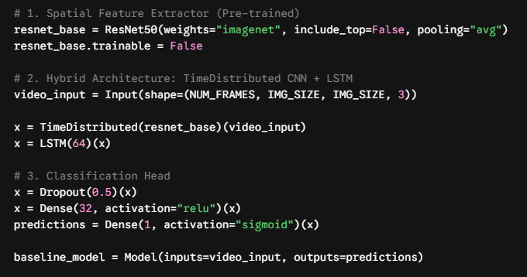
Baseline Implementation: Hybrid Architecture
BASELINE
Translating the spatial-temporal separation into PyTorch logic.
ResNet50 :Spatial Features
Loading pre-trained weights to act as a static, frame-by-frame feature extractor.
LSTM: Temporal Learning
Processing the sequence of ResNet outputs to learn the time-series dynamics of the clip.
Dense Layers: Binary Output
Final fully connected network using a Sigmoid activation to output violence probability.
Machine Learning Final Project 2026 | AI Smart Security
12

Slide 13
Baseline Results: ResNet50 + LSTM
BASELINE
Model collapse and the severe False Positive bias.
Baseline Confusion Matrix
52.6%
51.3%
98.1%
67.4%
Normal
Violence
Accuracy
Precision
Recall
F1-score
Normal
34
437
Poor Generalization: The model achieved only ~53% validation accuracy, essentially performing slightly better than a random guess.
Massive False Positives: The Confusion Matrix reveals a severe bias towards the 'Violence' class, misclassifying 437 out of 471 routine videos as violent.
Conclusion: The low F1-Score (0.67) proves this architecture cannot balance true detections and false alarms. A unified, multi-scale model is mandatory.
Actual
Violence
9
461
Machine Learning Final Project 2026 | AI Smart Security
13

Slide 14
Final Architecture: MViT V2 S
MODEL
Multi-scale Vision Transformer for spatial and temporal understanding.
2. MViT V2 S
3. Binary Head
4. Decision
1. Preprocessed Clip
Ordered frame sequence representing a short video segment.
Multi-scale attention captures patterns at different spatial and temporal resolutions.
Outputs a probability score for Violence vs Non-Violence.
Threshold converts probability into 0/1 label.
Why it fits the task: violence is defined by how bodies move over time, not only by what appears in one frame.
Machine Learning Final Project 2026 | AI Smart Security
14

Slide 15
The Unified Solution: Multi-scale Vision Transformer
MODEL
Shifting to MViT V2 S for simultaneous spatial-temporal attention.
Unified Attention:
Unlike our baseline ResNet-LSTM approach, MViT processes spatial (pixels) and temporal (frames) dimensions simultaneously via 3D Self-Attention.
Multi-Scale Hierarchy:
The model builds feature maps of increasing complexity, learning everything from fine-grained edge detection to global body motion patterns.
Smart Transfer Learning:
We initialized the model with Kinetics-400 pre-trained weights.
By freezing the early feature-extraction layers (which already recognize objects and human figures), we only trained the final layers to specifically classify "Violence." This saved massive compute time and prevented overfitting.
INPUT
16-Frame Tensor (3s)
Technical Strategy
Blocks 0-13 Locked:
Preservation of spatial-temporal weights pre-trained on Kinetics-400.
Blocks 14-15 Unlocked:
Adaptive learning of high-level aggression and
physical struggle dynamics.
Custom Binary Head:
Fully trained classifier mapping transformer features to a 0.0-1.0 Violence Probability score.
Blocks 0
(Cube embedding)
FROZEN
Blocks 1-13
(Spatial-temporal attention)
Blocks 14-15
FINE-TUNING
Machine Learning Final Project 2026 | AI Smart Security
15

Slide 16
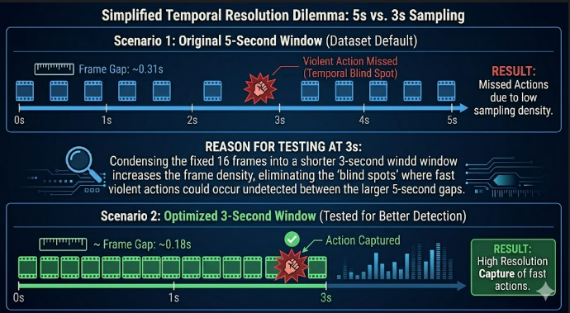
The Dataset & Temporal Resolution Challenges
MODEL
Overcoming dataset constraints, unpredictable inputs, and temporal blind spots.
Dataset Constraints & Sliced Actions
Most videos in the dataset were pre-cut into 5-second clips. Longer videos were sliced arbitrarily, often cutting the violent action right in the middle.
Real-World Uncertainty
In a real-world scenario, we cannot predict the length of the input video or when the violence will occur. Our system must be able to handle arbitrary, unsegmented video streams.
The 16-Frame Blind Spot
Spreading the required 16 frames across a full 5-second video yielded a low sampling rate (1 frame per ~0.31s). Fast, dynamic actions-such as a quick punch-often slipped entirely between frames.
The 3-Second Dilemma
We shrank the input window to 3 seconds to increase frame density and capture rapid motion.
However, this introduced a new risk: taking only a 3-second chunk might completely miss or cut the violence within the clip…
Machine Learning Final Project 2026 | AI Smart Security
16

Slide 17


Temporal Optimization: The Probability Math
MODEL
Balancing computational cost with 100% video coverage probability.
The Single-Epoch Constraint
Randomly cropping 3 seconds out of a 5-second clip gives us a 60% coverage window. This means a single training pass carries a 40% risk of completely missing the violent action.
The Probability Equation
By applying Random Temporal Cropping, what is the probability of capturing the violent event across E epochs?
$$P\left(\text{Capture}\right)=1−{\left(1−W\right)}^{E}$$
(Where W = 0.6 represents our 60% temporal window)
The 25-Epoch Sweet Spot
Running exactly 25 Epochs guarantees statistical certainty:
$$P\left(\text{Capture}\right)=1−{\left(0.4\right)}^{25}≈99.99\%$$
Result: This acts as massive temporal Data Augmentation, ensuring complete video analysis from multiple angles without wasting infinite GPU training time.
Machine Learning Final Project 2026 | AI Smart Security
17

Slide 18
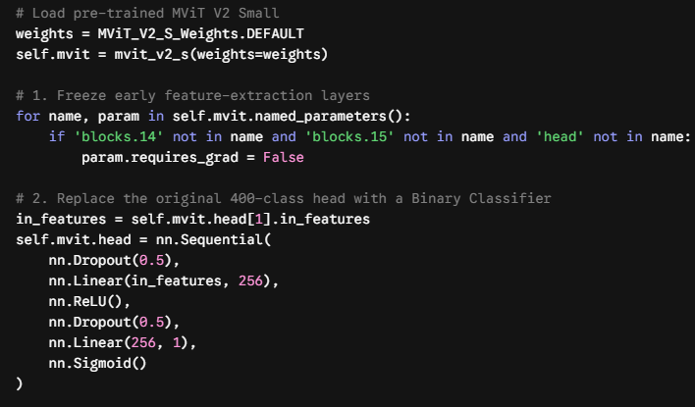
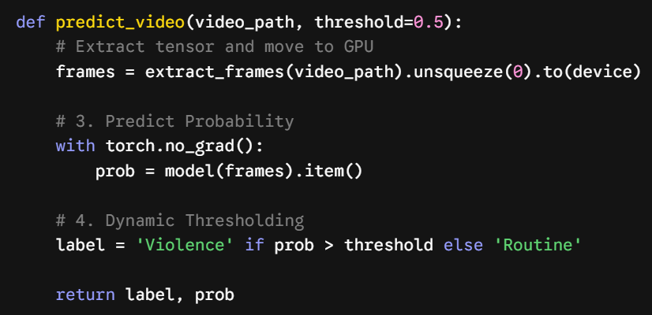
MViT Implementation & Dynamic Thresholding
MODEL
Translating transfer learning and decision boundaries into PyTorch logic.
Layer Freezing
Locking early layers to preserve pre-trained Kinetics-400 knowledge (object/human detection) and save compute resources.
Dynamic Thresholding
Converting the continuous probability score into a definitive security alert based on a customizable threshold.
Binary Head
Custom classification head ending with a Sigmoid activation to output a continuous violence probability (0.0 to 1.0).
Machine Learning Final Project 2026 | AI Smart Security
18

Slide 19
Final Results: Strong Class Separation
RESULTS
MViT V2 S learns spatial-temporal patterns and sharply reduces false alarms.
Final Model Confusion Matrix
Normal
Violence
94.0%
93.9%
96.4%
Validation Accuracy
F1-score
Precision
Normal
228
8
91.5%
97.6%
Actual
Recall
AUC
Violence
20
215
Decision threshold: 0.5; predictions above the threshold are classified as Violence.
Machine Learning Final Project 2026 | AI Smart Security
19

Slide 20
Training Methodology and Technology Stack
TRAINING
Controlled training setup for reproducible model comparison.
Technology Ecosystem
Training Setup
Overfit Control
PyTorch / neural network training
OpenCV / video frame extraction
NumPy + Pandas / analysis
scikit-learn / metrics
Matplotlib / visualizations
Optimizer: AdamW
Loss: Binary Cross-Entropy
Epochs: 25 cycles
Data augmentation for generalization
Pretrained weights + fine-tuning
Strict train/validation/test split
Continuous metric tracking
Early stopping on overfitting
Dropout and weight decay
Validation curves used for diagnosis
Machine Learning Final Project 2026 | AI Smart Security
20

Slide 21
Performance Delta: Baseline vs. MViT V2 S
COMPARISON
Use metrics and rates to compare fairly across evaluation splits.
Metric
Baseline
Change
Final MViT V2 S
Accuracy
52.6%
+41.4 percentage points
94.0%
F1-score
67.4%
+26.5% absolute gain
93.9%
Precision
51.3%
+45.1% absolute gain
96.4%
False positive rate
92.8%
≈96% relative reduction
3.4%
Interpretation: the final model preserves high recall while dramatically reducing false alarms compared with the baseline.
Machine Learning Final Project 2026 | AI Smart Security
21

Slide 22
Error Typology and Real-World Constraints
LIMITATIONS
The prototype is strong, but deployment requires robustness beyond the dataset.
FALSE ALARMS
MISSED EVENTS
Normal classified as Violence
Violence classified as Non-Violence
Likely causes
Likely causes
Intense sports or rough play
Group dancing or rapid crowd motion
Sudden camera jerks
Unusual body movement without aggression
Occlusion and hidden action
Very short aggression under the clip window
Low lighting or visual noise
Camera angles that hide contact
Machine Learning Final Project 2026 | AI Smart Security
22

Slide 23
Development Roadmap
NEXT STEPS
future work scales toward real-world deployment.
Real-Time Inference
Architecture Scaling
Localization
Multi-Class Detection
Longer Context
Optimize code for live-stream throughput.
Explore stronger video transformers and compression.
Add bounding boxes to identify where the action occurs.
Expand beyond binary labels to robbery, vandalism, fights, etc.
Remember longer sequences to improve event understanding.
1
2
3
4
5
Machine Learning Final Project 2026 | AI Smart Security
23

Slide 24
Prototype Performance Summary
SUMMARY
A strong foundation for AI-assisted video violence detection.
94.0%
93.9%
97.6%
Validation Accuracy
Final F1-score
AUC
From random-like baseline behavior to reliable AI-assisted clip prioritization.
Next step: external validation, speed benchmarking, and human-review integration before real-world deployment.
Thank you
Machine Learning Final Project 2026 | AI Smart Security
24

