Slide 1

Zoom Behavior Insight
Presented by:
Ofir Duek , Aviv Meir , Rotem Aloni

Slide 2
Project Review
Problem
What’s new since the first presentation:
Switched from 0 - 100% statistics to categorical behavior labels.
Novelty / Contribution
In online classes, instructors can’t reliably infer students’ behaviors from a single webcam feed (e.g., gaze, privacy, headphones, or object usage).
Our Goal
Given a single Zoom-like
We output multiple
webcam frame, predict
a discrete behavior
vector:
Gaze, Headphones,
Environment, Privacy,
Object-in-hand (incl.
Unknown).
Set strict labeling rules with Unknown when evidence is missing.
Started the data pipeline: real Zoom-like samples + synthetic augmentation.
interpretable behaviors
(not a single engaged
score) and use controlled
synthetic augmentation
to cover rare cases.

Slide 3

Related Work
Paper (Year) | Task | Signals / Cues | Method / Model | Data | How it relates to us
Stungage (2022)[1] | Engagement monitoring | Webcam video + meeting context | Real-time system + ML pipeline | Online meeting sessions | We predict a multi-attribute behavior vector from a single Zoom-like frame (not see engagement score).
Facial behavior engagement (2022/2023)[2] | Engagement estimation | Face cues (gaze, head pose) | Sequence model (LSTM on face features) | Online learning webcam videos | Similar gaze setting, but we output multiple behavior labels (incl. Unknown) and add non-face cues.
Emotion + eye/head (2019)[3] | Engagement classification | Emotion + eye/head movement | ML classifier on multi-cue features | Webcam e-learning sessions | Multi-cue idea fits; we extend cues to privacy / environment / object-in-hand and handle missing evidence with Unknown.

Slide 4
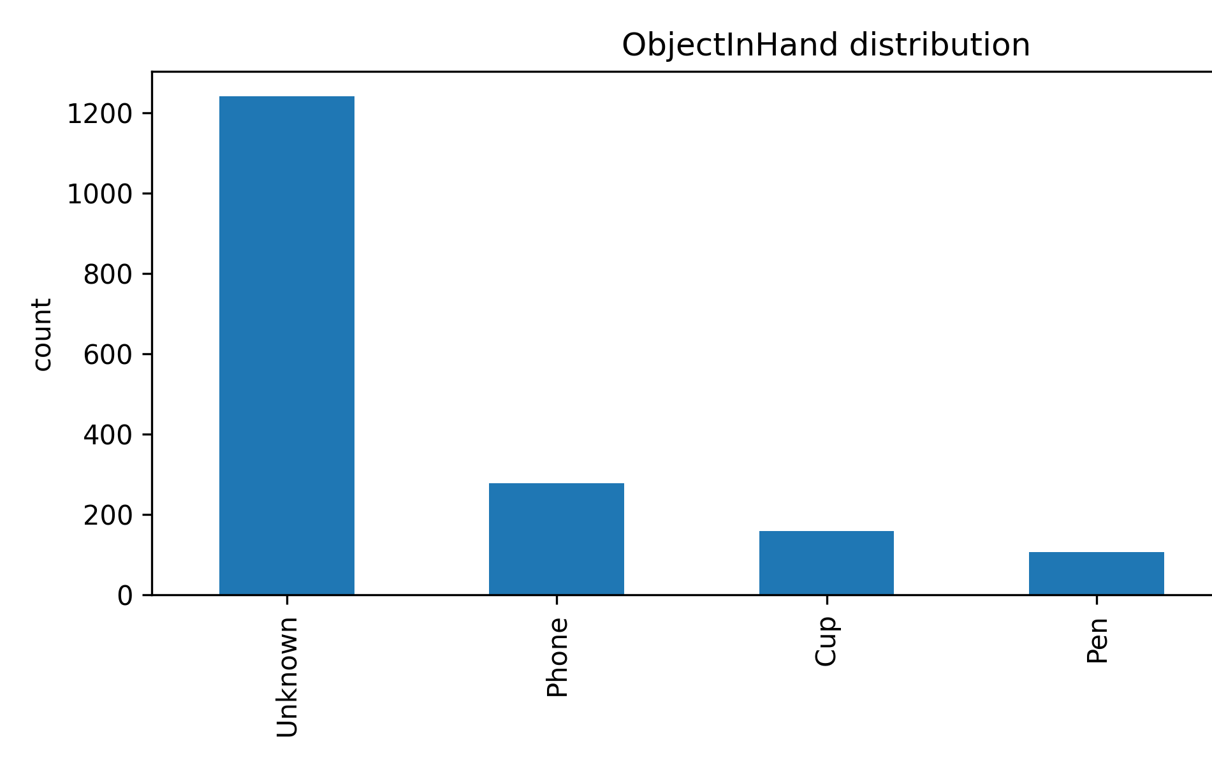
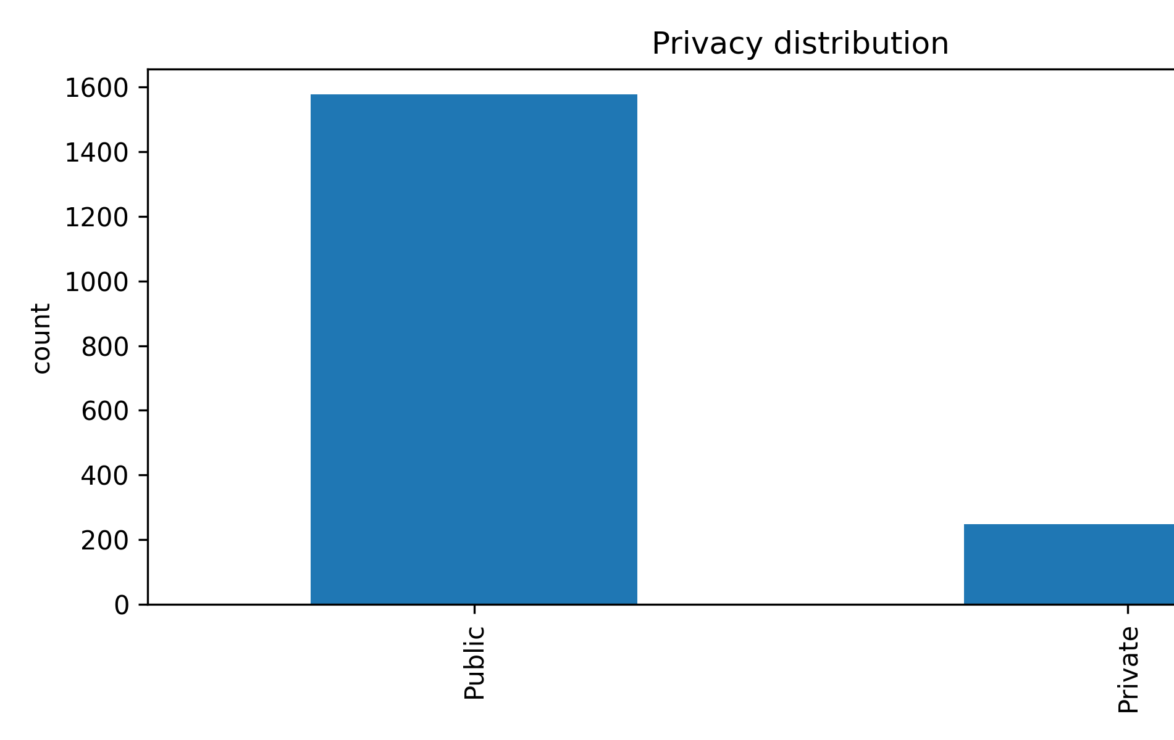
Dataset Overview + EDA
Our dataset combines real Zoom-like photos and synthetic images.
Each image is labeled with a 5-attribute discrete behavior vector, including Unknown when evidence is missing.
EDA: class distributions per attribute to identify imbalance and guide augmentation.

Slide 5
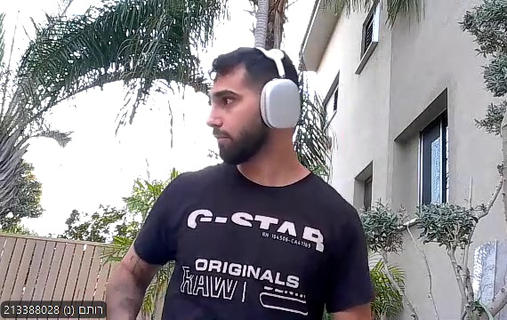
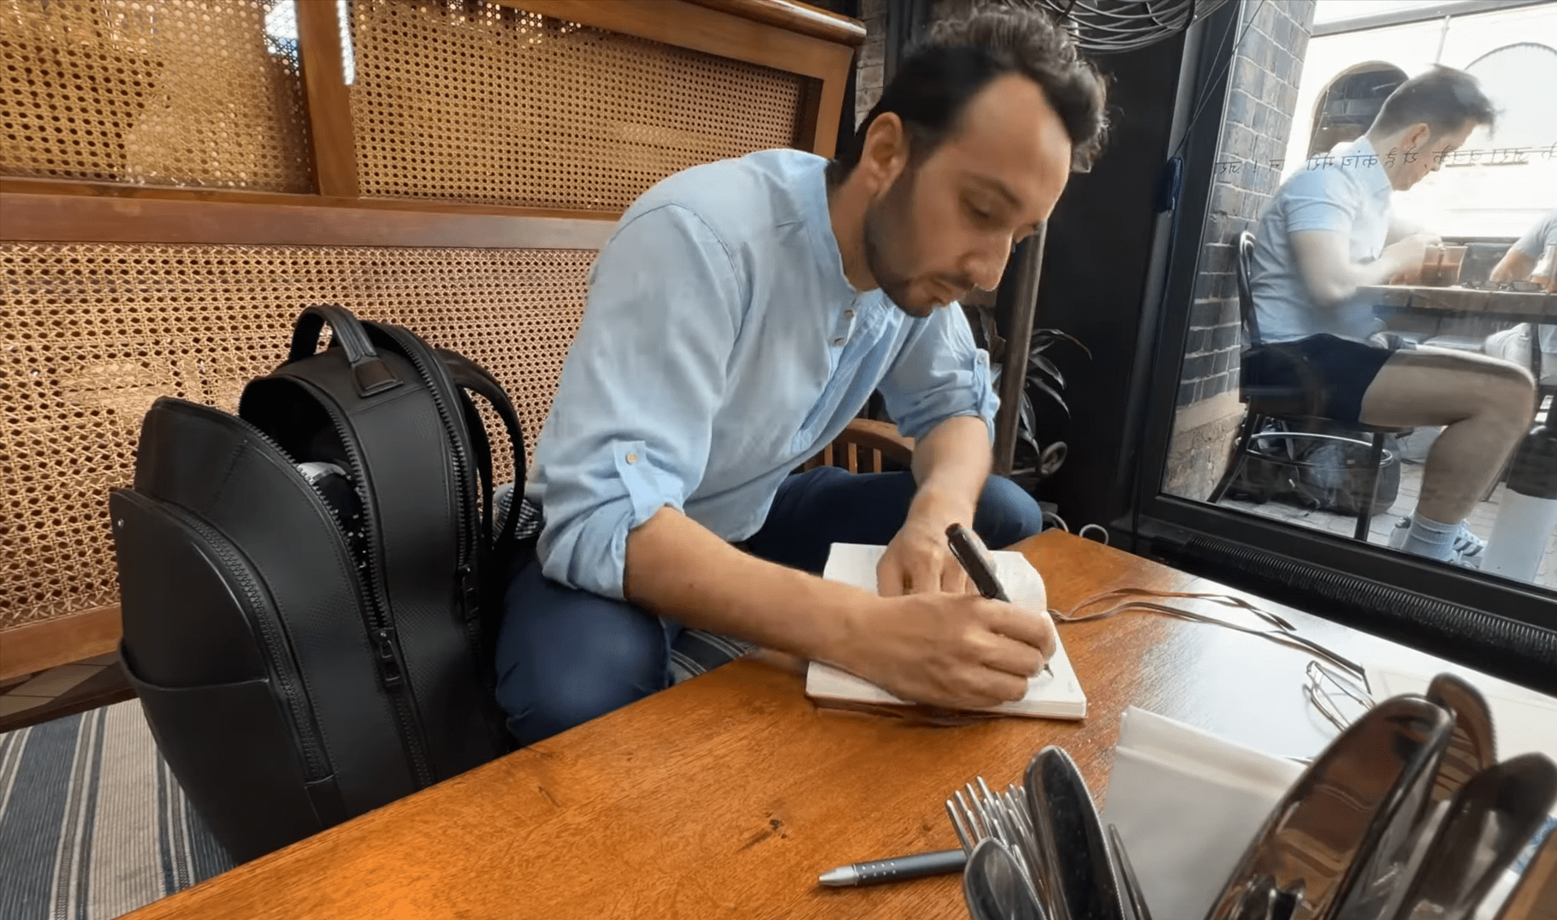
Real Data
Labels:
Gaze = Not_Camera, Headphones = With_Headphones, Environment = Outdoor, Privacy = Private, ObjectInHand = Unknown
Real Zoom-like images from team-captured photos and public online datasets.
Used as the most realistic reference for training and evaluation.
Labels:
Gaze = Not_Camera, Headphones = Without_Headphones, Environment = Outdoor, Privacy = Public, ObjectInHand = pen

Slide 6


Stable Diffusion (Text-to-Image)
Generated images from scratch using prompts.
Used to control behaviors and increase rare cases.
Sample prompts:
  Zoom-style webcam photo, gaze at camera, with headphones, outdoor public background with blurred people, holding a pen in hand. Realistic, natural daylight, shallow depth of field, sharp subject.
  Zoom-style webcam photo, eyes closed, with headphones, indoor private setting, holding a cup in hand. Realistic, soft light, shallow depth of field, centered framing.

Slide 7
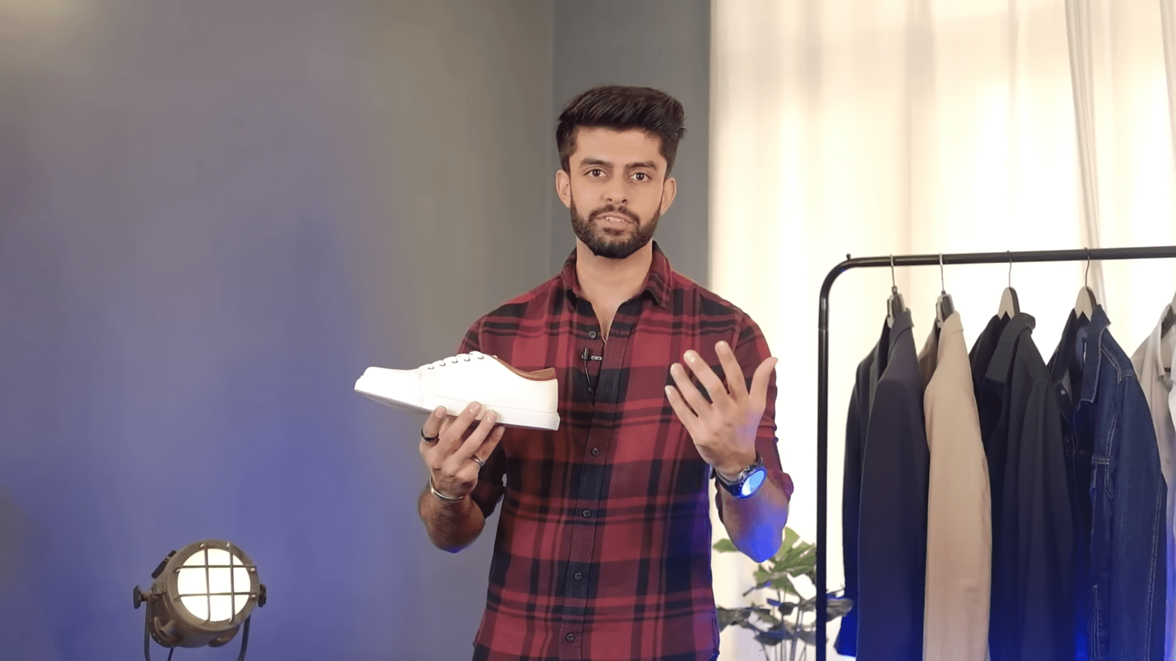
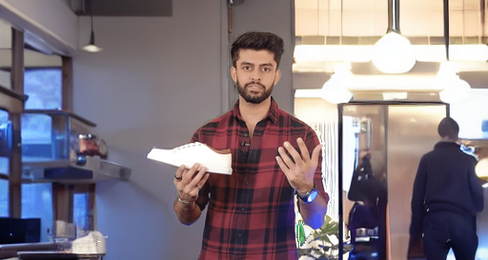
Inpainting background replacement
Replace the background only to control Environment and Privacy labels.
Keep the same subject to reduce confounding factors.
Produces paired samples: Before → After with consistent appearance.
Same subject, different context
Before
After

Slide 8
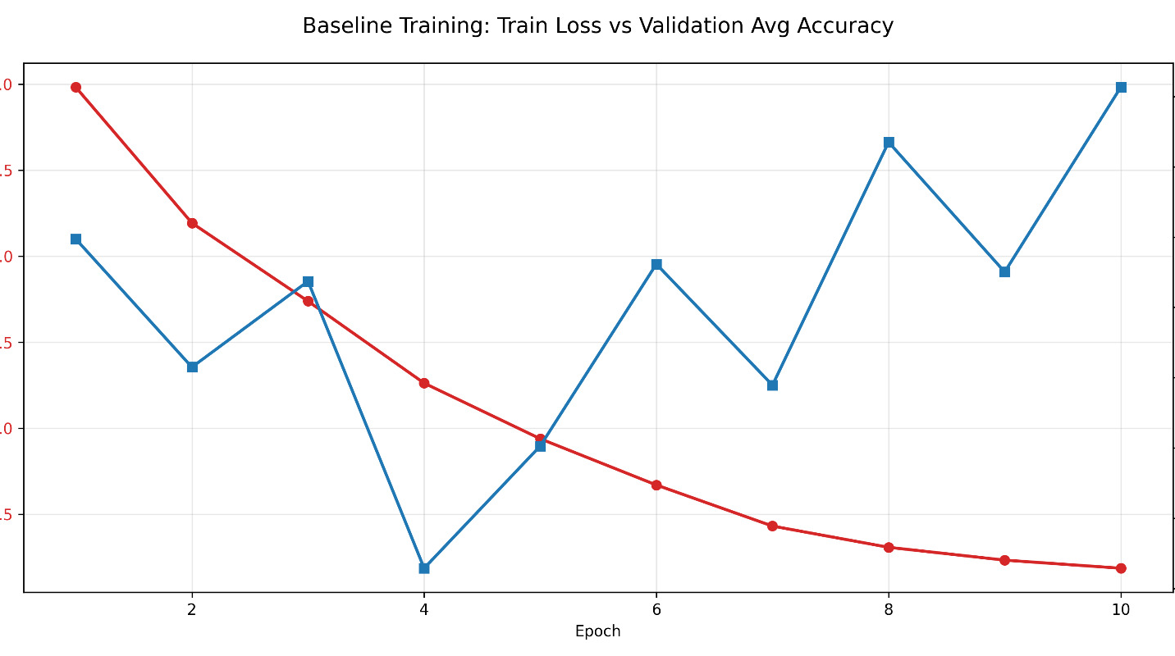
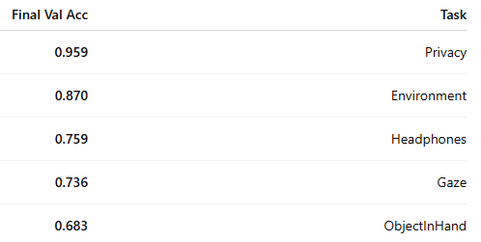
Baseline Model (ResNet18 Multi-Task) - Results
Baseline setup:
Model: ResNet18 (ImageNet pretrained), with one classification head per behavior.
Training: 10 epochs, batch=32, Adam lr=1e-3, 80/20 train–val split.
Key takeaway:
Train loss decreases strongly while validation avg accuracy changes only mildly → baseline overfitting.
Validation performance is uneven across tasks (best: Privacy, hardest: ObjectInHand).

Slide 9
Next Steps
Train an improved model on the finalized dataset (stronger baseline + regularization).
EDA-driven data balancing: add targeted real/synthetic samples for rare classes.
Evaluate on a held-out real test set and report per-behavior metrics.
Error analysis + prototype demo: input one Zoom-like frame → output the behavior vector.

