Slide 1
PATH PLANNING FOR
AUTONOMOUS VEHICLES
Dijkstra's Shortest-Path Algorithm • Weighted Terrain • 7 Obstacles
ENPM 661 — Robot Motion Planning
2026
1 / 12

Slide 2
AGENDA
01
02
Problem Statement & Motivation
Dijkstra Algorithm Theory
03
04
Weighted Terrain Model
Obstacle Map
05
06
Implementation Architecture
GUI Demonstration
07
08
Results & Analysis
Conclusions & Future Work
2 / 12

Slide 3
PROBLEM STATEMENT
The Challenge
Why It Matters
• Navigate a 300 × 200 grid from any start to any goal
• Real AVs do not treat all drivable space equally
• Avoid 7 static obstacles (circle, ellipse, triangles, rhombus, rod)
• Roads: fast, smooth, predictable (cost × 1.0)
• Respect robot body radius + safety clearance
• Open space: slower, less predictable (cost × 2.5)
• Prefer paved road bands over open space and off-road terrain
• Off-road / sidewalks: rough, unsafe (cost × 6.0)
• Find the globally optimal weighted path — no approximations
• Path planner must balance geometry AND terrain cost
3 / 12

Slide 4
DIJKSTRA'S ALGORITHM
1
Assign cost ∞ to every node; start node cost = 0
2
Push start into a MIN-HEAP (priority queue)
3
Pop node with the LOWEST cumulative cost
4
For each unvisited neighbour, compute: new_cost = current + edge_weight
5
If new_cost < neighbour's best known cost → update & push to heap
6
Repeat until goal is popped (optimal!) or heap empty (no path)
Edge weight = base_move_cost × avg_terrain_cost(from, to) × step_size [straight: 1.0 × cost × step, diagonal: √2 × cost × step]
4 / 12

Slide 5
WEIGHTED TERRAIN MODEL
ROAD
× 1.0
OPEN
× 2.5
OFF-ROAD
× 6.0
• Paved lanes (dark green bands)
• Parking lots, plazas (default background)
• Sidewalks, rough terrain (dark blue bands)
• 3 horizontal bands at rows 30–50, 90–110, 150–170
• All rows not in road or off-road zones
• 4 bands at rows 1–20, 60–80, 120–140, 180–200
• Cheapest — AV actively seeks these rows
• Moderate cost — acceptable but not preferred
• Most expensive — AV detours around these
KEY INSIGHT: Dijkstra routes the vehicle through road bands even if a straight diagonal path through open space is geometrically shorter.
5 / 12

Slide 6
OBSTACLE MAP — 7 SHAPES
Circle
Centre (150, 225), radius 25
Analytic: dist = r² − (r_obs + c_r)²
Ellipse
Centre (100, 150), axes 20 × 40
Normalised Euclidean ≤ 0
Triangle 1
Vertices ≈ (120,20), (150,50), (185,25)
Half-plane intersection (all ≤ 0)
Triangle 2
Vertices ≈ (150,50), (185,25), (185,75)
Half-plane intersection (all ≥ 0)
Rhombus
Centre (25, 225), 4 corners
Four half-planes (all ≥ 0)
Rectangle
Tilted diamond near row 75, col 150
Four half-planes (all ≤ 0)
Rod
Diagonal bar, rows 30–76, cols 30–95
Four half-planes, mixed sign
All obstacles are inflated analytically by c_r = clearance + radius before path validation.
6 / 12

Slide 7
IMPLEMENTATION ARCHITECTURE
utils.py
Dijkstra class: boundary checks, 8-directional search, terrain costs, lazy-deletion heap, CLI video export. Owns ROAD_ROWS / OFFROAD_ROWS — single source of truth.
gui_config.py
All visual constants: colors, grid size, slider ranges, defaults. Imports zone boundaries from utils.py and derives TERRAIN_ZONES automatically — no duplication.
gui_canvas.py
PathCanvas (subclass of tk.Canvas): draws terrain shading, inflated obstacles (60k cell scan), explored cells per animation frame, final path, start/goal markers.
gui.py
DijkstraGUI: wires sliders, buttons, canvas, and the frame-by-frame animation loop. 150 ms debounce on slider redraws. Entry point via main().
dijkstra.py
CLI wrapper: prompts for inputs, validates, runs search, exports dijkstra_path.avi. All logic under if __name__ == '__main__': — safe to import.
7 / 12

Slide 8
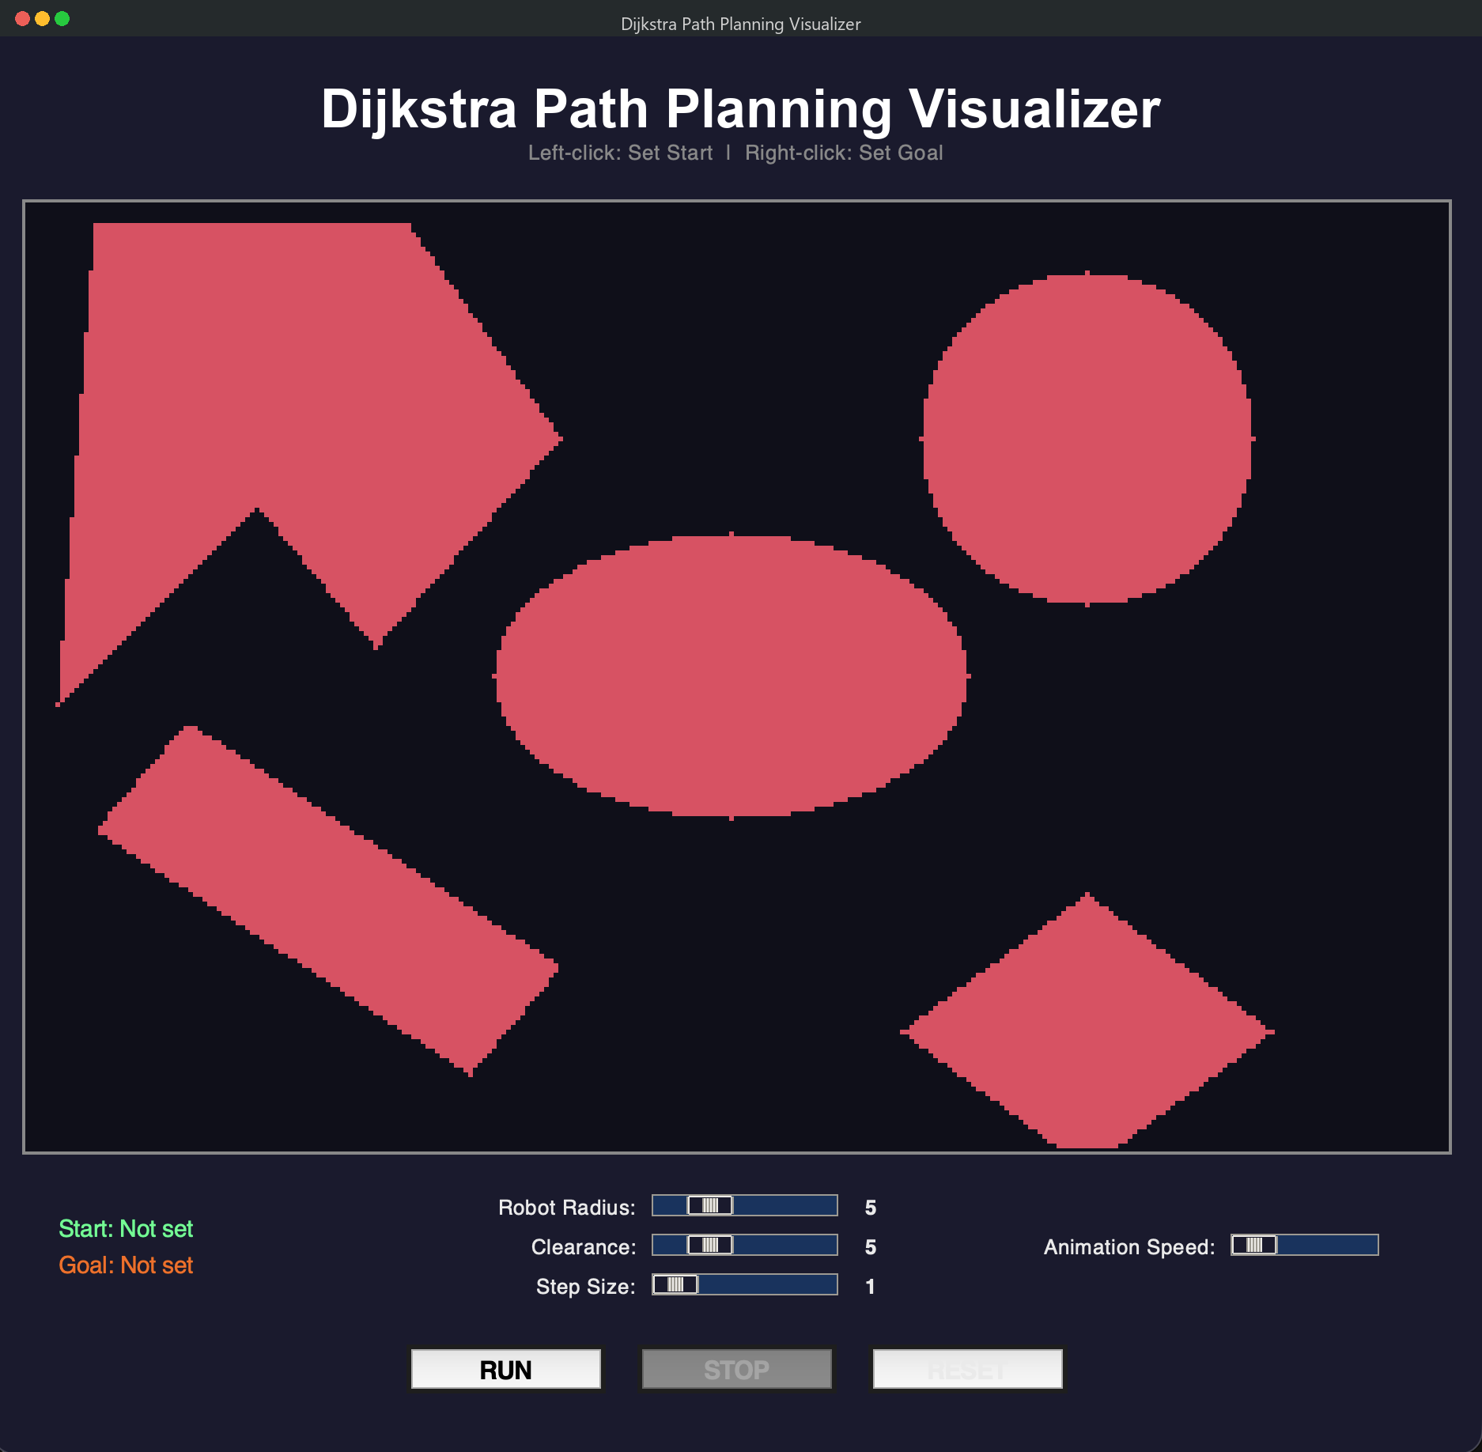
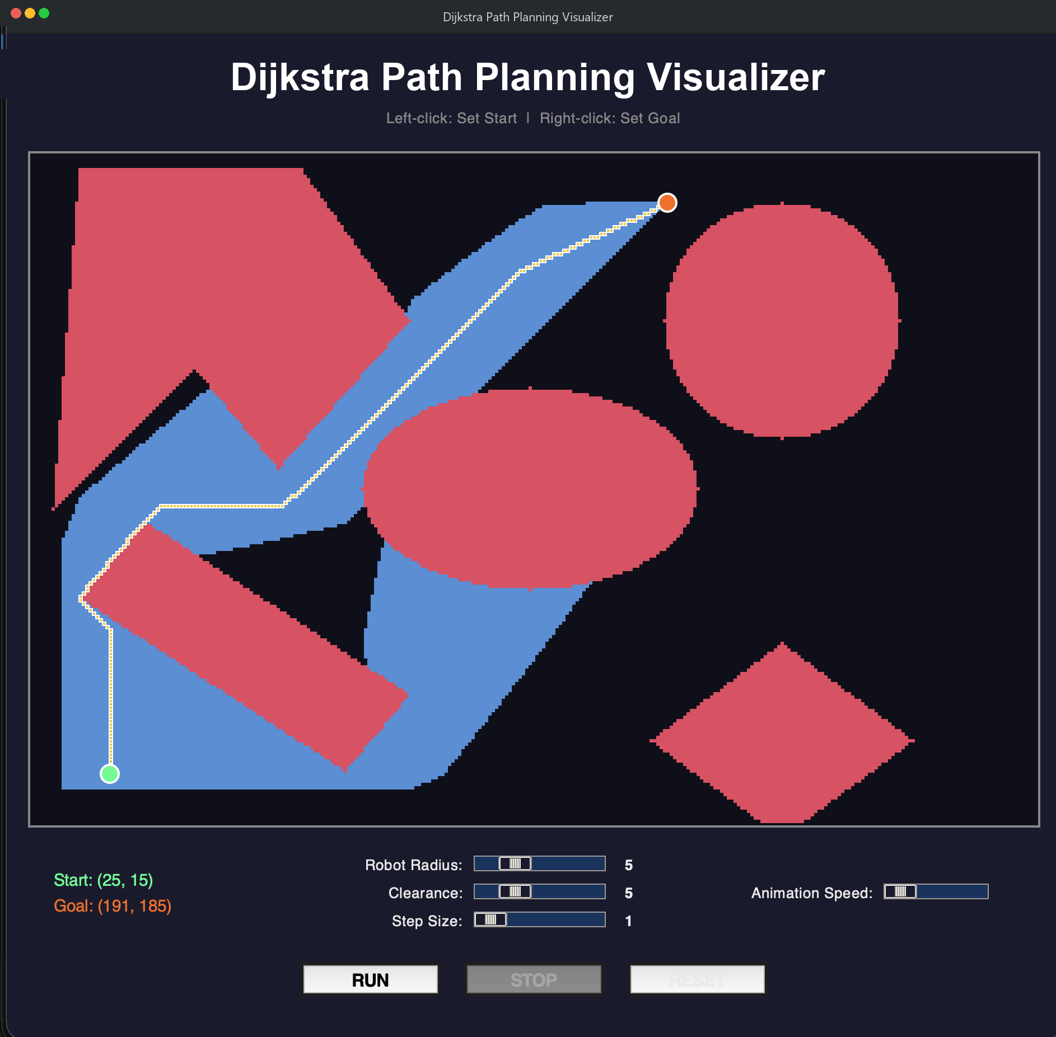
GUI DEMONSTRATION
Obstacle map with terrain zones
Exploration (blue) + optimal path (teal)
Controls
• Left-click: set Start (teal) | Right-click: set Goal (amber)
• Sliders: Robot Radius, Clearance, Step Size, Anim Speed
8 / 12
• RUN / Enter — STOP / Esc — RESET / R

Slide 9
RESULTS & ANALYSIS
~215
14k – 28k
180 – 260
< 3 seconds
Weighted Distance (units)
Nodes Explored
Path Length (nodes)
Runtime
Key Observations
• Path bends through road bands even when a straight diagonal is geometrically shorter
• Higher terrain weights (×6.0 off-road) create visible 'detours' around rough zones
• Nodes explored scales with step size: step=1 → ~28k nodes, step=5 → ~3k nodes
• Dijkstra guarantees the optimal weighted cost; A* would find it faster but requires a heuristic
• defaultdict cuts memory allocation from 180k pre-allocated entries to O(visited)
9 / 12

Slide 10
DIJKSTRA vs A*
Property
Dijkstra
A*
Heuristic
None — expands by cost only
Admissible h(n) guides search
Optimality
Guaranteed optimal
Guaranteed if h is admissible
Completeness
Complete
Complete
Nodes expanded
More (explores entire cost bubble)
Fewer (directed toward goal)
AV suitability
Good baseline, simple to tune
Better for real-time, larger maps
Implementation
Simpler — no heuristic design
Requires domain-specific h(n)
10 / 12

Slide 11
CONCLUSIONS & FUTURE WORK
Conclusions
Future Work
• Dijkstra finds the globally optimal terrain-weighted path — no heuristic needed
• Replace Dijkstra with A* or RRT* for real-time replanning
• Terrain model effectively steers the AV away from rough zones and onto roads
• Add dynamic obstacles (pedestrians, other vehicles)
• 7 analytic obstacle shapes with configurable robot radius + clearance
• Incorporate 4D spatio-temporal planning (velocity + time)
• Interactive GUI provides real-time visualization of exploration and path
• Integrate with ROS for physical robot deployment
• defaultdict + lazy-deletion heap keeps memory and runtime efficient
• Extend to continuous C-space (non-grid representation)
11 / 12

Slide 12
THANK YOU
Project Links
• GitHub Repository: https://github.com/OfirHaf/Autonomic-Vehicle
• Presentation Recording: [ADD YOUR VIDEO URL HERE]
References
• Dijkstra, E. W. (1959). A note on two problems in connexion with graphs.
• LaValle, S. M. (2006). Planning Algorithms. Cambridge University Press.
• Thrun, S. et al. (2005). Probabilistic Robotics. MIT Press.
12 / 12

