Slide 1


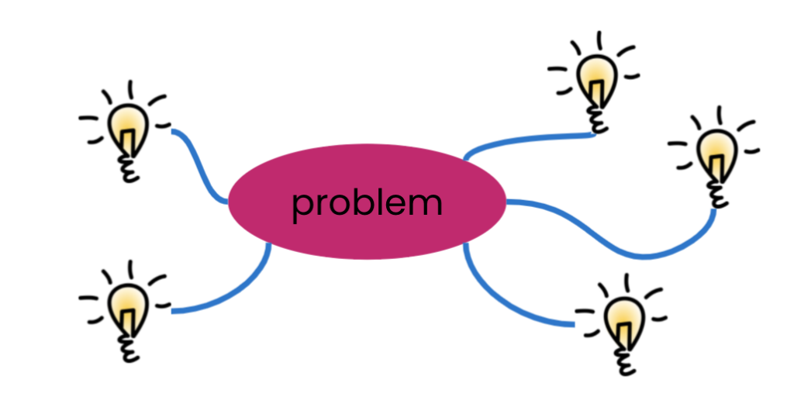








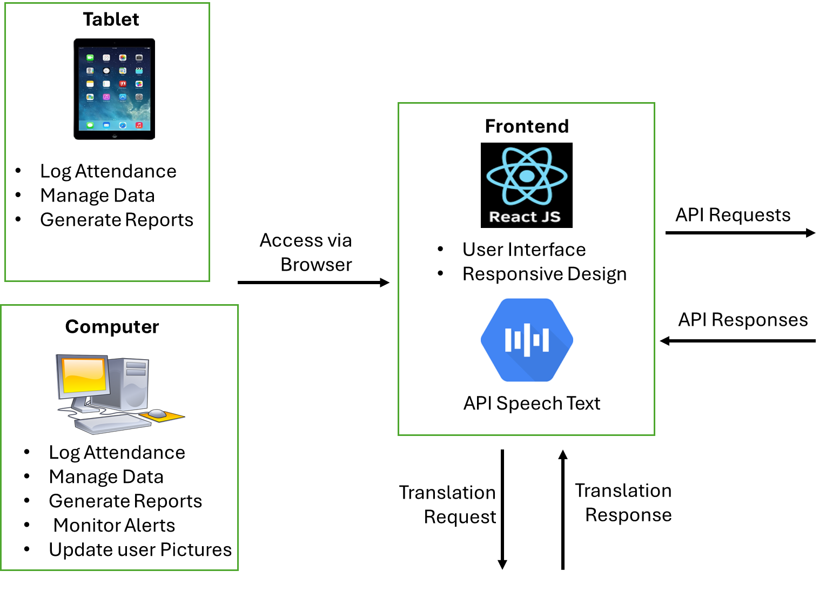
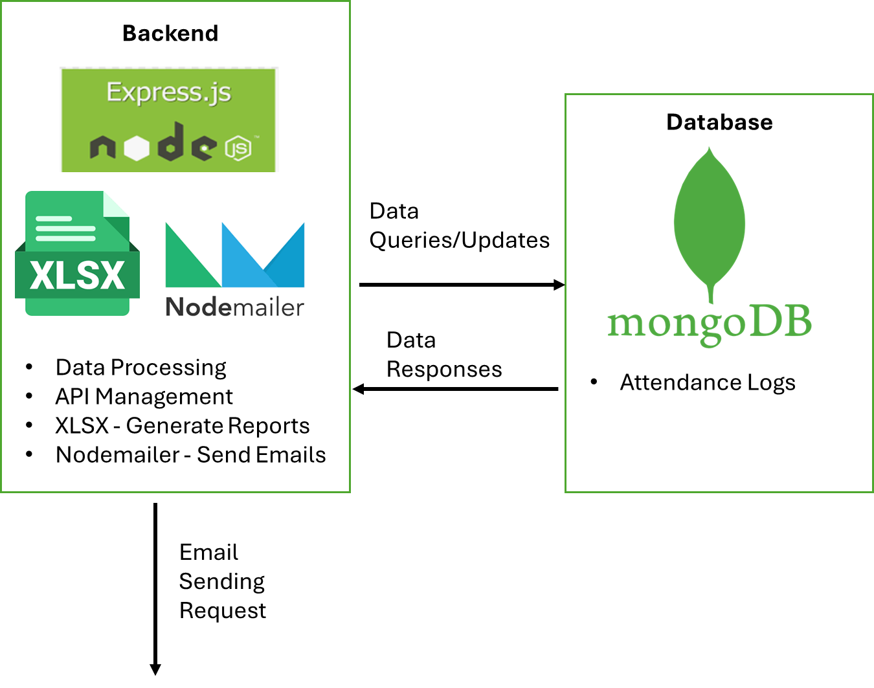



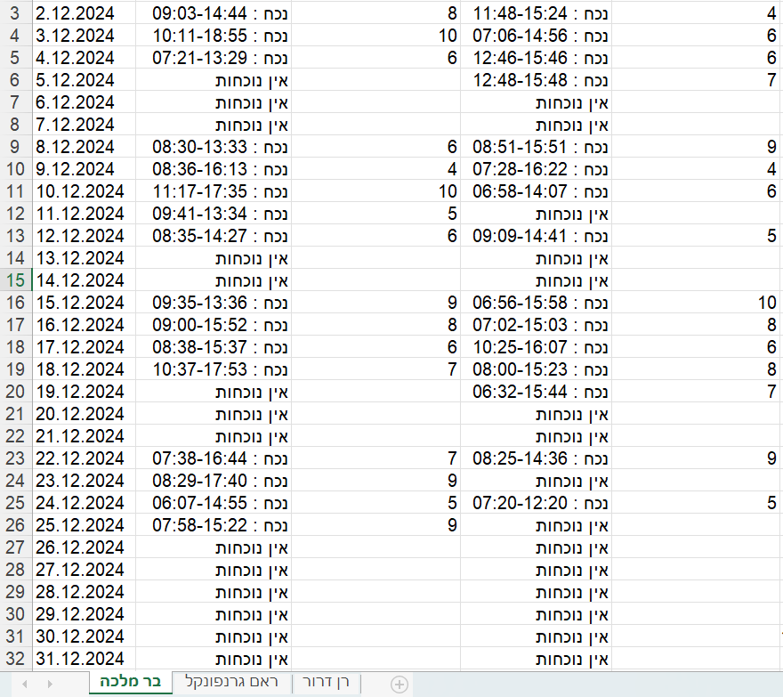
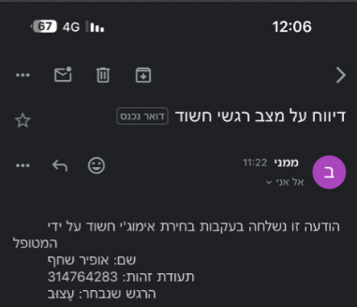
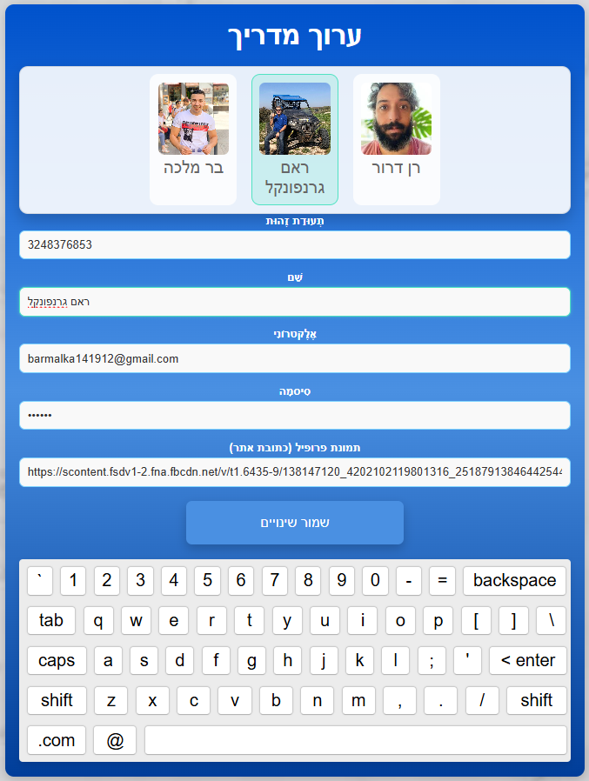
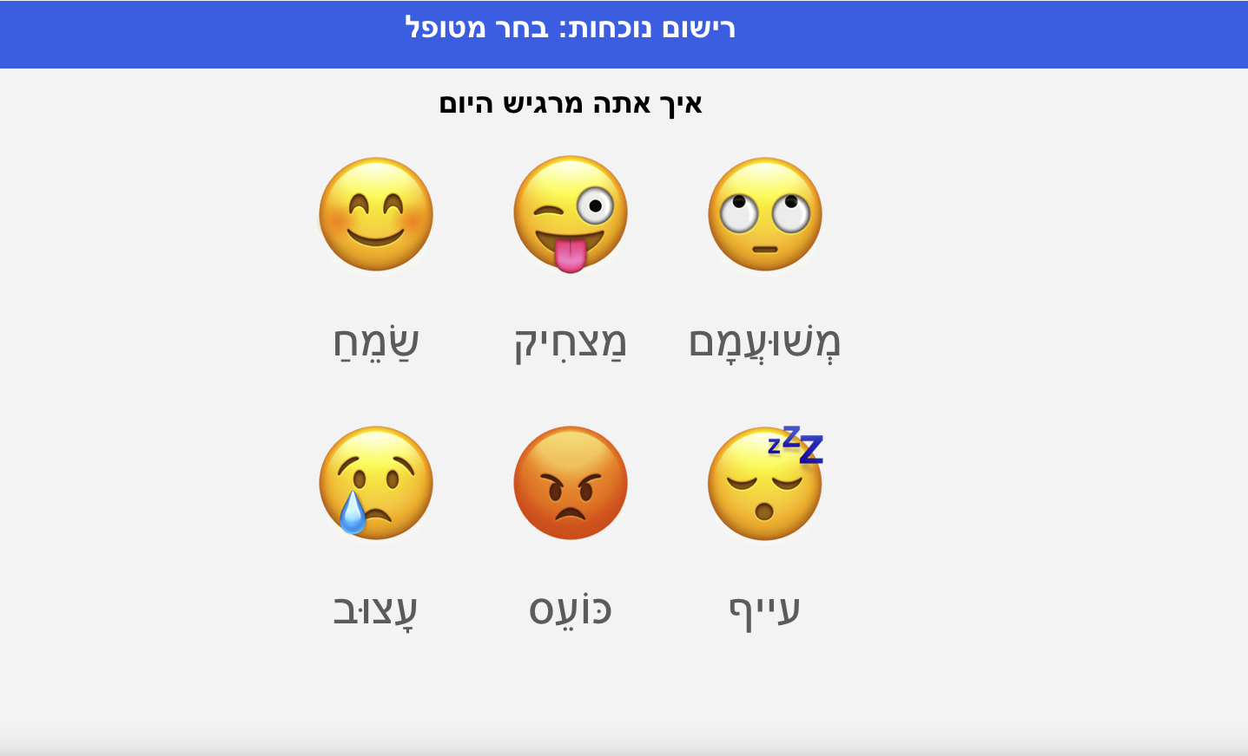
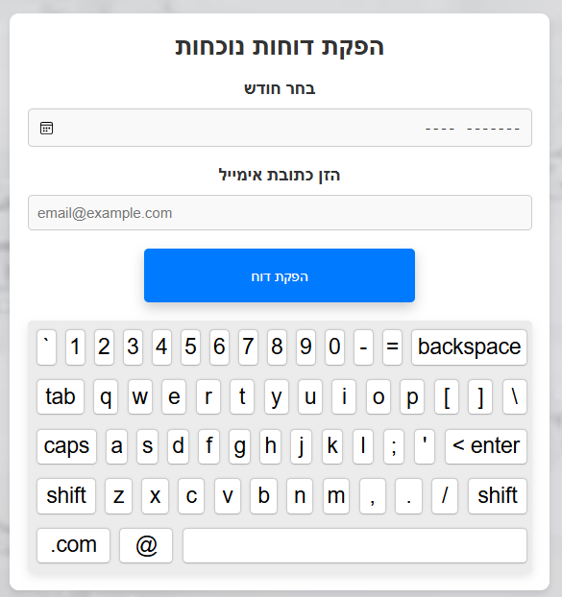
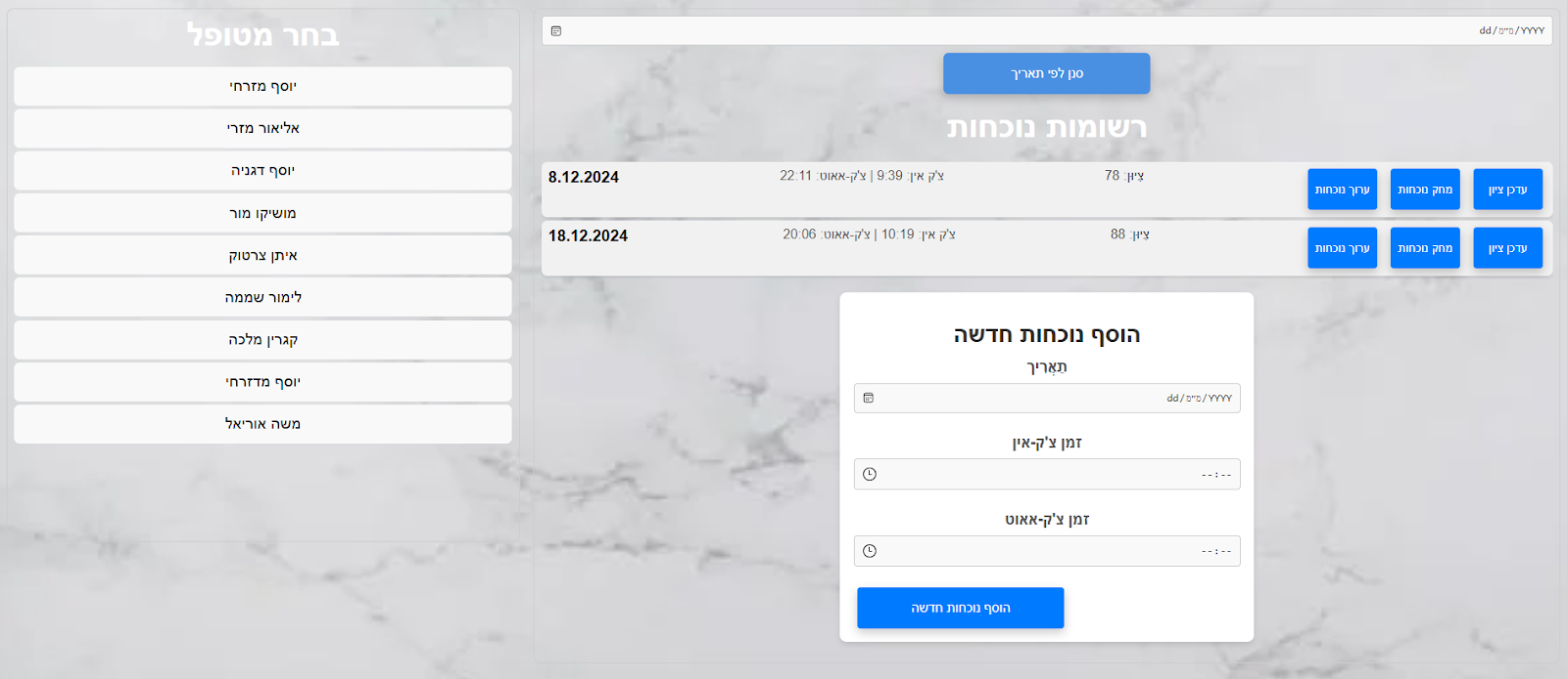
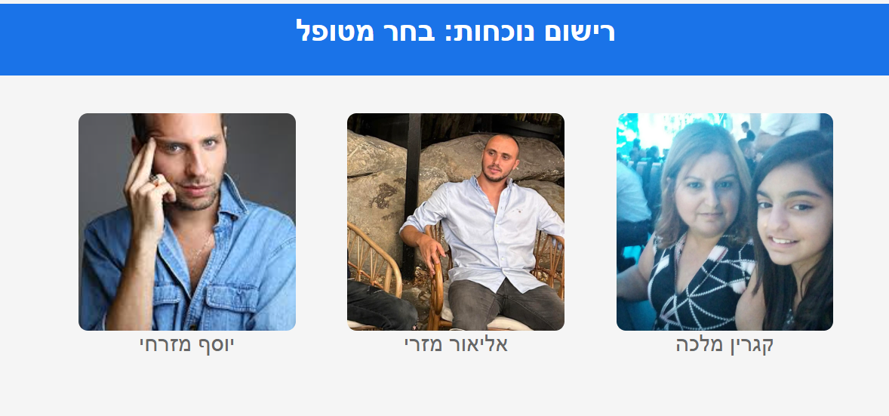
Attendance Management System - Carmey Gil Center
Bar Shimon Malka & Ofir Shahaf
Supervisor: Dr. Naomi Unkelos Shpigel
Problem Statement
Key Solution Requirements
The Carmey Gil Center Challenged with inefficient, error-prone manual attendance tracking and lacked real-time emotional state monitoring.
Simple and accessible interface based on images.
Multilingual support.
Voice reading.
Real-time attendance and behavior monitoring.
Easy-to-follow report generation.
Future support on various platforms including touch screens.
Process Engineering - Overflow
Problem Definition and Research
Identifying the challenges
literature review
Defining the solution.
Planning
Gathering requirement. Analyzing daily processes.
define the system's key features.
Design
Creating prototypes for the user interface. Designing the system architecture.
Incorporating early feedback from staff.
Development
User interface with React.js.
Backend with Node.js and Express.js.
Excel reports via XLSX library.
Emails with Nodemailer.
Text translation using Google Translate API.
Voice feedback via Web Speech API.
Implementation and Testing
Testing individual features, functionality and compatibility with the overall system.
Conducting tests on various devices.
Training the center’s manager and staff .
Collaboration with Carmey Gil Center
System Architecture
Regular meetings with the staff.
WhatsApp group.
Feedback from the staff helped developing features
User-friendly interfaces
Emotional tracking.
Findings and Results
Challenges
Automated attendance tracking with real-time updates.
Emotional state alerts via email.
Multilingual support and voice feedback.
Generate Excel reports.
Tools for accurate translation and text-to-speech.
Ensuring compatibility for both touch screen and computers.
Ensuring reliable and high-quality system performance with free solutions.
Main Screen in the System

