Slide 1


Infrared Controlled
Raspberry Pi
By John Lewis

Slide 2
The Kit
http://www.amazon.com/gp/product/B00D41RDBQ?psc=1&redirect=true&ref_=oh_aui_search_detailpage
http://www.amazon.com/gp/product/B00EFOQEUM?psc=1&redirect=true&ref_=oh_aui_detailpage_o04_s00
http://www.amazon.com/gp/product/B00XVPWLSK?psc=1&redirect=true&ref_=oh_aui_detailpage_o05_s00
http://www.amazon.com/Raspberry-Pi-Model-Project-Board/dp/B00T2U7R7I/ref=sr_1_2?s=pc&ie=UTF8&qid=1445574486&sr=1-2&keywords=Raspberry+pi+2
http://www.amazon.com/Omni-Universal-Adapter-Charger-Samsung/dp/B00YHZI0EC/ref=sr_1_43?ie=UTF8&qid=1445575530&sr=8-43&keywords=usb+power
http://www.amazon.com/Female-Solderless-Flexible-Breadboard-Jumper/dp/B00D7SCMZ8/ref=sr_1_21?s=electronics&ie=UTF8&qid=1445575914&sr=1-21&keywords=gpio
http://www.amazon.com/Official-Raspberry-Pi-Foundation-Model/dp/B00ZW4RKFM/ref=sr_1_2?ie=UTF8&qid=1445576202&sr=8-2&keywords=raspberry+pi+case
http://www.amazon.com/16GB-Mobile-Ultra-Microsd-Card/dp/B001T9CU40/ref=sr_1_17?s=pc&ie=UTF8&qid=1445576032&sr=1-17&keywords=micro+sd+card
http://www.amazon.com/Scotch-Office-Masking-3436-3-4-inch/dp/B00347A8E4/ref=sr_1_3?ie=UTF8&qid=1445576111&sr=8-3&keywords=masking+tape
http://www.amazon.com/Logitech-Desktop-MK120-Mouse-keyboard/dp/B003NREDC8/ref=sr_1_5?s=pc&ie=UTF8&qid=1445576171&sr=1-5&keywords=logitech+keyboard+and+mouse
http://www.amazon.com/Mediabridge-Cat5e-Ethernet-Patch-Cable/dp/B00EUHRLF6/ref=sr_1_5?s=pc&ie=UTF8&qid=1445576248&sr=1-5&keywords=ethernet+cable
http://www.amazon.com/Dell-1707FPT-DVI-Monitor-Silver/dp/B002M9QSCQ/ref=sr_1_15?ie=UTF8&qid=1445576391&sr=8-15&keywords=15+inch+vga+monitor

Slide 3
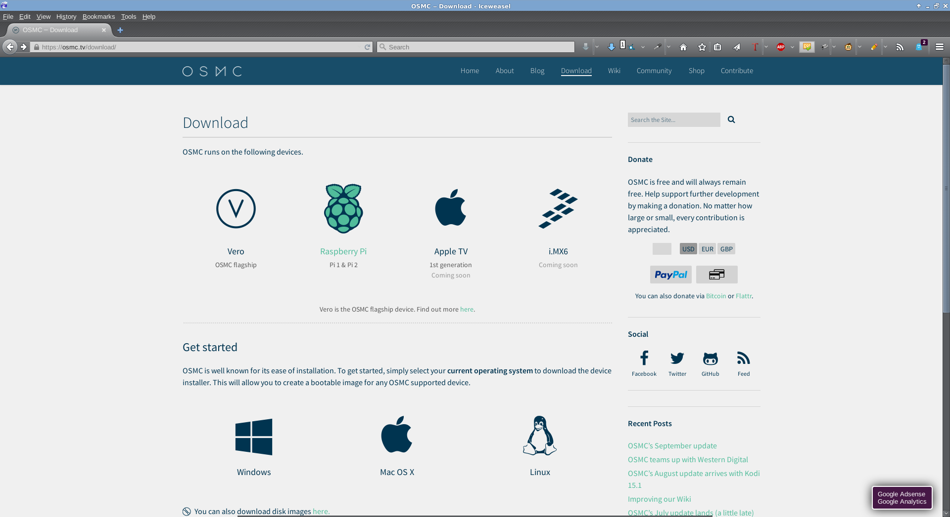
Get the Image

Slide 4
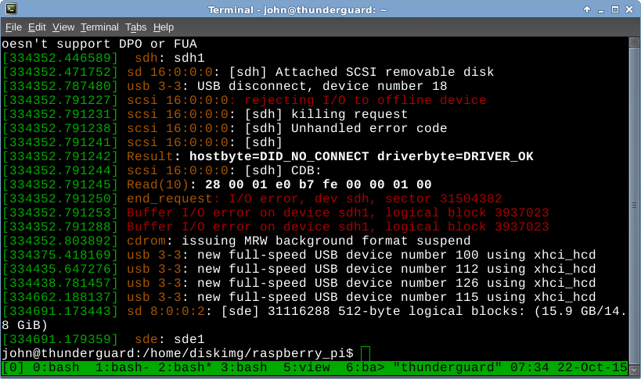
Find your Secure Digital Card
Notes:
What is that command?
dmesg

Slide 5
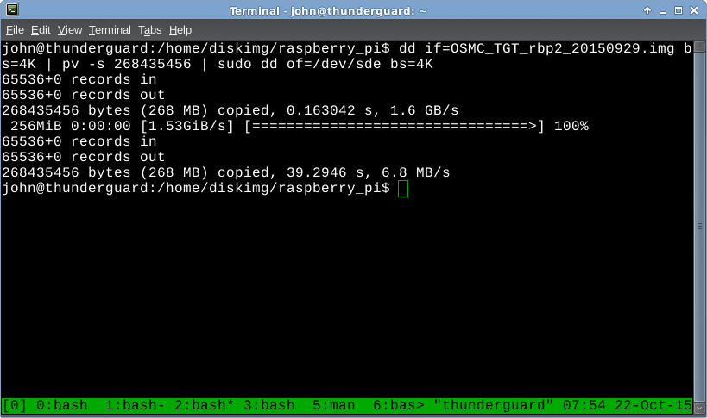
Use Convert and Copy on Your
Storage

Slide 6
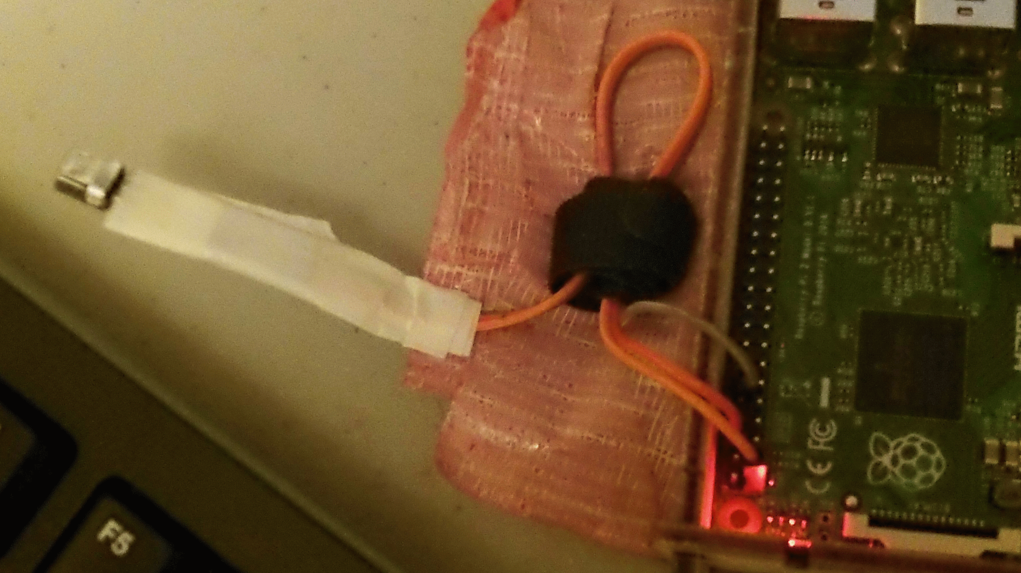
Mounting the Infrared Receiver

Slide 7
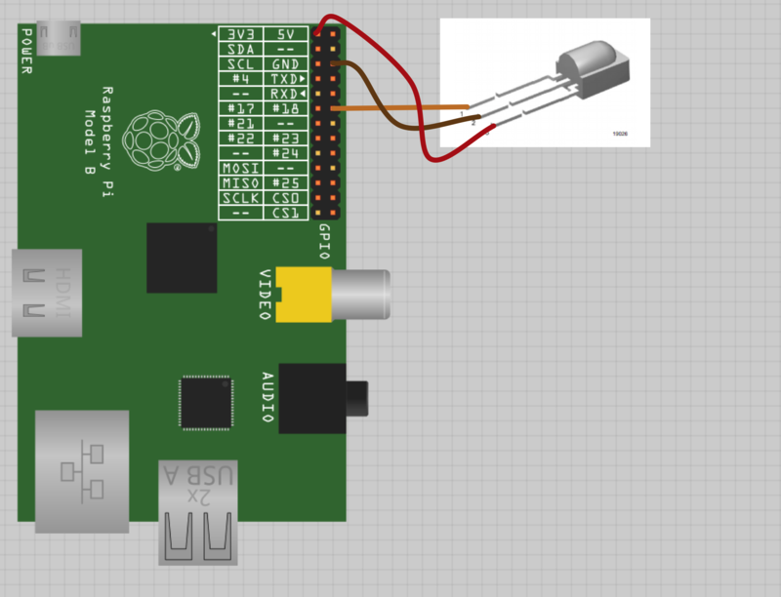
Infrared Receiver Pin out
From Adafruit.com

Slide 8
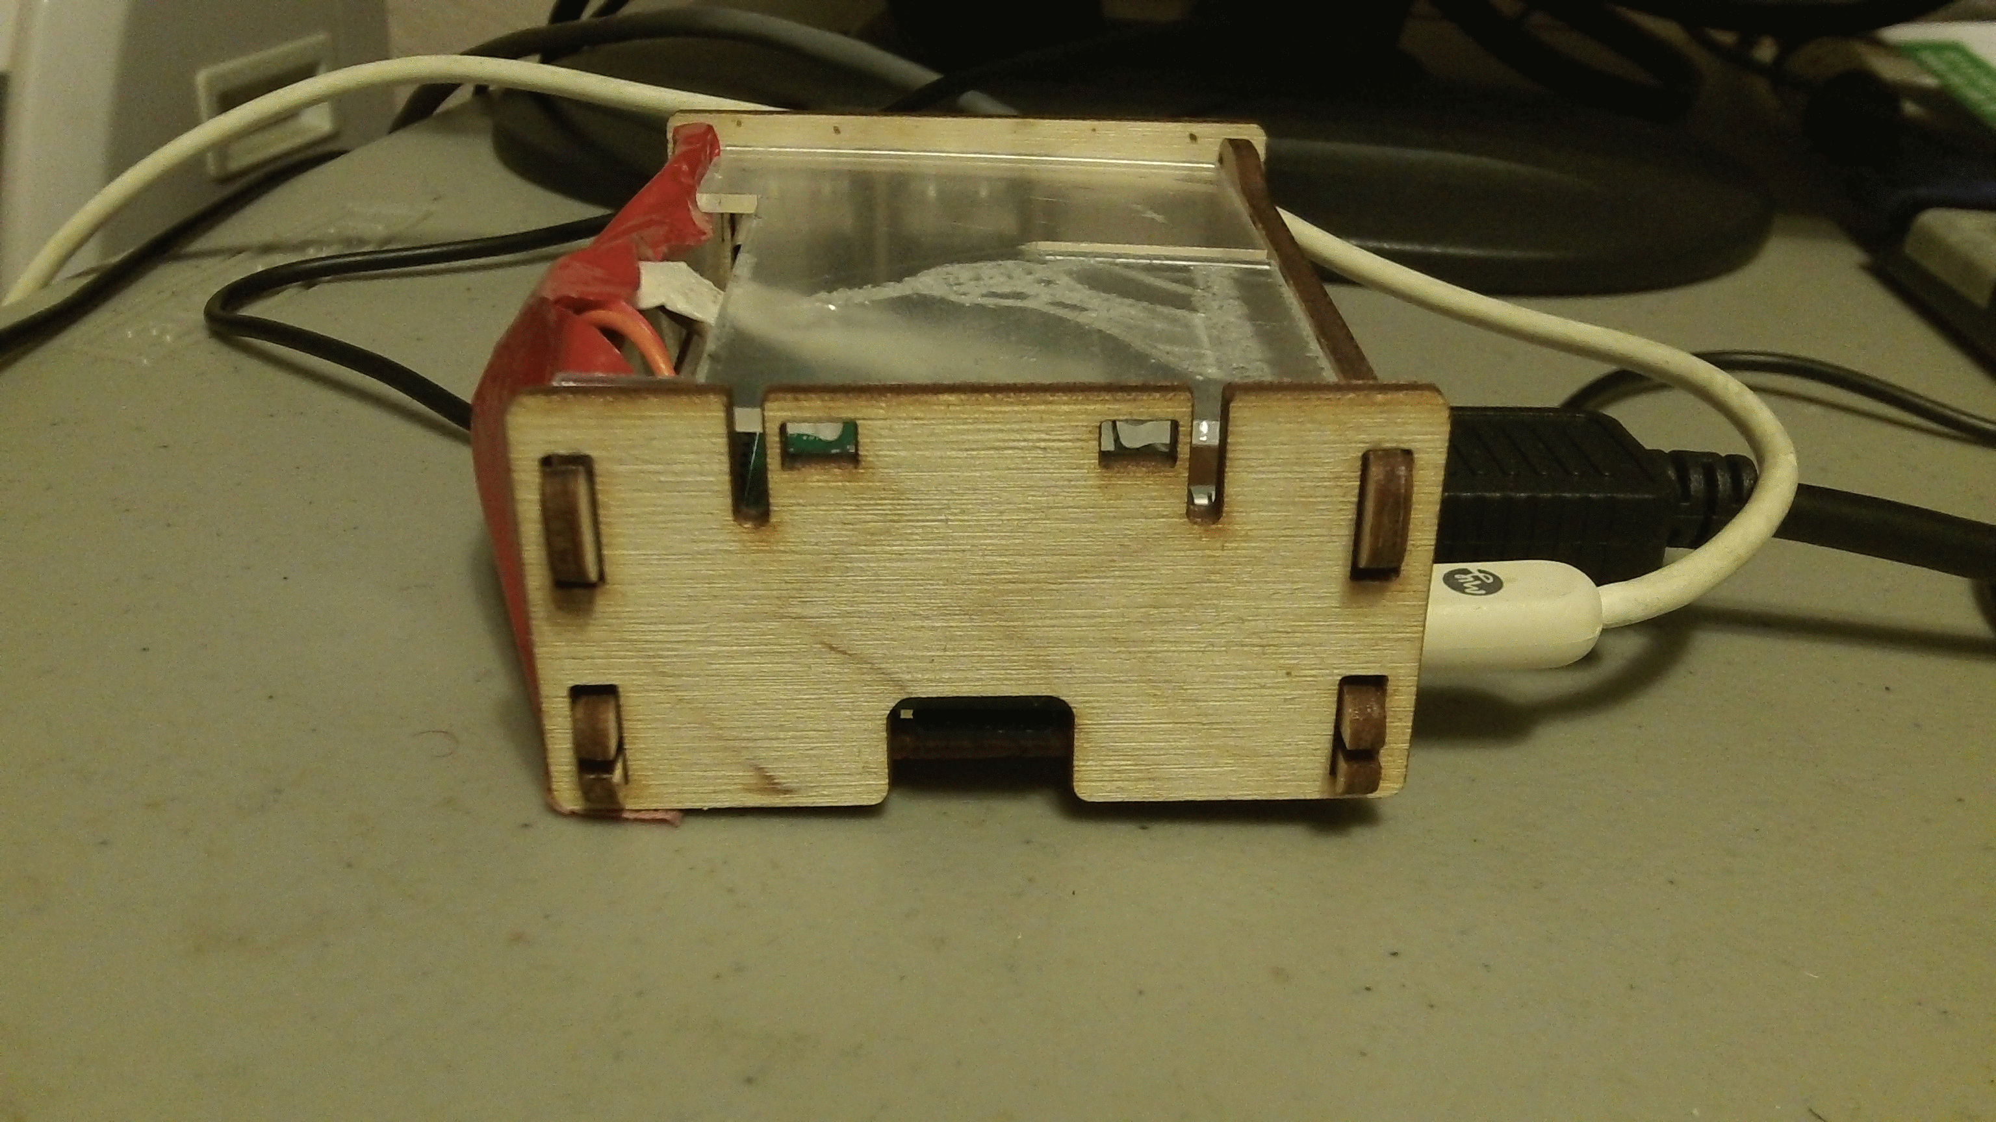
Plug Everything In

Slide 9
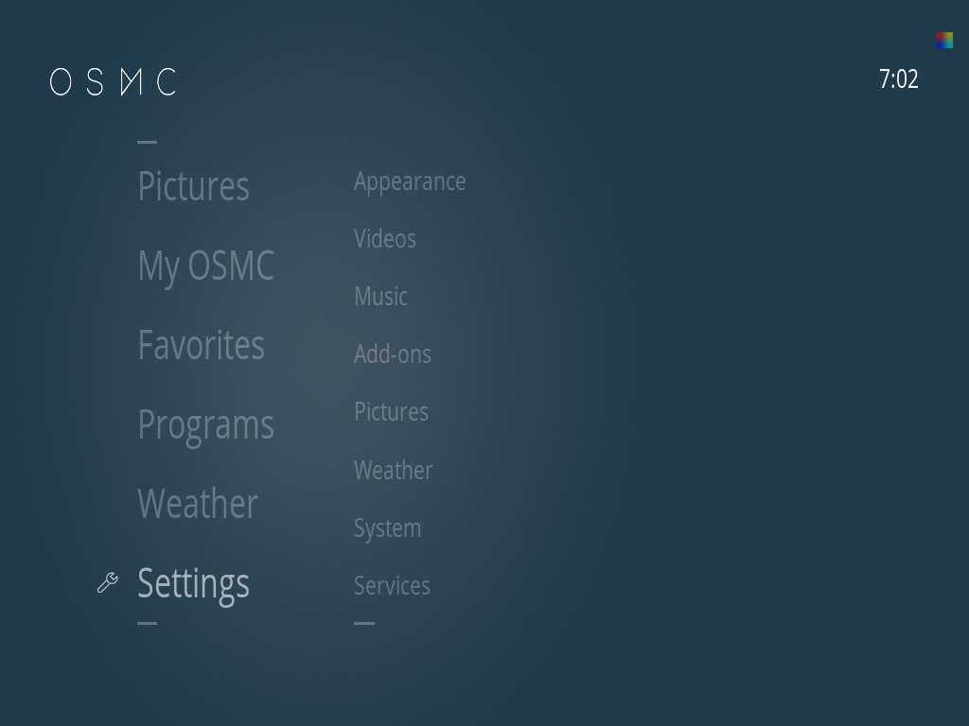
Oh, That Skin is Disgusting!

Slide 10
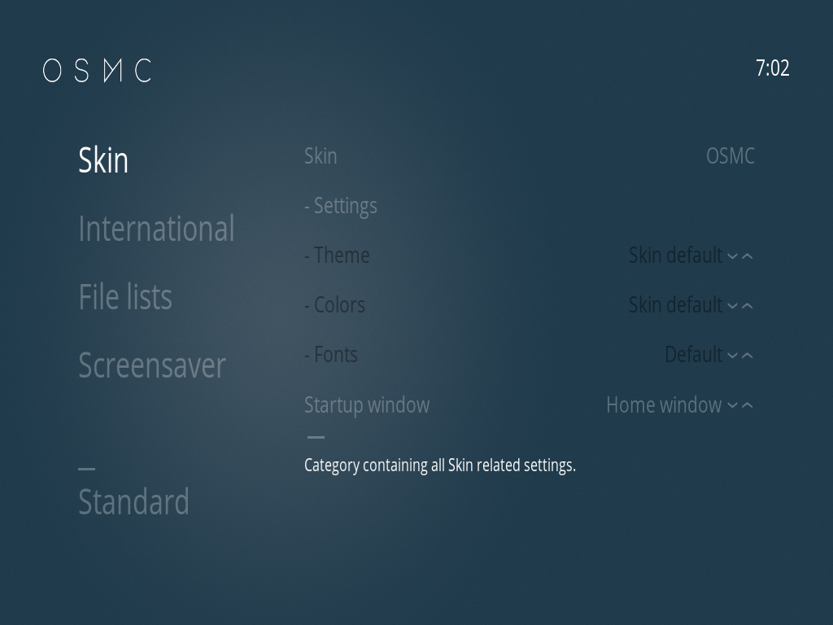
can I haz noo skin?

Slide 11
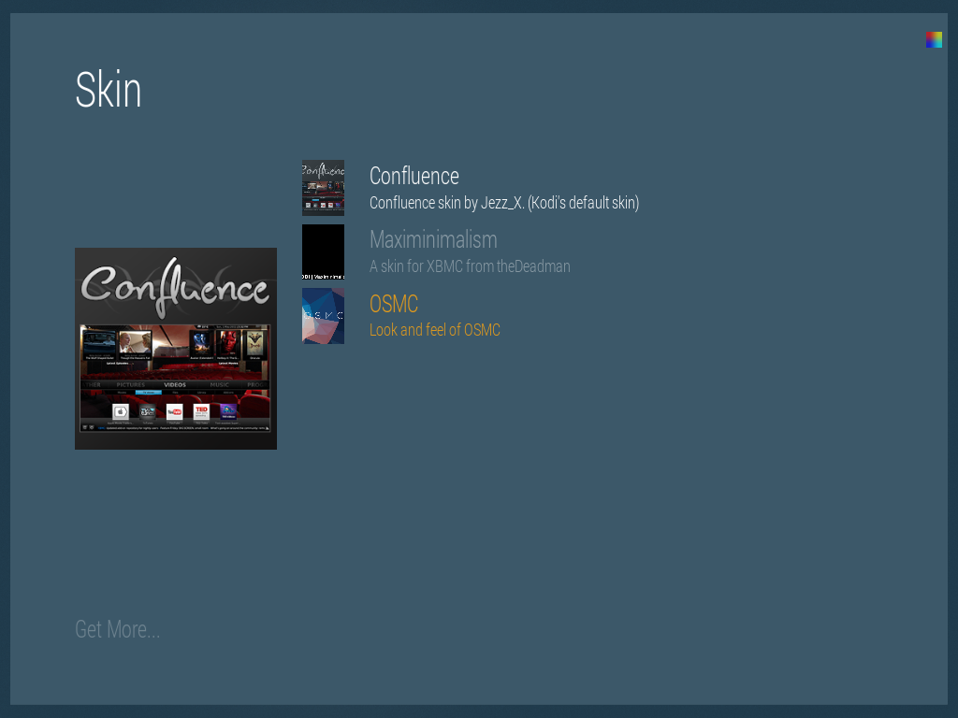
Skin Me!

Slide 12
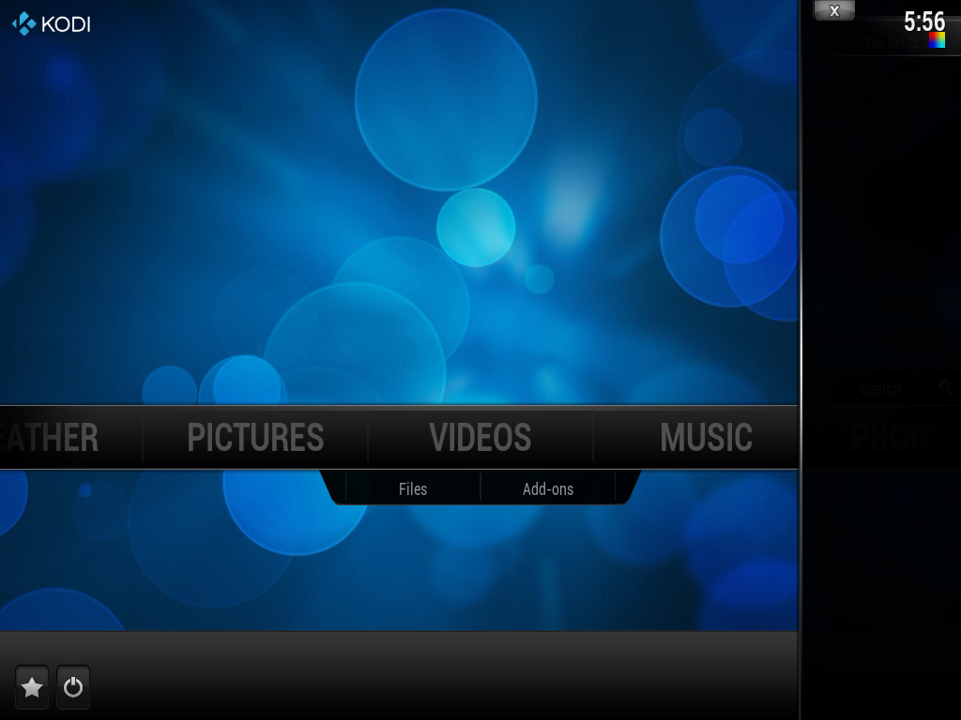
The Real Main Screen
Notes:
All of the tutorials of Kodi use confluence
The OSMC theme isn't ergonomic
The names are inappropriately changed in OSMC theme

Slide 13
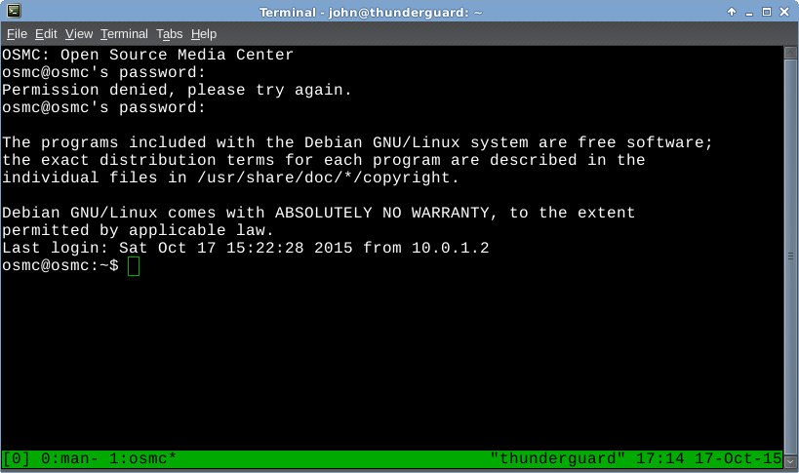
OSMC command line
Notes:
Two ways to get in.
ssh osmc@osmc
Password: osmc
Alt way from https://discourse.osmc.tv/t/command-line-access/172
EXIT >> esc-key
user:pass
osmc:osmc

Slide 14
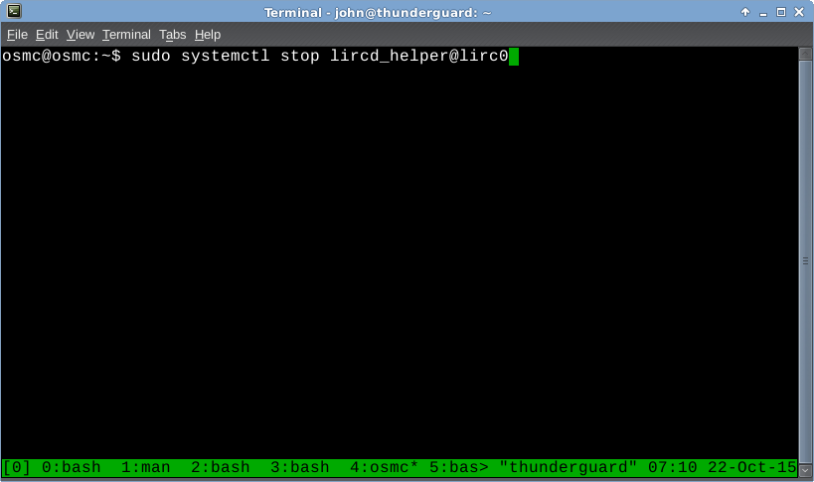
Stop lircd

Slide 15
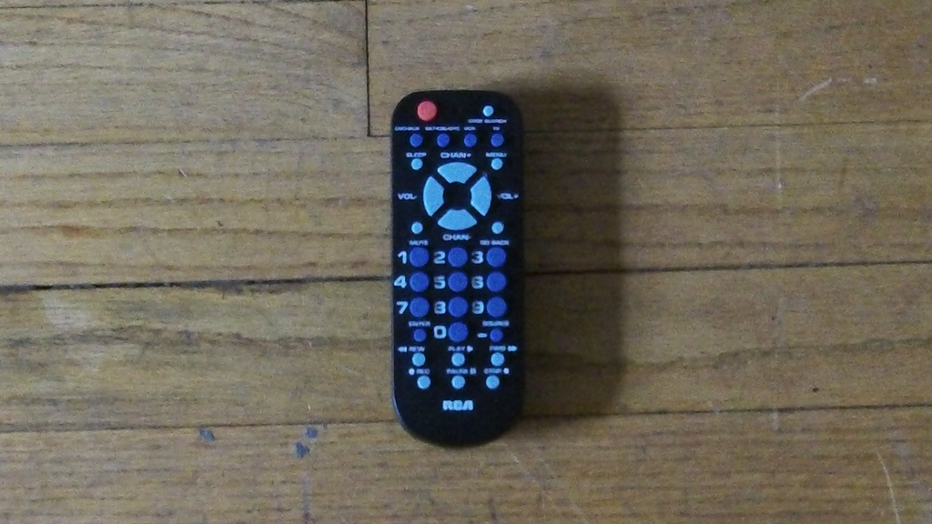
Equip Your Remote

Slide 16
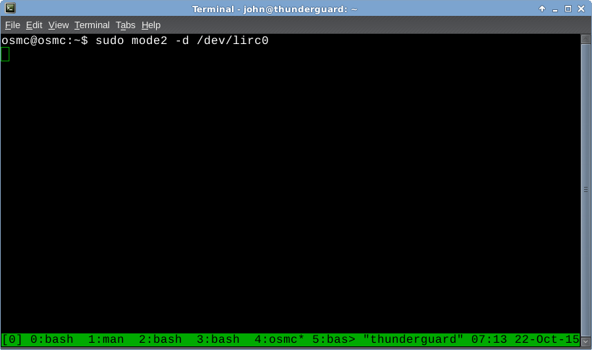
Check Your Connectivity

Slide 17
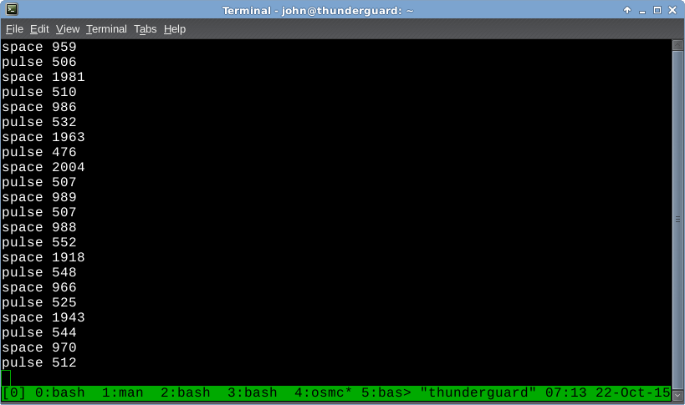
Connection Good!

Slide 18
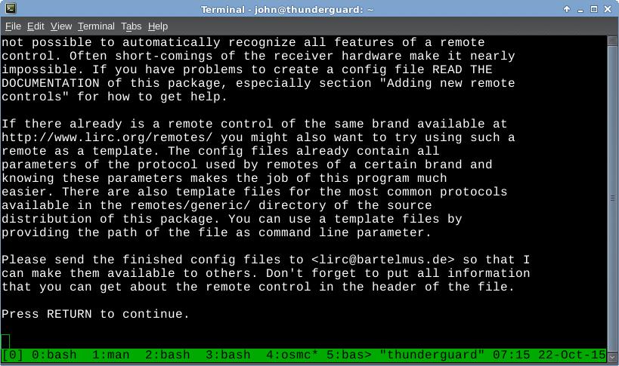
Generate lirc.conf for remote
irrecord -d /dev/lirc0 lirc.conf
Notes:
This doesn't have to be done of an already existing lirc.conf exist for your remote on http://lirc.org/

Slide 19
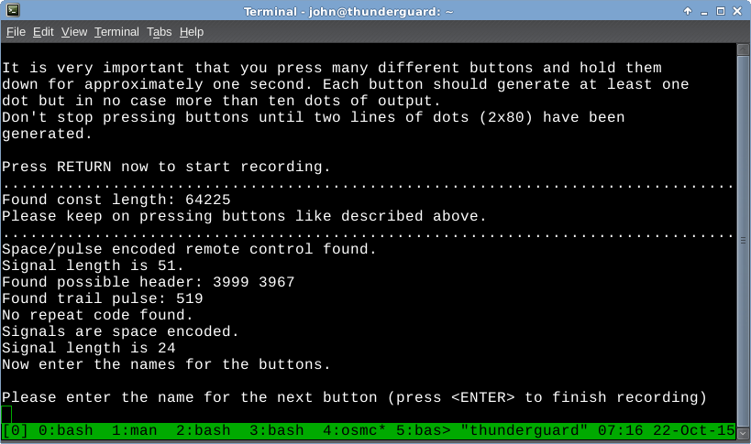
Finding Encoding

Slide 20
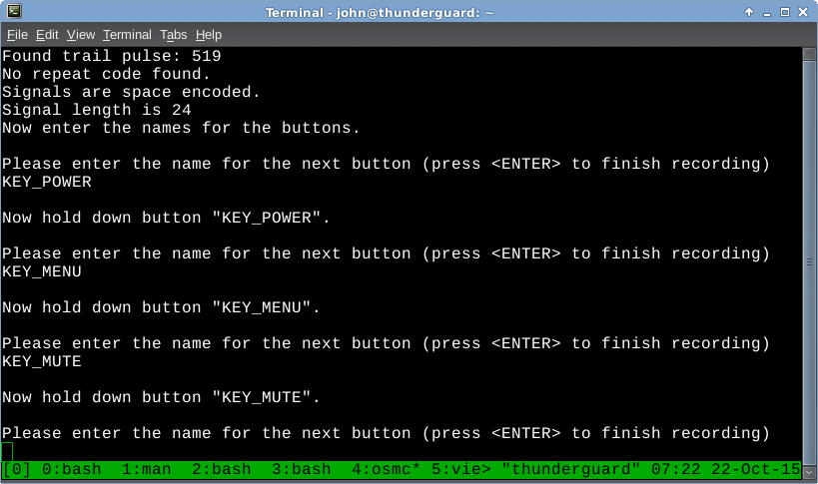
Signal Command Pairing
Notes:
If you remote can control multiple devices, make sure you program all of your keys using just one device.

Slide 21
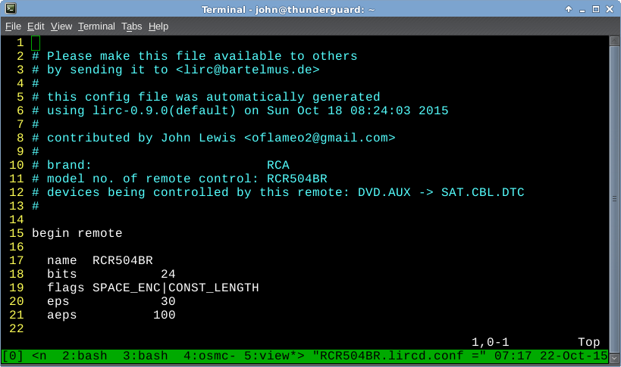
Lirc.conf

Slide 22
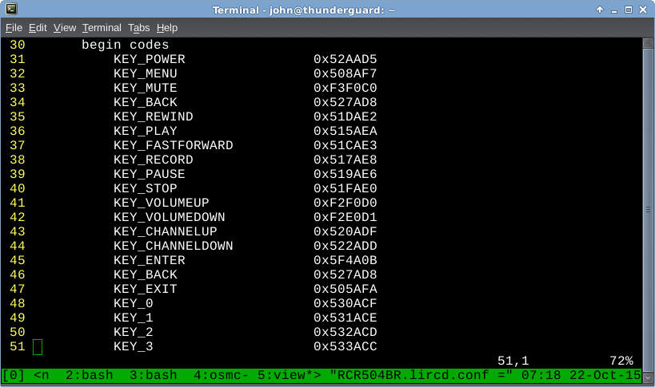
More Lirc.conf

Slide 23
Set Configuration
Move the configuration you just generated to /etc/lirc/lirc.conf
Reboot

Slide 24
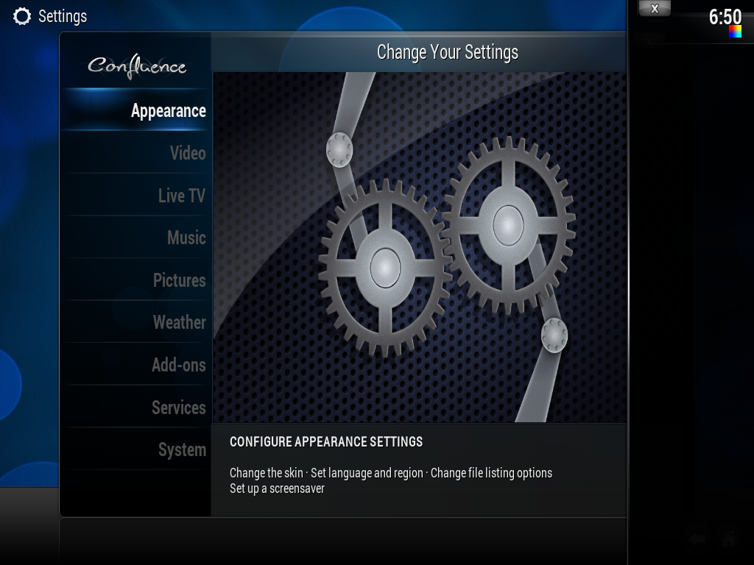
Settings

Slide 25
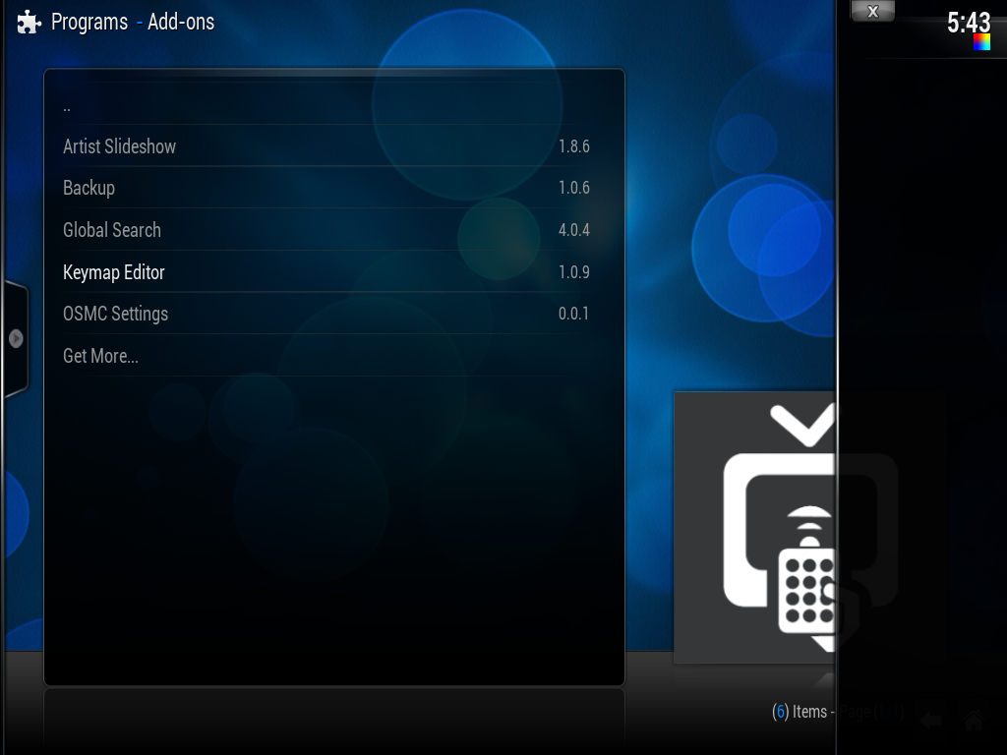
Find Addons

Slide 26
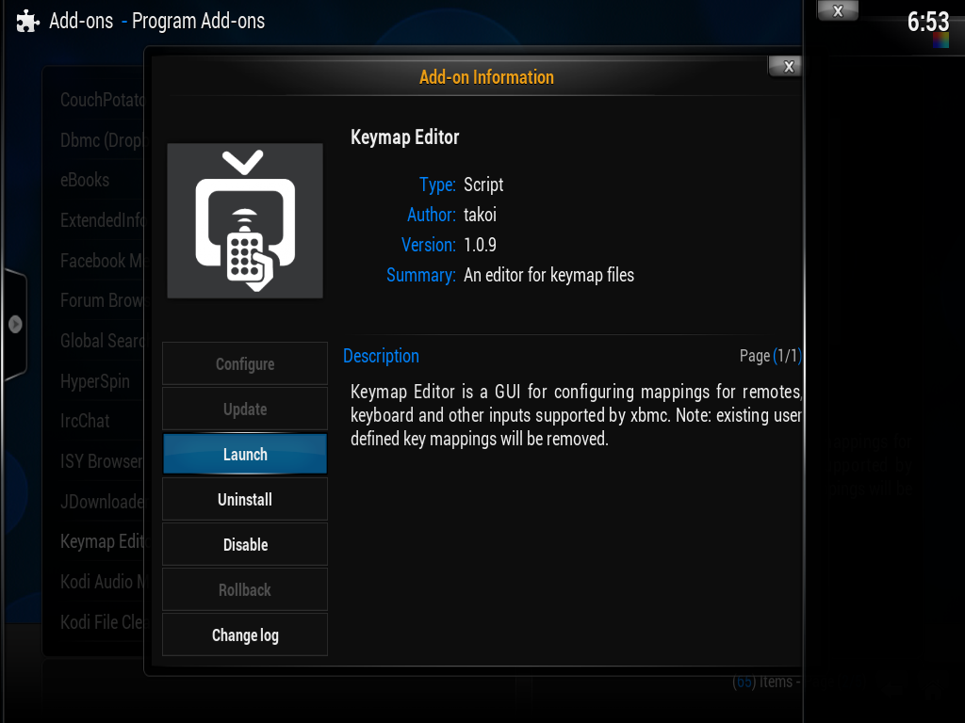
Install Keymap Editor

Slide 27
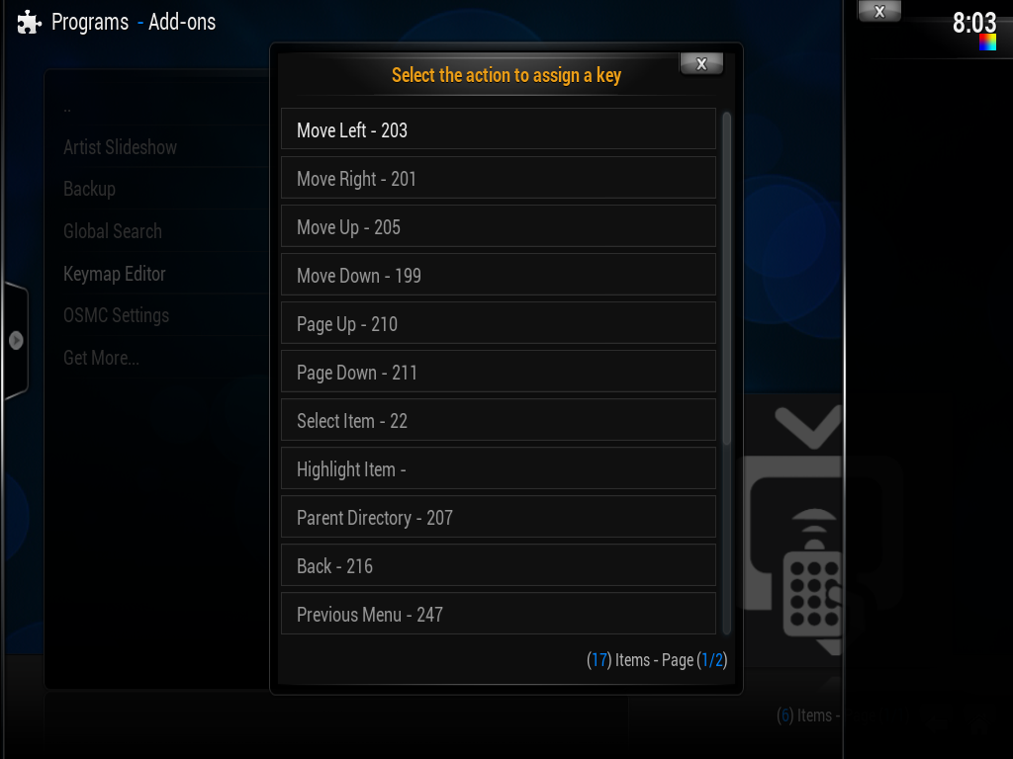
Edit Keymap
Notes:
Maps Kodi functions to LIRC keys easily

Slide 28
Finished!
Save Configuration
Use Remote
…
Kill Trans-Pacific Partnership

