Slide 1

ACHIEVE MORE WITH MICROSOFT TEAMS
PRESENTED BY:
MATTHEW OFOMI (POWER PLATFORM DEVELOPER)

Slide 2

OUTLINE
Popular Concerns and Challenges for Organizations
Overview of Microsoft Teams
Microsoft Teams Features
Questions and Answers

Slide 3

POPULAR CONCERNS AND CHALLENGES FOR ORGANISATIONS
GLOBAL
MOBILE
72% of workers will be working remotely by 2020
SOCIAL
4x as many devices per user
45% of workers use social tools at work

Slide 4
POPULAR CONCERNS AND CHALLENGES FOR ORGANISATIONS
of company worktime involves
collaborating
80%
59%
of managers miss important communication due to information overload
20%
of the average knowledge workers day is spent tracking down information

Slide 5

MICROSOFT TEAMS
A platform that spans across all the devices people in the business world are using. Teams is now the closest thing that Microsoft has at its disposal to transform into an OS style fabric that connects a significant share of information workers globally

Slide 6
Boost Team Productivity with Collaboration tools accessible by all
Empower end users to create their own apps
Amplify your solution using custom integrations
Launch ready-to-use apps within your environment

Slide 7


















Engage your people where they already are
Vertical solutions
Healthcare
Manufacturing
Retail
Banking
Custom
Apps
Organization-based applications
Departmental tools
Employee resources
Support & info
Processes & workflow
Partner applications
Ready to use
Office 365
applications

Slide 8
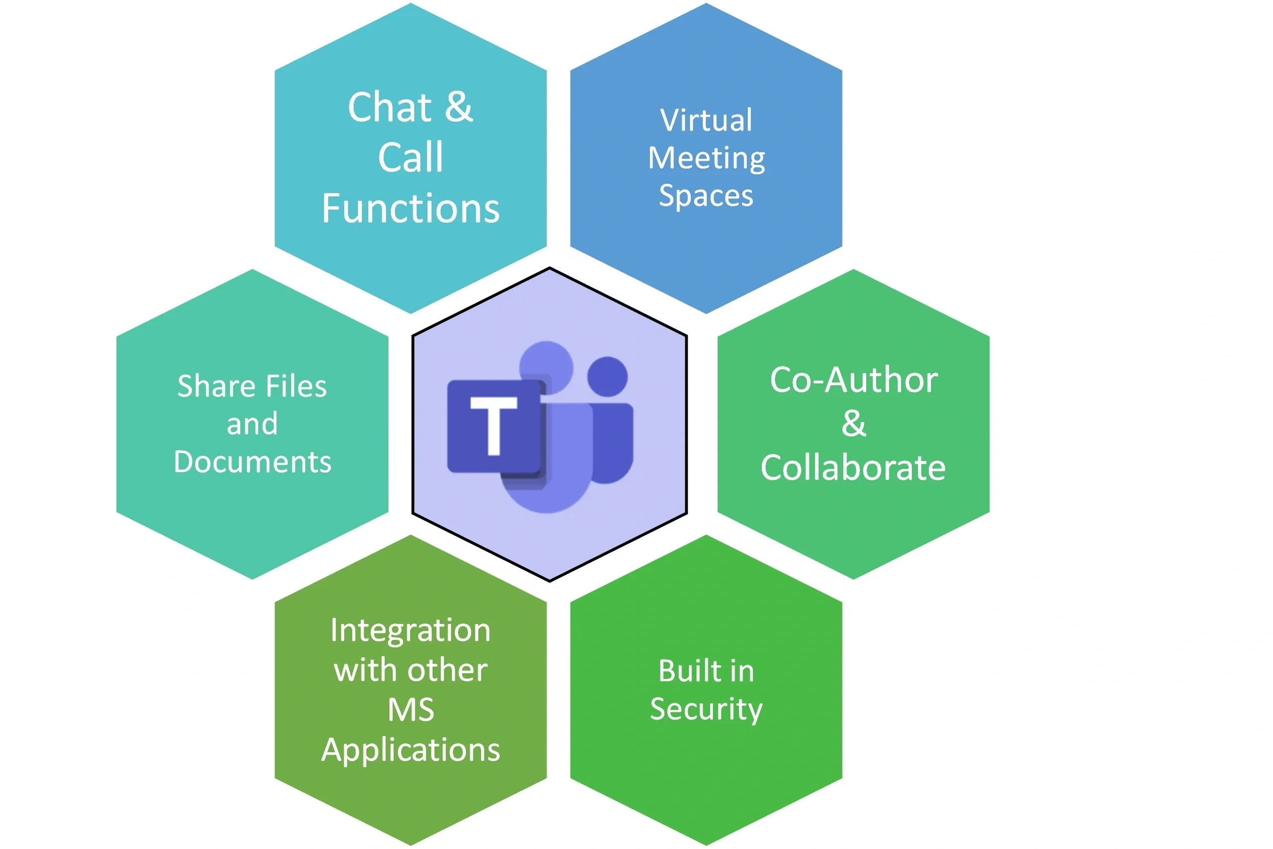
MICROSOFT TEAMS FEATURES
Teams and channels
Conversations within channels and teams.
A chat function
Document storage
Online video calling and screen sharing
Online meetings.
… and more

Slide 9

Questions & Demo

