Slide 1

COLLABORATIVE APPLICATIONS

Slide 2
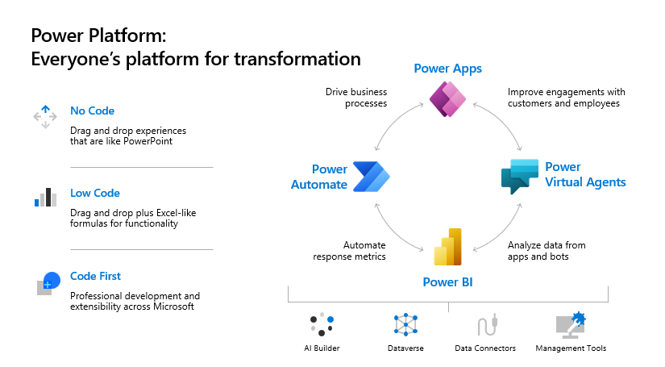

Slide 3
EMPLOYEE IDEAS
The app enables the Teams users to set up and configure an idea campaign. An idea campaign is a category for grouping ideas around common themes.
Teams users can also perform the following activities: - Configure a standard submission form that employees must submit for each idea. - Review and manage the ideas and list of campaigns. - Modify and delete campaigns. - Review leader boards of ideas. - Vote for and share prioritized ideas. - Submit ideas for a campaign. - View other team member's idea. - Vote on most liked ideas. - Review the performance of their ideas compared with others within a campaign.

Slide 4
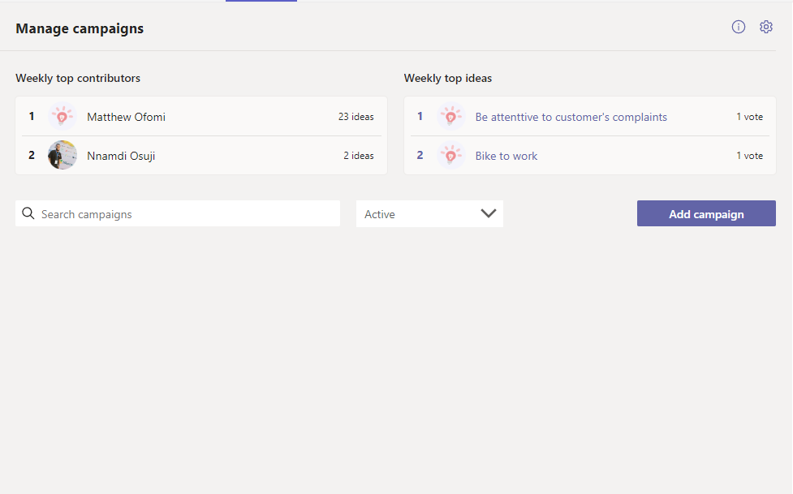
EMPLOYEE IDEAS
Beneficial across every organizations and departments, as this helps in fostering employees innovative and creative ideas

Slide 5
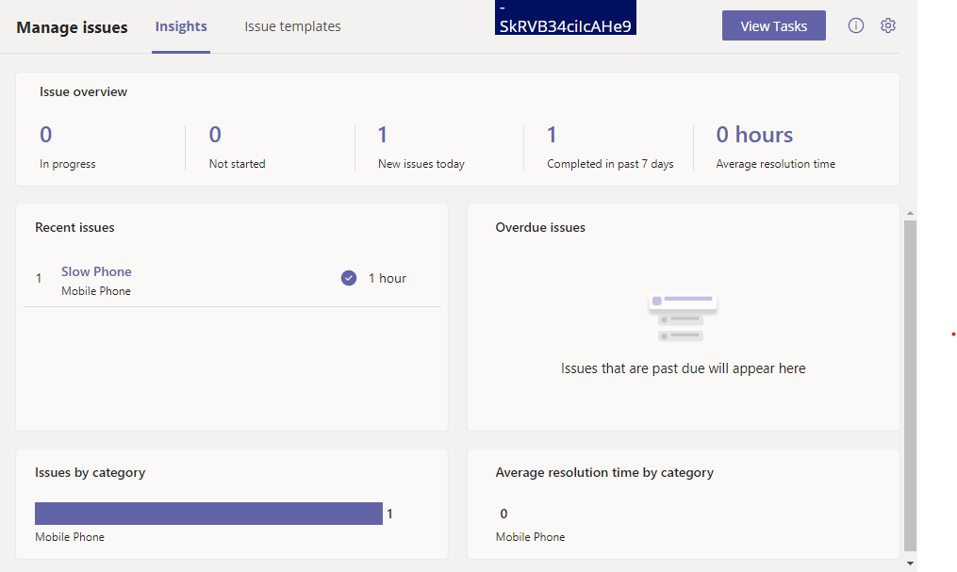
ISSUE REPORTING
The Issue Reporting app empowers the employees and managers to raise and manage issues. It consists of two apps, Issue reporting app for reporting issues and Manage Issues app for managing issues
The app is also used to review team issues, report on issue history, and efficiently manage issue resolution. The employees use the Issue reporting app to log issues and details required to resolve them. The app is also used to modify and resolve existing issues and get a high-level view of individual or team

Slide 6
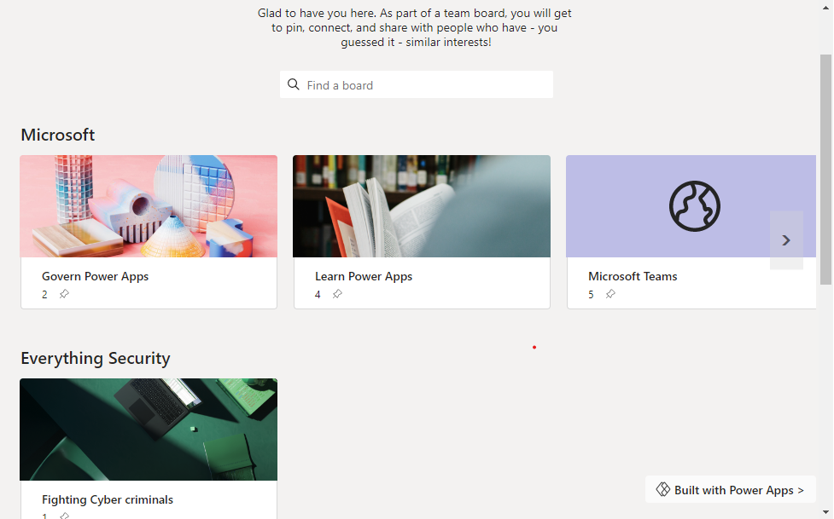
BOARDS
With the Boards app, you and your team can create boards about anything — interests, initiatives, onboarding, etc. You can also post just about anything to a board—images, articles, websites, and even direct links to teams, channels, and specific discussion threads within Microsoft Teams. This flexibility makes sharing ideas and content discovery efficient and seamless.

Slide 7
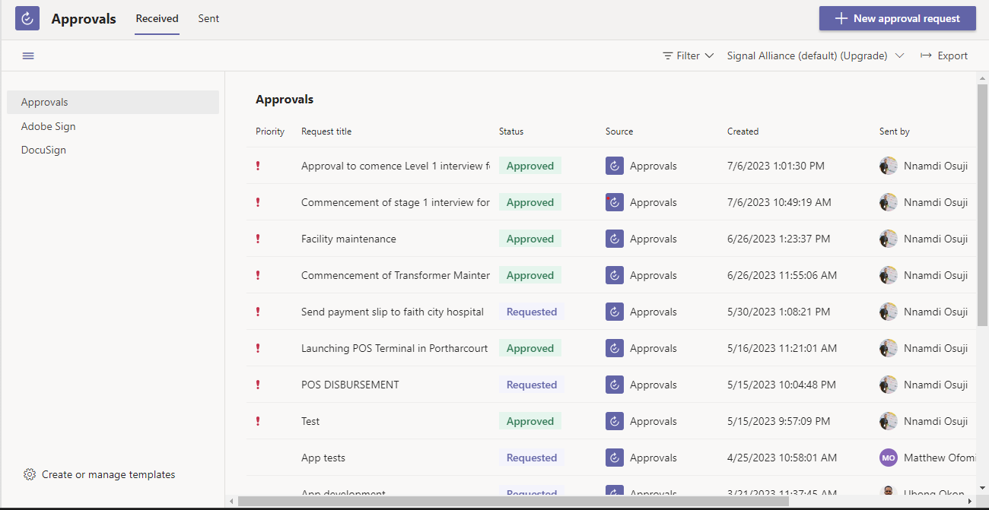
Approvals
Approval App in Teams is an app that allows users to bring together and centralize all of the workflow approval processes. Specifically, it will enable the users to approve or reject items/documents submitted by others or initiate an approval workflow themselves.

