Slide 1
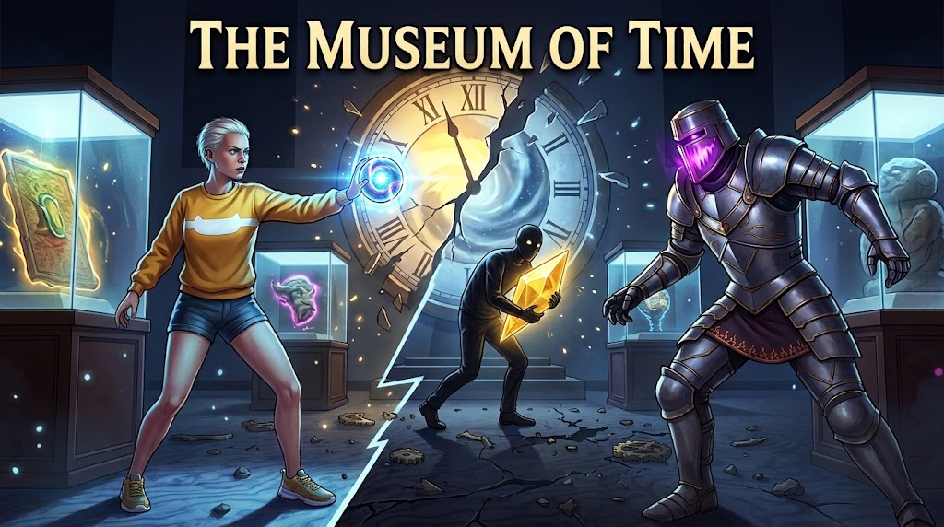
The Museum of Time
KNOWN BUGS
A night guard enters fractured historical moments to restore the stolen first moment and repair the timeline.
Gear pickup can become unreachable in FrozenCity
Blocking
The third-person camera can drift away from Noa. Past nine metres the interaction cast no longer reaches the tower gear, so no prompt appears.
Ofri Hamou (ID: 211906813) Jonathan Pilnick (ID: 212836134)
Trailer [ YouTube link to be added ] Repository github.com/OfriHamou/MuseumOfTime
Animator grounded flag reads false while standing
Cosmetic
The Animator’s grounded parameter stays false while Noa rests on the floor. Animation state only — movement is unaffected.
Stealth cover layers are declared but unused
Minor
The Warden’s vision mask names two layers no scene object is assigned to. Sight is blocked by ordinary geometry instead, so stealth still works.
The Museum of Time — Game Design Document
01

Slide 2
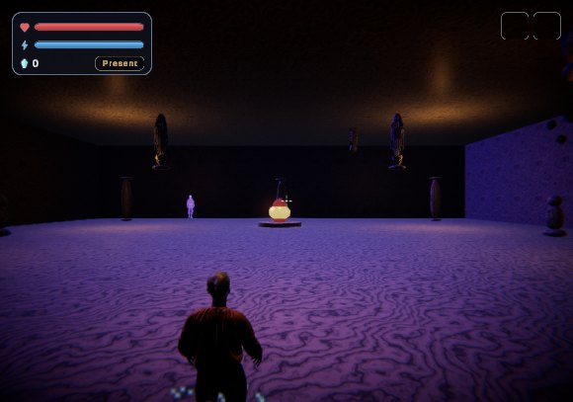
High Concept
A compact 3D adventure-puzzle built around cause and effect
The player controls Noa, a night guard who discovers that every exhibit is a preserved historical moment.
The museum’s first moment has been stolen, and history begins to come apart.
Each scene is a contained time puzzle: change the past, solve the present, verify the future.
Noa has no weapon that kills — her one projectile freezes and rewinds.
3
2
56.8 MB
gameplay scenes
carry-over items
compressed build
ClockCore — the final confrontation.
The Museum of Time — Game Design Document
02

Slide 3
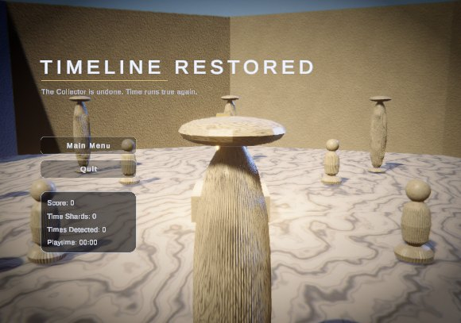
Story & Player Objective
Noa repairs broken moments without rewriting history
NARRATIVE
After the Clock of Creation breaks, the eras begin to overlap. Noa is the only person who still remembers the original timeline.
PLAYER GOALS
Explore the museum, the frozen city and the clock core.
Collect Time Shards and repair broken exhibits.
Avoid the Time Wardens and keep Shadows away from your shards.
Solve the three-era gear puzzle to free the frozen city.
Confront the Collector at the heart of the clock.
The victory screen reports the run back to the player.
Ending shipped: the timeline returns to its course. The player’s final state — score, shards, detections, playtime — is carried into the victory screen.
The Museum of Time — Game Design Document
03

Slide 4
Core Gameplay Loop
The same short loop repeats in every scene
Explore
the era
›
Find
what broke
›
Switch
era
›
Solve
the cause
›
Collect
the shard
Time is the mechanic, not the setting.
WHY THE LOOP HOLDS TOGETHER
Past — move objects and undo the cause.
Present — perform the main objective.
Future — check the consequence and open the way on.
An object moved in the Past stays moved in the Present and the Future — its position propagates forward through the eras.
That is what makes the cross-era puzzles solvable, and what lets a careless fix in the past show up later as a consequence.
Switching era costs energy, so travelling through time is a resource the player spends, not a free camera.
PLAYER VERBS
Move
›
Interact
›
Throw
›
Slow time
›
Hide
The Museum of Time — Game Design Document
04

Slide 5
Game Structure
Five Unity scenes; three of them are gameplay
Main
Menu
›
Scene 1
MuseumNight
›
Scene 2
FrozenCity
›
Scene 3
ClockCore
›
Victory
Screen
LOGICAL CONNECTION
The Clock of Creation breaks during Noa’s night shift, and era travel unlocks.
The Time Lens found in the museum is what opens the door to the frozen city.
Freeing the city yields the Chrono Hourglass, which opens the clock core.
Defeating the Collector restores the timeline and leads to the victory screen.
ERA COVERAGE PER SCENE
MuseumNight
Present only — time travel is withheld until the clock breaks.
FrozenCity
Past, Present and Future, all three playable.
ClockCore
Every gameplay scene carries its own objective, HUD, camera toggle, patrols and hidden checkpoints. Nothing resets between them: health, energy, score, shards and both items travel in one saved state.
One era per boss phase, in order.
MuseumNight is single-era on purpose: it teaches movement, interaction, cameras and stealth before it teaches time.
The Museum of Time — Game Design Document
06

Slide 6
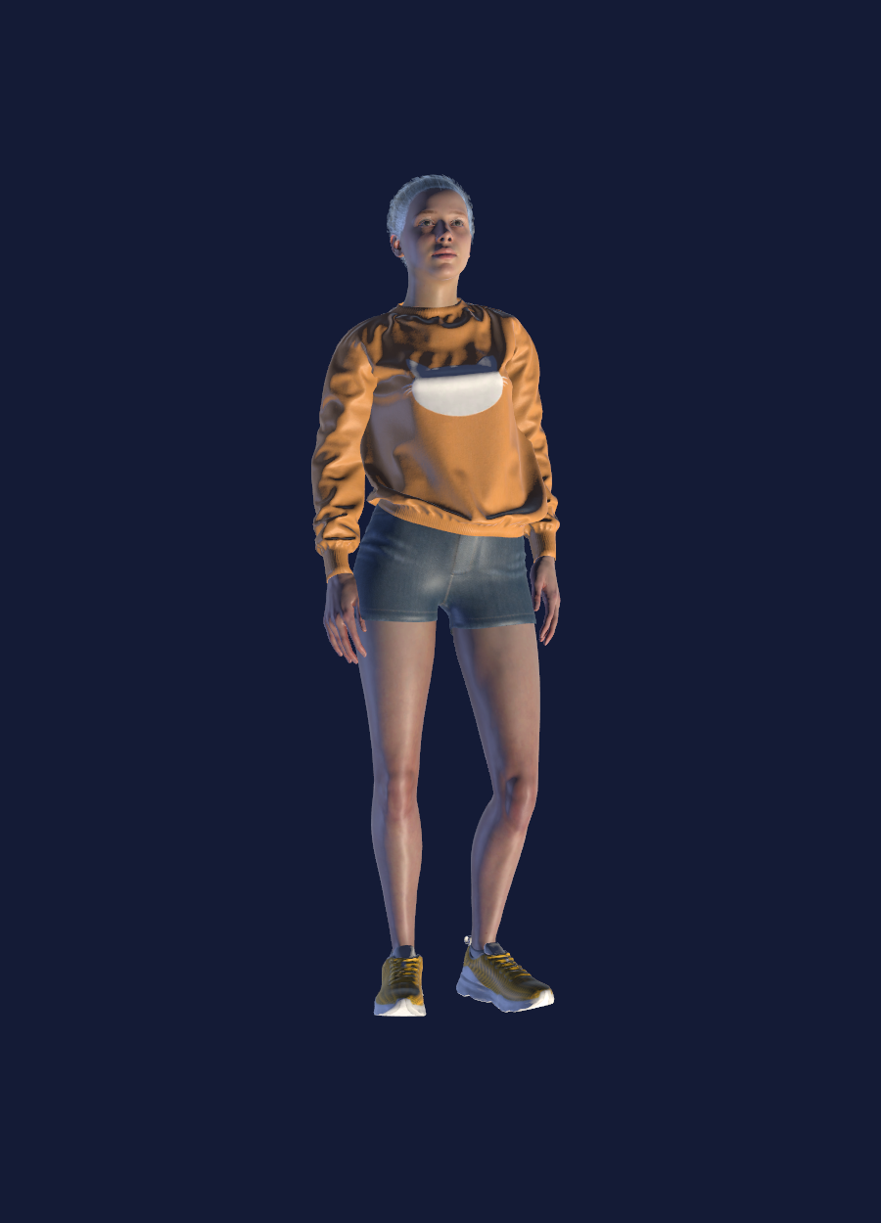
Player, Controls & Input
Every action read through the new Input System
INPUT ACTIONS
CARRIED ITEMS
Move
WASD
Time Lens
Look
Mouse
Run
Shift
Found at the end of MuseumNight. Reveals the hidden Time Anchors and opens the way to FrozenCity.
Jump
Space
Interact
E
Throw Chrono Orb
Left Mouse
Slow time
Ctrl
Chrono Hourglass
Camera toggle
C
Revealed by solving the gear puzzle. Slows time, and the Collector’s last phase cannot be survived without it.
Travel between eras
Q / R
Time Journal
Tab
Noa
Pause
Esc
The Museum of Time — Game Design Document
05

Slide 7
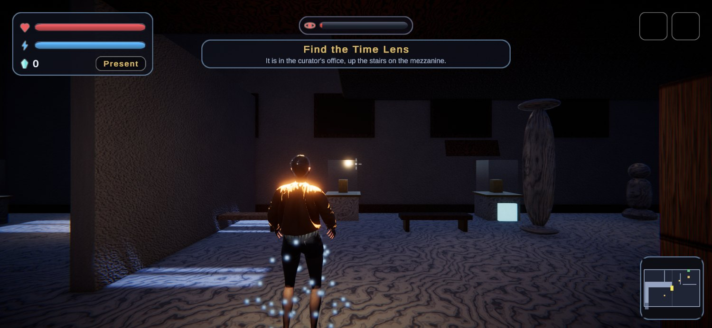
Scene 1 — MuseumNight
Tutorial, a two-storey museum, and the night the clock breaks
OBJECTIVE
Learn to move and interact, find the Time Lens in the curator’s office upstairs, and survive the moment the Clock of Creation shatters.
Key scripts: PlayerController, PlayerInteractor, TutorialTrigger, WardenAI, FracturedObject, MinimapController, ItemPickup
REQUIREMENTS MET IN THIS SCENE, AND HOW
Dynamic 3D tutorial — eight world-space signs raised by triggers, showing live health and energy
Triggers — twelve volumes of five kinds: room entry, tutorial, era zone, hazard, exit
Collisions — falling debris, swinging hazards and thrown orbs, all reading contact data
Hinge joints — the clock pendulum on a spring, a motorised gate, a signboard
Two-storey building — upper floor at 5 m, a stepped staircase, textures made in-project
Voronoi fracture — the Clock of Creation, into 29 shards each with a rigidbody
LOD assets — the stone column and the marble statue, three tiers each
Patrol with pause — four waypoints with real stops of 2.5–3.0 seconds
Steering, two agent types — Warden and Shadow, each on its own navmesh bake
Recast with stealth — distance, then a view cone, then a line-of-sight raycast
LayerMask in code — built when the component wakes, never set in the Inspector
Minimap — an orthographic camera to a texture, running the whole scene
First and third person — two Cinemachine cameras, toggled with C
Score, health, energy — plaques and shards add, capture subtracts, orbs cost energy
Items between scenes — the Time Lens is found here and opens the next scene
New Input System — one action asset, and no legacy input call anywhere
Animator — Noa six states, the Warden five, both authored in-project
Physical shooting — the Chrono Orb, a rigidbody sphere thrown on left mouse
The Museum of Time — Game Design Document
07

Slide 8
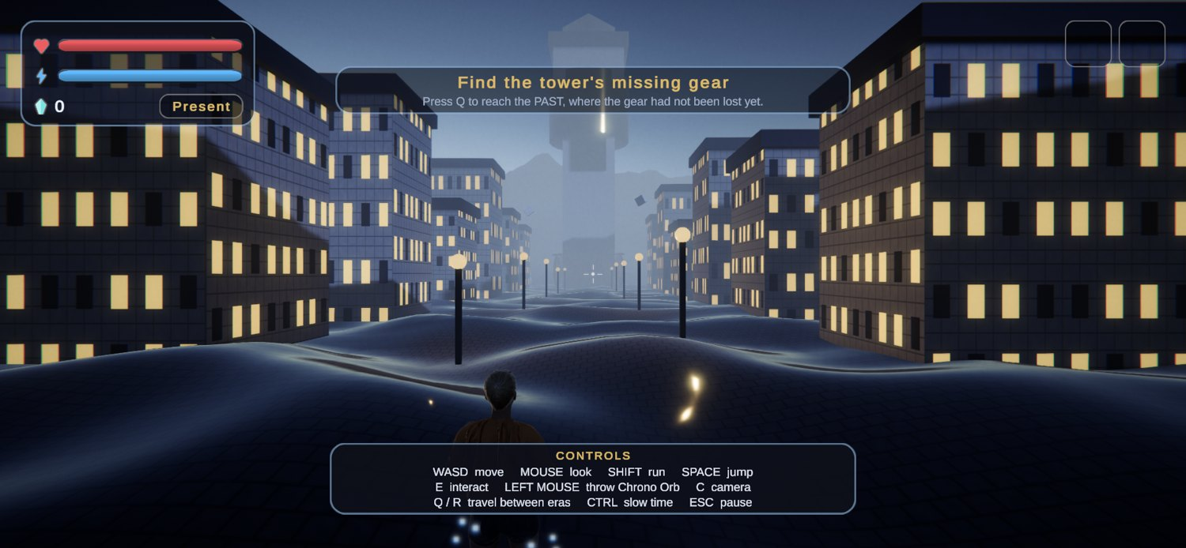
Scene 2 — FrozenCity
Terrain, three playable eras, stealth and the first hidden teleports
OBJECTIVE
Free a city stopped before sunset: find the tower’s missing gear in the Past, fit it in the Present, and confirm in the Future that the bell finally rang.
Key scripts: GearPuzzle, TimeAnchor, RespawnService, EraManager, ShadowAI, SteeringBehaviours, TerrainBuilder
REQUIREMENTS MET IN THIS SCENE, AND HOW
Self-built terrain — a 513 × 513 heightmap over 200 × 40 × 200 m, with 34 m of sculpted relief
Terrain layers — cobble, dirt and snow, generated in-project and painted by height
Hidden teleports — two Time Anchors, invisible unless Noa carries the Time Lens
Failure returns there — back to the last anchor, not the level start, with health restored
Items between scenes — the Lens opened this scene; the Chrono Hourglass is earned here
Dynamic 3D tutorial — four world-space signs, including the one that teaches era travel
Triggers — nine volumes of five kinds, the two anchors among them
Collisions — falling debris, a swinging hazard, and every thrown orb
Hinge joint — the tower bell, hung on a spring with limits
Voronoi fracture — the frozen statue, into 48 shards each with a rigidbody
LOD assets — sixteen LOD groups dressing the streets
Patrol with pause — four waypoints with a real 2.5-second stop at each
Steering, two agent types — a 0.7 m ledge only the Shadow can climb, so the routes differ
Recast with stealth — the city blocks sight lines where the museum used walls
LayerMask in code — the same masks, built against the Recast bake
First and third person — two Cinemachine cameras, toggled with C
Score, health, energy — carried in from scene 1; era travel and orbs cost energy
Input System, Animator, shooting — unchanged — one action asset, two controllers, the orb
The Museum of Time — Game Design Document
08

Slide 9
Scene 3 — ClockCore
Every mechanic at once, against a boss reachable only through time
OBJECTIVE
Face the Collector across three phases — one in each era — and restore the first moment to its place.
Key scripts: Collector, CollectorHitVolume, ChronoOrb, ChronoHourglass, SwingingHazard, FallingDebris, TimeAnchor
REQUIREMENTS MET IN THIS SCENE, AND HOW
Physical shooting — the Chrono Orb is the only thing that can hurt the Collector
Collisions — the boss reads orb impacts as phase changes; debris and pendulums too
Hinge joints — two pendulum bobs swinging over the arena floor
Hidden teleports — two more Time Anchors, in the east and west wings
Items between scenes — the Hourglass opened the door and keeps Noa alive in phase three
Dynamic 3D tutorial — three world-space signs naming the era each phase demands
Triggers — six volumes of three kinds
Patrol with pause — the Warden summoned in phase two, with real stops
Steering, two agent types — both hunting on their own separately baked surfaces
Recast with stealth — the summoned Warden hunts under the same sight rules
LayerMask in code — the same masks, built when each component wakes
LOD assets — seventeen LOD groups around the arena
First and third person — two Cinemachine cameras, toggled with C
Score, health, energy — carried in; phase three drains health until time is slowed
New Input System — era switching, slowing time and the throw all from one asset
Animator — the same two controllers drive Noa and the summoned Warden
The Museum of Time — Game Design Document
09

Slide 10
Main Mechanic — Time Shifting
Three prepared versions of the same place, one active at a time
PAST
PRESENT
FUTURE
Change the cause
Solve the event
Check the result
Press Q. Objects can still be moved, and what happens here is felt in both later eras.
Where the museum stands tonight, and where most objectives are performed.
Press R. The consequence is already visible — this is where a fix is confirmed or exposed.
HOW IT IS BUILT
Each era is a sibling group of objects, switched on and off — not a separate scene, so the change is instant.
Noa keeps her position across the switch; only the world around her changes.
Objects that were moved carry their new position forward into the later eras.
WHY IT IS BUILT THIS WAY
It looks like time travel but avoids simulating it: three small prepared dressings are swapped, and the only state that has to survive is where things were left.
That keeps it cheap, instant, and simple to explain in the defence.
The Museum of Time — Game Design Document
10

Slide 11
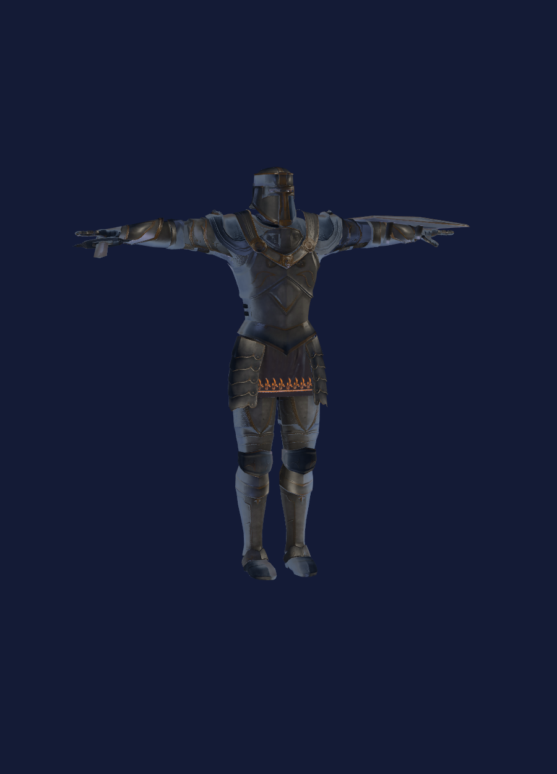
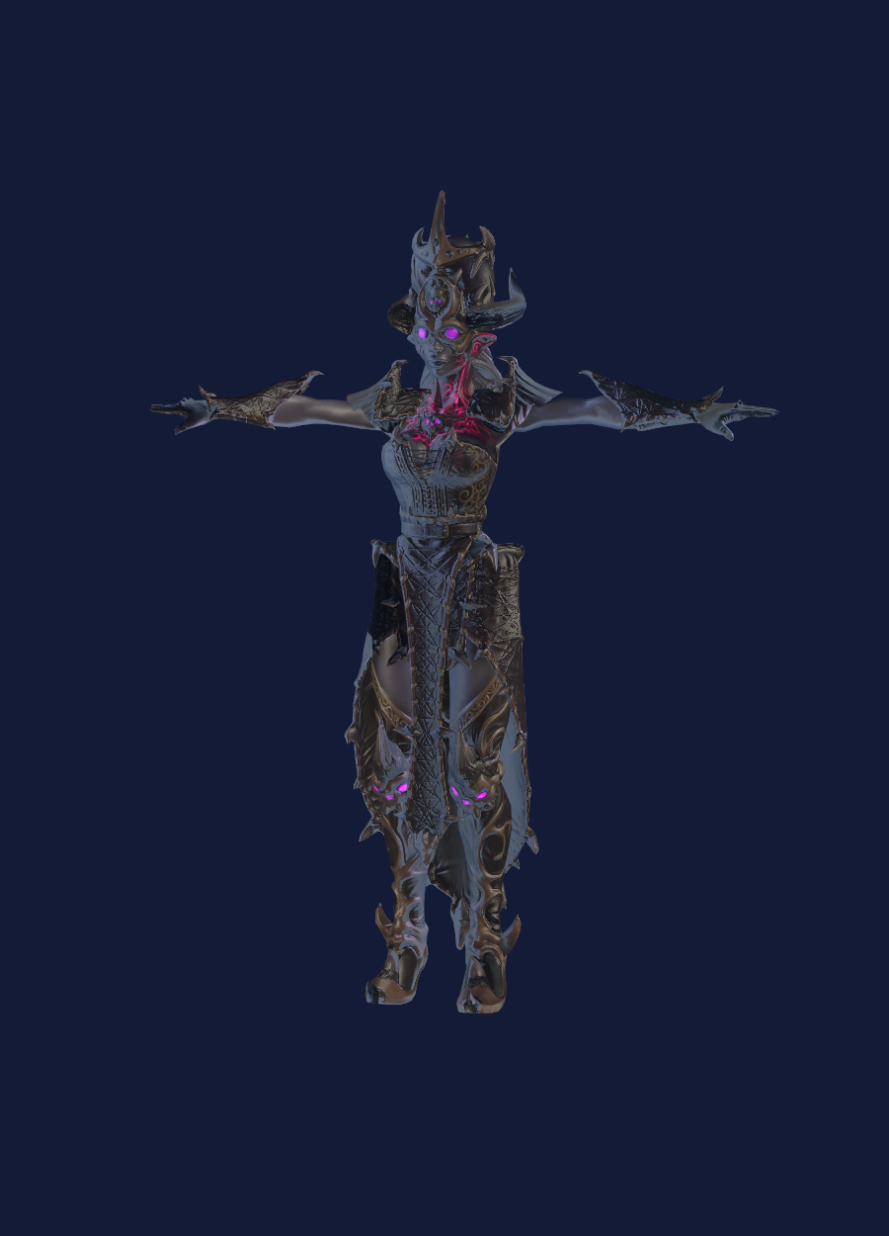
AI & Stealth Design
Two agent types, two separate navmesh bakes, sight decided by raycast
AGENT 1
AGENT 2
Time Warden
Chronological Shadow
Radius 0.5 m · height 2.0 m · climb 0.4 m
Radius 0.3 m · height 1.2 m · climb 0.9 m
Patrol → Pause → Alert → Chase → Search
Aims at where Noa will be, not where she is
Pauses 2.5–3.0 s at every waypoint
Frozen by a Chrono Orb hit
Drift → Seek shard → Flee → Frozen
Steals Time Shards on contact, costing real score
Climbs a 0.7 m ledge the Warden cannot
Recoverable by freezing it
RAYCAST + LAYERMASK DECIDES VISIBILITY
Detection runs the cheapest test first: distance, then a view cone, then a line-of-sight raycast against a mask built in code rather than assigned in the Inspector. A detection meter fills only while Noa is actually visible, so breaking the line of sight behind a column or a display case genuinely loses the guard. Both agents implement one freeze interface, so a single orb handles either.
The Museum of Time — Game Design Document
11

Slide 12
Player Systems & Persistence
One saved state carries the whole run
GameState
›
GameManager
›
SaveService
›
SceneLoader
›
HUD
›
RespawnService
WHAT IS STORED
WHAT CHANGES IT
Health, energy, score and Time Shards.
Both acquired items: the Time Lens and the Chrono Hourglass.
The last armed checkpoint — scene, position and era.
Deaths and how many times Noa was detected, for the final screen.
Reading an exhibit plaque
score up
Collecting a Time Shard
score and shards up
A Shadow steals a shard
score down
Caught by a Warden
health and score down
Dying
score down, health restored at the anchor
Era travel, orb throw, slowing time
energy down
The state is written to JSON, so a run survives quitting as well as a scene load. The manager is created once and outlives every scene change.
The Museum of Time — Game Design Document
12

Slide 13
Physics & Interactions
Course mechanics doing real work in the game
Hinge joints
Thrown physical body
Collisions acted upon
Six across the three scenes: the clock pendulum on a spring, a motorised gallery gate, a swinging signboard, the tower bell, and two pendulum bobs over the arena floor.
The Chrono Orb is a rigidbody sphere thrown on left mouse. It freezes what it hits, shatters what was built to break, and never destroys anything else.
Four handlers read real contact data: the orb, falling debris, the swinging hazards, and the Collector, who counts orb impacts as his phase transitions.
THE SHOT, END TO END
Left mouse
pressed
›
Energy
spent
›
Orb
spawned
›
Force
applied
›
Collision
contact read
›
Freeze,
break or phase
TRIGGERS ACROSS THE GAME
Twenty-seven trigger volumes of six distinct kinds: room entry, tutorial text, era zones, hazards, scene exits and hidden Time Anchors. They are separate components rather than one script wearing six hats, so each does one legible job — and every one of them is a real gameplay event, not a demonstration placed to satisfy a checklist.
The Museum of Time — Game Design Document
13

Slide 14
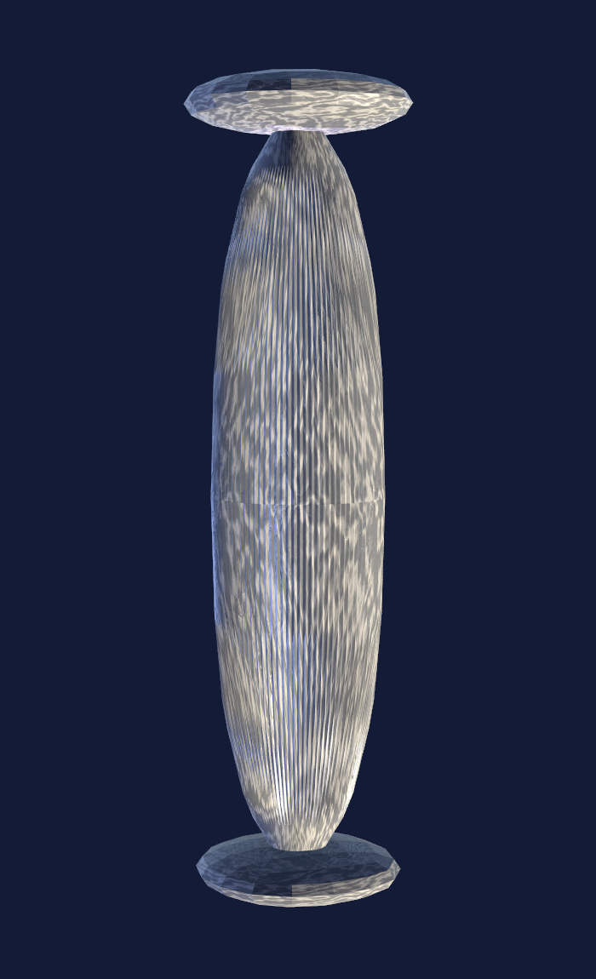
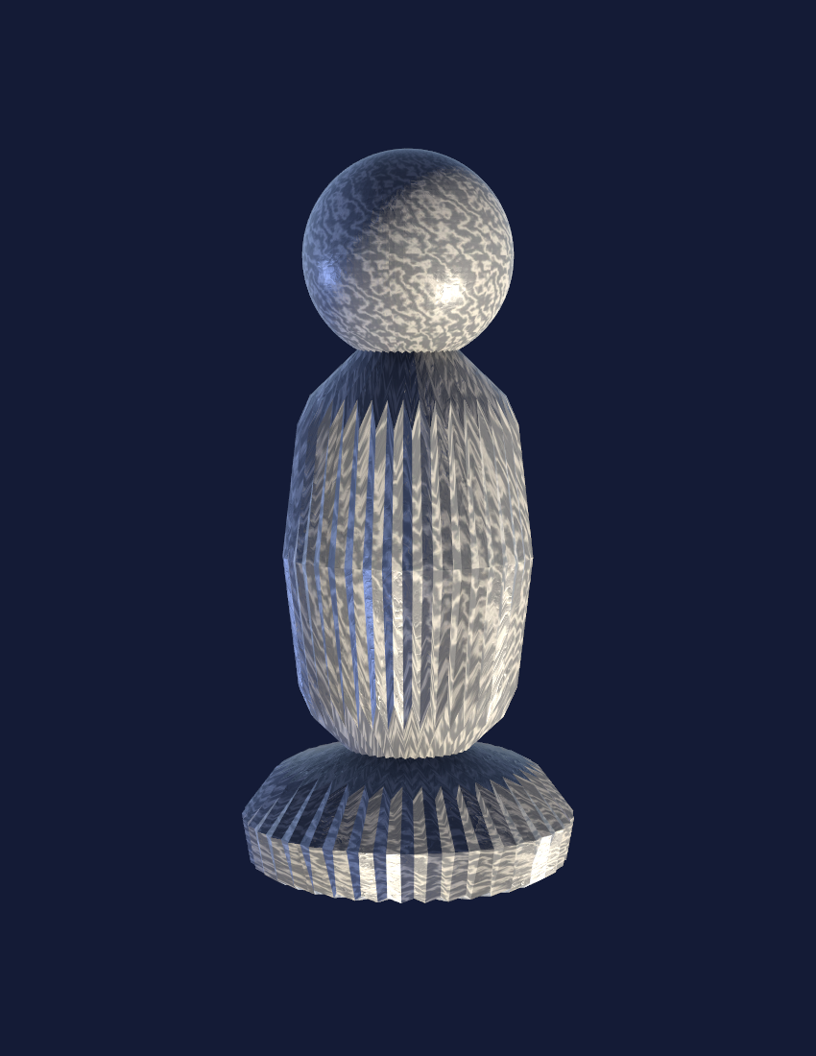
Assets & Optimization
Fractured and reduced by hand, then kept inside the size budget
VORONOI FRACTURE
LOD ASSETS
Two assets were fractured in Blender with a Voronoi cell script and imported as breakable prefabs.
Two different models had their polygons reduced by hand and were rebuilt as Unity LOD groups.
Clock of Creation — 29 shards, breaks at the end of MuseumNight.
Frozen Statue — 48 shards, shattered by the orb in FrozenCity.
Every shard carries its own rigidbody, is hidden until the break, takes an explosion force, and is cleaned up afterwards so the pieces never accumulate.
STAYING UNDER THE CAP
Texture import sizes are capped and compressed, animation is compressed, shard and LOD counts are deliberately small, and materials are reused across scenes. The last measured release build was 137.6 MB uncompressed and 56.8 MB compressed, against a 300 MB limit.
Stone Column
Marble Statue
4 992 → 2 496 → 998
9 760 → 4 880 → 1 952
triangles, LOD0 → LOD2
triangles, LOD0 → LOD2
The Museum of Time — Game Design Document
14

Slide 15
UI, Camera & Orientation
The player should always know where they are and what to do next
HUD
Health and energy bars
Score and Time Shards
Current era
A detection meter while a Warden looks
The current objective, in the world and on screen
CAMERAS
Third-person camera for exploring
First-person camera for reading and aiming
Toggled with C through Cinemachine priorities, so the view blends rather than cuts
The minimap camera is separate and does not count toward the two
Every element below is visible in this single frame.
MINIMAP
Objectives are written into the world as 3D text as well as on the HUD, and they name the era a task needs. A player who has forgotten what they were doing can look up and read it off a sign rather than a menu.
An orthographic camera rendering to a texture
Follows Noa for the whole of MuseumNight
Shows the player marker and the objective
Generated from the museum geometry, so it matches what is really there
The Museum of Time — Game Design Document
15

Slide 16
Requirement Map — Core Gameplay
Where each mandatory element is demonstrated
Requirement | Where it is demonstrated | How it is done
Entry and victory menus | MainMenu, Victory | New Game, Continue, Controls and Quit; Continue unlocks only when a save exists. Victory reports score, shards, detections and playtime.
In-game tutorial, dynamic text, in 3D | All three scenes | 15 world-space signs raised by their own triggers; the text substitutes the player’s live health and energy as it appears.
At least four triggers | All three scenes | 27 trigger volumes of six distinct kinds: room entry, tutorial, era zone, hazard, scene exit and hidden anchor.
At least three collisions | All three scenes | Four handlers read contact data: the thrown orb, falling debris, the swinging hazards, and the Collector.
Physical hinge joints | All three scenes | Six hinges: clock pendulum, motorised gate, signboard, tower bell and two arena pendulums.
Self-built Terrain | FrozenCity | A 513 × 513 heightmap over 200 × 40 × 200 m, sculpted and painted with three surface layers made in-project.
Patrol with pause | All three scenes | Four waypoints per route with real stops of 2.5–3.0 seconds, during which the guard sweeps its head.
Score, health and energy | All scenes | Plaques and shards add score; theft, capture and death subtract it. Energy pays for era travel, orbs and slowing time.
Parameters between scenes, two acquired items | All scenes | One serialized state carries health, energy, score, shards, both items and the last checkpoint. The Lens and the Hourglass each gate a door.
Two assets fractured with Voronoi | MuseumNight, FrozenCity | Clock of Creation into 29 shards, Frozen Statue into 48; every shard has its own rigidbody.
Two assets reduced and used as LOD | All five scenes | Stone Column at 4 992 / 2 496 / 998 triangles and Marble Statue at 9 760 / 4 880 / 1 952, both as three-tier LOD groups.
The Museum of Time — Game Design Document
16

Slide 17
Requirement Map — Technical Systems
AI, input, cameras and the teleport rule
Requirement | Where it is demonstrated | How it is done
Only the new Input System | Whole project | One action asset and one reader class. There is no call to the legacy Input class anywhere, in gameplay code or editor tooling.
Steering AI, two agent types, separate bakes | All three scenes | Seek, flee and pursue are named methods. Warden and Shadow have different agent types and their own baked navmesh surface in every scene.
Animator defined by hand, four or more states | Player and Warden | Noa’s controller has six states, the Warden’s five. Both were authored in the project rather than imported with a model.
Shooting — impact of a physical body | All three scenes | The Chrono Orb is a rigidbody sphere; its effect is scaled by the relative velocity of the impact, so a tap and a hard throw differ.
Recast together with stealth | All three scenes | Navmesh bakes plus a three-stage sight test — distance, view cone, then line of sight — with a detection meter that decays when sight is broken.
LayerMask defined in code, against Recast | AI and interaction | Masks are built with LayerMask.GetMask when each component wakes, not assigned in the Inspector.
Simple minimap, one whole scene | MuseumNight | An orthographic camera renders to a texture and follows the player for the entire scene, with a marker and the objective on it.
First to third person, two cameras besides the minimap | All three scenes | Two Cinemachine cameras and a Brain, toggled with C so the view blends. The minimap camera is a separate third camera.
Two-storey building, own textures, stairs | MuseumNight | The museum has an upper floor at 5 m reached by a stepped staircase, dressed with marble, plank and plaster textures generated in-project.
Two hidden teleports from the second scene onward | FrozenCity, ClockCore | Two anchors in each, invisible without the Time Lens. Failing returns Noa to the last one armed with health restored, not to the level start.
The Museum of Time — Game Design Document
17

