Slide 1

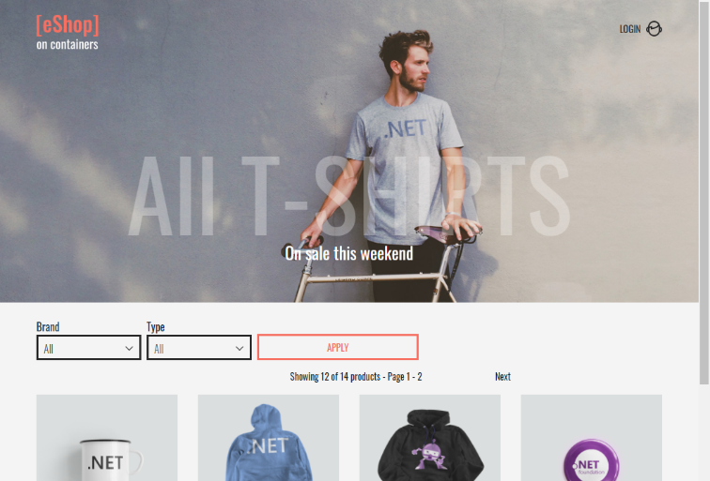
QA – Final Project
Ofri Shapira
eShopOnContainers by Microsoft
https://github.com/dotnet-architecture/eShopOnContainers

Slide 2
01
System Introduction
Agenda
02
Unit Under Test Introduction
03
Full Order Flow
The QA Process
04
05
The Automation Testing Process
06
Tests Metrics
07
Retrospective and Conclusions

Slide 3
System Introduction
What is eshopOnContainers?
The eshopOnContainers app is an ecommerce open-source reference application.
The app is designated for being a practical guide for design, build and deploy a cloud-native application using modern technologies and best practices.
The app is based on a microservices architecture and deployed on containerized infrastructure.
The app provides to its users an online shopping experience, where they can browse products, add them to a shopping cart, and place orders.

Slide 4
System Introduction
Full system flow
The full main system flow of the application can be broken down into the following steps:
User browses the product catalog.
User adds items to the shopping cart.
User checks out.
User provides shipping and payment information.
Order is processed.
Order is shipped.

Slide 5
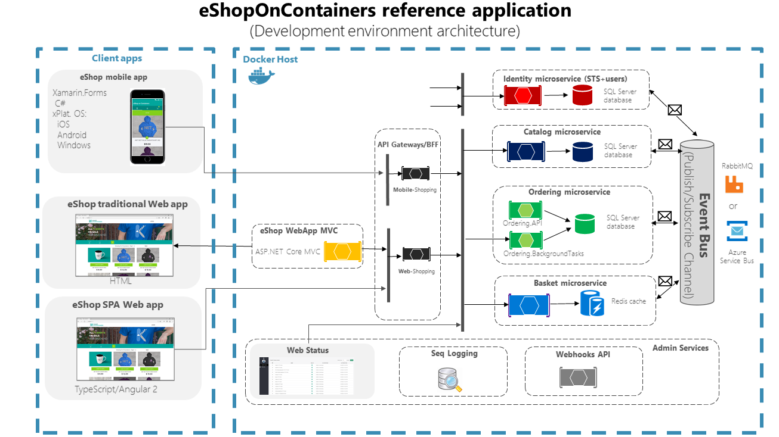
System Introduction
The eshopOnContainers application architecture

Slide 6
Unit Under Test Introduction
What are we testing?
In the eShopOnContainers application, our Unit Under Test consists of several different software applications that act together to create a single microservice.
This microservice is the Ordering service, which is responsible for managing the ordering process for the e-commerce app, which is a key component of the platform.
When a user places an order, the ordering service creates a new order and populates it with the items from the user's shopping cart. The service then validates the order, and sends messages to other services, such as the catalog service and the payment service, to process the order.
Finally, the order can be ship to the user, or cancel.

Slide 7
Unit Under Test Introduction
Order statuses
From the moment that the user placed an order on the app, till the order is being ship to the user, there are 6 possible order statuses:
submitted - The user’s order has been picked by the system.
awaitingvalidation - The system validates that the order details are valid.
stockconfirmed – The system confirms that all the ordered items are exits in the stock.
paid - The system confirms that the payment process has been completed.
shipped - The user’s order has been shipped.
canceled - The user’s order has been canceled.

Slide 8
Unit Under Test Introduction
Order statuses restrictions
The order cannot be shipped before being paid.
The order cannot be canaled after being shipped.
submitted
awaitingvalidation
stockconfirmed
paid
shipped
canceled

Slide 9
Unit Under Test Introduction
Unit Under Test components
Ordering API
Provides a RESTful API that allows clients to place new orders, retrieve existing orders, cancel orders and ship them.
Ordering Background Task
Used to perform various tasks asynchronously in the background by subscribing to messages from RabbitMQ (like update the order status in the database).
Ordering SignalRHub
When an event occurs on the server, such as a new order being placed or an order being shipped, the Ordering SignalRHub sends a message to all the connected services, which updates the client's UI in real-time.
Ordering Database
Is responsible for managing customer orders, payment information, and shipping details.

Slide 10

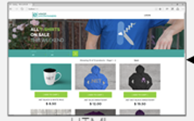





Unit Under Test Introduction
Unit Under Test architecture
GUI
Ordering Service
Identity Microservice
SQL Server database
Catalog Microservice
Ordering Background Tasks
SQL Server database
SQL Server database
Basket Microservice
SQL Server database +n Redis
Ordering API
Payments Microservice
SQL Server database

Slide 11
The QA Process
The QA process stages
Analyzing customer requirements and ICD (the Interface Communication Document) for the Ordering service.
Exploring the communications between the different services with the Unit Under Test using the ICD.
Creating a requirements tree based on the different functionalities of the Ordering service.
Start writing test cases based on the requirements tree.
Converting the manual test cases into automated scripts.
Automated test suite executions and maintenance.

Slide 12
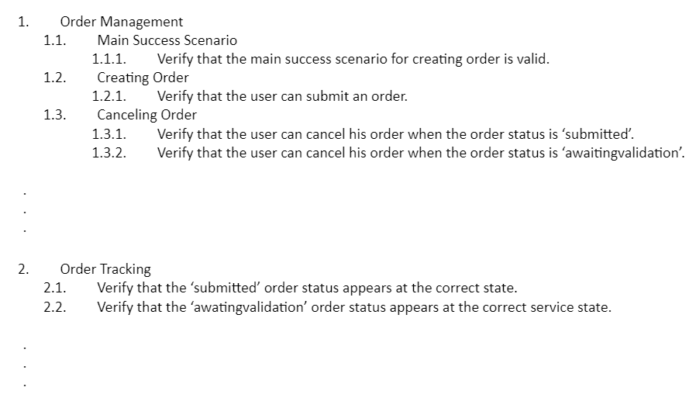
The QA Process
Requirements tree structure
Original test plan file link

Slide 13
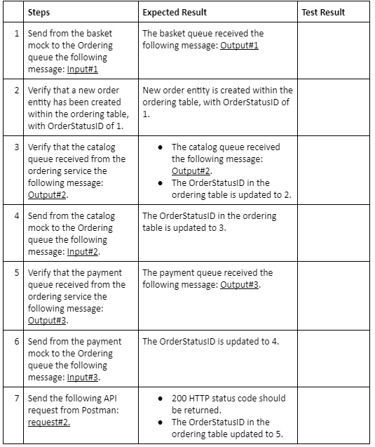
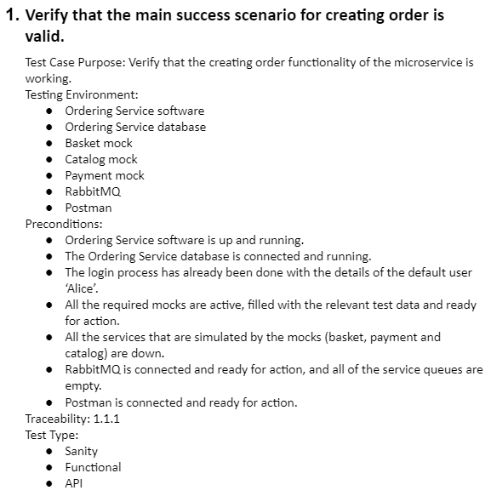
The QA Process
Test Case structure
Original test plan file link

Slide 14




The Automation Process
Testing environment
Docker Host
Microservices Simulators
GUI Simulators
Ordering Service
Payment
Basket
Ordering Background Tasks
OR
SQL Server database
Ordering API
Catalog

Slide 15
The Automation Process
The automation infrastructure
The automation infrastructure that testing the ordering service has been written in python, using Pytest as the testing framework, and composed from the following key components:
Tests suites package – contains the actual tests to run.
Scenarios package - meant to add shared steps functionality to the tests.
Simulators package – contains a couple of microservices simulators that are mocking RabbitMQ message publication and consumption.
Message Generator class (data factory implementation) – class that generates unique RabbitMQ messages.
Utils package – contains utilities wrapper classes for: Ordering API, SQL Server driver, Docker API and Pika library (for communicate with RabbitMQ).

Slide 16
Test Metrics
Test Coverage
Requirement ID | Requirement Title | Requirement Description | Test Cases Amount | Automated Tests Amount
1 | Order Management | The microservice should be able to manage the entire order process, including creating, updating, and canceling orders. | 12 | 12
2 | Order Tracking | The microservice should provide online updates on the status of each order, including shipping information and delivery estimates. | 6 | 6
3 | Payment Processing | The microservice should integrate with a payment gateway to securely process payments from customers. | 3 | 3
4 | Inventory Management | The microservice should communicate with the inventory management system to ensure that products are available for purchase and to update inventory levels after an order has been placed. | 2 | 2
5 | Security | The microservice should implement robust security measures to protect customer data and prevent unauthorized access to sensitive information. | 11 | 11

Slide 17
Test Metrics
Test Coverage
Requirement ID | Requirement Title | Requirement Description | Test Cases Amount | Automated Tests Amount
6 | Scalability | The microservice should be designed to handle high volumes of at list 100 orders in one hour. | 2 | 2
7 | Reliability | The service can crash but when it is restarted it should continue from the point where it crashed | 3 | 3
8 | Reporting and Analytics | The microservice should provide business owners with reports and analytics on sales, customer behavior, and other key metrics to help optimize the e-commerce platform. | 7 | 0
9 | Integration | The microservice should integrate with other systems and services, such as the product catalog, shipping providers, and customer management system, to ensure a seamless order process. | 0 | 0

Slide 18
Test Metrics
Test Coverage
Test coverage
Automated test per requirement

Slide 19
Retrospective and Conclusions
What new topics have I learned during the project?
From my experience, the project was a very valuable learning process, which included researching a variety of unfamiliar topics and gaining experience in project design, planning and implementation.
For example, during the project, I learned a new technique for generating test data that is consistent and repeatable. This pattern is known as ‘Data Factory’. By using data factories, you can generate test data that is representative of the data that the application will work with in production. In the MessageGenerator class, I have implemented this pattern.

Slide 20
Thank You for the Listening

Slide 21
Appendix
Personal Project GitHub Branch: https://github.com/nirarad/rafael-ness-bootcamp/tree/ofri-shapira
eShopOnContainers GitHub Repository: https://github.com/dotnet-architecture/eShopOnContainers
Test Plan File: https://docs.google.com/document/d/1Z3mP5loE8gpcdw7demSttCnpLfKLmf622tpoLxcyl-o/edit?usp=sharing
Requirements Document: https://docs.google.com/document/d/1qhbbURGk-h4LkoLZAyATUig15kULQU52hPuFNzdFLZk/edit?usp=share_link
ICD Document: https://docs.google.com/document/d/1c7mtthgOwYmB9osn0Dy_9p-uxYaMTd35KHYfA7NjaP8/edit?usp=share_link

