Slide 1
Introduction to Computing Science
Dr Anu Mary Chacko

Slide 2
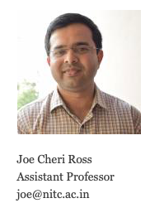
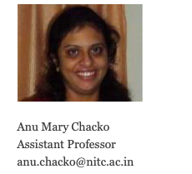
About Facilitators

Slide 3
My focus
3rd module
Computational thinking

Slide 4
Lecture Hours
Faculty | B Morning | J Morning | B afternoon | J afternoon
Anu | Mon 11.00 | Tue 10.00 | Mon 4.00 pm | Tue 3.00 pm
Anu | Wed 9.00 | Fri 12.00 | Wed 2.00 pm | Friday 1.00 pm
Joe | Tue 10.00 | Mon 11.00 | Tue 3.00 pm | Mon 4.00 pm
Joe | Fri 12.00 | Wed 9.00 | Friday 1.00 pm | Wed 2.00 pm

Slide 5
Syllabus
Computational Thinking
What is Computational Thinking Sample Datasets - Iterator Flowcharts - Variables: Count Sum Average Accumulator - Filtering: Simple Conditions, Compound Conditions, Looking for a data element, Dynamic Conditions (Maximum Minimum) - Data types: Basics - Compound data types: Subtypes - Pseudocode
References:
G. Venkatesh and Madhavan Mukund, Computational Thinking: A Primer for Programmers and Data Scientists, 1st ed. India: Notion Press, 2021.

Slide 6
Mark Distribution
Midterm 30
Final 40
Assignment/quiz 30
Total 100

Slide 7
What is computational thinking?
Something we do everyday…
Shopping in Super Market -→ Similar activities
To do List → ……
Arranging bookshelf from cartons of book
We observe a shared patten consisting of a sequence of atomic action
Computational thinking = search for shared pattern among commonly occurring activities
Notes:
Items in Kitchen
Book in bookshelf
To do List – Shopping list – invitation list
Hanging clothes intelligently -- placing books from box to shelf

Slide 8
Why
Helps us to make our thought process clearer when we deal wit activities of this sort
Improve productivity due to pattern identification
Helps to communicate the procedures to others -→ communicate to a computer effectively.

Slide 9
Problem
I want to organize a birthday party for my grandmother who is going to be 70

Slide 10
Steps of Problem solviing
Decomposition
Pattern Identification
Abstraction
Representation

