Slide 1
Dataset Bottleneck Analysis
Quantifying the Reconstruction Gap for AI-Era Biosecurity Screening
AIxBio Hackathon · April 24–26, 2026 · Track: AI Biosecurity Tools
Key result: ESM-2 reveals 13.2× higher reconstruction risk than BLAST-style screening
Toxin ESM-2 R = 0.873 · 98.6% coverage · 32× k-mer
github.com/Ogak-AI/DBA

Slide 2
The Problem
Current screening assumes BLAST-era adversaries
How biosecurity screening works today
What AI adversaries can actually do
1. Synthesis order submitted
• Protein language models (ESM-2, ESM-3)
2. Sequences compared vs restricted DB
encode functional & structural similarity
3. BLAST-style k-mer identity check
• Two sequences can share < 30% identity
4. Order blocked if similarity > threshold
yet fold into the same structure and
perform the same biochemical function
Threshold calibrated on sequence identity
• An adversary needs functional similarity
-> assumes adversary does copy-paste
— not sequence identity
-> BLAST thresholds miss this entirely
Core question: Does restricting sequences actually create a meaningful information barrier?

Slide 3
The DBA Framework
Measuring reconstruction gap with bootstrap-validated metrics
D1 (Restricted)
3 Representations
Redundancy Score R
Policy Output
1,698 seqs UniProt Swiss-Prot
->
K-mer · Projection · ESM-2
->
Coverage@τ + norm_MSE
->
R ± 95% CI per method
Redundancy Score: R = 0.5 × Coverage@τ + 0.5 × (1 − norm_MSE)
Coverage@τ = fraction of D1 seqs with nearest-neighbour similarity ≥ τ in D2
norm_MSE = MSE(x, x̂_NN) / MSE(x, x̂_random) — NN reconstruction vs random-retrieval null
R -> 1 : D1 broadly reconstructable from D2 (restriction creates minimal barrier)
R -> 0 : D1 genuinely unique (restriction is a real information bottleneck)
Cluster-aware split: whole k-mer clusters assigned exclusively to D1 or D2 — no within-family leakage

Slide 4
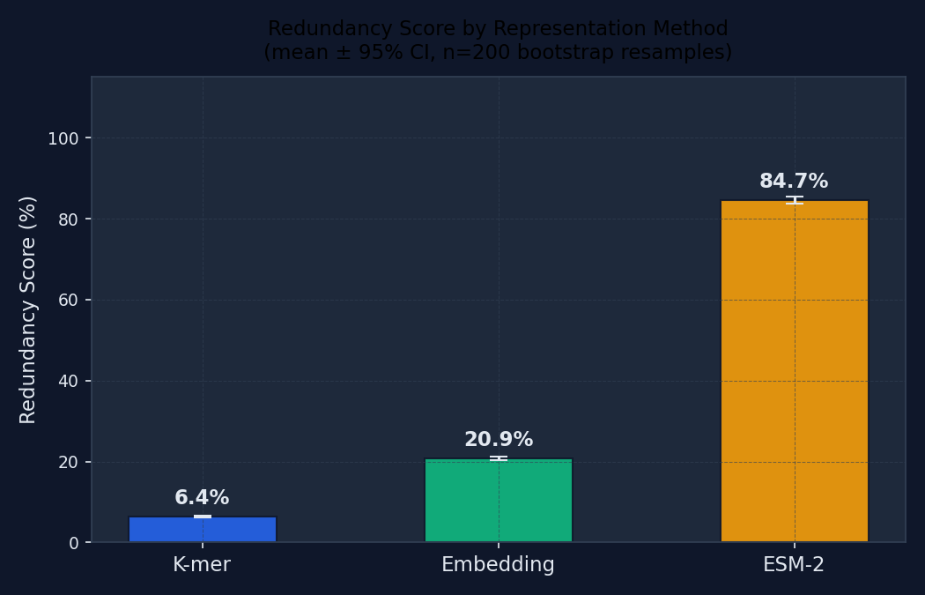
Main Results
4,844 UniProt Swiss-Prot proteins · cluster-aware split · D1=1,698 · D2=3,146
Key numbers
K-mer R
0.064
[0.062, 0.067]
0% coverage
Projection R
0.209
[0.204, 0.213]
0.06% coverage
ESM-2 R
0.847
[0.838, 0.855]
95.5% coverage
13.2×
ESM-2 / K-mer ratio
Wilcoxon p ≈ 0 (n = 1,698)
AI threat multiplier: a language-model adversary has 13.2× more reconstruction leverage than BLAST assumes

Slide 5
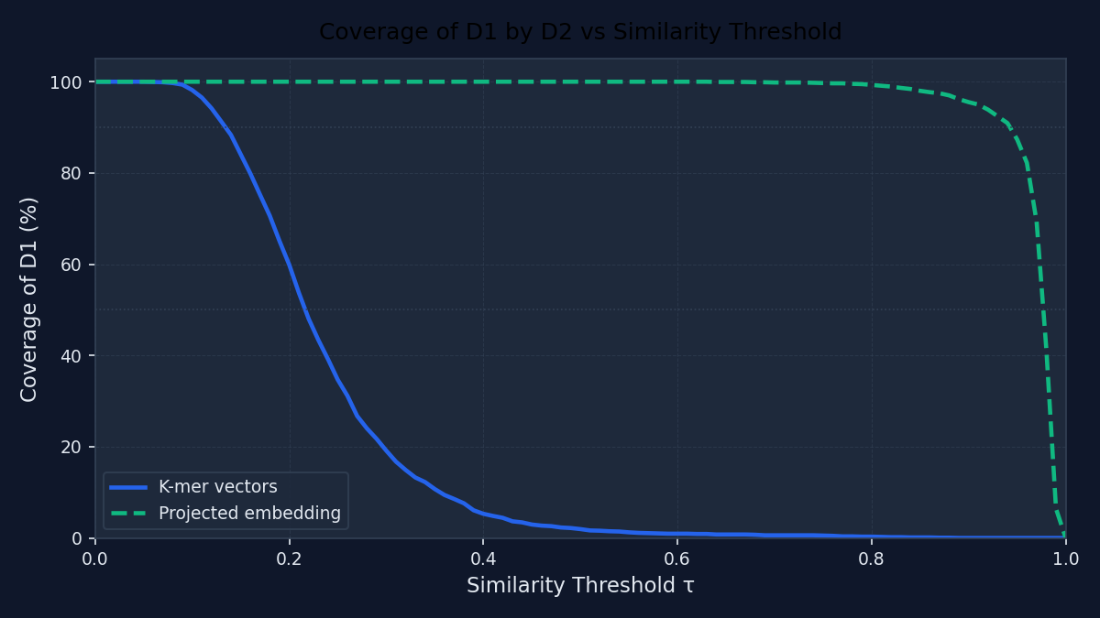
Coverage Curve
Fraction of D1 sequences recoverable at each similarity threshold
Reading the curve
At τ = 0.90:
K-mer -> 0% coverage
ESM-2 -> 95.5% coverage
Current screening operates
at τ ≈ 0.35–0.50 in cosine
similarity terms.
At that range, 15–30% of
restricted sequences have a
recoverable ESM-2 analogue
in the public corpus.
Correct τ for ESM-2 < 5%
coverage: τ ≈ 0.95

Slide 6
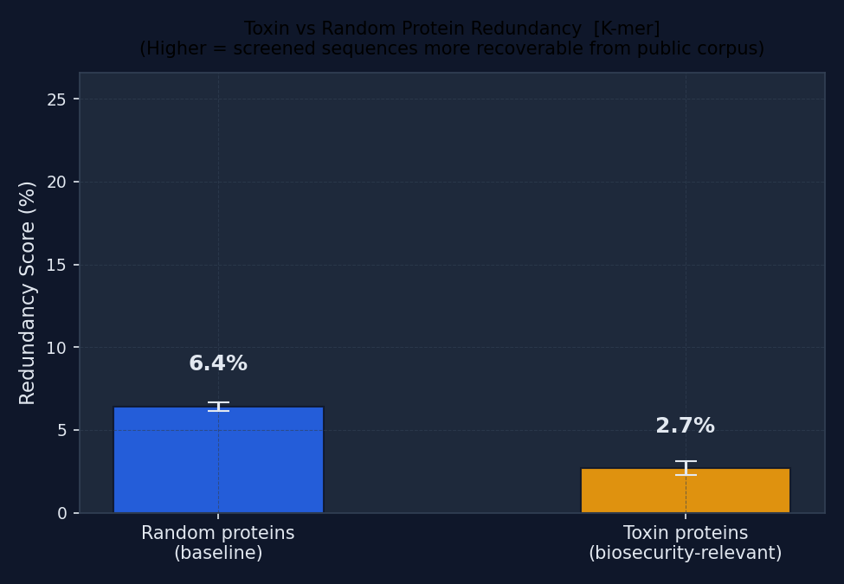
The False Signal: Toxin Proteins
K-mer and ESM-2 give completely opposite risk rankings
K-mer says: TOXINS ARE SAFE
Random Swiss-Prot
R = 0.064
Toxin proteins
R = 0.023 (−64%)
⬇ ESM-2 says: TOXINS ARE MORE RISKY
Random Swiss-Prot
R = 0.847 95.5% cov
Toxin proteins
R = 0.873 98.6% cov (+3%)
32×
toxin ESM-2 / K-mer
K-mer screening inverts the true toxin risk ranking — the most dangerous category appears safest

Slide 7
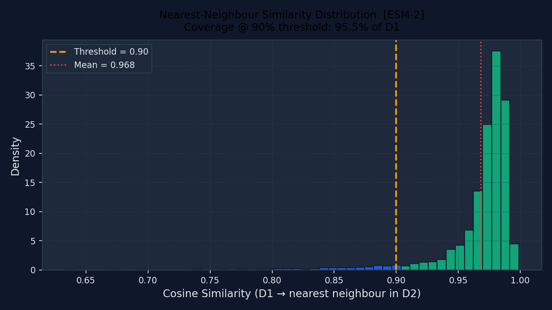
What 95.5% Coverage Looks Like
ESM-2 nearest-neighbour similarity distribution
Interpretation
Peak at similarity ≈ 0.97:
most restricted sequences
have a near-identical ESM-2
match in the public corpus.
At τ = 0.90 (dashed):
95.5% fall to the right.
An adversary queries D2 with
ESM-2 and finds a functional
scaffold for essentially every
restricted sequence.
This is not similarity noise —
it is functional proximity.

Slide 8
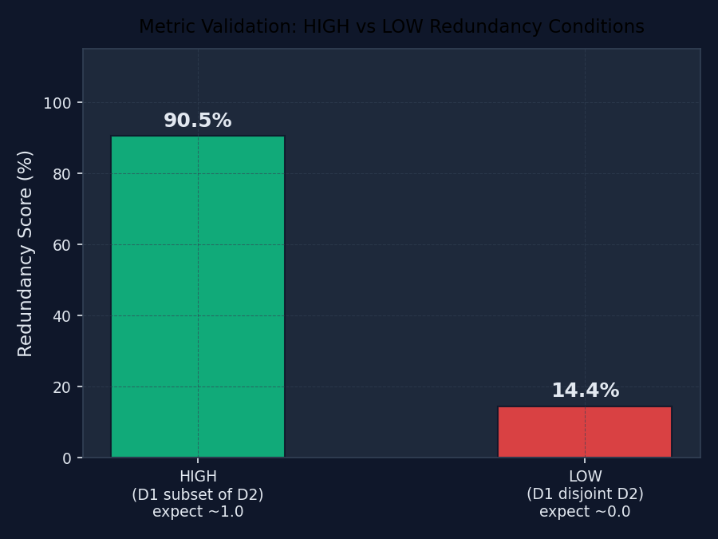
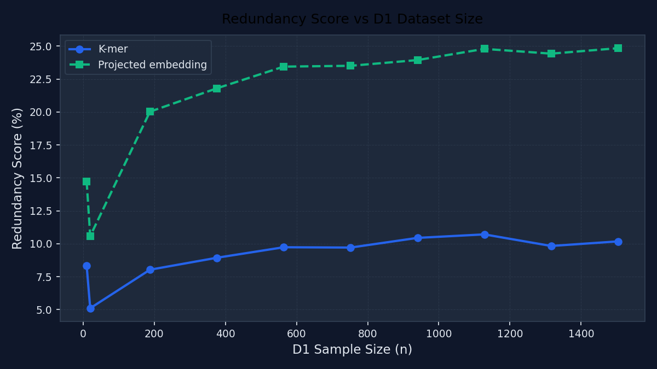
Validation & Robustness
Multiple checks confirm the results are genuine
✓ Sanity check
✓ Null model
HIGH (D1⊂D2): R=0.905 ≈ 1.0 LOW (disjoint): R=0.144 ≈ 0.0
Column-permuted D2 -> real signal confirmed (ESM-2 real−null = +0.436)
✓ Bootstrap CI
✓ Held-out check
n=50–200 resamples; CIs narrow (ESM-2: [0.838, 0.855])
Full D1 R=0.065 ≈ held-out 10% R=0.065
✓ Wilcoxon test
✓ Size sensitivity
K-mer vs ESM-2: p ≈ 0 (n=1,698)
Scores plateau at |D1| ≈ 200–400; results stable across dataset sizes

Slide 9
Policy Implications
Concrete recommendations for screening programme designers
Replace BLAST thresholds with embedding-based thresholds
1
At τ = 0.90, k-mer -> 0% coverage; ESM-2 -> 95.5%. The threshold must be re-calibrated in embedding space to maintain equivalent security.
Run DBA before deploying any new screening category
2
5 steps: define D1, run core pipeline, read coverage curve, run ESM-2, document the ratio. If ESM-2/K-mer > 5×, thresholds need upgrading.
Treat toxin categories as highest priority
3
K-mer suggests toxins are safer than average (R=0.023). ESM-2 shows they are more reconstructable (R=0.873, 98.6% coverage). This inversion is specific to functional families under evolutionary selection pressure.

Slide 10
Conclusions & Future Work
✓ 13.2× AI threat multiplier confirmed on 4,844 real proteins (full corpus, CPU, 22 min)
✓ Toxin screening false signal: K-mer R=0.023 (appears safe) -> ESM-2 R=0.873, 98.6% coverage
✓ DBA is a practical pre-deployment audit tool — open-source, no GPU required
Future Work
• Integration with SecureDNA screening pipeline
• Wet-lab validation of ESM-2 functional proximity
• Scale to full UniProt Swiss-Prot (~570K entries)
• Larger ESM-2 models (650M, ESM-3)
• Extend false-signal analysis to viral/Select Agent categories
github.com/Ogak-AI/DBA · Full report: DBA_report.md

