Slide 1
General Surgery Resource Utilization Analysis
Analysis, Findings, and Recommendations

Slide 2
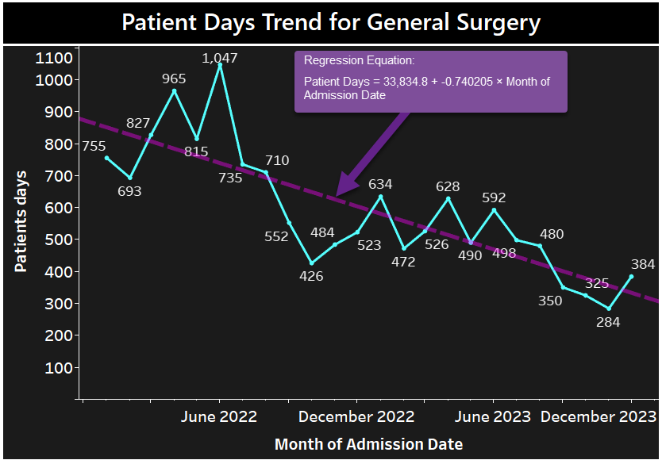
Patient Days Trend for General Surgery
General Surgery accounts for 14,195 total patient days.
Average Length of Stay (LOS): 0.86 days.
Trends show efficient utilization due to streamlined surgical workflows.
DRG Weight: Cases in General Surgery have a higher average DRG weight (2.12), indicating greater complexity and resource intensity compared to Internal Medicine (1.53).

Slide 3

Key Factors Contributing to Efficiency
Use of minimally invasive techniques reducing LOS.
Enhanced Recovery After Surgery (ERAS) protocols.
Effective discharge planning and care coordination.
Predictive analytics optimizing scheduling and resource allocation.

Slide 4
Recommendations for General Surgery
1. Expand Enhanced Recovery Protocols (ERAS):
Apply to all high-volume procedures.
2. Broaden Minimally Invasive Techniques:
Invest in advanced technologies for complex cases.
3. Implement Predictive Analytics:
Develop models for LOS prediction and resource optimization.

Slide 5
Applicability to Other Hospital Areas
Apply Enhanced Recovery Protocols to chronic care in General Medicine.
01
Leverage predictive analytics for ICU/PCU transitions.
02
Implement minimally invasive or non-invasive techniques in diagnostic settings.
03
Standardize discharge planning for chronic conditions.
04

