Slide 1
BUSINESS ANALYTICS CASE STUDY
Telco Customer Churn Analysis
Understanding why customers leave — and what it takes to keep them
Data Analytics Presentation • 2026

Slide 2
Problem Statement
The company is losing a substantial share of its customer base — directly affecting revenue and long-term profitability.
Acquiring a new customer costs significantly more than retaining an existing one, making it critical to know who is at risk and why.
Key question: What customer and service attributes are most strongly associated with churn — and what can the company do about it?
26.6%
of customers churned
1,869 of 7,032 customers
left the company
TELCO CHURN ANALYSIS
02

Slide 3
Dataset Overview
7,032
21
11
0
Customer
Records
Columns /
Variables
Incomplete Records
Removed
Duplicate
Records
What the data covers
Demographics: gender, SeniorCitizen, Partner, Dependents
Account & Contract: tenure, Contract, PaymentMethod, PaperlessBilling
Services: InternetService, OnlineSecurity, TechSupport, StreamingTV/Movies
Billing & Target: MonthlyCharges, TotalCharges, Churn (Yes/No)
TELCO CHURN ANALYSIS
03

Slide 4
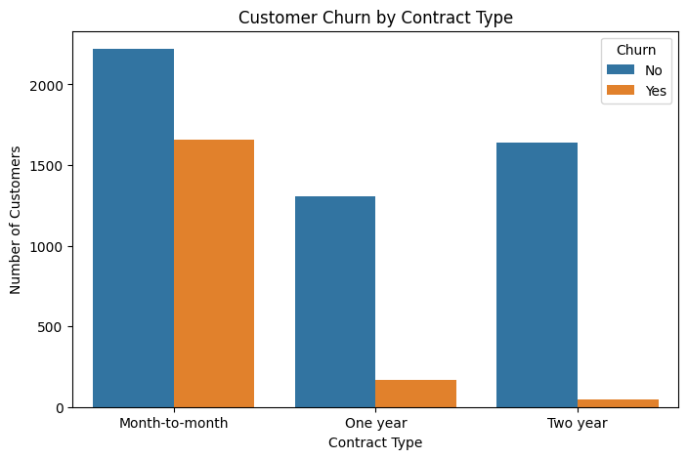
Key Visualization: Churn by Contract Type
3x
roughly the churn gap between month-to-month and longer-term contracts
INSIGHT
Month-to-month customers churn far more than one-year or two-year customers. Two-year contracts are the most stable segment — contract length is a strong retention lever.
TELCO CHURN ANALYSIS
04

Slide 5
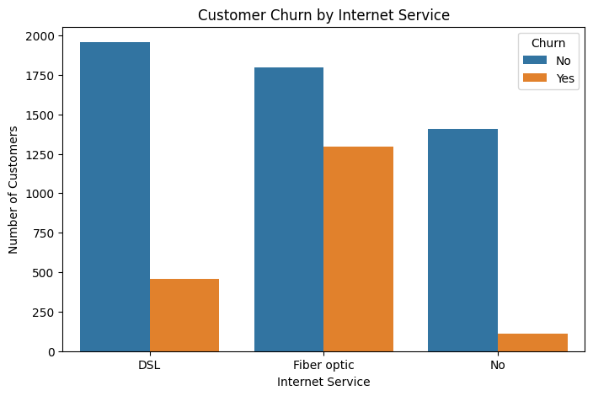
Key Visualization: Churn by Internet Service
#1
Fiber Optic is the highest-churn service segment
INSIGHT
Fiber Optic customers churn the most, DSL customers churn less, and customers with no internet service churn the least — pointing to a price/value gap in Fiber Optic.
TELCO CHURN ANALYSIS
05

Slide 6
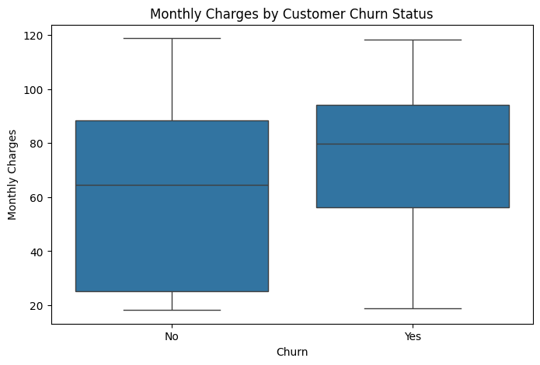
Key Visualization: Monthly Charges by Churn Status
$80
vs. ~$65 median charge for retained customers
INSIGHT
Churned customers have a higher median monthly charge (~$80) than retained customers (~$65) — higher bills track with a greater likelihood of leaving.
TELCO CHURN ANALYSIS
06

Slide 7
Major Findings
1
Overall churn rate is 26.6% — 1,869 of 7,032 customers left the company.
2
Gender is not a meaningful driver — Churn behavior is nearly identical between male and female customers.
3
Contract & service type matter most — Month-to-month contracts and Fiber Optic internet show the highest churn.
4
Churned customers pay more — Median Monthly Charges: ~$80 (churned) vs. ~$65 (retained).
5
Pricing risk is independent of tenure — Tenure and MonthlyCharges are only weakly correlated (0.25) — high bills aren't just a newer-customer effect.
TELCO CHURN ANALYSIS
07

Slide 8
Recommendations
1
Incentivize Contract Upgrades
2
Strengthen Early-Lifecycle Retention
Offer discounts, loyalty rewards, or bundles to move month-to-month customers to 1- or 2-year plans.
Structured onboarding, welcome offers, and proactive check-ins in the first six months.
3
Improve Fiber Optic Service
4
Target High-Bill Customers
Run satisfaction surveys and quality audits to resolve the root causes of high Fiber Optic churn.
Proactively reach out to customers paying above ~$70/month with value-reinforcing offers.
TELCO CHURN ANALYSIS
08

Slide 9
CONCLUSION
Churn is driven mainly by contract flexibility, service type, and pricing — not demographics.
The highest-risk segment: short-tenure, month-to-month, Fiber Optic customers paying higher monthly bills. A retention strategy focused on these levers — contract upgrades, early onboarding, Fiber Optic service quality, and high-bill outreach — offers a clear, data-driven path to reducing churn and protecting revenue.
Thank you

