Slide 1
Profitability & Sales Performance Analysis
Global Superstore
Edeh Ogechukwu Evelyn Data Analyst | Excel | SQL | Power BI

Slide 2
Business Challenge
Strong revenue
Unstable profitability
Rising returns
Inconsistent regional performance
Key Question: Where is the company losing profit?

Slide 3
Project Objective
The objectives was to:
Evaluate sales vs profit performance
Identify loss-making products
Analyze discount impact
Examine regional performance
Support decision-making

Slide 4
Analytics Pipeline:
Excel → SQL → Power
excel:
Power bi:
sql:
Inspection
Cleaning
Joins
Transformations
Aggregation
DAX measures
Dashboard
Insights

Slide 5
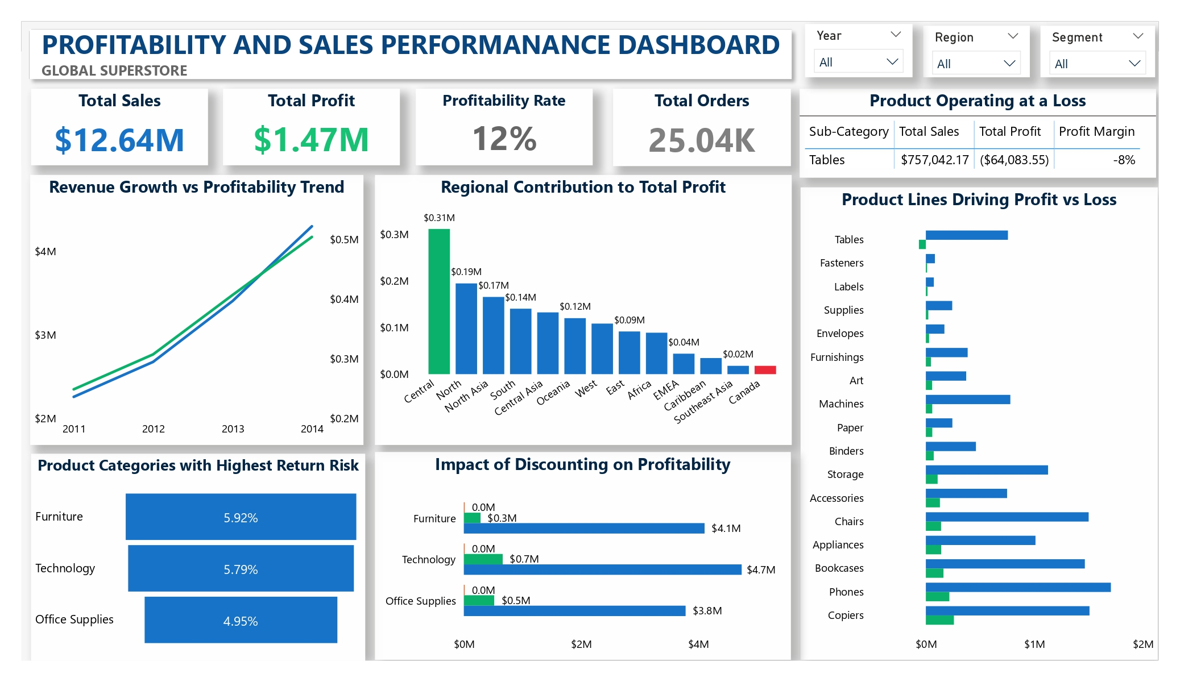

Slide 6
Overall Business Performance
Total Sales: $12.64M
Total Profit: $1.47M
Profit Margin: 12%
Total Orders: 25.04K

Slide 7
Regional Performance
Central region:
Highest profit → $311,403.88
Canada:
Lowest profit → $17,817.39

Slide 8
Product Performance Risk
Tables sub-category:
Loss → –$64,083.55
Furniture:
Highest return rate → 5.92%

Slide 9
Sales vs Profit Relationship
Profit increases as sales increase
Business relies on:
volume rather than efficiency

Slide 10
Discount Impact
Higher discounts → lower profit margins

Slide 11
Key Insight
This is NOT a revenue problem.
This is a profit optimization problem.

Slide 12
Strategic Recommendations
Pricing optimization
Product portfolio restructuring
Return reduction strategy
Regional performance optimization

Slide 13
Business impact
If implemented, there will be:
Higher margins
Reduced losses
Smarter investments
Improved product strategy
Executive decision support

Slide 14
Project value
This project demonstrates:
SQL data transformation
Power BI dashboard design
Business analytics thinking
Executive storytelling
Decision-driven insights

Slide 15
closing
Data becomes valuable when it drives decisions.
Thank you

