Slide 1
COLLEGE admission agent
AICTE INTERNSHIP PROJECT
Presented By: Agrim Puriya
Student name : Agrim Puriya
College Name & Department : Madhav Institute of Technology and Science Gwalior, Centre for AI

Slide 2
OUTLINE
Problem Statement
Technology used
Wow factor
End users
Result
Conclusion
Future scope
IBM Certifications
Git-hub Link

Slide 3
Problem Statement
New college students often have to rely on staff or personal connections to get information about the admission process. This can be challenging, as there’s no simple or personalized way to access the details they need, making the admission process more confusing and stressful.
Proposed Solution: An AI College Helper Agent that uses Natural Language Processing (NLP) and Retrieval-Augmented Generation (RAG) to help students access accurate and up-to-date information about the admission process — all through natural, conversational language, making it easy for anyone to get the information they need.

Slide 4
Technology used
IBM cloud lite services
Natural Language Processing (NLP)
Retrieval Augmented Generation (RAG)
IBM Granite 3b instruct model

Slide 5
IBM cloud services used
IBM Cloud Watsonx AI Studio
IBM Cloud Watsonx AI runtime
IBM Cloud Agent Lab
IBM Granite foundation model

Slide 6
Wow factors
This agent will significantly reduce the time students spend searching for college admission information, improve the accuracy of responses, guide applicants through complex admission procedures, and make the entire process more accessible by using natural, conversational AI.
Unique Features:
Semantic search across admission documents, brochures, FAQs, and official notices
Real-time information updates from linked sources like GitHub or official college repositories
Personalized responses based on the user’s academic profile and preferences
Natural language Q&A — no need for complex queries or technical terms
Admission timeline tracking — reminders and updates for deadlines, results, and counselling
Multi-college comparison based on courses offered, fees, placements, and eligibility

Slide 7
End users
Students
Institutions and Universities
Parents
Faculty

Slide 8
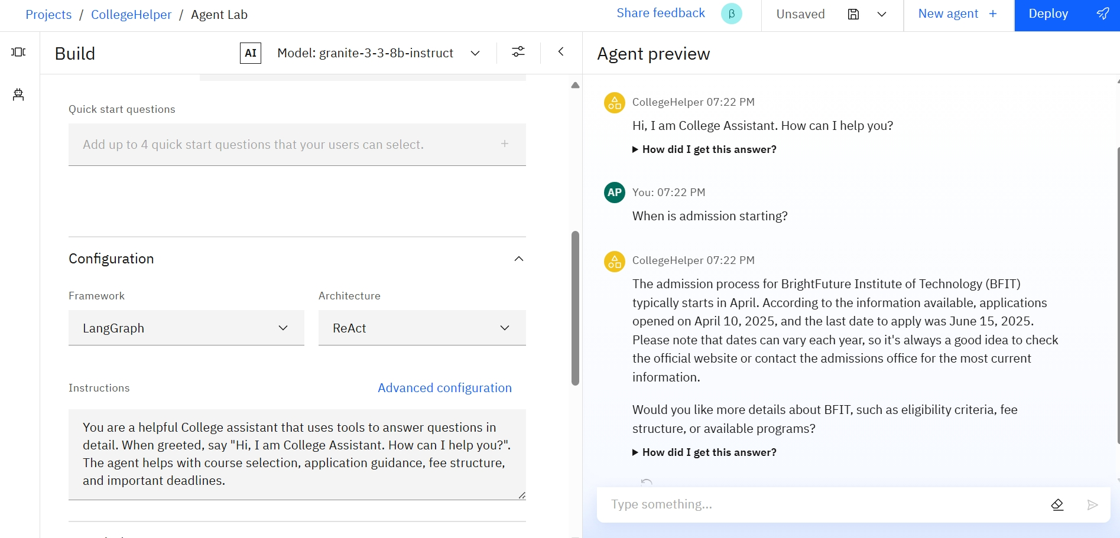
Results

Slide 9
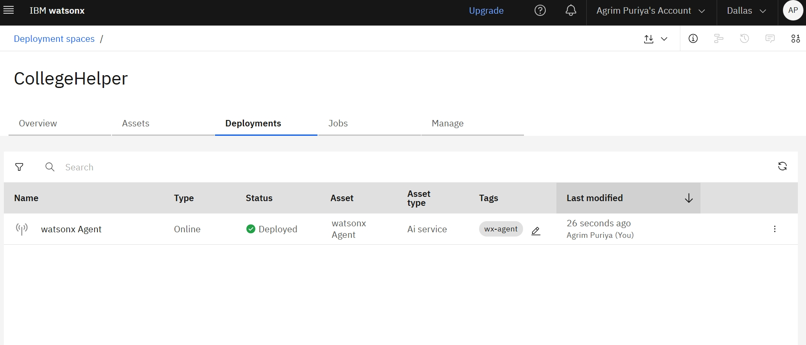
Results
Deployed AI Agent

Slide 10
Conclusion
The agent can guide the student in the admission process, provide relevant information and overall streamline the admission process.
Gives a reliable and easy source for useful information about the institution
These Helper Agents enhance efficiency and accuracy for many institutions not just academic ones.

Slide 11
Future scope
Multilingual Helper Agent
Voice-Activated Institute Assistant
Real-Time Collaboration Features
NLP guided form filling (admission process)
Real-time integration with institutional data sources (e.g., ERP, LMS, websites).
Automatic updates of admission rules, course offerings, deadlines, and regulations.

Slide 12
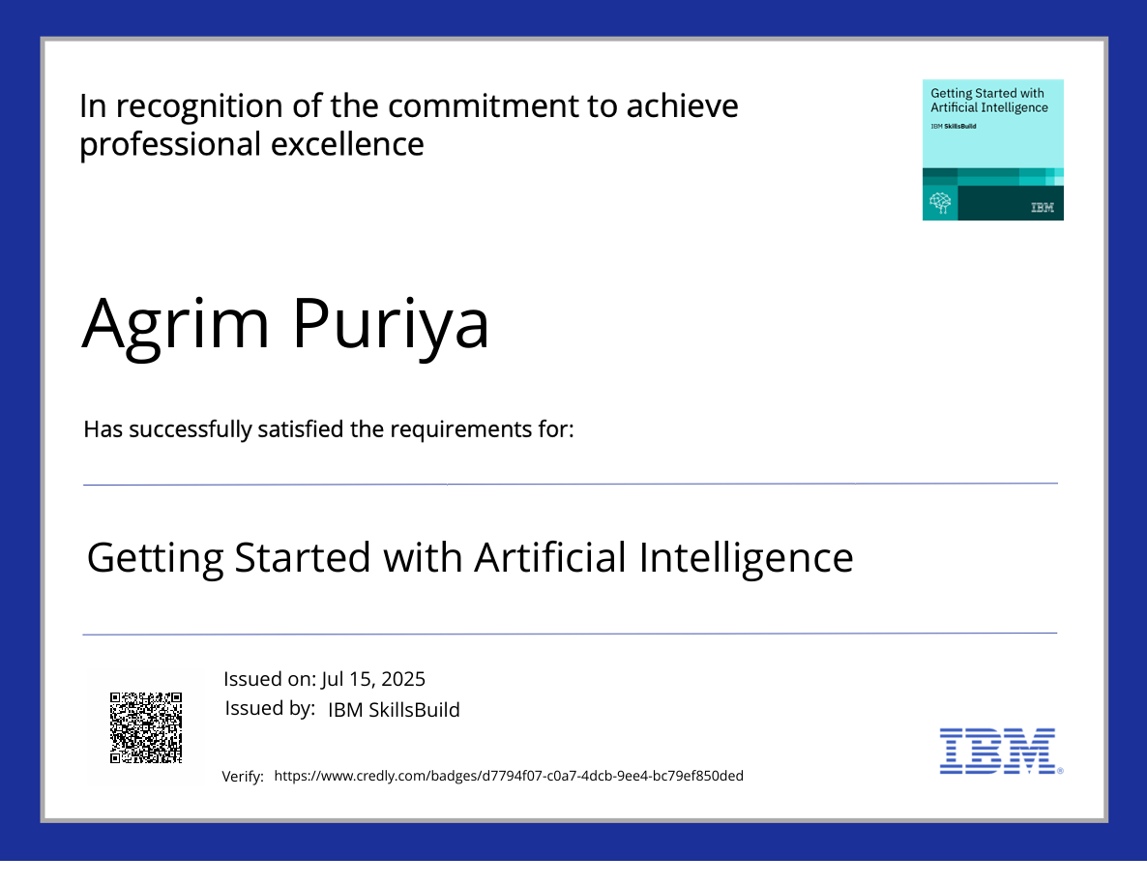
IBM Certifications

Slide 13
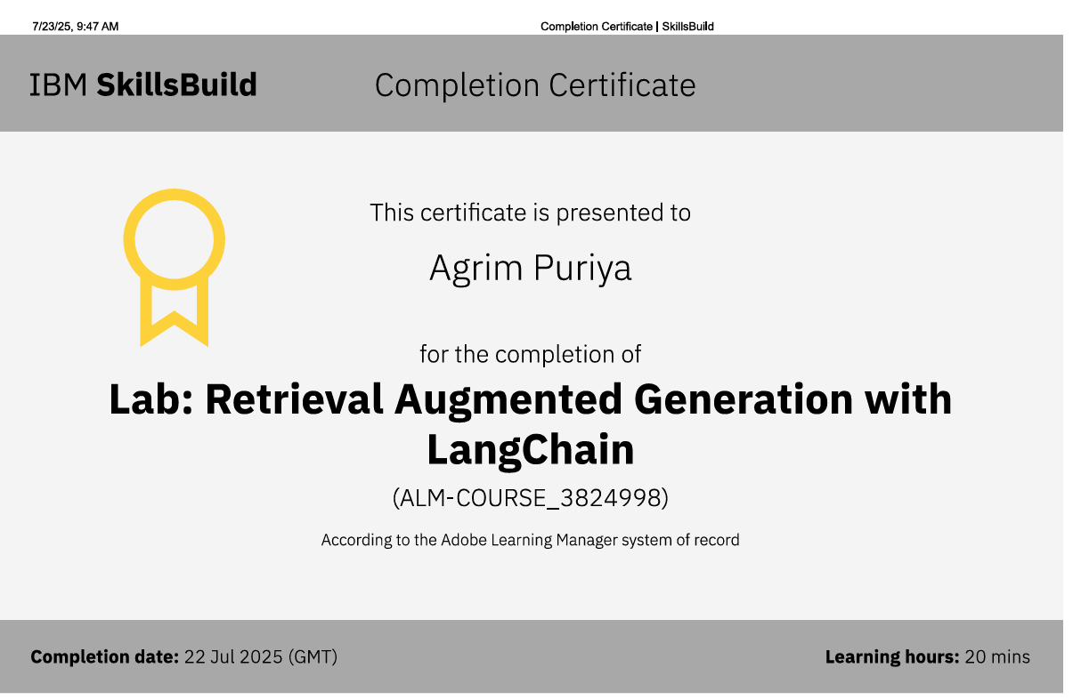

Slide 14
GITHUB LINK
Git hub link : OggyBoi08/CollegeHelper: Documents for College Helper rag backend
www.github.com/OggyBoi08/CollegeHelper

Slide 15
THANK YOU

