Slide 1
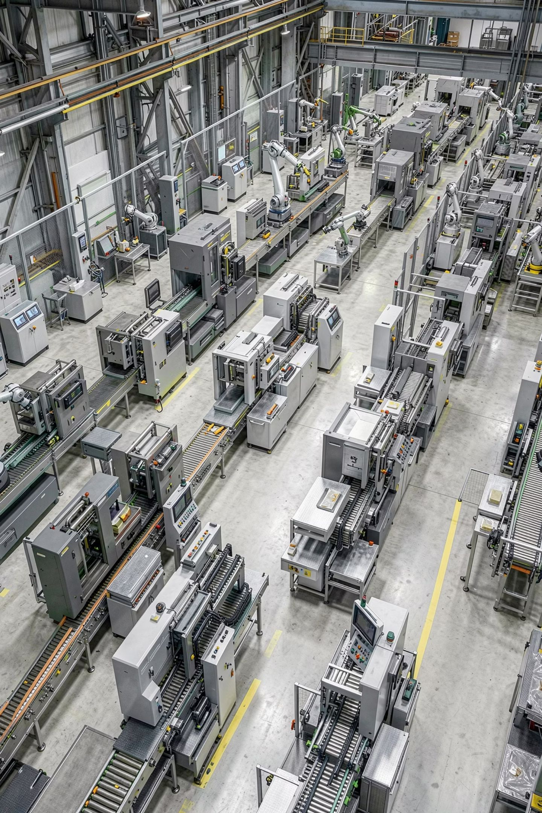
Employee Attrition Analysis
ABC Manufacturing Ltd
Prepared by Ogheneughwe Godwin AKISE, Junior Data Scientist at AnalystLab Africa Consulting
Understanding why employees are leaving before investing in predictive machine learning

Slide 2
Agenda
01
02
Business problem and objective
Project outline and approach
03
04
Analysis objectives
Executive summary of findings
05
06
Key business questions answered
Business insights from the data
07
08
Recommendations for HR
Open discussion and Q&A

Slide 3
Project Outline
1
Understand the business problem
2
Data loading and inspection
IBM HR Analytics dataset — 1,470 employees and 35 variables, no missing or duplicate records
3
Exploratory data analysis
Covering workforce demographics and attrition drivers
4
Correlation analysis
To flag variables relevant for future predictive modelling
5
Business insights report
6
Recommendations for reducing attrition

Slide 4

Objectives
Business Problem
Business Objective
ABC Manufacturing Ltd is experiencing employee attrition and HR wants answers before investing in machine learning
Analyze the IBM HR dataset to understand workforce characteristics and identify factors associated with employee attrition through exploratory data analysis
Guiding Questions
Workforce profile, department level attrition, effect of age, effect of monthly income, effect of overtime, job roles with highest turnover, and variables important for future predictive modelling

Slide 5
Executive Summary
1,470
16%
Employees
Attrition Rate
35 variables, no missing or duplicate records
237 left vs. 1,233 who stayed
Key Findings
Attrition is concentrated among younger, early career employees, lower earners, and staff who work overtime
Sales Representatives, Laboratory Technicians, and Human Resources roles show the highest turnover rates
Tenure, job level, income, and satisfaction all show a negative relationship with attrition
These patterns give HR a clear, actionable starting point before committing budget to predictive modelling

Slide 6

Business Question 1: What Does the Workforce Look Like?
Workforce Profile
The workforce skews male, with 882 men versus 588 women
Most employees are 25 to 40 years old, peaking around 30 to 35
Research and Development is the largest department with 961 employees, followed by Sales with 446 and Human Resources with 63
The workforce is highly educated, with the largest group holding a Bachelor's degree
Monthly income is right skewed, with most employees earning between roughly 2,000 and 5,000 per month
Sales Executive, Research Scientist, and Laboratory Technician are the most common job roles

Slide 7
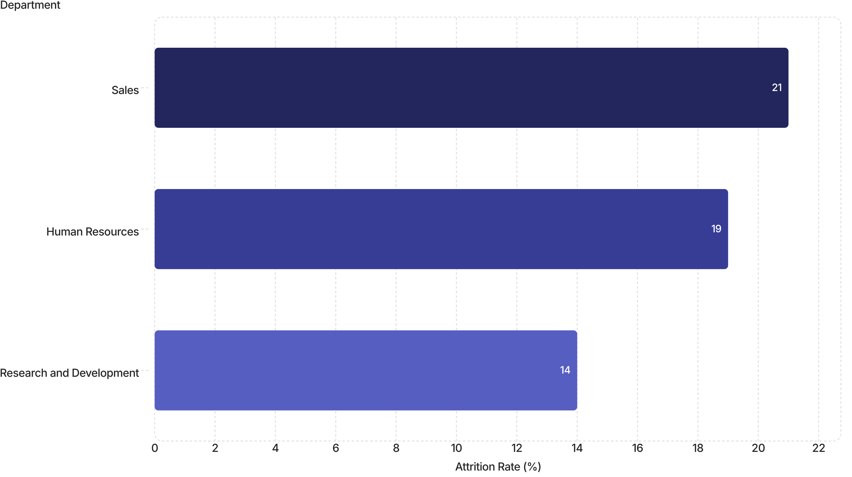
Business Question 2: Which Departments Have the Highest Attrition?
Research and Development has the lowest rate but the largest absolute number of leavers due to its size.

Slide 8
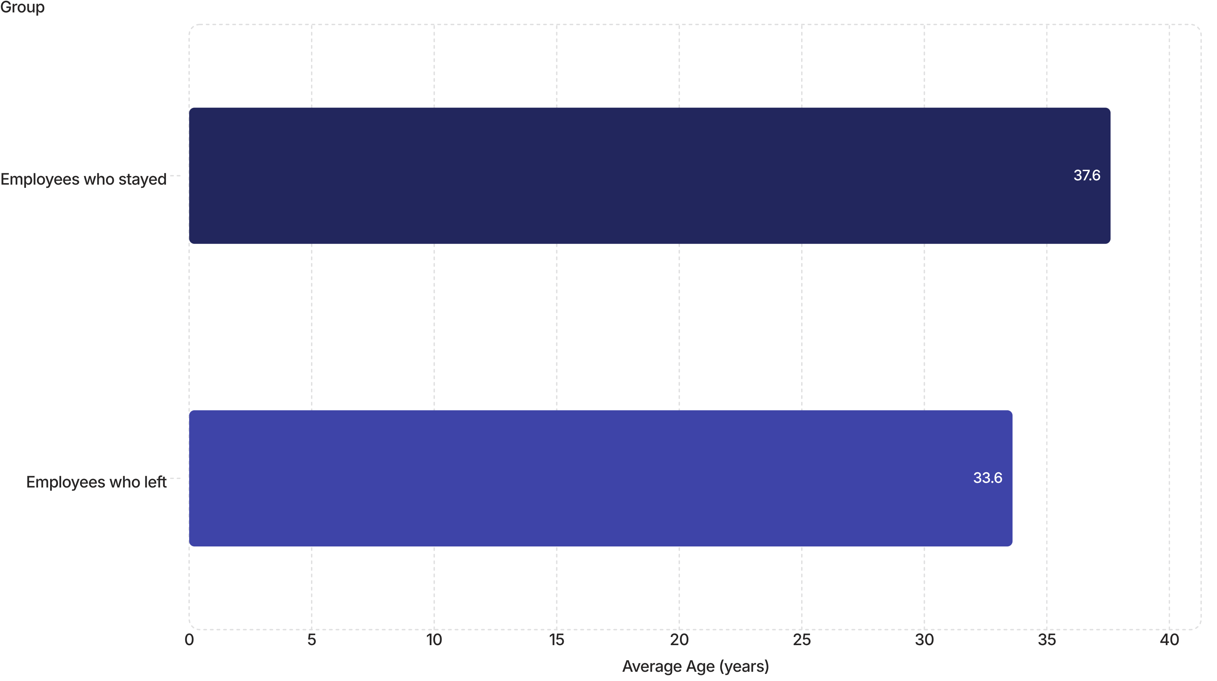
Business Question 3: Does Age Influence Attrition?
Early Career (26–35)
Young Adults (18–25)
This group has the largest absolute number of leavers across all age bands
This group has the highest proportional attrition rate relative to its size

Slide 9

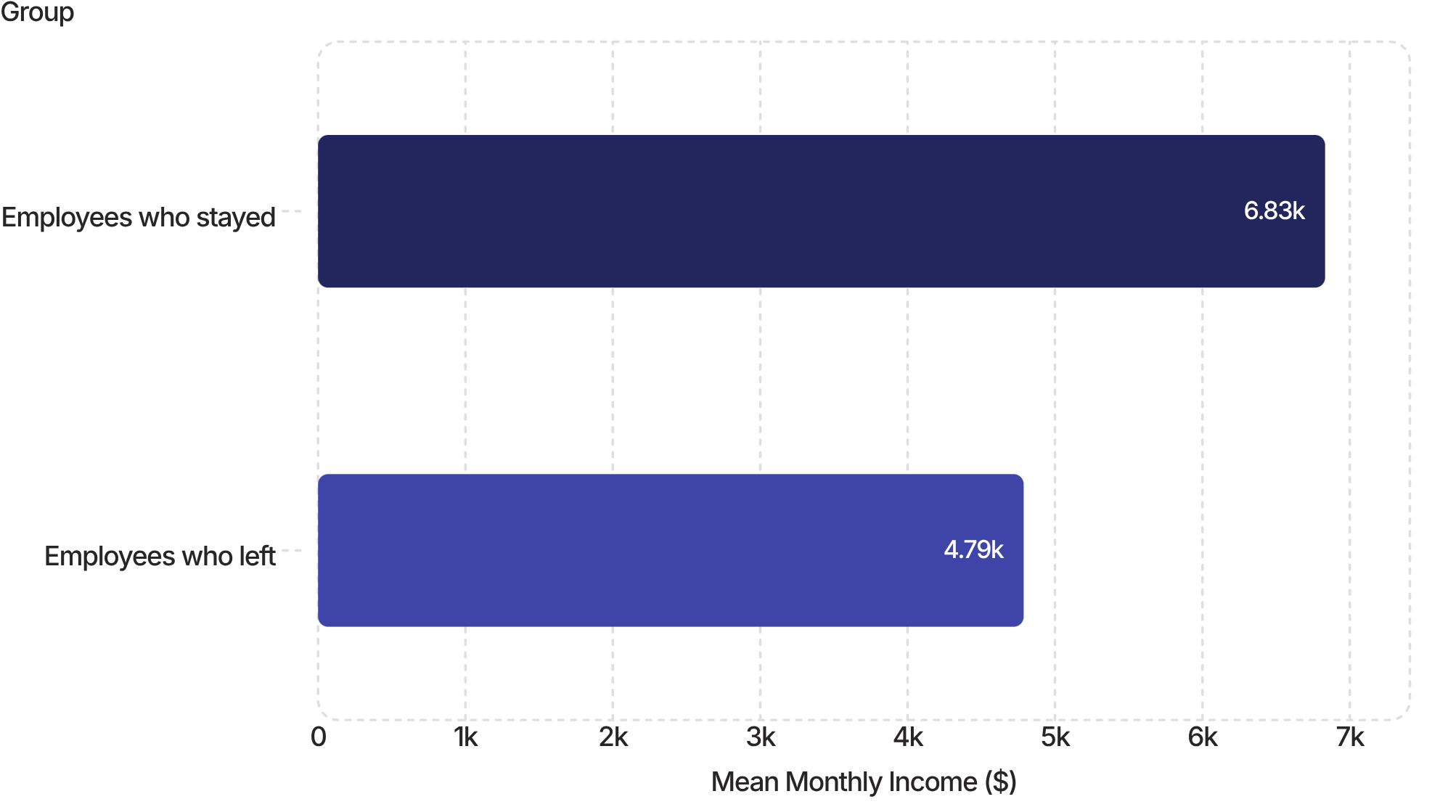
Business Question 4: Does Monthly Income Affect Retention?
Monthly income has a negative correlation of about −0.16 with attrition — employees who left earned significantly less on average than those who stayed.
Employees who stayed earned an average of $6,832/month, compared to $4,787/month for those who left — a gap of over $2,000. This suggests that compensation is a meaningful lever in reducing voluntary turnover.

Slide 10

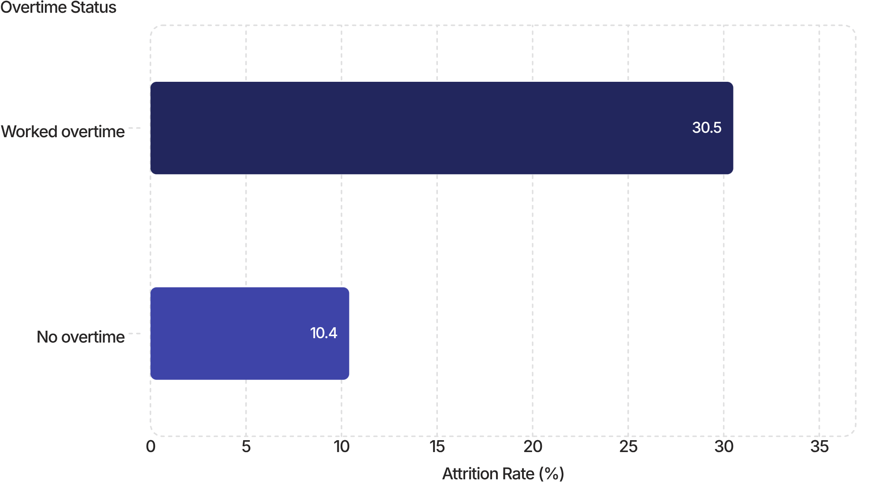

Business Question 5: Does Overtime Influence Attrition?
Overtime is one of the strongest behavioral signals of attrition risk in the dataset. Employees who worked overtime left at nearly three times the rate of those who did not.
Employees who worked overtime had a 30.5% attrition rate — nearly 3× the 10.4% rate of those without overtime. This is a critical risk factor requiring immediate attention.

Slide 11
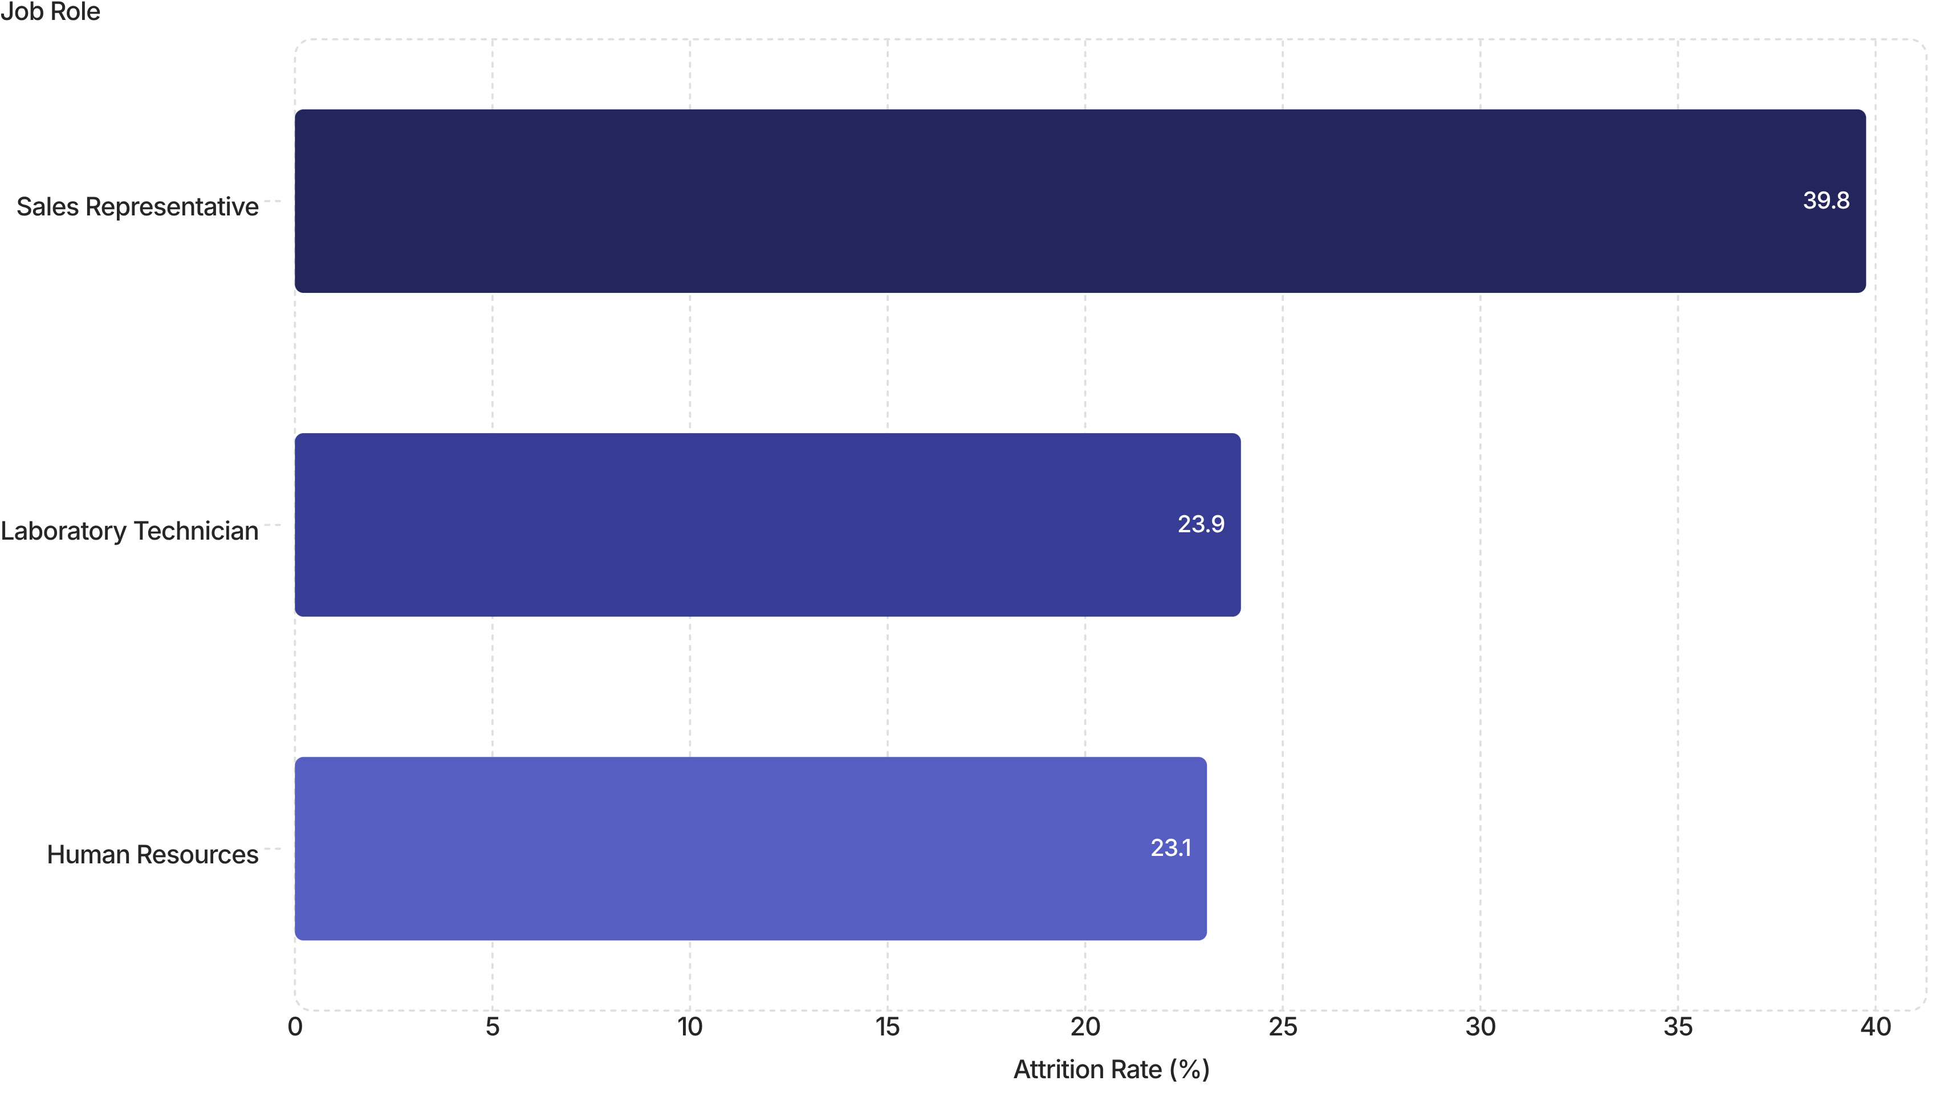
Business Question 6: Which Job Roles Experience the Highest Turnover?
Three roles stand out as requiring immediate, targeted retention attention based on their disproportionately high attrition rates.
Sales Representative
Laboratory Technician
Human Resources
39.76% attrition — the highest of any role in the dataset. Nearly 2 in 5 Sales Reps leave.
23.94% attrition — a significant rate suggesting systemic dissatisfaction or limited growth.
23.08% attrition — notable given HR's role in managing retention for others.

Slide 12


Business Question 7: Which Variables Matter for Predictive Modelling?
Strongest Negative Correlates of Attrition
Satisfaction Variables
Job Satisfaction and Environment Satisfaction also show a negative relationship with attrition — employees who are more satisfied are less likely to leave.
The following variables show the strongest negative relationship with attrition — meaning higher values are associated with employees who stay:
Total Working Years
Job Level
Years In Current Role
Monthly Income
Age
Years With Current Manager
Stock Option Level
These variables are strong candidates for feature selection in a future predictive attrition model.

Slide 13
Business Insights
The analysis surfaces a clear and consistent picture of attrition risk across the workforce. Key findings include:
Age & Career Stage
Compensation
Younger, early-career employees are disproportionately likely to leave.
Lower monthly income is strongly linked to higher attrition.
Overtime
High-Risk Roles
Working overtime substantially increases the likelihood of leaving.
Sales Representatives, Laboratory Technicians, and Human Resources staff face the highest turnover of any role.
Tenure & Satisfaction
Data Quality
Employees with less tenure, lower job level, and lower job or environment satisfaction are more likely to leave.
No missing or duplicate data issues were found, so the dataset is reliable for further analysis and future modelling.

Slide 14
Recommendations for HR
1
Target Early-Career Retention
Target retention programs at younger and early-career employees through mentorship, clear growth paths, and regular feedback.
2
Review Compensation
Review compensation and benefits for lower-income roles, including base pay, performance bonuses, and benefits packages.
3
Address Overtime Culture
Address the overtime culture through workload monitoring, flexible arrangements, and burnout prevention programs.
4
Investigate High-Turnover Roles
Investigate high-turnover roles such as Sales Representative, Laboratory Technician, and Human Resources through exit interviews and focus groups, then act on the findings.
5
Strengthen Engagement & Satisfaction
Strengthen employee engagement and satisfaction by improving job and environment satisfaction, fostering an inclusive culture, and ensuring transparent promotion processes.
6
Next Step: Predictive Modelling
Once retention drivers are addressed and monitored, revisit the case for investing in a predictive attrition model using the variables identified in this analysis.

Slide 15

Thank You
Questions and Discussion

